Slide 1





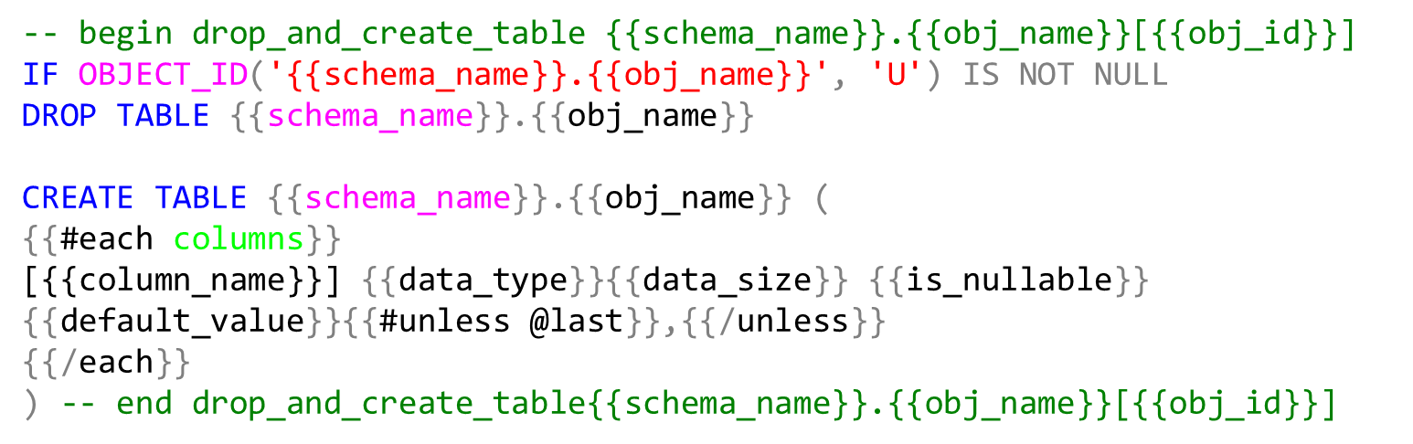
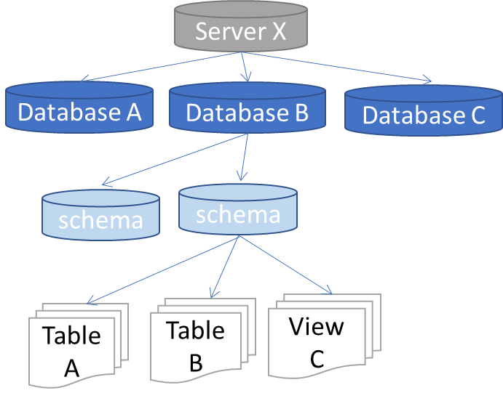
Data warehouse automation
ETL Tool
Meta data
Templates
Code generator
ETL
DDL
Orchestration
Object tree
Mapping
Business rules
Properties

Slide 2
Object tree (dbo.Obj_ext)
Server X
Database A
Database B
Database C
schema
schema
Table A
Table B
View C
Users (dbo.Obj_ext)
User A
User B

Slide 3
Object tree (dbo.Obj_ext)
Properties (static.Property)
Server X
target_schema_id
Database A
Database B
Database C
template_name_create_table
schema
schema
log_level
View C
delete_detection
Table A
Table B
etc…
Users (dbo.Obj_ext)
User A
User B
exec info select * from obj_ext select * from col_ext
exec set_p <property>,<value>,<obj_name>
exec get_p <property>,<value>,<obj_name>
select * from prop_ext

Slide 4
Server X
Database A
Database B
Database C
schema
schema
Table A
Table B
View C
Users (dbo.Obj_ext)
User A
User B

Slide 5
-- begin drop_and_create_table {{schema_name}}.{{obj_name}}[{{obj_id}}]
IF OBJECT_ID('{{schema_name}}.{{obj_name}}', 'U') IS NOT NULL
DROP TABLE {{schema_name}}.{{obj_name}}
CREATE TABLE {{schema_name}}.{{obj_name}} (
{{#each columns}}
[{{column_name}}] {{data_type}}{{data_size}} {{is_nullable}} {{default_value}}{{#unless @last}},{{/unless}}
{{/each}}
) -- end drop_and_create_table{{schema_name}}.{{obj_name}}[{{obj_id}}]

Slide 6
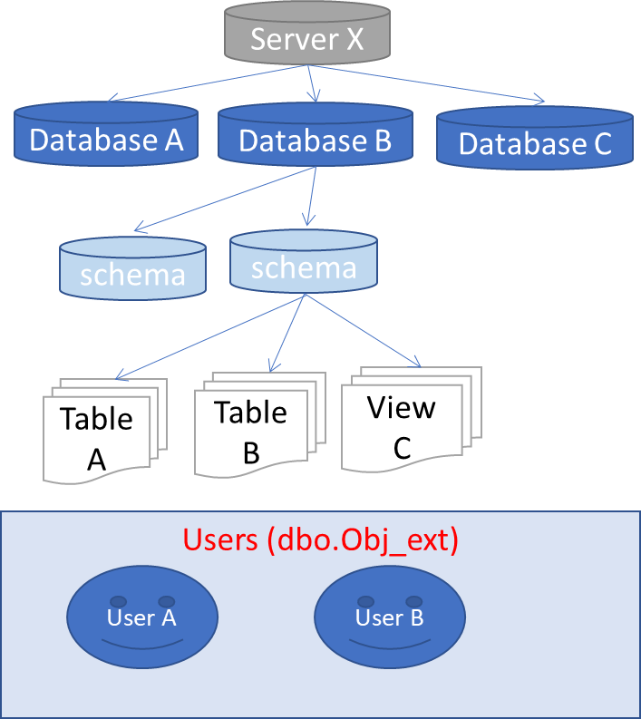
Source database
BETL
object tree query
stored procedure ingest object tree
object tree
select
null src_obj_id
, isnull(o.object_id, db.database_id) external_obj_id
, dbo.server_type() server_type
, @@SERVERNAME server_name
, …..
from
sys.databases db
full outer join sys.schemas s on db.database_id = db_id()
left join sys.objects o on o.schema_id = s.schema_id
and o.type in ( 'U','V') -- only tables and views
….

