Slide 1
Discord Demo DWA 9 juli 2021
Wie ben ik
Wat is DWA
Design time versus runtime DWA
BETL demo
Discussie

Slide 2

Wat is Data warehouse automation?
Templates
ETL Tool
Code generator
ETL
DDL
Orchestration
Meta data

Slide 3
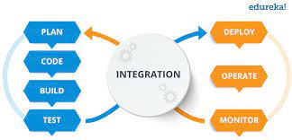
Design time versus runtime DWA
Templates
ETL Tool
Code generator
ETL
DDL
Orchestration
Meta data

Slide 4




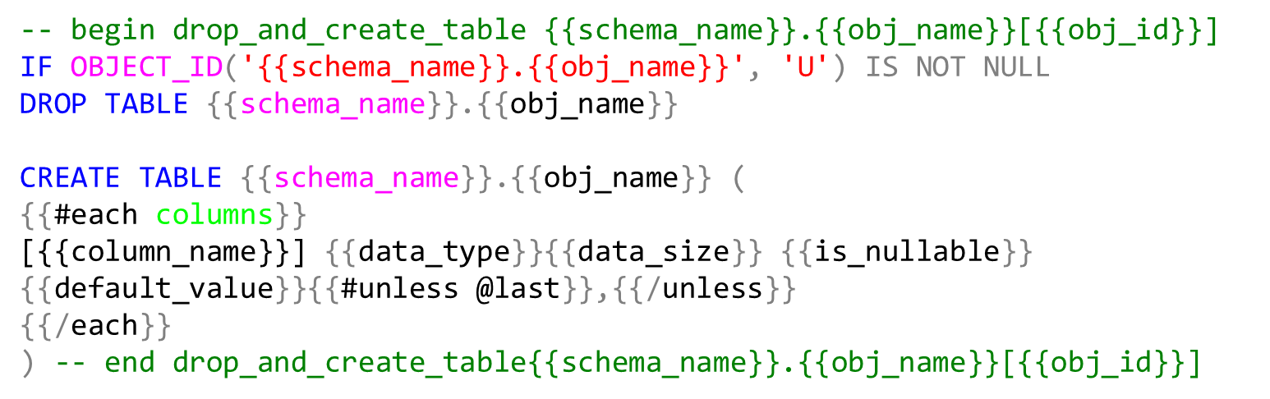
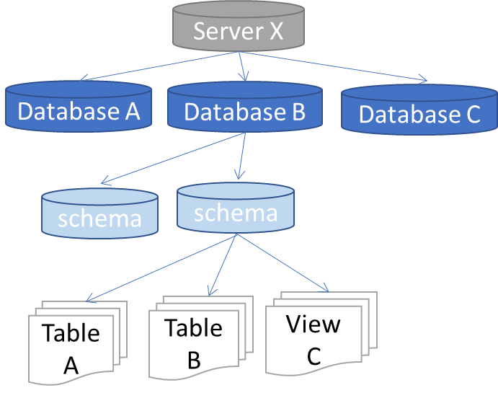
Data warehouse automation
Templates
ETL Tool
Code generator
ETL
DDL
Orchestration
Meta data
Object tree
Mapping
Business rules
Properties

Slide 5
Object tree (dbo.Obj_ext)
Server X
Database A
Database B
Database C
schema
schema
Table A
Table B
View C
Users (dbo.Obj_ext)
User A
User B

Slide 6
Object tree (dbo.Obj_ext)
Properties (static.Property)
Server X
target_schema_id
Database A
Database B
Database C
template_name_create_table
schema
schema
log_level
View C
delete_detection
Table A
Table B
etc…
Users (dbo.Obj_ext)
User A
User B
exec info select * from obj_ext select * from col_ext
exec set_p <property>,<value>,<obj_name>
exec get_p <property>,<value>,<obj_name>
select * from prop_ext

Slide 7
-- begin drop_and_create_table {{schema_name}}.{{obj_name}}[{{obj_id}}]
IF OBJECT_ID('{{schema_name}}.{{obj_name}}', 'U') IS NOT NULL
DROP TABLE {{schema_name}}.{{obj_name}}
CREATE TABLE {{schema_name}}.{{obj_name}} (
{{#each columns}}
[{{column_name}}] {{data_type}}{{data_size}} {{is_nullable}} {{default_value}}{{#unless @last}},{{/unless}}
{{/each}}
) -- end drop_and_create_table{{schema_name}}.{{obj_name}}[{{obj_id}}]

Slide 8
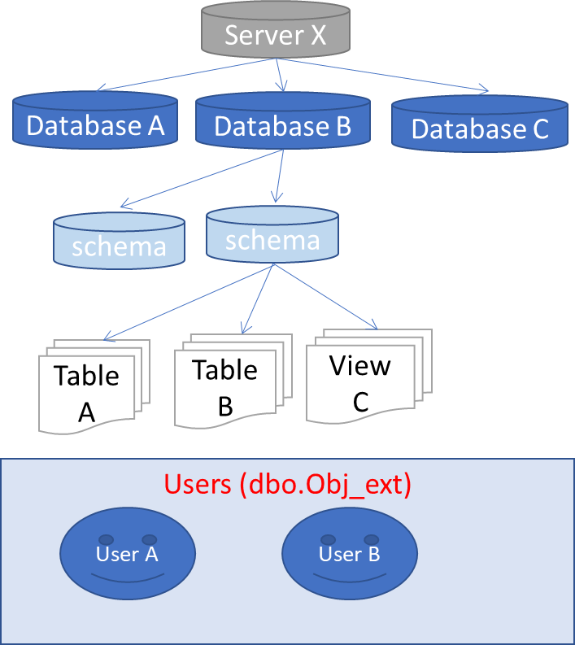
Source database
BETL
object tree query
stored procedure ingest object tree
object tree
select
null src_obj_id
, isnull(o.object_id, db.database_id) external_obj_id
, dbo.server_type() server_type
, @@SERVERNAME server_name
, …..
from
sys.databases db
full outer join sys.schemas s on db.database_id = db_id()
left join sys.objects o on o.schema_id = s.schema_id
and o.type in ( 'U','V') -- only tables and views
….

Slide 9
ETL Tool
1
3
Obj tree source
Obj tree target
Tables
2
Tables
source
target

Slide 10
ETL Tool
1
2
Obj tree source
Obj tree target
Tables
3
Tables
source
target

Slide 11
datamarts
Integrated data warehouse
raw data warehouse
staging

Slide 12
Meta data
Object tree
Mapping
Business rules
Properties

Slide 13
Templates
ETL Tool
Code generator
ETL
DDL
Orchestration
Meta data
Object tree
Mapping
Business rules
Properties

Slide 14
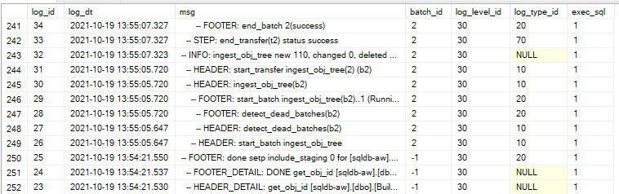
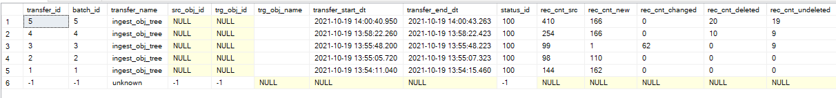
parent_batch_id
Batch
Logging
Transfer

Slide 15



for each
observe
observe source dataset structure
dataset
describe
for every layer
describe what needs to be done
datamarts
structure change (ddl)
data loading and transforming (etl)
orchestration
Integrated data warehouse
raw data warehouse
execute
staging
for each
Generate code
ddl
Etl
Orchestration
Execute code
dataset object

Slide 16


betl
betl
2.define staging
7.define rdw
T-SQL DDL
3.materialize staging
6.observe
T-SQL DDL
8.materialize staging
1.observe
4.observe
9.observe
Adventure
Works
MyDWH Staging
MyDWH RDW
⊳
5.staging etl
⊳
10.rdw etl

