Slide 1
Indian Economy:
Privatisation and Innovation
- A Data Driven Approach
Lecture by Dr. Baswanth Oruganti

Slide 2
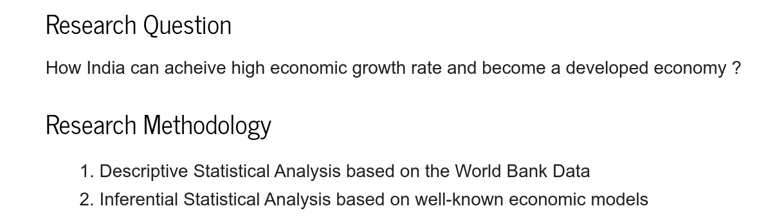

Slide 3
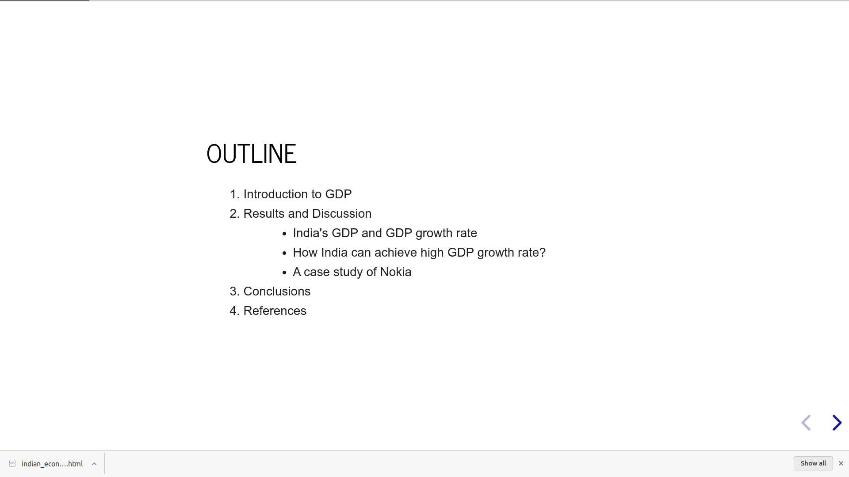

Slide 4
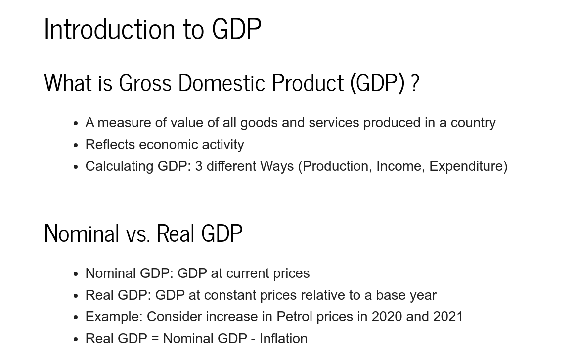

Slide 5
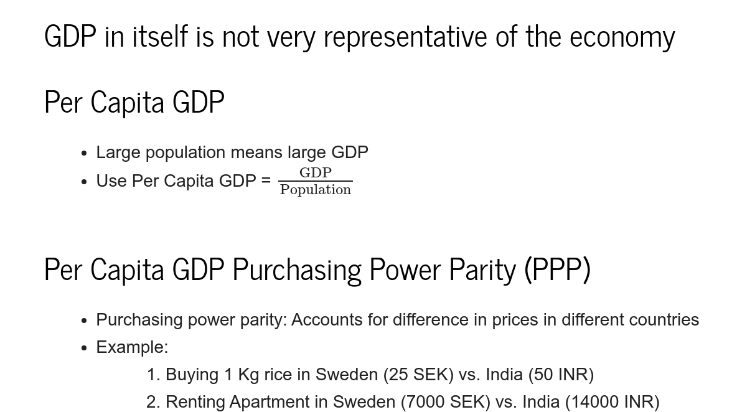

Slide 6
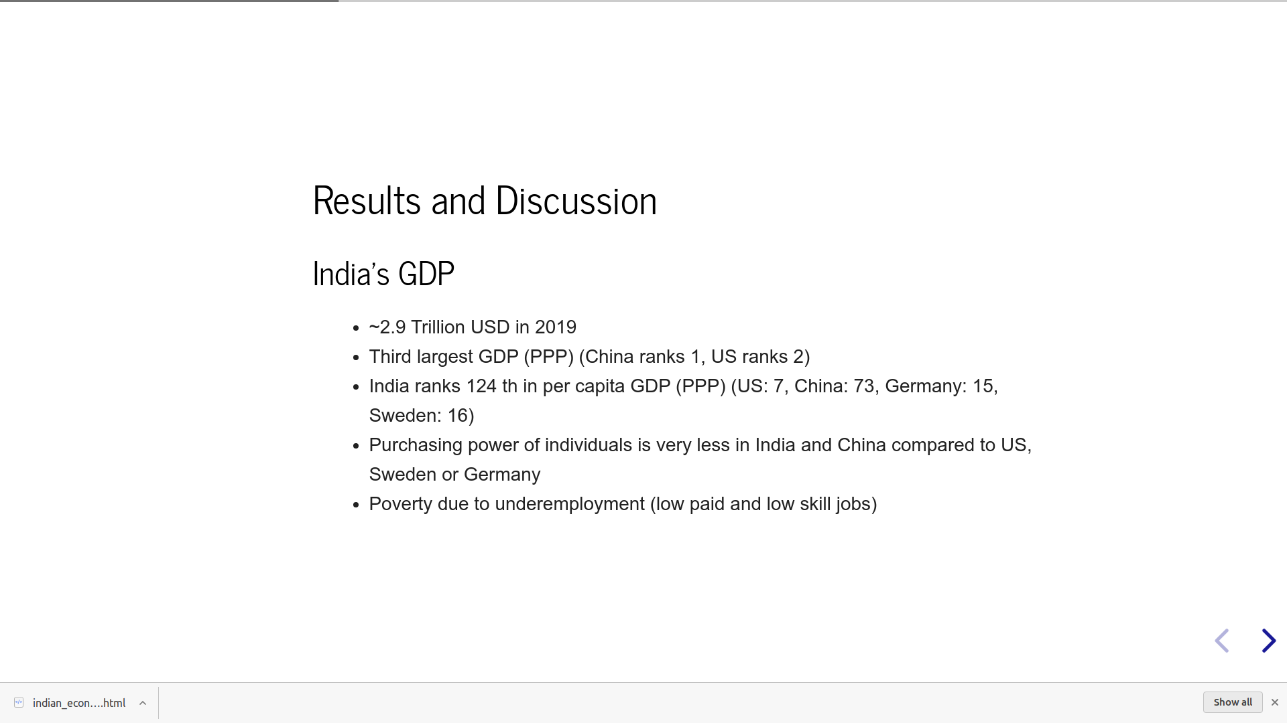

Slide 7
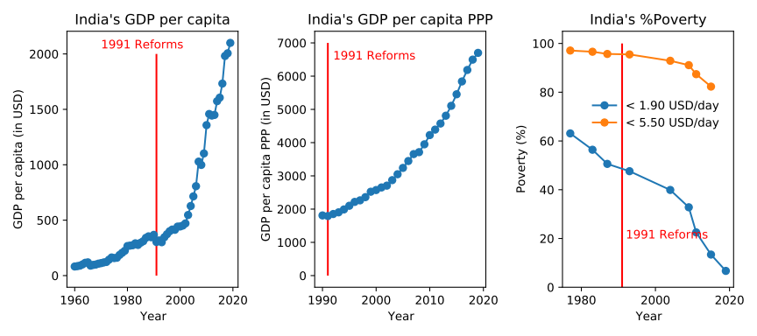

Slide 8
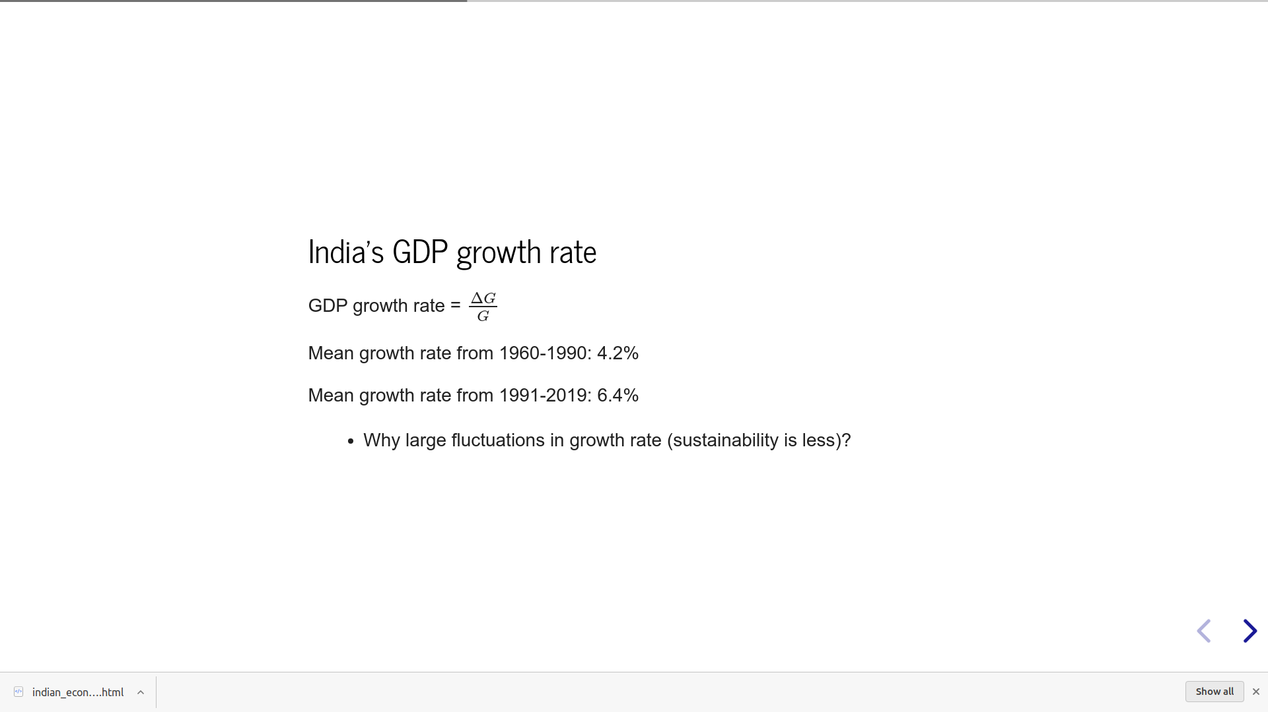
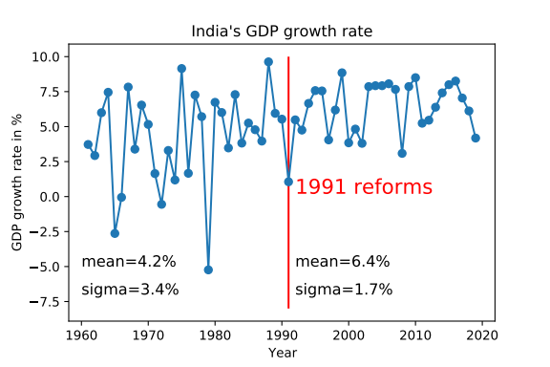
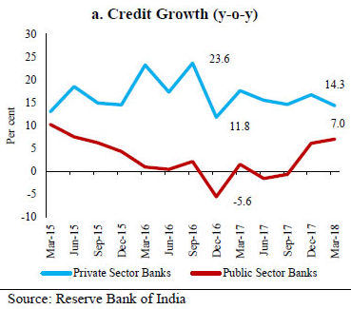
Demonetisation:
“A Monumental Blunder”
GDP growth rate is continuosuly decreasing from 2016: Why?
Taken from RBI website

Slide 9
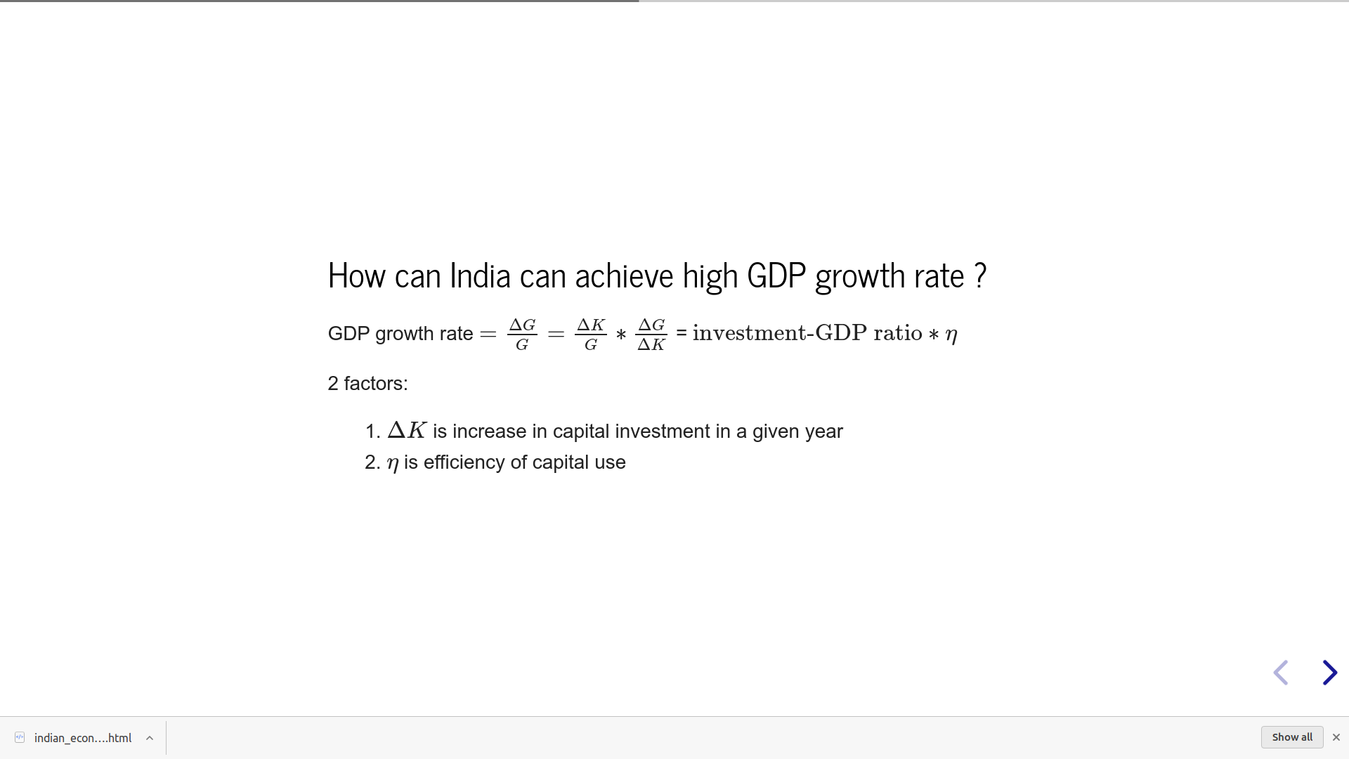
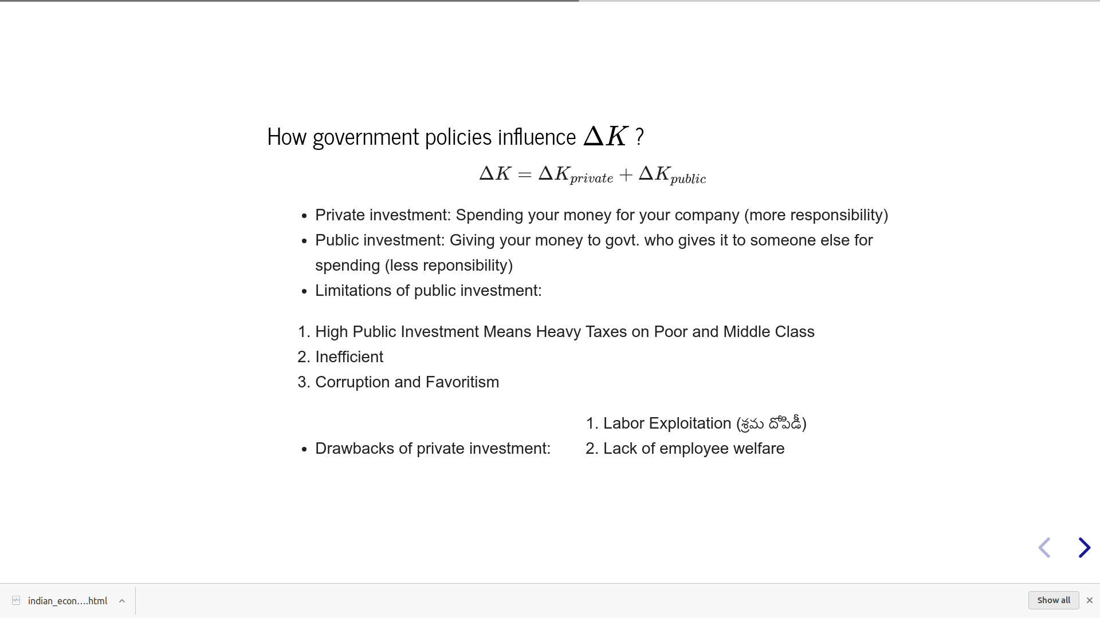

Slide 10
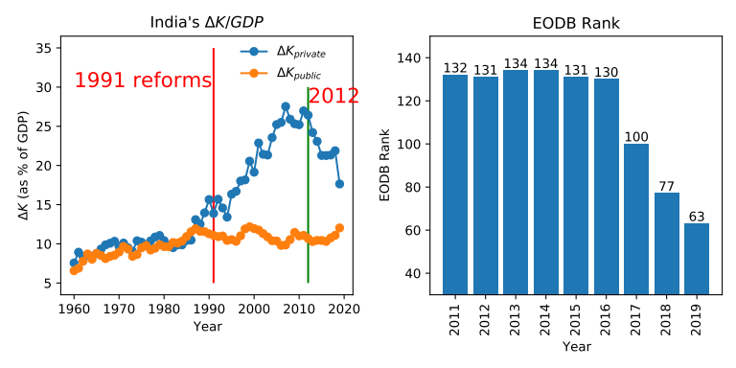
II-Gen reforms
VAT: 2005
IBC: 2016
GST: 2017
Corp. Tax cut: 2019
Labour reforms: 2019
Farm bills: 2020
Public investment is almost constant or slightly increasing
Private investment continuously decreasing from 2012: Why?
No ease of doing businees: Complicated Tax System & High Corporate Tax

Slide 12
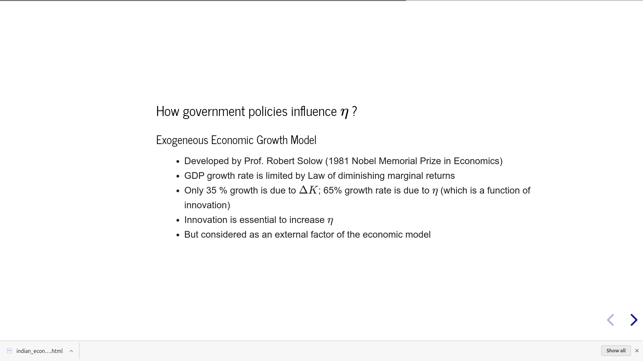
GDP growth rate = A.f(K, L)

Slide 13
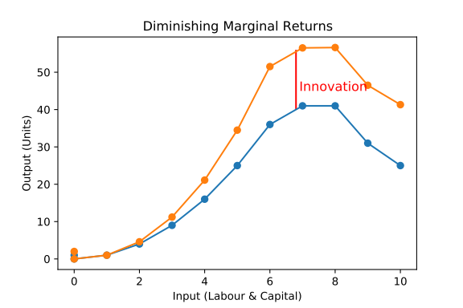

Slide 14
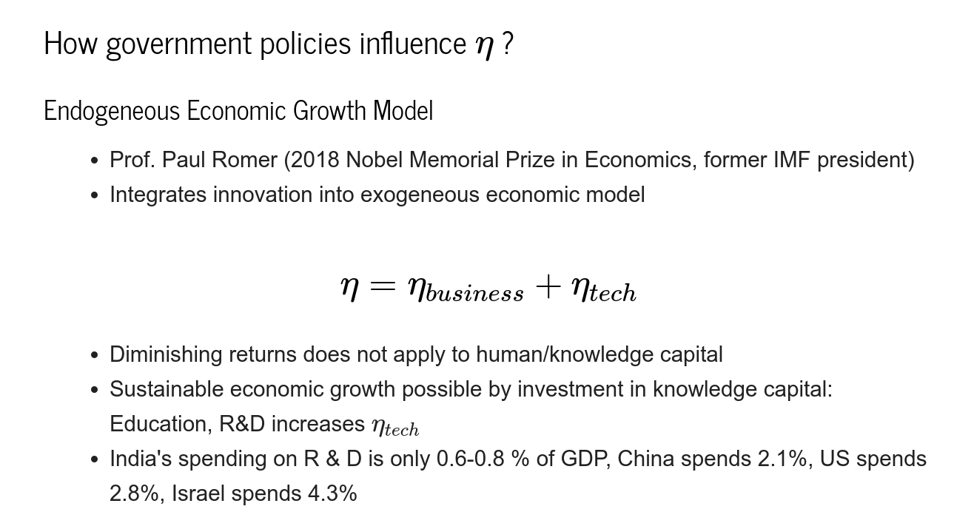
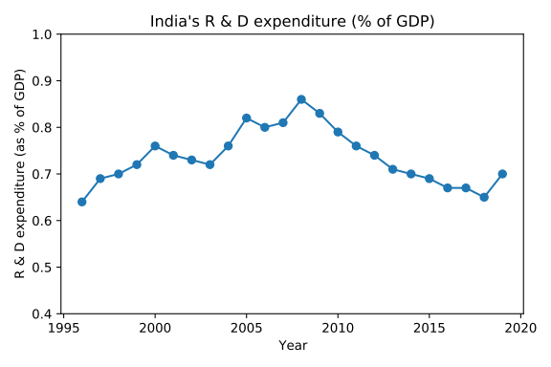
infl. ~ 9%
infl. ~ 5%

Slide 15



Slide 16
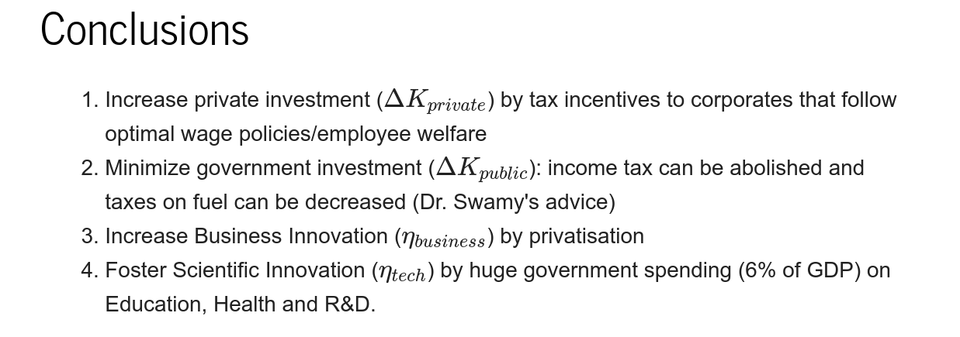
A Incentive-driven Innovation-Structured Free Market economy

Slide 17

Final Thoughts
1. “Government must be an umpire (that governs rules and laws) not a player of the game.”
2. “Socialism means a large government, and a large government means heavy taxation that kills incentive for hardwork and risk-taking.”
3. “The only way to achieve economic equality in India is to create adequate emplyoment and ensure certain minimum amenities (like housing and transportation) for those employed. Taxation should be used as an instrument to give incentives to capitalists for providing these facilities.”

Slide 18
Questions ?

Slide 19
“A banker merely exchanges a more liquid form of asset for a less liquid form” – Henry Hazlitt
“Credit is something a man already has” -Henry Hazlitt

