Slide 1
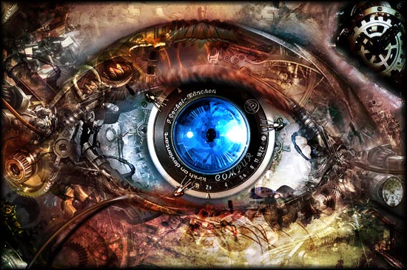
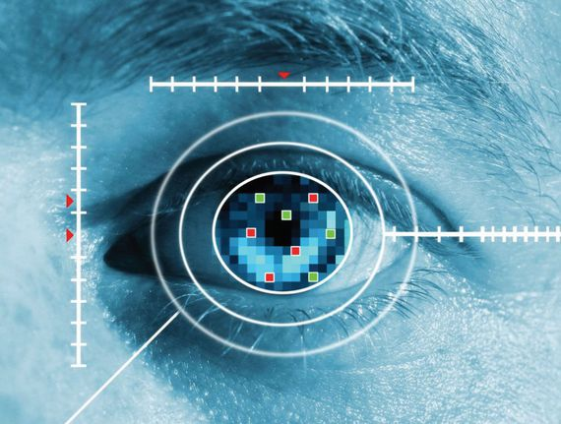


m roads
What is computer vision?
Computer vision is concerned with the automatic extraction, analysis and understanding of useful information from a single image or a sequence of images.

Slide 2
m roads
Computer Vision problems
Classification
Localization
Instance segmentation
Object detection

Slide 3
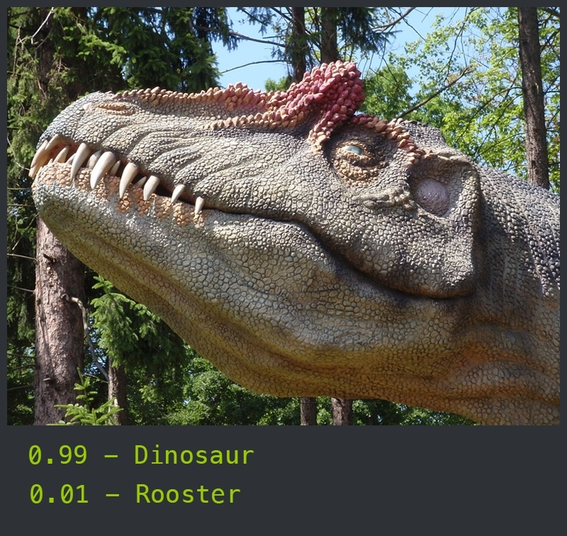
m roads
Classification
Classification is the process of categorizing a stimuli into a finite set of classes or labels.

Slide 4
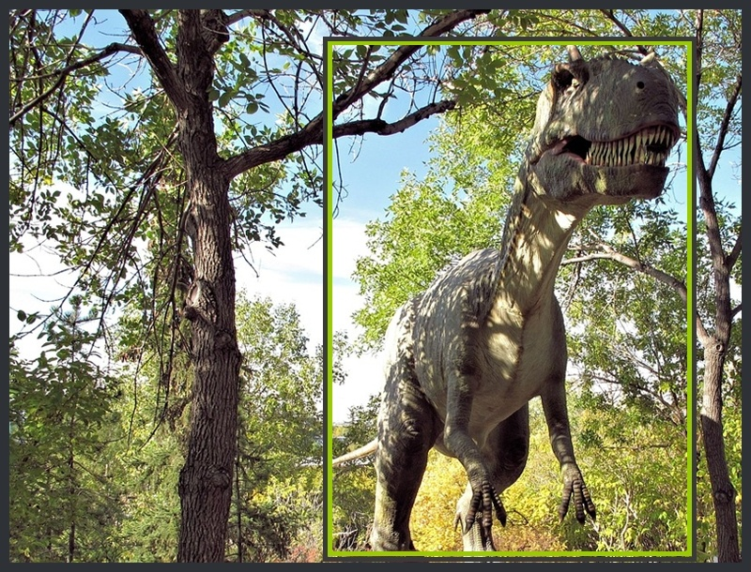
m roads
Localization
Localization finds the location of a single object inside the image.

Slide 5
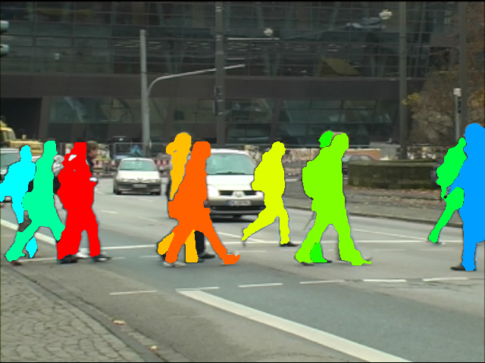
m roads
Instance Segmentation
Find a pixel by pixel mask of each of the detected objects

Slide 6
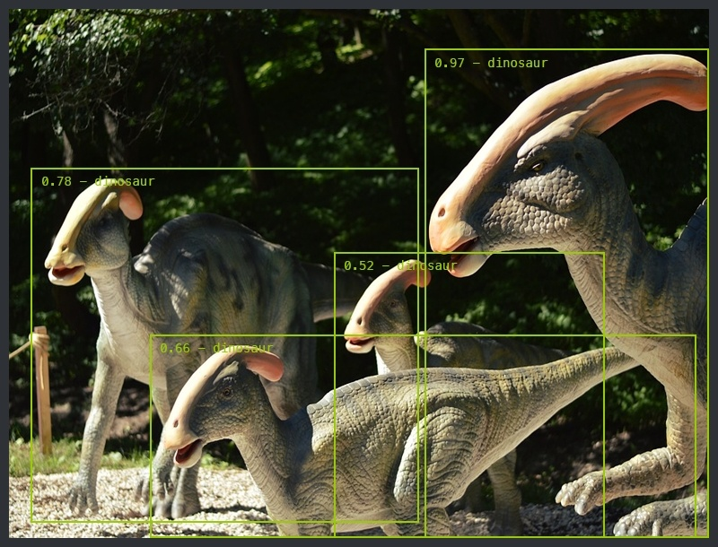
m roads
Object Detection
Object detection is the problem of finding and classifying a variable number of objects on an image.

Slide 7
m roads
Applications of Computer Vision
Face detection
Counting
Visual Search Engine
Aerial image analysis
Autonomous car

Slide 8
m roads
Thank you

