Slide 1
Wireless robot control
von Adrian Stangl und Bastian Wunderlich

Slide 2
Goals
Fun with robot
Drive the robot
Control the robot
Wireless
Possible extensions (because we thought it is going to be easy):
Increase speed when moving upwards
Automatic collision avoidance

Slide 3
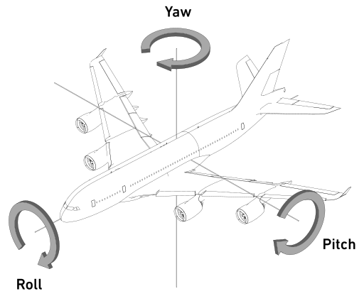
Control
The robot moves in a 2D world (x and y)
=> Only pitch and roll are necessary for controlling
Could have used pitch and yaw instead
but better range of motion with roll

Slide 4
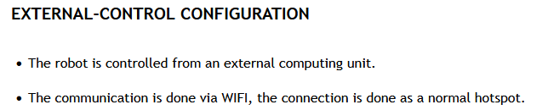
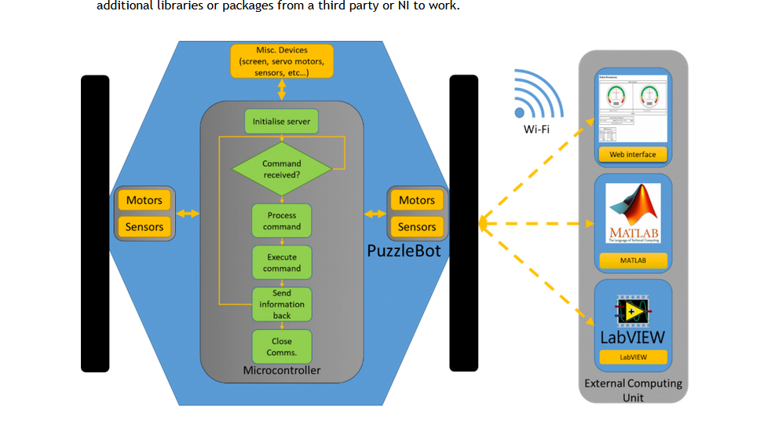
The Robot
How to control the robot?

Slide 5
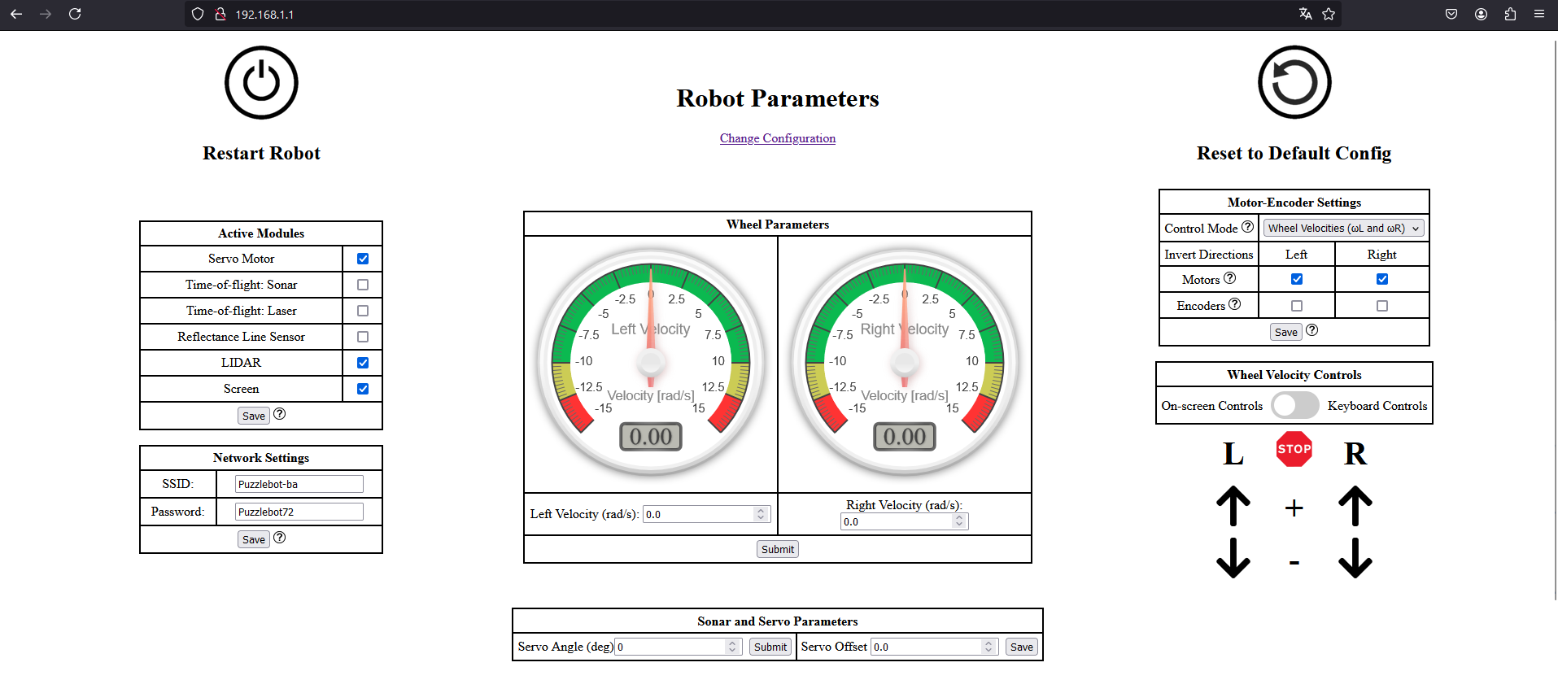
How to Control the Robot

Slide 6
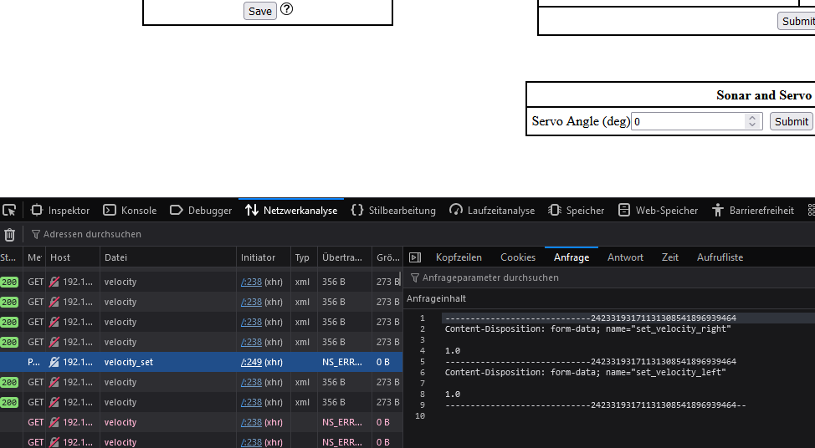
How to Control the Robot

Slide 7
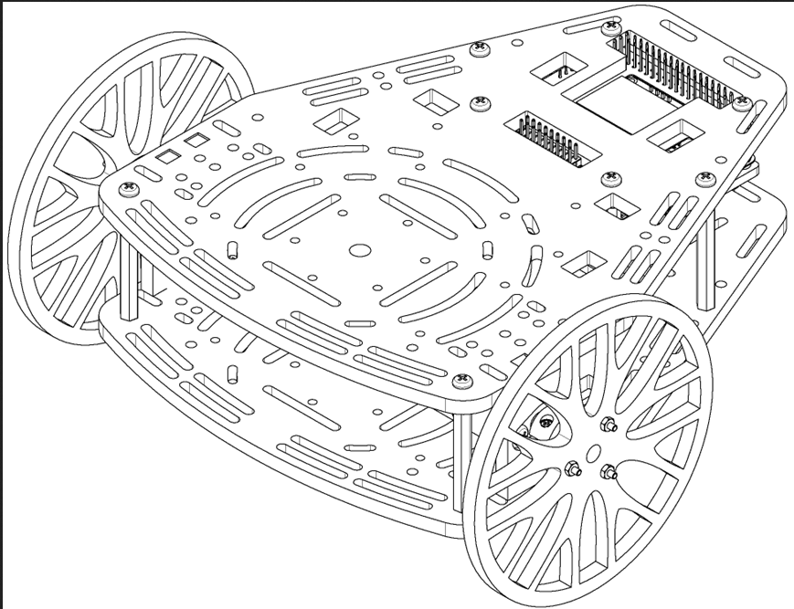
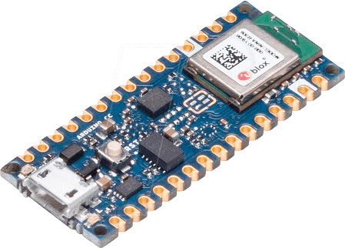

Sensor fusion
We need Roll and Pitch
Since we do not need the yaw angle
=> magnetometer not needed
=> Fuse only Gyroscope and Accelerometer
=> Send wheel orders to robot
We are doing early fusion

Slide 8
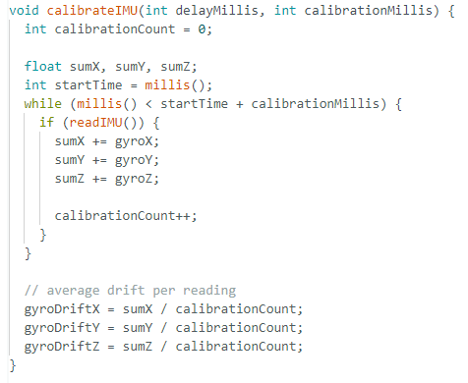

Slide 9
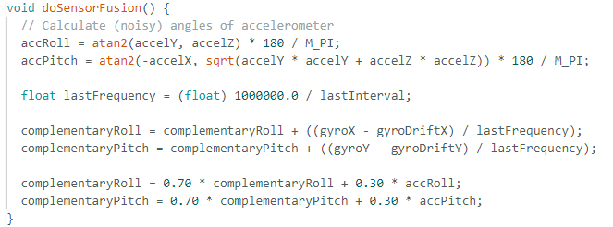
Notes:
Time Integration:
lastFrequency is the sampling frequency, calculated as 1000000.0 / lastInterval. This represents how often the sensor data is being read (in Hz).
To integrate the angular velocity over time, you divide by the frequency (1 / frequency = time interval). This converts the angular velocity into an angular displacement
(gyroX - gyroDriftX) / lastFrequency: This converts the angular velocity to an angular displacement by dividing by the frequency (which is equivalent to multiplying by the time interval in seconds).

Slide 10


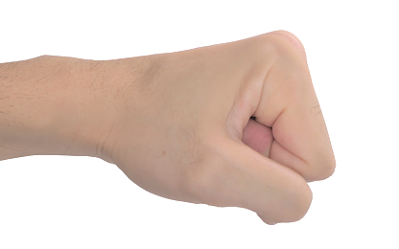
30°
30°

Slide 11
This is where the problems started…

Slide 12
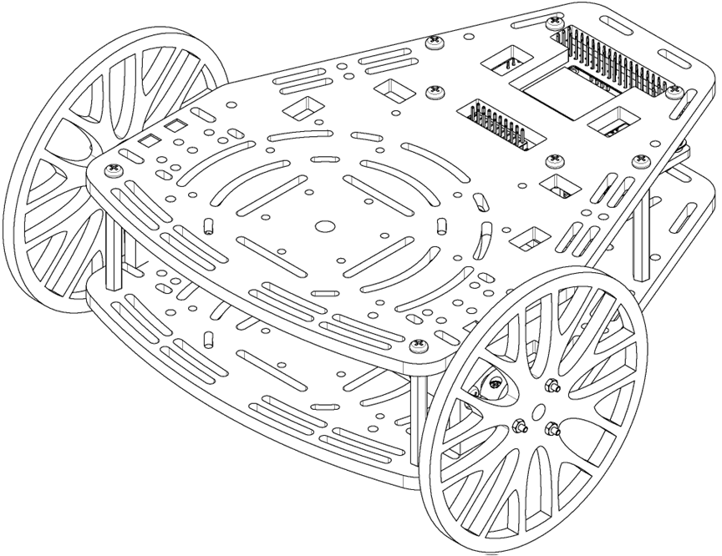
Our architecture:
sense()
fuse()
send()
drive()

Slide 13
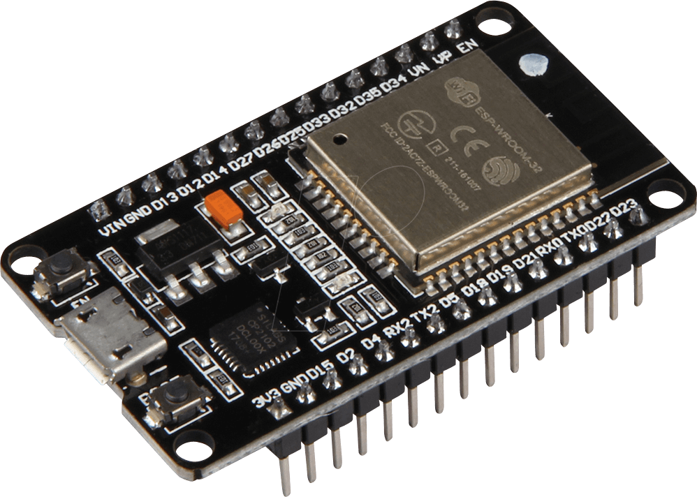
Arduino and Wifi:
Arduino Nano does not have WiFi
=> Connect to ESP32 with serial
Send to robot with ESP32

Slide 14
Our architecture:
Serial
drive()
sense()
fuse()
sendSerial()
receiveSerial()
send()

Slide 15
Web interface:
Despite the statement of the website. Web interface is buggy
=> Communication with
ROS and topics

Slide 16
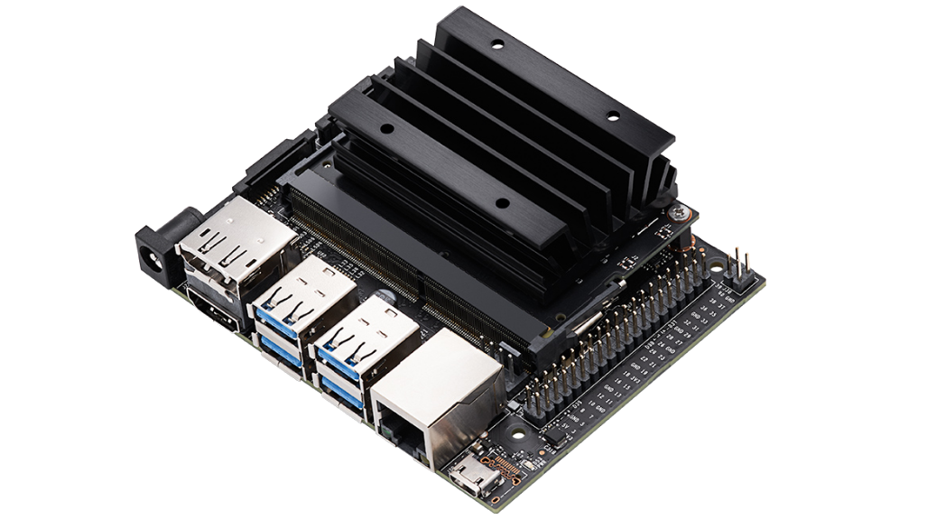

Our architecture:
ROS
topics
Serial
sense()
fuse()
sendSerial()
receiveSerial()
send()
drive()

Slide 17
Replacing the ESP
While the ESP could stay we wanted to replace it
Flashing the chips slows down development
We like writing in python
Overall more comfort

Slide 18

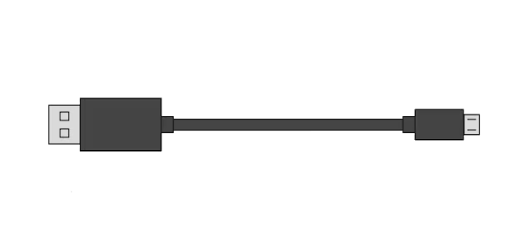
Our architecture:
ROS
topics
Serial
sense()
fuse()
sendSerial()
receiveSerial()
send()
drive()

Slide 19
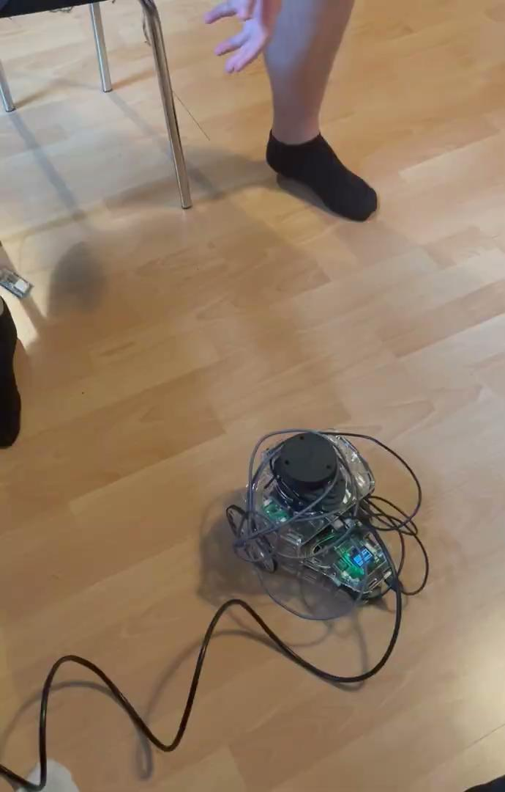
Demonstration

Slide 20
Conclusion
Unforeseen problems slow down the development
The robots instructions are a bit misleading
Overall the control works very nicely :D!
Future work:
Increase speed when going upwards (here a new sensor on the robot needs to be involved)
Automatic collision avoidance (could use the Lidar)

