Slide 1
IBM WebSphere Core Components
    Profile
    Cell
    Deployment Manage (Network Deployment Manager)
    Admin Console
    Serve or App Server or Managed Server
    Cluster
    Node
    Federation
    Node Agent
    Managed and Unmanaged nodes
    Administrative Agent

Slide 2
Profile
The first steps after installing WAS is to create profile
Profiles is a set of files/.xml files that provides the runtime environment of a websphere application server
We can create multiple profiles form a single Websphere Installation ,there e are advantage of creating a profiles instead of multiple installation of the WAS products(Not recommended for prod)
A need for more than one profiles one server is common ex. You might want create separate profiles of the application server for deployment
Not only disk-space but updating the application server is simplifies when you maintain a single set of core files Also creating new profiles is more efficient and less prone to errors than full installation of the WAS
Each profile has its own administrative console and administrative script interface.

Slide 3
Cell and Domain
A Cell is a logical group of one or more nodes in a websphere application server.
The cell provides a way to manage and configure all the nodes and serer under a single administrative umberalla, It allows us to centralized management of the entire websphere environment.
Cell includes a deplyment manager (DMGR) and various nodes each contaning one or more application server
The defauls profile name when you create a CELL profile is AppSrv01
A Domain (Cell) can contain multiple Nodes.
Managed by the Deployment Manager (DMGR).
Provides centralized administration for configuration and management.

Slide 4
Network Deployment Manager
Centralized administration: Manage entire cell via Deployment Manager (dmgr).
Cell-based topology: Organizes nodes and servers into one manageable unit.
Node agents: Sync configuration and manage server operations.
Federated nodes: Easily add/remove nodes in the cell.
Cluster management: Create/manage clusters for scalability and high availability.
Rolling updates: Apply changes with minimal downtime.
Central config repository: Versioned XML-based configuration sync.
App lifecycle management: Deploy, update, start/stop apps centrally.
Load balancing: Distribute workload using plugins and internal balancing.
High availability: Session replication and failover support.
Security: Centralized LDAP/SSL integration and role-based access.
Automation: Use wsadmin scripting (Jython/JACL) for admin tasks.
Monitoring: Track health via console, logs, and JMX metrics.
Web server plugins: Auto-generate routing plugins for clusters.
Backup & recovery: Config export/import for DR and migration.
Performance tuning: Optimize JVM, threads, and connection pools.

Slide 5
Admin Console
The DMGR is the central control point of the WebSphere Cell.
The Admin console in WebSphere , also know as the Integrated Solution Console (ISC), is a web-based Administrative interface that allows administrators to manage and configur the webspehre Application sever environment.
Manages configuration repository for the entire cell.
Handles synchronization with Node Agents.

Slide 6
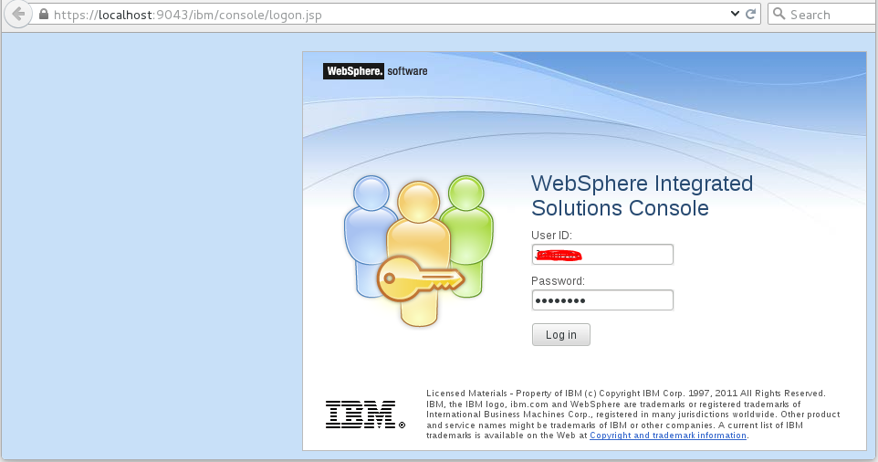
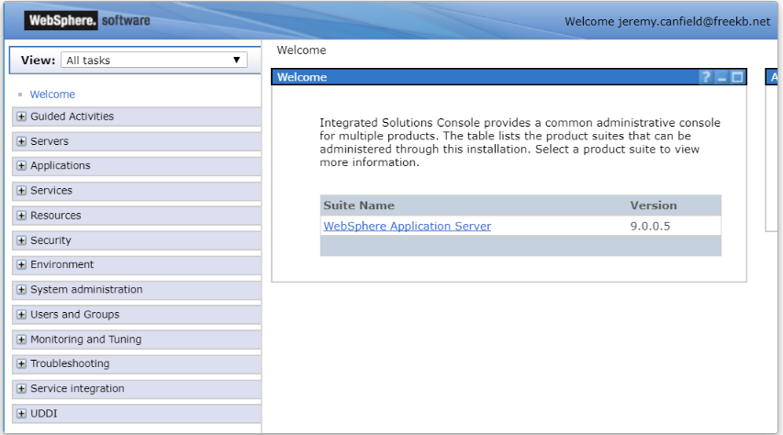

Slide 7
    Standalone Application Server or App Server or Managed Server
In Websphere Application server , an application server or Managed server is an instance of WebSphere that hosts and runs enterprise application
The primary role of an application server in WebSphere is to provide a runtime environment for enterprise application , such as java EE application web services and more
This profile is used to create a standalone application server
The purpose of standalone server is to prepare a runtime environment which works independent to other application sever instance and is managed independently using its own console
Although this server profile (node) later can be added to deployment manager to become part of bigger deployment , but normally it is used to prepare standalone application deployment
When you create this profile , a default application server instance automatically get created

Slide 8
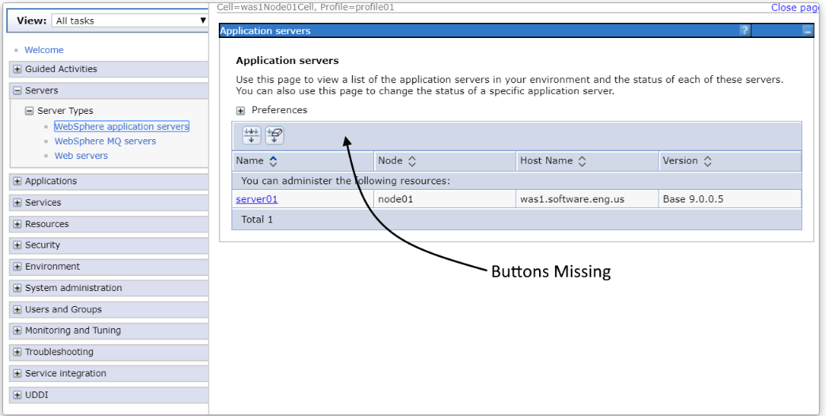

Slide 9
Cluster
A Cluster is a logical group of Application Server instances that host the same applications.
Provides scalability and load balancing.
Ensures high availability and failover.
Managed as a single unit by the DMGR
Example : - An e-commerce website uses a WebSphere cluster to ensure high availability and handle peak traffic by distributing the load across multiple servers, keeping the site responsive and reliable even if one server fails.

Slide 10
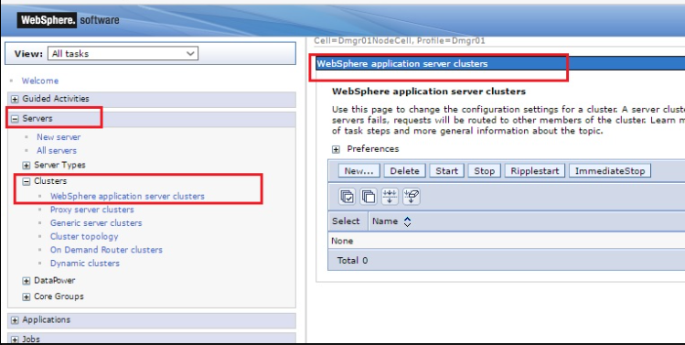
Go to Servers > Clusters > WebSphere application server clusters.

Slide 11
Node
A Node represents a logical group of servers instances within a WebSpehre Application server environment, It typcally represents a physical machine or virtual machine
Node Agent communicates between DMGR and Application Servers on that node.
Handles configuration synchronization, startup, and monitoring.
A node can contain mulitiple application servers (JVM) that run and hot application
By default ,node names are based on the host name of the computer.

Slide 12
Federation
Adding the application server node to a cell is know as federation.
Federation changes the standalone application serer node into a managed node, you can use the administrative console of the deployment manager to manage the node

Slide 13
Node Agent (created Automatically when you create Node)
Each node in the cell has a node agent that communicate with the DMGR. The node Agent ensure that the configuration and operations specified by the DMGR are applied to the node’s server
Role of Node Agent
  Communication : Facilitating communication between the DMGR and the application server
  Configuration Synchronization : Ensuring that configuration changes made by the DMGR are propagated and applied to the server instanced on the node
  Server Management : starting , stopping and monitoring the server instance based on commands for the DMGR.
  When we do the command line synchronization node agent mush be stopped.

Slide 14
Managed and Unmanaged nodes
An unmanaged node does not have a node or administrative agent to manage its server, whereas a managed node does.
A stand-alone application server is an unmanaged node. The application server node become a managed node when it is either federated in to a cell or register with an administrative agent.
When you create a managed mode by federating the application server node into a deployment mange cell, a node agent is automaticity created , the node agent process manages the application server configuration and server on the node.

Slide 15
Administrative Agent
The Administrative Agent provides centralized administration for standalone servers.
Simplifies management of multiple application servers on one machine.
Allows administrative operations such as start/stop and configuration.
An admin agent provide a single web console to admin one or more nodes
The Admin agent web console looks like very similar to the dmgr web console
The administrative agent and application server must be on same machine , so you can only mange nodes that are on the same machine as the admin agent . Since the nodes must be on the same machine as the admin agent, the only scenario where it really make sense to user an admin agent is when you have two or more nodes on a machine
A Dmgr can mange nodes on different machines, so you would use a dmgr when you need a singe management console for nodes on different machine

