Slide 1
AN INTELLIGENT IOT BASED WATER QUALITY MONITORING SYSTEM USING ESP32 AND TURBIDITY SENSOR NETWORKS
PIP104 PROFESSIONAL PRACTCE-ll
VIVA-VOCE
Batch Number:1
Roll Number | Student Name
20201CEI0009 | BHARATH N
20201CEI0007 | DADA LAKSHMI CHARAN
20201CEI0073 | KUMMETHA JYOTHIKA REDDY
Under the Supervision of,
Dr. SASIDHAR BABU SUVANAM
Professor
School of Computer Science & Engineering
Presidency University

Slide 2
Introduction
In the 21st century, there were lots of inventions, but at the same time were pollutions, global warming and so on are being formed, because of this there is no safe drinking water for the world’s pollution.
Nowadays, water quality monitoring in real time faces challenges because of global warming limited water resources, growing population, etc.
Hence there is need of developing better methodologies to monitor the water quality parameters in real time.
The water quality parameters pH measures the concentration of hydrogen ions. It shows the water is acidic or alkaline.
Pure water has 7pH value, less than 7pH has acidic, more than 7pH has alkaline.

Slide 3
The range of pH is 0-14 pH.
For drinking purpose it should be 6.5-8.5pH.
Turbidity measures the large number of suspended particles in water that is invisible.
Higher the turbidity higher the risk of diarrheoa, collera. Lower the turbidity then the water is clean.
Temperature sensor measures how the water is, hot or cold.
Flow sensor measures the flow of water through flow sensor.

Slide 4
The traditional methods of water quality monitor involves the manual collection of water samples from different locations.
Water pollution is one of the biggest fears for the green globalization. In order to ensure the safe supply of the drinking water the quality needs to be monitor in real time.
we present a design and development of a low cost system for real time monitoring of the water quality in IOT(internet of things).

Slide 5
Literature Review
1) Nikhil Kedia entitled “Water Quality Monitoring for Rural Areas-A Sensor Cloud Based Economical Project.” Published in 2015 1st International Conference on Next Generation Computing Technologies (NGCT-2015) Dehradun, India.
Review: This paper highlights the entire water quality monitoring methods, sensors, embedded design, and information dissipation procedure, role of government, network operator and villagers in ensuring proper information dissipation. It also explores the Sensor Cloud domain. While automatically improving the water quality is not feasible at this point, efficient use of technology and economic practices can help improve water quality and awareness among people.
2] Jayti Bhatt,Jignesh Patoliya entitled “Real Time Water Quality Monitoring System”.
Review: This paper describes to ensure the safe supply of drinking water the quality should be monitored in real time for that purpose new approach IOT (Internet of Things) based water quality monitoring has been proposed. In this paper, we present the design of IOT based water quality monitoring system that monitor the quality of water in real time. This system consists some sensors which measure the water quality parameter such as pH, turbidity, conductivity, dissolved oxygen, temperature.

Slide 6
Literature Review
3] Michal Lom, Ondrej Pribyl, Miroslav Svitek entitled “Industry 4.0 as a Part of Smart Cities”.
Review: This paper describes the conjunction of the Smart City Initiative and the concept of Industry 4.0. The term smart city has been a phenomenon of the last years, which is very inflected especially since 2008 when the world was hit by the financial crisis. The main reasons for the emergence of the Smart City Initiative are to create a sustainable model for cities and preserve quality of life of their citizens.
4] Sokratis Kartakis, Weiren Yu, Reza Akhavan, and Julie A. McCann entitled “Adaptive Edge Analytics for Distributed Networked Control of Water Systems”
Review: This paper presents the burst detection and localization scheme that combines lightweight compression and anomaly detection with graph topology analytics for water distribution networks. We show that our approach not only significantly reduces the amount of communications between sensor devices and the back end servers, but also can effectively localize water burst events by using the difference in the arrival times of the vibration variations detected at sensor locations. Our results can save up to 90% communications compared with traditional periodical reporting situations

Slide 7
Research Gaps Identified
Scalability and Network Optimization:
Investigate the scalability of the system when deployed in large-scale water bodies or distributed environments.
Explore optimization techniques for efficient data transmission and communication within the sensor network to reduce energy consumption and enhance network lifetime.
Sensor Calibration and Reliability:
Address challenges related to sensor calibration and ensure the reliability of turbidity measurements over time.
Investigate methods to handle sensor drift and degradation, ensuring accurate and consistent water quality monitoring results.

Slide 8
Research Gaps Identified
Integration of Additional Sensors:
Explore the integration of additional sensors to monitor other water quality parameters such as pH, dissolved oxygen, temperature, or specific contaminants.
Assess the impact of integrating multiple sensors on power consumption, data accuracy, and overall system performance.
Real-time Data Analytics and Decision Support:
Develop real-time data analytics algorithms to process and analyze water quality data on the edge (ESP32) or in the cloud.
Explore the implementation of decision support systems that can provide actionable insights based on the analyzed data, facilitating prompt responses to water quality issues.

Slide 9
Research Gaps Identified
Security and Privacy Concerns:
Investigate security measures to protect the IoT-based system from potential cyber threats, unauthorized access, and data breaches.
Address privacy concerns related to the collection, storage, and sharing of water quality data, especially in sensitive or private locations.
Energy Efficiency and Power Management:
Explore advanced power management techniques to enhance the energy efficiency of the ESP32-based sensor nodes.
Investigate the feasibility of energy harvesting technologies to extend the operational lifetime of the monitoring system, especially in remote or inaccessible locations.

Slide 10
Research Gaps Identified
Community Engagement and User Interface Design:
Assess the effectiveness of community engagement strategies in involving local communities in water quality monitoring.
Explore user interface design improvements to make the system more user-friendly, ensuring that stakeholders can easily interpret and act upon the collected data.
Environmental Impact Assessment:
Conduct an environmental impact assessment of the IoT-based monitoring system, considering factors such as the production and disposal of sensors, energy consumption, and potential ecological consequences.

Slide 11
Proposed Method
The proposed system uses four sensors which are pH, turbidity, ultrasonic, DHT-11, microcontroller unit as the main processing module and one data transmission module ESP32 Wi-Fi module (NodeMCU).
The microcontroller unit is a significant part of the system developed for water quality measurement because The Arduino Mega consumes low power, and it is a small size, where the size is a good use for a crucial point-of-sale technology criterion.
Among four sensors, two of the sensors collect the data in the form of analog signals; the MCU has an on-chip ADC that translates the sensor analog signals into the digital format for further study.

Slide 12
Proposed Method
So, to get this analog output from the sensor, the sensor's analog output of will be connected to the MCU's analog pins.
Whereas the other two sensors output directly connected to the digital pins of the MCU units. All the sensors data processed by the MCU and updated to the ThingSpeak server using the Wi-Fi data communication module ESP32 (NodeMCU) to the central server.

Slide 13
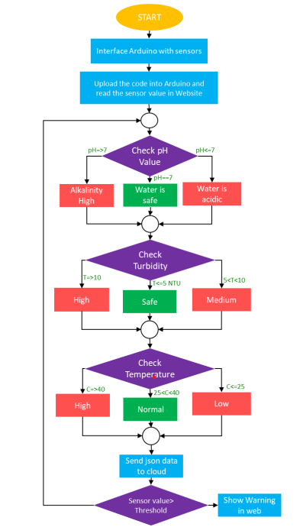
Proposed Method
Fig: Flow chart

Slide 14
Methodology
Select Sensors: Choose appropriate sensors to measure key water quality parameters like pH, turbidity, total dissolved solids (TDS), temperature, and conductivity.
IoT Hardware: Select suitable IoT hardware, such as microcontrollers (e.g., Arduino or Raspberry Pi) and connectivity modules (Wi-Fi, Bluetooth, etc.).
Data Acquisition: Connect the sensors to the IoT hardware to collect data. You may need analog-to-digital converters for some sensors.
Data Transmission: Send the collected data to a central server or cloud platform using MQTT, HTTP, or other suitable protocols.
Cloud Platform: Utilize a cloud platform (e.g., AWS IoT, Azure IoT, or Google Cloud IoT) to manage and store data. Set up a database to store water quality information.

Slide 15
Components
ESP32
NodeMCU
pH Meter
Turbidity Sensor
Temperature Sensor
Logic Level Converter
Serial Communication
Firebase Connection
Processing data and send data to cloud

Slide 16
Objectives
Ensuring Safe Drinking Water and Real-time Monitoring : The primary objective is to ensure that the water purifier consistently provides safe and clean drinking water to the residents of the home. This includes monitoring for contaminants such as bacteria, viruses, heavy metals, and other harmful substances in the input water and ensuring they are effectively removed in the output water.To provide real-time monitoring of water quality. This allows homeowners to have immediate information about the safety of the water they are consuming.
Early Detection of Contaminants and Energy Efficiency : Detect contaminants or changes in water quality early, allowing for timely maintenance and replacement of purification components to prevent health risks. Optimize energy usage by the water purifier by only activating the purification process when necessary. For instance, the system could detect when water quality is below a certain threshold and activate purification accordingly.

Slide 17
Objectives
3. Water Conservation and User Alerts : Promote water conservation by ensuring that the water purifier is only treating water that actually requires purification. This is especially relevant in areas facing water scarcity. Notify homeowners when the water quality falls below acceptable levels or when the purification system requires maintenance or replacement of filters. This ensures that users are aware of potential issues and can take corrective action.

Slide 18
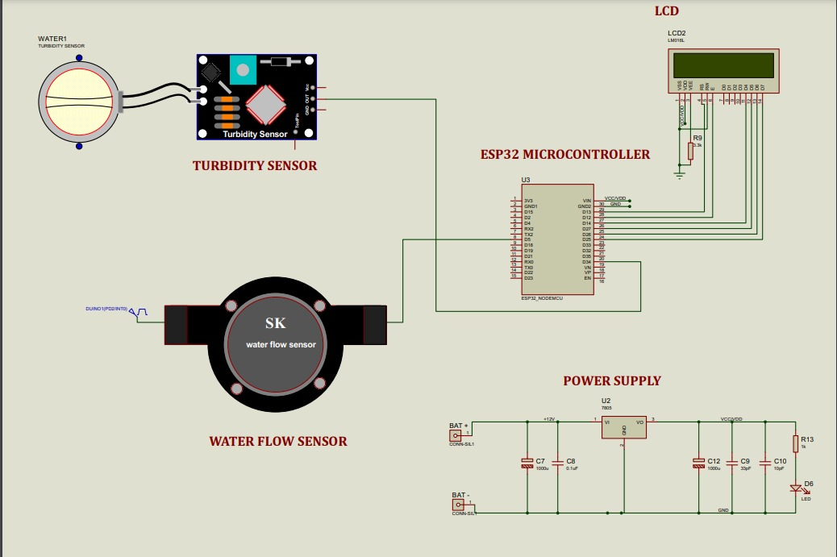
Circuit Diagram
Fig: Circuit Diagram of water quality monitoring system

Slide 19
System Design
Define System Requirements:
Identify the specific water quality parameters to monitor (e.g., turbidity, pH, temperature).
Determine the deployment environment (e.g., lakes, rivers, industrial facilities).
Define the frequency of data collection and reporting.
Select Hardware Components:
Choose ESP32 microcontrollers for sensor nodes due to their low power consumption and built-in Wi-Fi capabilities.
Select turbidity sensors and other relevant sensors based on the identified parameters.
Network Architecture:
Design a sensor network architecture, considering the spatial distribution of sensor nodes.
Decide on a communication protocol (e.g., MQTT) for data transmission between nodes and the central server.

Slide 20
System Design
Power Management:
Implement power-efficient strategies, such as sleep modes and energy harvesting if applicable.
Choose appropriate power sources (e.g., batteries, solar panels).
Data Security and Privacy:
Incorporate encryption and authentication mechanisms to secure data transmission.
Develop protocols for handling and storing sensitive water quality data securely.
User Interface:
Design a user-friendly interface for data visualization and system monitoring.
Consider web-based dashboards or mobile applications for remote access.

Slide 21
System Implementation
Hardware Integration:
Connect ESP32 microcontrollers to turbidity sensors and other selected sensors.
Implement a reliable power supply mechanism for sensor nodes.
Sensor Calibration:
Calibrate turbidity sensors to ensure accurate measurements.
Implement algorithms to compensate for sensor drift over time.
Firmware Development:
Develop firmware for ESP32 microcontrollers to read sensor data.
Implement communication protocols for data transmission within the sensor network.
Communication Setup:
Configure Wi-Fi settings on ESP32 for communication with the central server.
Set up MQTT or another communication protocol for data exchange.

Slide 22
System Implementation
Centralized Data Storage:
Establish a centralized database or cloud storage to store water quality data.
Implement mechanisms for efficient data retrieval and storage.
Real-time Data Analysis:
Develop algorithms for real-time data analysis on the edge or in the cloud.
Implement decision support mechanisms for identifying anomalies or trends in water quality.
User Interface Development:
Design and implement a user interface for stakeholders to visualize water quality data.
Include features for setting alerts, generating reports, and accessing historical data.
Testing and Validation:
Conduct thorough testing of the entire system, including sensor accuracy, data transmission, and user interface functionality.
Validate the system in real-world scenarios to ensure its reliability and performance.

Slide 23
System Implementation
Deployment:
Deploy the sensor network in the target environment, considering factors such as accessibility and coverage.
Monitor the system during the initial deployment phase to address any unforeseen issues.
Maintenance and Updates:
Establish a maintenance plan for regular sensor calibration, battery replacement, and system updates.
Provide ongoing support for users and address any issues that arise.

Slide 24
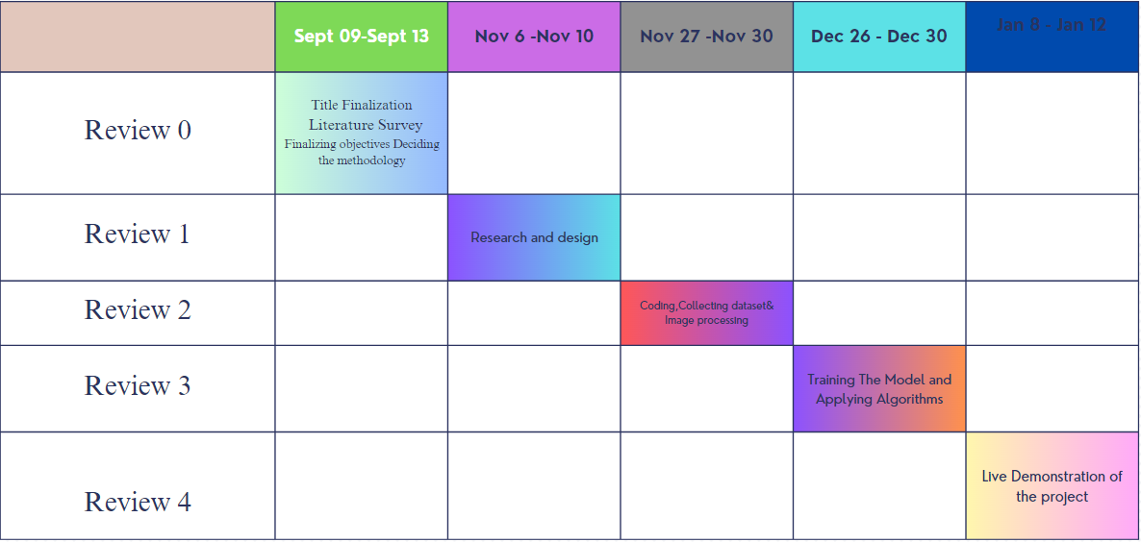
Timeline of the Project

Slide 25
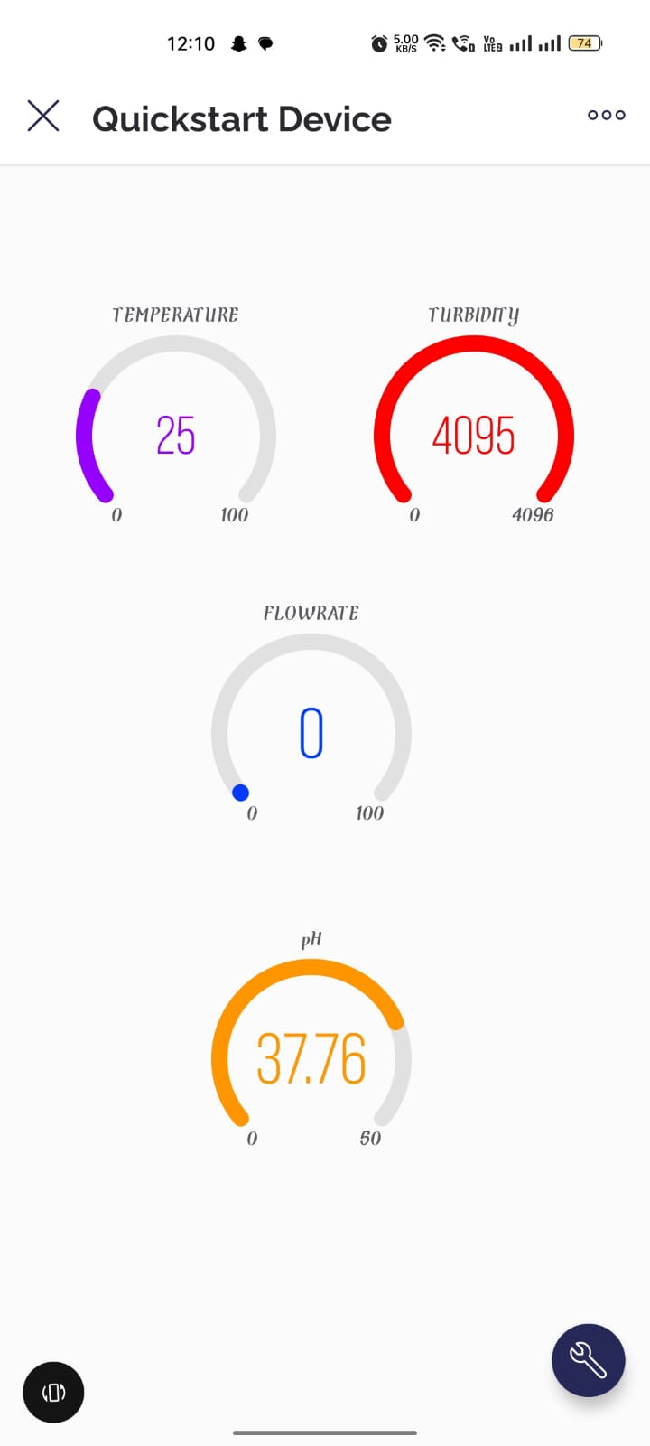
Outcomes

Slide 26
Expected Outcomes
Improved Water Safety: Enhanced monitoring and real-time data analysis can lead to safer drinking water by detecting and mitigating contaminants and impurities more effectively.
Consistent Water Quality: Homeowners can expect a consistent and high level of water quality, ensuring that the water purifier consistently delivers clean and safe water.
Early Detection of Contaminants: The system's ability to detect contaminants early allows for timely maintenance and component replacement, reducing health risks associated with poor water quality.
Energy Efficiency: Optimization of energy usage results in cost savings and a reduced environmental footprint. Homeowners can expect lower utility bills.

Slide 27
Conclusion
Monitoring of Turbidity, PH & Temperature of Water makes use of water detection sensor with unique advantage and existing GSM network. The system can monitor water quality automatically, and it is low in cost and does not require people on duty.
So the water quality testing is likely to be more economical, convenient and fast. The system has good flexibility.
Only by replacing the corresponding sensors and changing the relevant software programs, this system can be used to monitor other water quality parameters. The operation is simple.
The system can be expanded to monitor hydrologic, air pollution, industrial and agricultural production and so on. It has widespread application and extension value.

Slide 28
References
[1] Yaroshenko, I.; Kirsanov, D.; Marjanovic, M.; Lieberzeit, P.A.; Korostynska, O.; Mason, A.; Frau, I.; Legin, A. Real-time water quality monitoring with chemical sensors. Sensors 2020, 20, 3432. [Google Scholar] [CrossRef]
[2] Ruchitra K, Reshma N, Seema LB, Sharanamma, Suvanam Sasidhar Babu, Water Quality Monitoring and Filter System to Preserve Water Resource Using IOT, Published by: The Mattingley Publishing Co., Inc, May-June 2020 ISSN: 0193-4120 Page No. 4156-4159.
[3] Varsha Lakshmikantha, Anjitha Hiriyannagowda, Akshay Manjunath, Aruna Patted, Jagadeesh Basavaiah∗ , Audre Arlene Anthony, IoT based smart water quality monitoring system, Global Transitions Proceedings 2 (2021)

Slide 29
[4] A. N. Prasad, K. A. Mamun, F. R. Islam and H. Haqva, "Smart Water Quality Monitoring System",2nd Asia-Pacific World Congress on Computer Science and Engineering 1-6.-References-Scientific Research Publishing“, 2021 IEEE.
[5] G. N. Satya Sai, R. Sudheer, K. S. Manikanta, S. G. Arjula, B. N. Rao and D. V. Sai Maneeswar Mutyala, "IoT based Water Quality Monitoring System," 2021 IEEE 9th Region 10 Humanitarian Technology Conference (R10-HTC), Bangalore, India, 2021, pp. 01-06, doi: 10.1109/R10-HTC53172.2021.9641630.
[6] K. Shanmugam, M. E. Rana, D. Tan Zi Xuen and S. Aruljodey, "Water Quality Monitoring System: A Smart City Application With IoT Innovation," 2021 14th International Conference on Developments in eSystems Engineering (DeSE), Sharjah, United Arab Emirates, 2021, pp. 571-576, doi: 10.1109/DeSE54285.2021.9719480.

Slide 30
[7] Y. Liu, Q. Xue, C. Chang, R. Wang, Z. Liu, L. He, Recent progress regarding electrochemical sensors for the detection of typical pollutants in water environments. Anal Sci 38, 55 (2022).
[8] O.V. Kuznetsova, N.V. Dushenko, A.R. Timerbaev, How feasible is direct determination of rare earth elements in seawater by IcpMs? Anal. Sci. 37, 1633 (2021)
[9] R. Kumar, M. Mohan, S. Vengateshapandiyan, M. Kumar and R. Eswaran, "Solar based advanced water quality monitoring system", International Journal of Science Engineering and Technology Research (IJSETR), vol. 3, no. 3, 2020
[10] A.N. Prasad, K.A. Mamun, F.R. Islam and H. Haqva, "Smart water quality monitoring system", The University of the South Pacific. 2nd Asia-Pacific World congress on Computer Science and Engineering IEEE Conference, 2015.

Slide 31
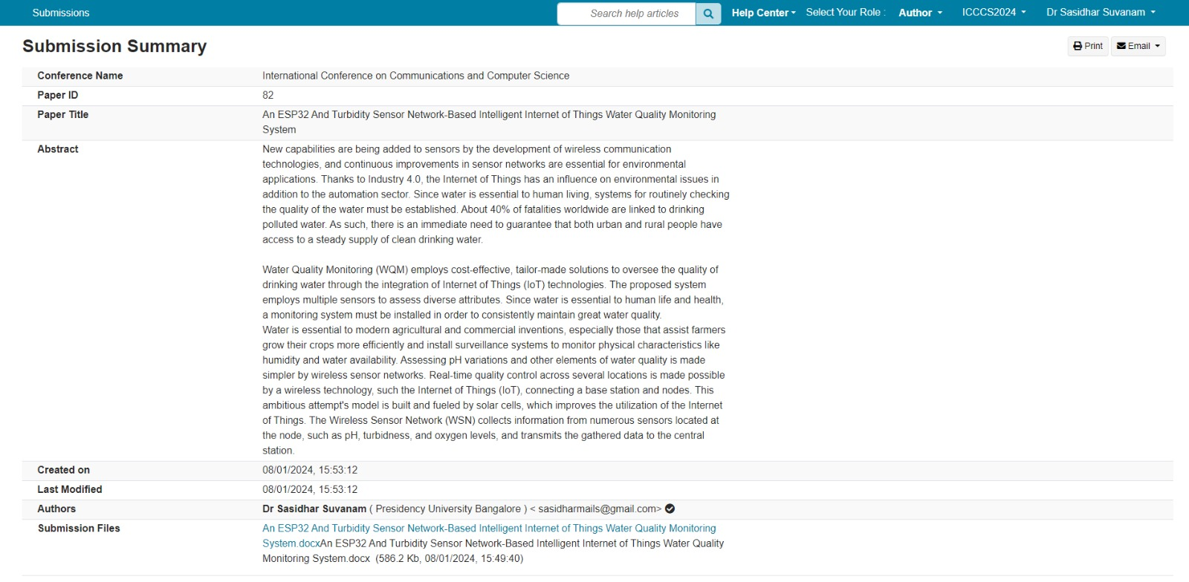
Publication Details

Slide 32
Thank You

