Slide 1

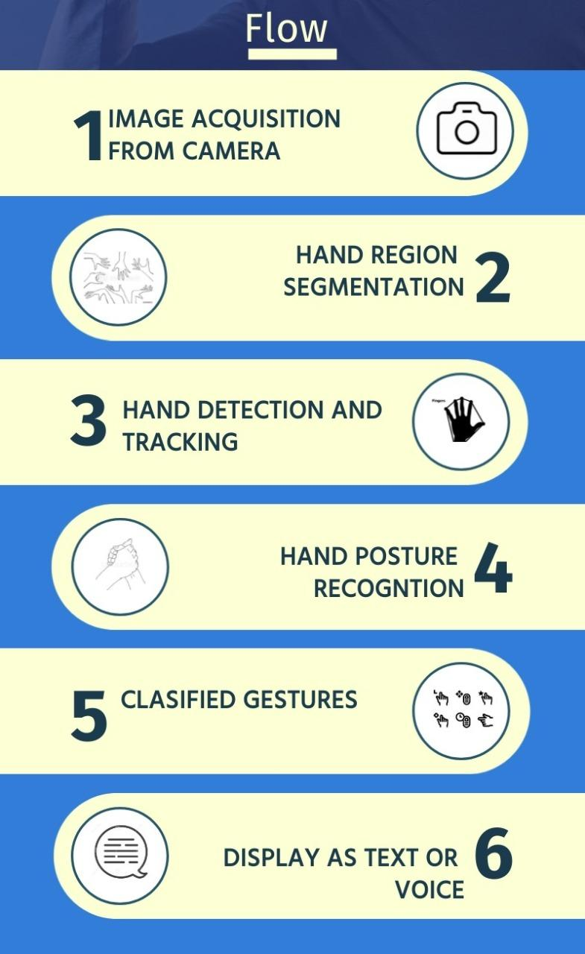

Proposed Methodology/Design
To begin, we will be using OpenCV to capture the hand gesture images through a Computer/Mobile camera.
This captured images will be segmented and only the gesture part of the hand is stored in the database.
This image is now fed to the model which will use tensorflow to classify the image.
After this the model recognises the gesture using the images in the dataset.
Now, for training and testing our model. We use at least 30-40 images per gesture. Here most of the images, say 80% is used for training our model and 20% is used for testing.
Once the training is complete, in the testing phase, we try to display the gestures as text or voice based output.

Slide 2

Department of Computer Science and Engineering
Project Phase – II (18CSP83)
Review – 1
Hand Gesture Recognition for Differently Abled People
Group No.: 03 Batch No.: 2021_CSE_35
Student 1.: 1KS18CS024 Goutham M
Student 2.: 1KS18CS018 Dhananjaya S
Student 3.: 1KS18CS033 Kiran V Dambal
Student 4.: 1KS18CS023 Ganesh A
Guided By:
Dr. Deepa S R,
Associate Professor,
Department of CSE, KSIT

Slide 3
Contents
Introduction
Comparison with similar work
Problem Statement and Objectives
Methodology Proposed/ Design
Technologies / Tools Used
Implementation of Modules with codes
Snapshots
References

Slide 4
Introduction
In the last decades, keyboard and mouse have played a significant role in Human-Computer Interaction (HCL). However, owing to the rapid development of hardware and software, new types of HCI methods have been required. In particular, technologies such as speech recognition and gesture recognition have got great amount of attention in the field of HCI.
Hand gestures are the natural way of interactions when one person is communicating with one another and therefore hand movements can be treated as a non verbal form of communication. Hand gesture recognition is a process of understanding and classifying meaningful movements by the human hands.
The general definition when it comes to computers and technology is, gesture recognition is the ability of a computer to understand gestures and execute commands based on those gestures.
Gesture recognition is an alternative user interface for providing real-time data to a computer. Instead of typing with keys or tapping on a touch screen, a camera / sensor perceives and interprets movements as the primary source of data input. This is what happens between the time a gesture is made and the computer reacts.

Slide 5
Introduction
Gesture-based interfaces are applications that allow users to control devices using hand and other body parts. Today, they are found in devices used in sign language recognition, home automation, shopping, consumer electronics, virtual reality and augmented reality gaming, navigation, and driving, among others.
In recent years, the number of deaf-mute people has increased because of birth defects and other issues. Since a deaf and mute person cannot talk with an ordinary person in order that they ought to rely on some kind of communication system. Sign Language Recognition using meaningful gestures is used to help them.
Hand gesture identification tiers from the static gesture with the complex background or dynamic gestures that express the human feeling. The hand is directly use as the input to the machine, for the communication purpose of gesture identification there is no need of an intermediate medium.
So, The aim of this project is to build a system for hand gesture recognition that acknowledges hand gestures and then converts them into text/voice.

Slide 6
Comparison with similar work
Sl no. | Publication Details | Problem Focused | Technique | Outcome
1. | Parshwa P. Patil, Maithili J. Phatak, Suharsh S. Kale, “Hand Gesture Recognition for Deaf and Dumb” International Research Journal of Engineering and Technology (IRJET) Volume: 06 Issue: 11 | Nov 2019 | To create a hand gesture recognition model using Machine Learning. | * Adaptive Boosting * Motion Detection * Region of Interest * Thresholding | This produced decent classification results of 73.68% with a small feature vector size containing 8 features.
2. | Kundan Kumar Dubey, Ajitanshu Jha, Akshay Tiwari, K. Narmatha, "Hand Gesture Movement Recognition System Using Convolution Neural Network Algorithm", International Research Journal of Computer Science (IRJCS) Issue 04, Volume 6 (April 2019) | Hand Gesture Detection using Convolutional Neural network and Deep Learning model. | * OpenCV * Computer Vision * Deep Learning * Inception v3 | The proposed system is capable to immediately understand hand gestures from the entire image without the use of any image region selection framework.

Slide 7
Comparison with similar work
Sl no. | Publication Details | Problem Focused | Technique | Outcome
3. | “Design and evaluation of a hand gesture recognition approach for real-time interactions” Vaidyanath Areyur Shanthakumar Chao Peng Jeffrey Hansberger Lizhou Cao, Springer Science Publisher- 21 February 2020 | In this work, they detect and recognize in-air hand gestures, which are natural and intuitive to perform and can be used to interact with touchless user interfaces. | This is different from machine learning approach, they’re angular-velocity method do not require data preprocessing like data collection, annotation, or training. | The overall mean accuracy is 97.3%, which takes both static and dynamic gestures into account.
4. | Guillaume Devineau, Wang Xi, Fabien Moutarde, Jie Yang. “Deep Learning for Hand Gesture Recognition on Skeletal Data”. 13th IEEE Conference on Automatic Face and Gesture Recognition May 2018, Xi’An, China. | In this work, they use convolutional neural network to classify (recognize) hand gestures using skeletal data. | They introduce a new 3D hand gesture recognition approach based on a deep learning model using Convolutional Neural Network (CNN) where sequences of hand-skeletal joints’ positions are processed by parallel convolutions. | Our model achieves a 91.28% classification accuracy for the 14 gesture classes case and an 84.35% classification accuracy for the 28 gesture classes case.

Slide 8
Problem Statement and Objectives
PROBLEM STATEMENT
“To design a Deep Learning Model which will recognize
the hand gestures of Differently Abled People and then
convert the gestures into text/voice”
OBJECTIVES
The main objective is to create a model which accurately identifies the hand gesture and provides the proper outcome every single time.
To create a stable system which recognizes sign language which is accepted by Indian Sign Language Organization.
Since, there are no proper methods for Differently Abled People to communicate in India, we want to create a system that will help everyone in their day to day to life.

Slide 9
Technologies/ Tools Used
Minimum Hardware Requirements:
· Windows OS version 8 or higher
· Intel i5 processor or higher
· Minimum of 4GB RAM or higher
· Web Camera
· Graphics Card 2GB or higher
Software Requirements:
· Python
· Jupyter Notebook
· Tensorflow
· OpenCV
Dataset:
https://www.kaggle.com/abdullahmujahidali/hand-gesture-recongition-yolo-v3?select=234.JPG
https://www.kaggle.com/muhammadkhalid/sign-language-for-alphabets

Slide 10
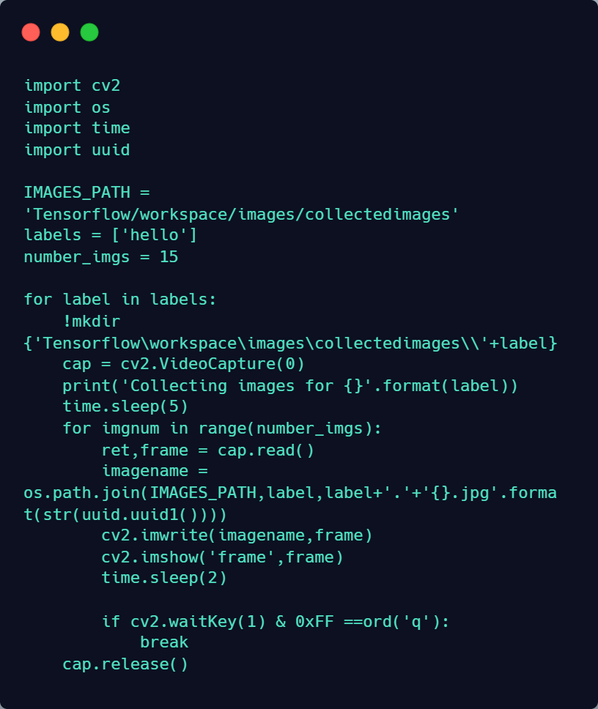
Implementation of Modules

Slide 11
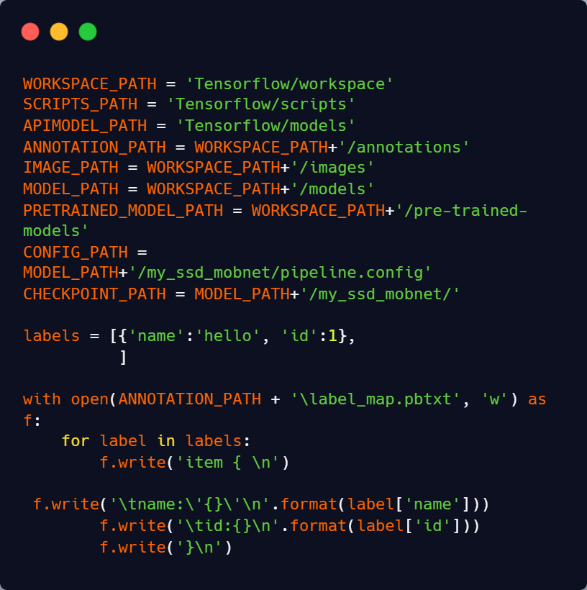
Implementation of Modules

Slide 12
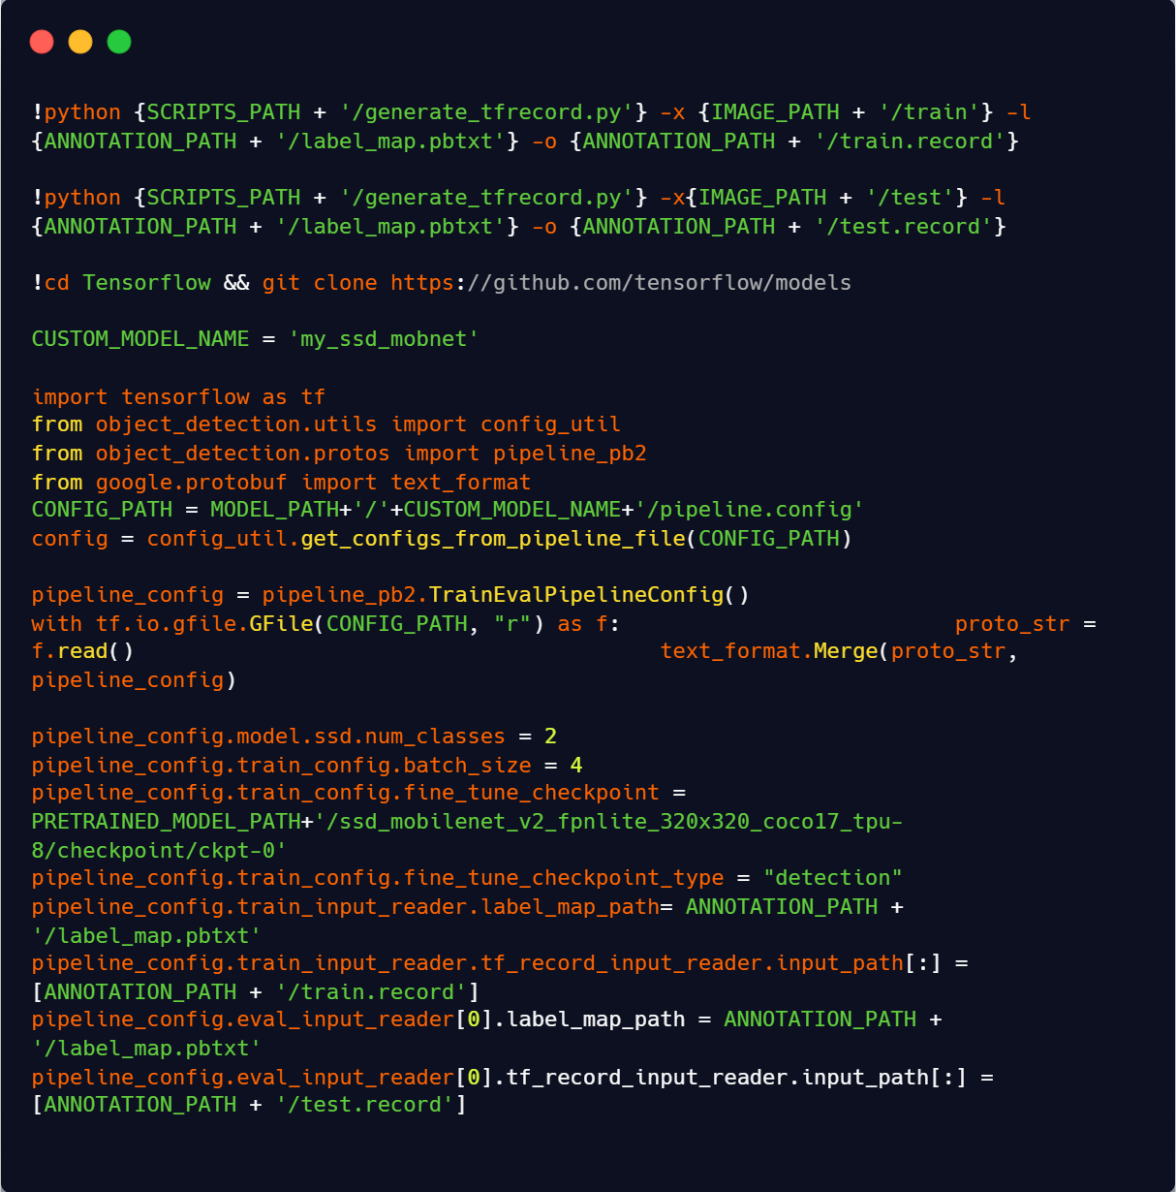
Implementation of Modules

Slide 13
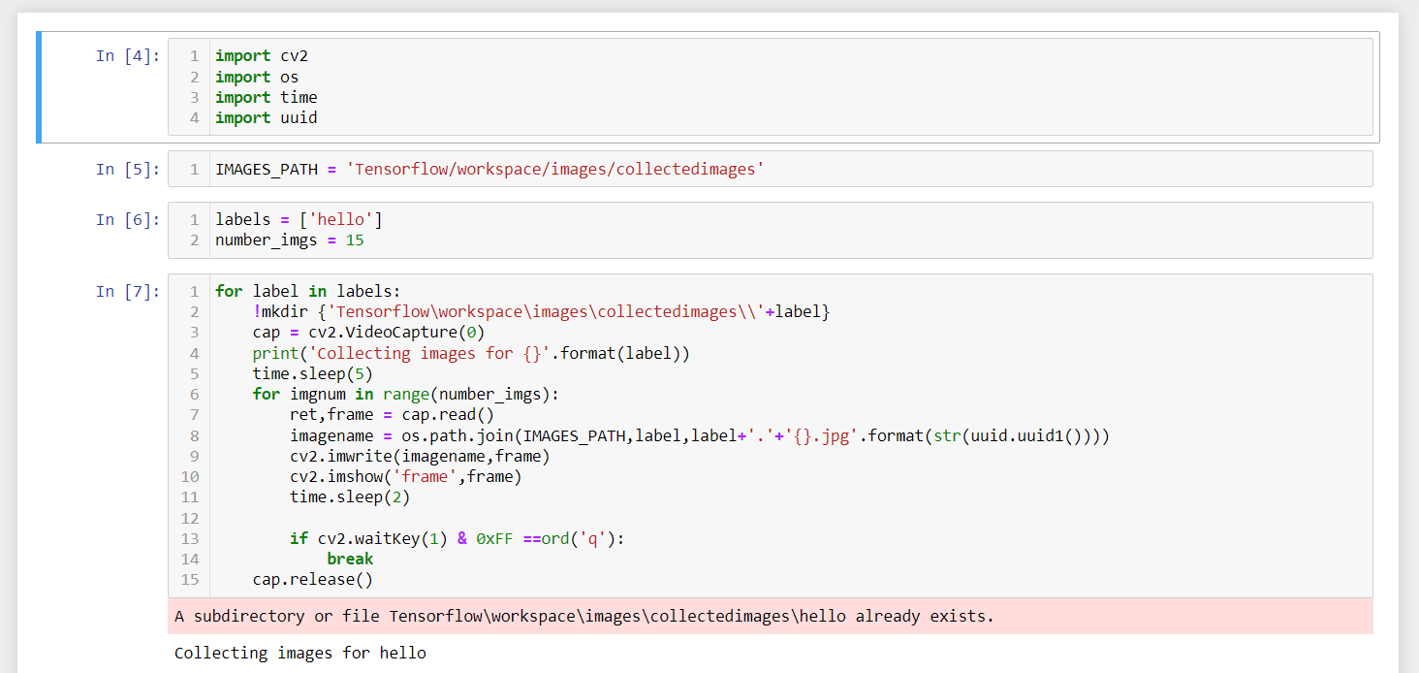
Snapshots

Slide 14
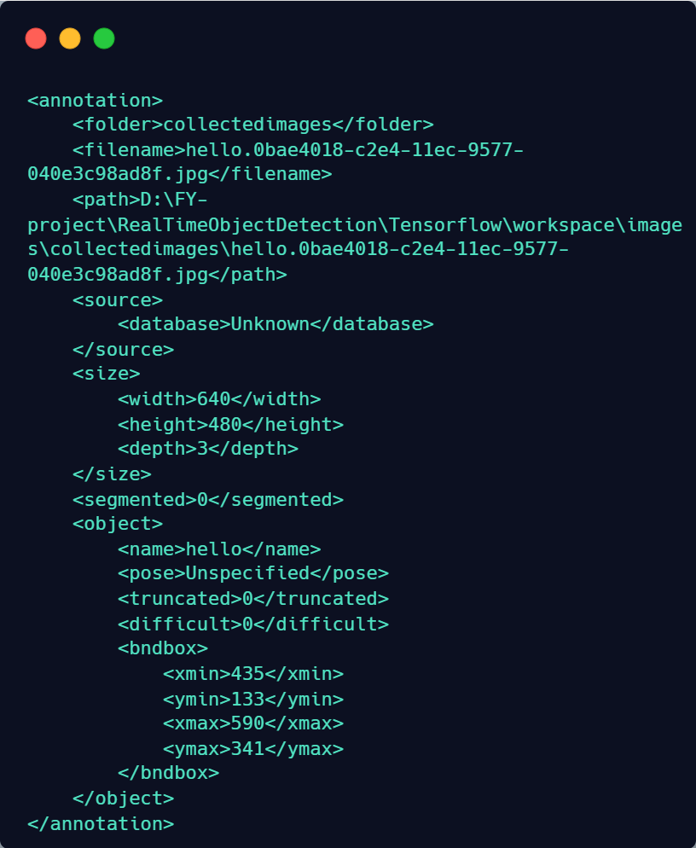



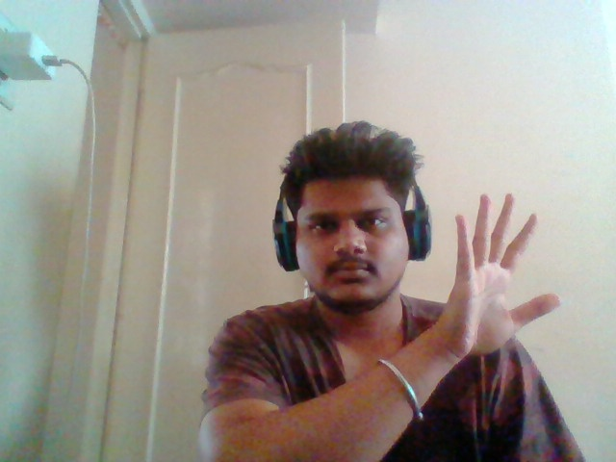
Snapshots

Slide 15
References
[1] “Hand Gesture Recognition for Deaf and Dumb” ,Parshwa P. Patil, Maithili J. Phatak, Suharsh S. Kale,International Research Journal of Engineering and Technology (IRJET) Volume: 06 Issue: 11 | Nov 2019
[2] "Hand Gesture Movement Recognition System Using Convolution Neural Network Algorithm", Kundan Kumar Dubey, Ajitanshu Jha, Akshay Tiwari, K. Narmatha, International Research Journal of Computer Science (IRJCS) Issue 04, Volume 6 (April 2019)
[3] “Hand Gesture Recognition Based on Computer Vision: A Review of Techniques”,Munir Oudah, Ali Al-Naji, and Javaan Chahl, Journal of Imaging -23 July 2020
[4] “A Sensor-Based Hand Gesture Recognition System for Japanese Sign Language”, Xianzhi Chu, Jiang Liu, School of Fundamental Science and Engineering Waseda University 2021 IEEE 3rd Global Conference on Life Sciences and Technologies (LifeTech 2021)

Slide 16


