Slide 1


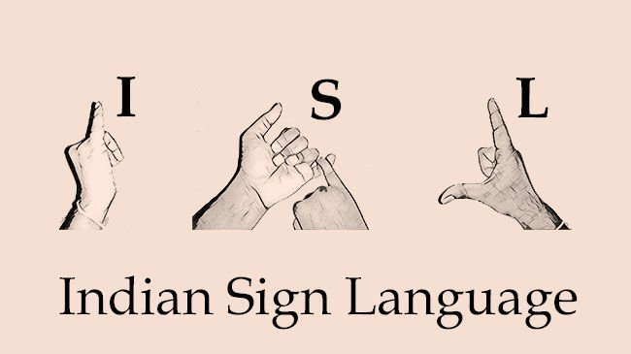
Kammavari Sangham (R) 1952, K.S.Group of Institutions
K. S. INSTITUTE OF TECHNOLOGY, BENGALURU-560109
(Affiliated to VTU, Belagavi & Approved by AICTE, New Delhi, Accredited by NAAC & IEI)
DEPARTMENT OF COMPUTER SCIENCE AND ENGINEERING
PROJECT TITLE
Hand Gesture Recognition for Deaf and Mute
Project Guide: Dr. Deepa S R
Team Number: 2021_CSE_35
Team Members:
Goutham M
Dhananjaya S
Kiran V Dambal
Ganesh A
‹#›

Slide 2
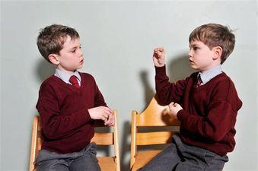
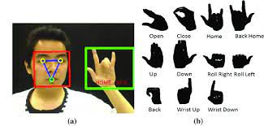
Overview of Project
In recent years, the number of deaf-mute people has increased because of birth defects and other issues. Since a deaf and mute person cannot talk with an ordinary person in order that they ought to rely on some kind of communication system.
Linguistic communication provides the most effective conversation platform for the mute person to speak with an ordinary person.
This problem demands a better solution which can assist speech impaired population converse without any difficulties.
The aim of this project is to build up a system for hand gesture recognition that acknowledges hand gestures and then converts them into text/voice.
‹#›
‹#›

Slide 3
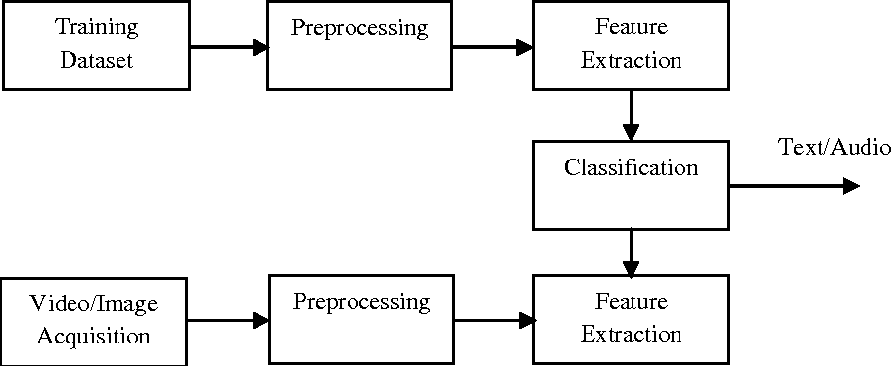
Overview of Project contd..
This model will be a reliable tool for the deaf and mute people to effectively communicate with ordinary person without relying on someone to translate.
The use of Machine learning algorithms helps in recognising the hand gesture and converts it into text.
‹#›
‹#›
‹#›

Slide 4




System Architecture
BASIC SYSTEM DESIGN
‹#›

Slide 5
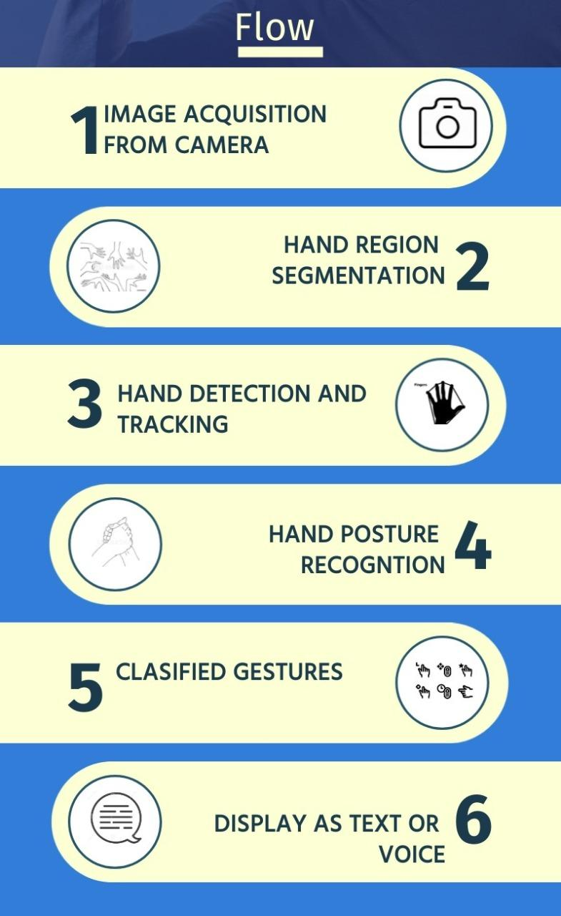
Project Flow Diagram
Project flow
‹#›
‹#›

Slide 6

Project Goals
The main goal is to build a model using machine learning algorithms that can be used to recognise hand gestures and convert it into text or voice.
To provide a reliable and effective system for the deaf-mute community where they can interact without the help of other people.
‹#›

Slide 7
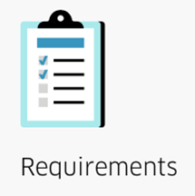

Requirement Specification
Minimum Hardware Requirements:
· Windows OS version 8 or higher
· Intel i5 processor or higher
· Minimum of 4GB RAM or higher
· Web Camera
· Graphics Card 2GB or higher
Software Requirements:
· Python
· Jupyter Notebook
· Tensorflow
· OpenCV
Dataset:
https://www.kaggle.com/abdullahmujahidali/hand-gesture-recongition-yolo-v3?select=234.JPG
‹#›

Slide 8
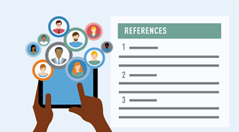
References
Base Papers
[1] Guillaume Devineau, Wang Xi, Fabien Moutarde, Jie Yang. Deep Learning for Hand Gesture Recognition on Skeletal Data. 13th IEEE Conference on Automatic Face and Gesture Recognition (FG’2018), May 2018, Xi’An, China. ff10.1109/FG.2018.00025ff. ffhal-01737771
[2] “International Research Journal of Engineering and Technology (IRJET)” Parshwa P. Patil1, Maithili J. Phatak1, Suharsh S. Kale,Hand Gesture Recognition for Deaf and Dumb
Websites
https://becominghuman.ai/deep-learning-hand-gesture-recognition-b265f4e6cf02
https://indiansignlanguage.org/
‹#›

Slide 9


