Slide 1

Art Gallery with E-Commerce (Artquarium.com)
A project presentation submitted in partial fulfilment of requirements for the degree of
BACHELOR OF ENGINEERING IN COMPUTER SCIENCE AND ENGINEERING
By
Karthik K
1KS18CS028
Avinash Prasad​
1KS18CS008
Kavita Chaudhary
1KS18CS029
Shewani Chib
1KS18CS124
Under the Guidance Of
Mrs. Geetha R.
Department of Computer Science and Engineering
K.S. Institute of Technology, BENGALURU-560109
(Affiliated to VTU, Belagavi & Approved by AICTE, New Delhi, Accredited by NAAC & IEI)

Slide 2
INTRODUCTION

Slide 3

This project "Art Gallery with E-commerce" will be a platform where artist can not only share their artist work but also they can sell their masterpiece from the comfort of home.

Slide 4
LITERATURE SURVEY

Slide 5
Title | Author | Problem Addressed | Outcomes
Art Galleries in transformation: Is covid-19 driving digitisation | Beatrix E.M. Habelsberger & Pawan V. Bhansing | How covid-19 forces art galleries to consider digital channels & it's limitations : plain representation of information, online anonymity, personal interaction. | Mobility was restricted for all market participants events & art fairs were cancelled for months. Live streams, filmed guided tours, videos, providing rich info. on artworks, photo of material used & informative video.
Art in age of Social media: Interaction behavior analysis of Instagram art accounts | Xin Kang, Wenyin chen & Jian Kang | People are experienced to physical artworks, how to deal with interactive psychology of artwork & digital marketing in social media. | Extensive analysis of the interaction between artists and their followers are done for the platform. It determines most like liked art-works & whether the interaction with their followers affects artists creation or not.
Consumer and online payments | Shubham vaid | We are analyzing various factors affecting online payment methods as security concerns, trust factors, ways of payment available. | People followed online payment options only when payment gateway is trusted and secured.

Slide 6
Title | Author | Problem Addressed | Outcomes
E-Commerce : The new art market | Dr. Archana Rani | How invasion of E- commerce has played an important role in the revival of the Indian market | Taking digital first approach to selling art, providing original, ethnic, & unique art forms from artists to larger audience.
Database security for E-Commerce websites | Karan Gadgil, Samiksha Potey, Karan Pardeshi, Karan Gupta | Security concerns for E-commerce such as attacked by hackers, intrusion of 3rd party & causes lead to decrease in quality of security & trust of the user. | Different security issues like XSS, URL injection. This paper also considers into account various ransom ware attacks, their consequences & preventive measures.
Project for an online Art Gallery as Social Cooperative | Carolina Marques de Carvalho | Commercialization of artwork in the hands of physical art galleries that charge commission of 40% & works only with known artists. | Creating online art gallery to achieve projection in market & sell their artwork to gain income and create opportunity for several art vendors & students to promote work done by them.

Slide 7
PROBLEM IDENTIFICATION
Local Artist quitting their business because of facing difficulties in selling their work due to pandemic.
Extinction of Indian traditional culture.
Artist not getting credits for their talent.
Local Artist not getting platform to showcase their Art-work.

Slide 8
PROBLEM STATEMENT
Due to Covid-19 local artist incurred losses in their work so they are :
Quitting their profession & are moving to secondary business
Not getting credit for their talent
Which results in depletion of our Indian culture.

Slide 9
SCOPE
To provide a digital platform which helps to raise and maintain the ethnicity of Indian art-work by getting local artist & vendors to an online platform & providing credits for their talent.

Slide 10
GOALS AND OBJECTIVES

Slide 11
Main goals of this project are :
Promoting the traditional art-work.
Buying & selling of masterpiece.
Description about art and its origin of each Indian states.
Locating nearby art shops.
To save time & travelling cost of customers and local vendors in purchasing and selling the art-work.
To provide opportunities to earn money from home with the help of user-friendly environment.

Slide 12
Main objectives of this project are :
Encouraging the growth of Indian art & culture on Digital platform.
Provides user-friendly environment.
Feasibility of making payment online itself to support Digital India
Movement

Slide 13
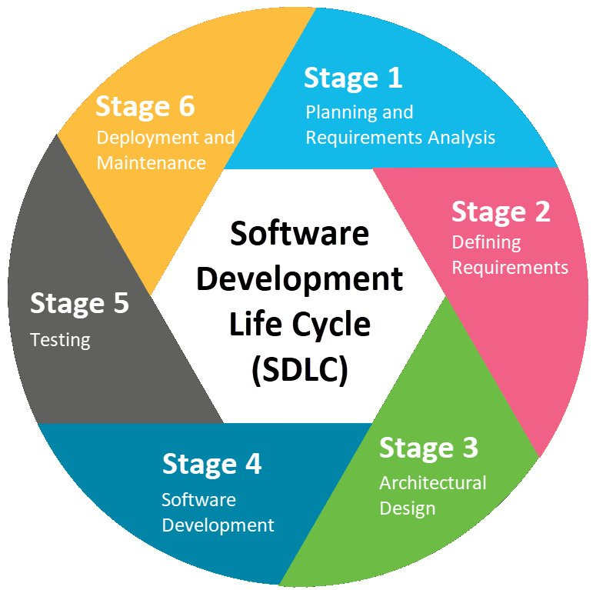
METHODOLOGY
Basically, to develop this project we will be using the 6 stages of
SDLC (Software Development Life Cycle) process :
Starting from :
1. Zeroth Review : We did problem identification
and Requirement analysis which was described
In project abstract.
2. First Review : We did detail study & planning
based on problem scope and statement, we
Prepared a mockup design of our website.

Slide 14
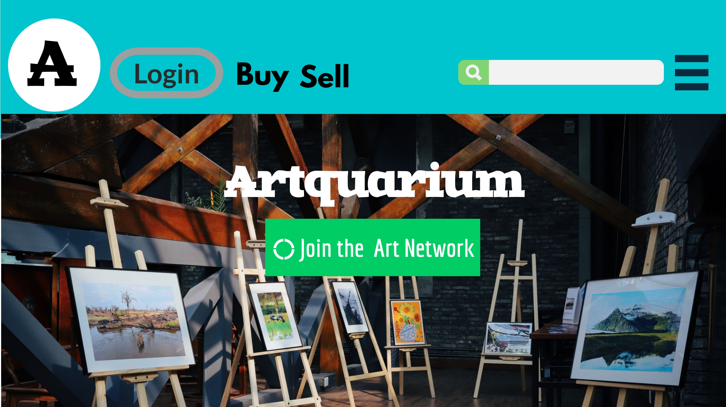
Mockup Design for the main page of the website.

Slide 15
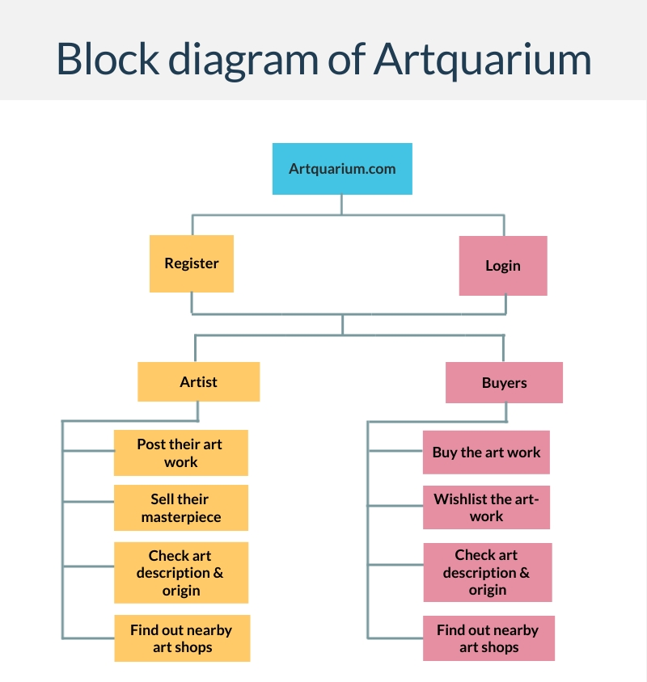

Slide 16
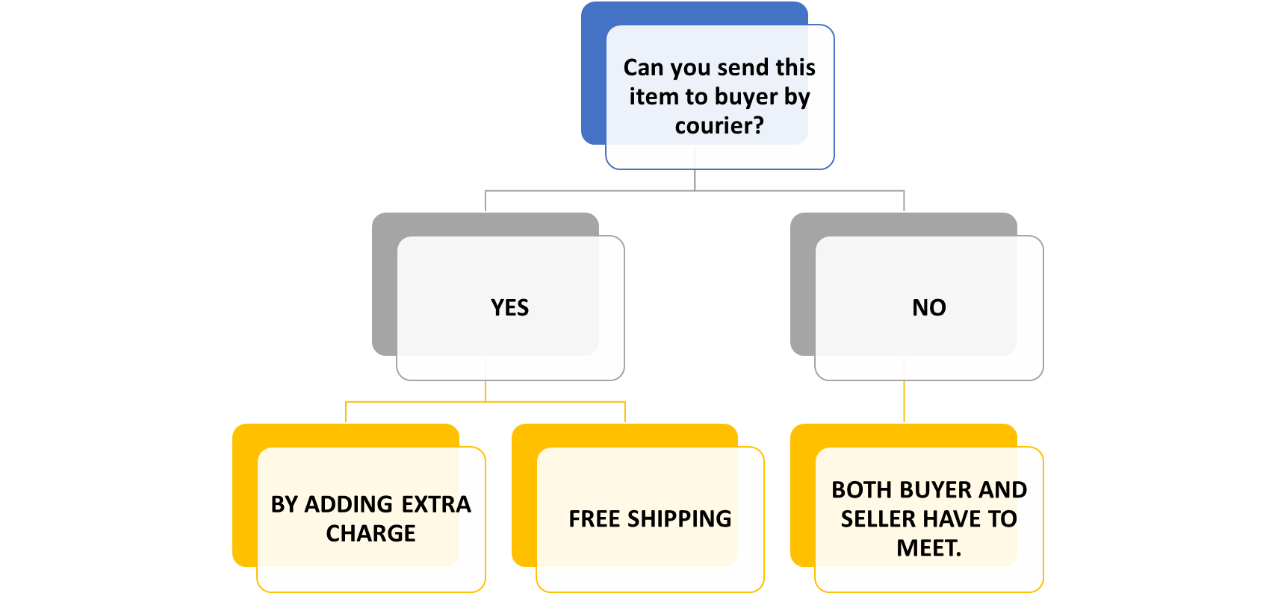
How Shipping will work :

Slide 17

Contribution to Society
Encouraging the growth and providing information about different traditional Indian arts like paintings, sculptures, crafting etc.
Opportunity to local artist of society to sell their art-works through digital platform & earn money from it.
Helping artist in gaining credibility & recognition for their outstanding work.

Slide 18
REFERENCES
How E-Commerce is reviving a lost Art : https://fedexbusinessinsights.com/how-e-commerce-is-reviving-a-lost-vietnamese-art/
How Artists on social media can grow : https://abj.artrepreneur.com/artists-on-social-media/
How to get your artwork recognised through social media : https://blog.artweb.com/how-to/get-your-artwork-recognised-through-social-media/

Slide 19
THANK YOU

