Slide 1





dblp Search
Find publications and
Get BibTeX entries
Without leaving your page
Notes:
Large promo tile of size 920x680

Slide 2
dblp Search
Find publications and
Get BibTeX entries
Without leaving your page
Notes:
small promo tile of 440x280

Slide 3
dblp Search
Find publications and get BibTeX entries
Without leaving your page
Notes:
Marquee promo tile of size 1400x560

Slide 4




Slide 5
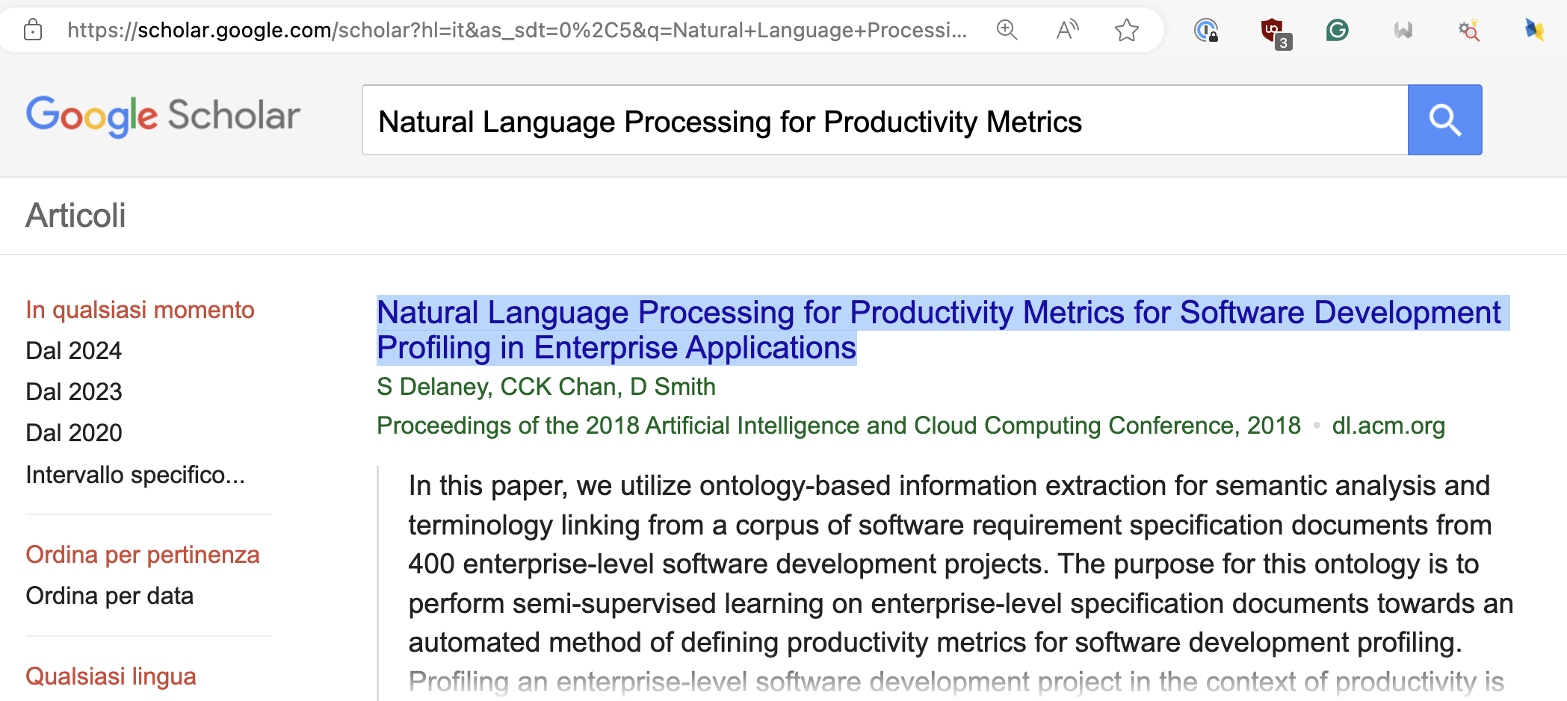
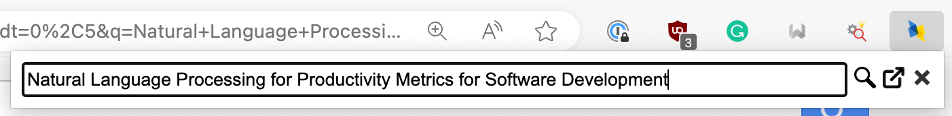
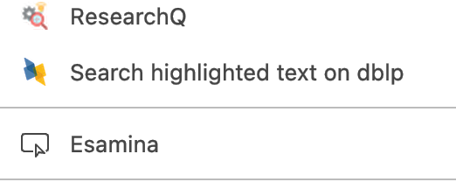
Click the extension button and search the
highlighted text without leaving the current page
Right-click and search the
highlighted text on dblp.org

