Slide 1
俄罗斯方块设计
数据结构和算法的设计

Slide 2
数据结构的设计
舞台的数据结构
砖块的数据结构

Slide 3
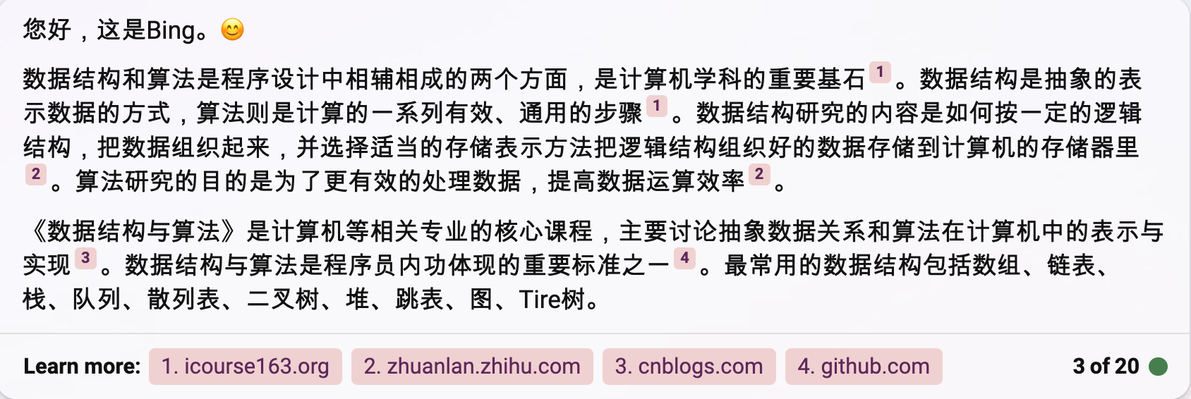
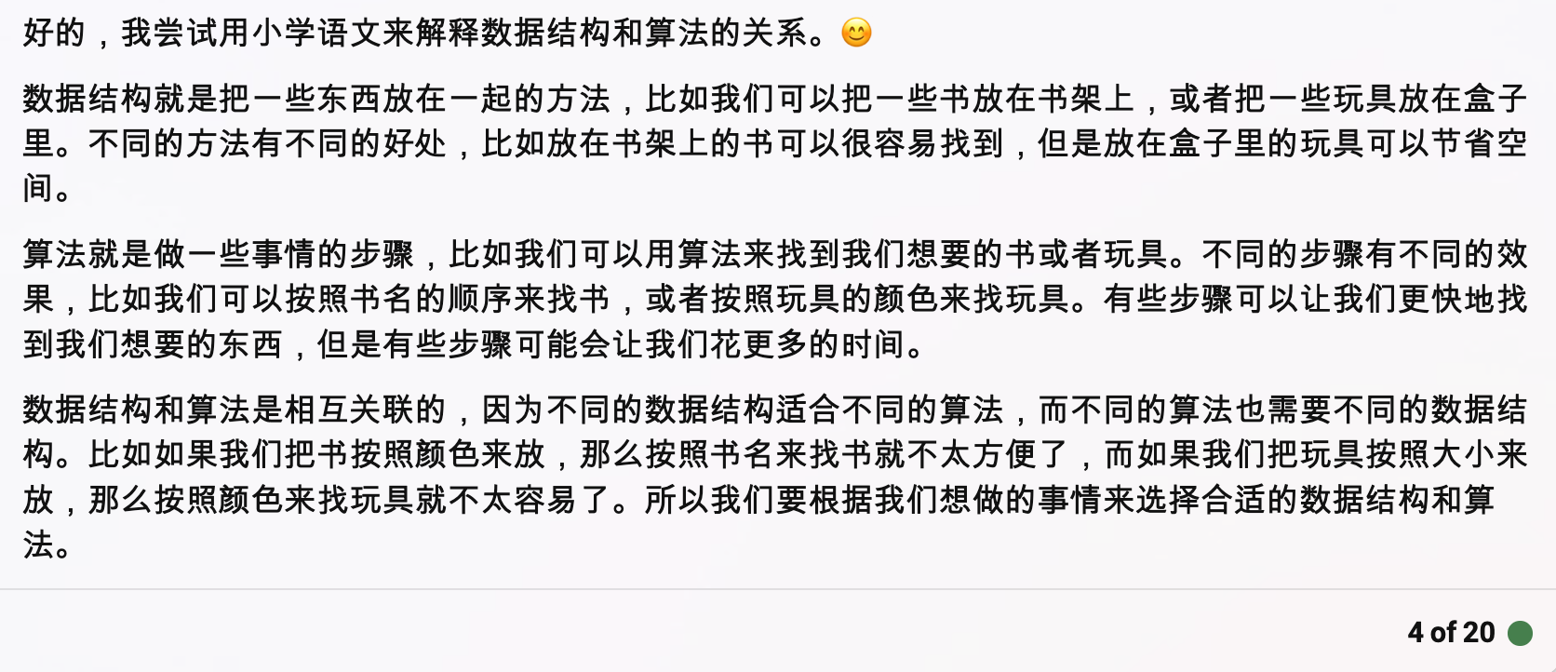

Slide 4
Scratch中的变量定义
变量
数组

Slide 5
舞台的数据结构
[
[0, 0, 0, 0, 0, 0, 0, 0, 0, 0],
[0, 0, 0, 0, 0, 0, 0, 0, 0, 0],
[0, 0, 0, 0, 0, 0, 0, 0, 0, 0], [0, 0, 0, 0, 0, 0, 0, 0, 0, 0],
[0, 0, 0, 0, 0, 0, 0, 0, 0, 0],
[0, 0, 0, 0, 0, 0, 0, 0, 0, 0],
[0, 0, 0, 0, 0, 0, 0, 0, 0, 0],
[0, 0, 0, 0, 0, 0, 0, 0, 0, 0],
[0, 0, 0, 0, 0, 0, 0, 0, 0, 0],
[0, 0, 0, 0, 0, 0, 0, 0, 0, 0],
[0, 0, 0, 0, 0, 0, 0, 0, 0, 0],
[0, 0, 0, 0, 0, 0, 0, 0, 0, 0],
[0, 0, 0, 0, 0, 0, 0, 0, 0, 0],
[0, 0, 0, 0, 0, 0, 0, 0, 0, 0],
[0, 0, 0, 0, 0, 0, 0, 0, 0, 0],
[0, 0, 0, 0, 0, 0, 0, 0, 0, 1],
[0, 0, 0, 0, 0, 0, 0, 0, 0, 1],
[0, 0, 0, 0, 0, 0, 0, 0, 3, 1],
[0, 1, 0, 1, 1, 3, 3, 0, 3, 1],
[1, 1, 1, 1, 1, 0, 3, 3, 3, 3],
]
[1,10]
用二维数组表示方块所在的整个舞台区域，得到一个10 * 20的全为0二维数组矩阵。0表示无方块，1表示有方块。
[1,20]

Slide 6
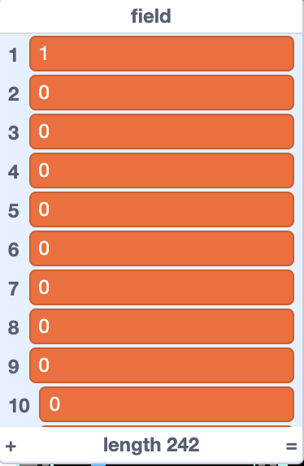
[
[1, 0, 0, 0, 0, 0, 0, 0, 0, 0, 0 ],
[1, 0, 0, 0, 0, 0, 0, 0, 0, 0, 0 ],
[1, 0, 0, 0, 0, 0, 0, 0, 0, 0, 0 ],
[1, 0, 0, 0, 0, 0, 0, 0, 0, 0, 0 ],
[1, 0, 0, 0, 0, 0, 0, 0, 0, 0, 0 ],
[1, 0, 0, 0, 0, 0, 0, 0, 0, 0, 0 ],
[1, 0, 0, 0, 0, 0, 0, 0, 0, 0, 0 ],
[1, 0, 0, 0, 0, 0, 0, 0, 0, 0, 0 ],
[1, 0, 0, 0, 0, 0, 0, 0, 0, 0, 0 ],
[1, 0, 0, 0, 0, 0, 0, 0, 0, 0, 0 ],
[1, 0, 0, 0, 0, 0, 0, 0, 0, 0, 0 ],
[1, 0, 0, 0, 0, 0, 0, 0, 0, 0, 0 ],
[1, 0, 0, 0, 0, 0, 0, 0, 0, 0, 0 ],
[1, 0, 0, 0, 0, 0, 0, 0, 0, 0, 0 ],
[1, 0, 0, 0, 0, 0, 0, 0, 0, 0, 0 ],
[1, 0, 0, 0, 0, 0, 0, 0, 0, 0, 0 ],
[1, 0, 0, 0, 0, 0, 0, 0, 0, 0, 0 ],
[1, 0, 0, 0, 0, 0, 0, 0, 0, 0, 0 ],
[1, 0, 0, 0, 0, 0, 0, 0, 0, 0, 0 ],
[1, 0, 0, 0, 0, 0, 0, 0, 0, 0, 0 ],
[1, 0, 0, 0, 0, 0, 0, 0, 0, 0, 0 ],
[1, 1, 1, 1, 1, 1, 1, 1, 1, 1, 1],
]
[1,11]
舞台的现状数据结构-field数组
[1,22]

Slide 7
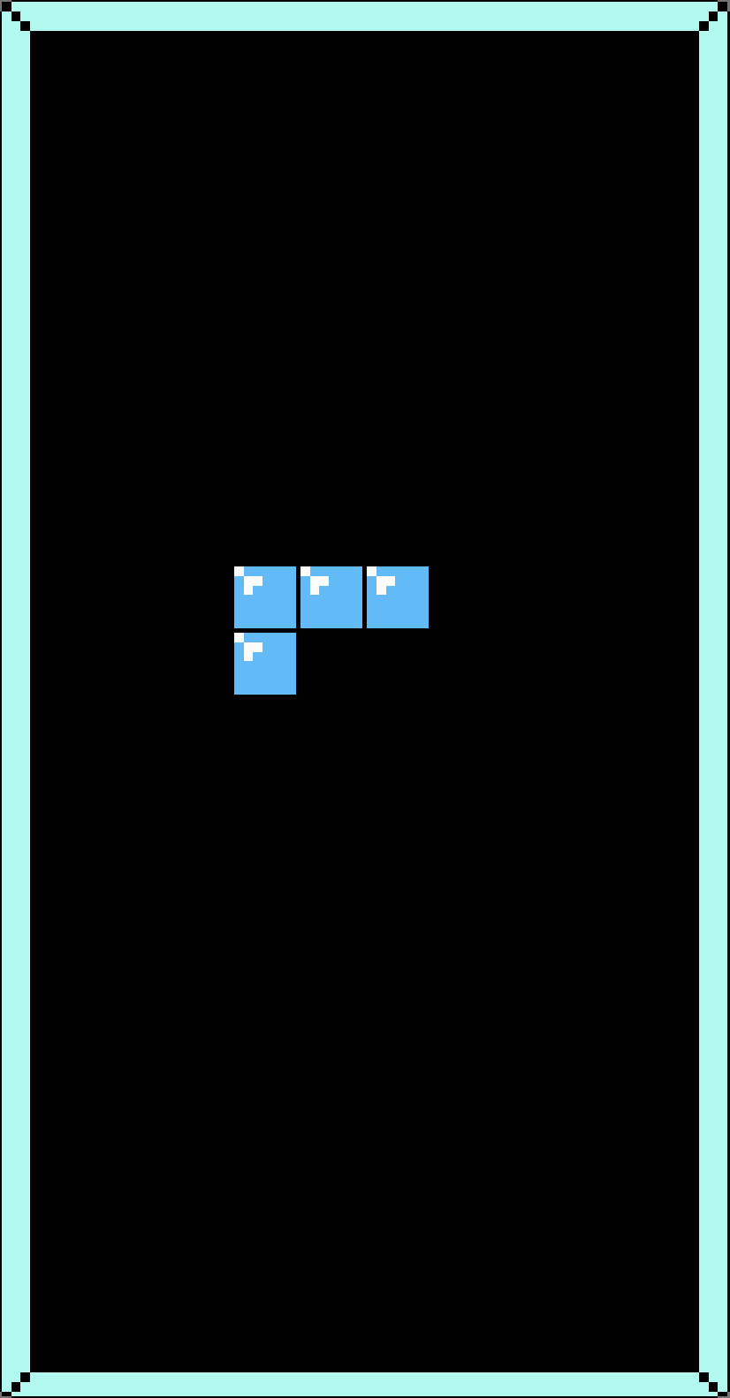
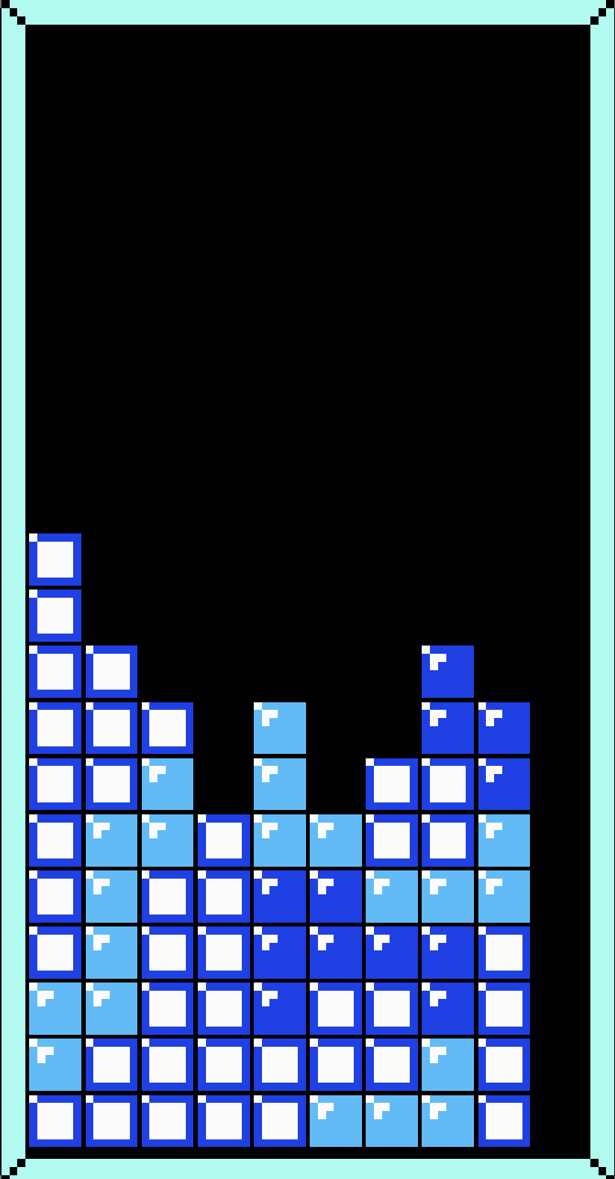
Line 1:
10000000000
10000000000
10000000000
10000000000
10000000000
10000000000
10000000000
10000000000
10000000000
10000000000
10000000000
10000000000
10000000000
10000000000
10000000000
10000000000
10000000000
10000000000
10000000000
10000000000
10000000000
11111111111
Line 1:
10000000000
10000000000
10000000000
10000000000
10000000000
10000000000
10000000000
10000000000
10000000000
10000000000
11000000000
11000000000
11100000100
11110100110
11110101110
11111111110
11111111110
11111111110
11111111110
11111111110
11111111110
11111111111
10000000000
10000000000
10000000000
10000000000
10000000000
10000000000
10000000000
10000000000
10000000000
10000000000
10000000000
10000000000
10000000000
10000000000
10000000000
10000000000
10000000000
10000000000
10000000000
10000000000
10000000000
11111111111
Line 2:
Line 2:
Line 3:
Line 3:
Line 4:
Line 4:
Line 5:
Line 5:
Line 6:
Line 6:
Line 7:
Line 7:
Line 8:
Line 8:
Line 9:
Line 9:
Line 10:
Line 10:
Line 11:
Line 11:
Line 12:
Line 12:
Line 13:
Line 13:
Line 14:
Line 14:
Line 15:
Line 15:
Line 16:
Line 16:
Line 17:
Line 17:
Line 18:
Line 18:
Line 19:
Line 19:
Line 10:
Line 10:
Line 21:
Line 21:
Line 22:
Line 22:

Slide 8





砖块的数据结构-Tetronimo
1
2
3
Black
Tetris Dead

Slide 9

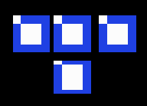
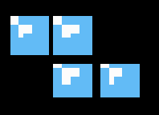

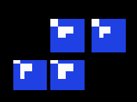
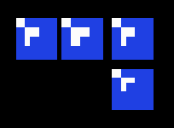
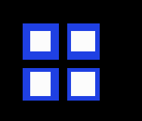
砖块的数据结构-4个小型正方形组成的规则图形
[ [0, 0, 0, 0],
[0, 0, 0, 0],
[1, 1, 1, 1],
[0, 0, 0, 0],]
[ [0, 0, 0, 0],
[1, 1, 1, 0],
[0, 1, 0, 0],
[0, 0, 0, 0]]
[ [0, 0, 0, 0],
[3, 3, 0, 0],
[0, 3, 3, 0],
[0, 0, 0, 0]],
[ [0, 0, 0, 0],
[3, 3, 3, 0],
[3, 0, 0, 0],
[0, 0, 0, 0]]
[ [0, 0, 0, 0],
[0, 2, 2, 0],
[2, 2, 0, 0],
[0, 0, 0, 0]]
[ [0, 0, 0, 0],
[2, 2, 2, 0],
[0, 0, 2, 0],
[0, 0, 0, 0], ]
[ [0, 0, 0, 0],
[0, 1, 1, 0],
[0, 1, 1, 0],
[0, 0, 0, 0]]

Slide 10
砖块的数据结构-tetronimoes数组
Index 1:
0000111001000000010011000100000001001110000000000100011001000000
0000222000200000020002002200000020002220000000000220020002000000
00003300033000000300330030000000
00000110011000000000011001100000
00000220220000002000220002000000
0000333030000000330003000300000000303330000000000300030003300000
00000000111100000100010001000100
Index 2:
Index 3:
Index 4:
Index 5:
Index 6:
Index 7:

Slide 11
砖块的数据结构-tetronimoes数组-index 1
Clockwise
0000111001000000010011000100000001001110000000000100011001000000
0000 0100 0100 0100
1110 1100 1110 0110
0100 0100 0000 0100
0000 0000 0000 0000
Anti-clockwise
0000111001000000010011000100000001001110000000000100011001000000
0000 0100 0100 0100
1110 1100 1110 0110
0100 0100 0000 0100
0000 0000 0000 0000

Slide 12
砖块的数据结构-tetronimoes数组-Index 2
Clockwise
0000222000200000020002002200000020002220000000000220020002000000
0000 0200 2000 0220
2220 0200 2220 0200
0020 2200 0000 0200
0000 0000 0000 0000
Anti-clockwise
0000222000200000020002002200000020002220000000000220020002000000
0000 0200 2000 0220
2220 0200 2220 0200
0020 2200 0000 0200
0000 0000 0000 0000

Slide 13
砖块的数据结构-tetronimoes数组-Index 3
Clockwise
00003300033000000300330030000000
0000 0300
3300 3300
0330 3000
0000 0000
Anti-clockwise
00003300033000000300330030000000
0000 0300
3300 3300
0330 3000
0000 0000

Slide 14
砖块的数据结构-tetronimoes数组-index 4
Clockwise
00000110011000000000011001100000
0000 0000
0110 0110
0110 0110
0000 0000
Anti-clockwise
00000110011000000000011001100000
0000 0000
0110 0110
0110 0110
0000 0000

Slide 15
砖块的数据结构-tetronimoes数组-index 5
Clockwise
00000220220000002000220002000000
0000 2000
0220 2200
2200 0200
0000 0000
Anti-clockwise
00000220220000002000220002000000
0000 2000
0220 2200
2200 0200
0000 0000

Slide 16
砖块的数据结构-tetronimoes数组-index 6
Clockwise
0000333030000000330003000300000000303330000000000300030003300000
0000 3300 0030 0300
3330 0300 3330 0300
3000 0300 0000 0330
0000 0000 0000 0000
Anti-clockwise
0000333030000000330003000300000000303330000000000300030003300000
0000 3300 0030 0300
3330 0300 3330 0300
3000 0300 0000 0330
0000 0000 0000 0000

Slide 17
砖块的数据结构-tetronimoes数组
Clockwise
00000000111100000100010001000100
0000 0100
0000 0100
1111 0100
0000 0100
Anti-clockwise
00000000111100000100010001000100
0000 0100
0000 0100
1111 0100
0000 0100

Slide 18
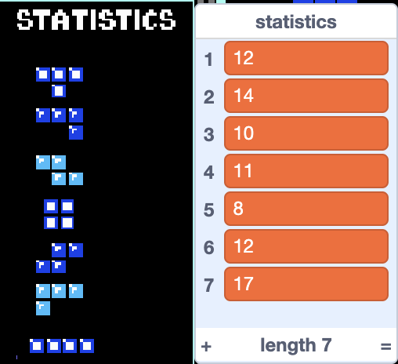
砖块统计数组-statistics

Slide 19
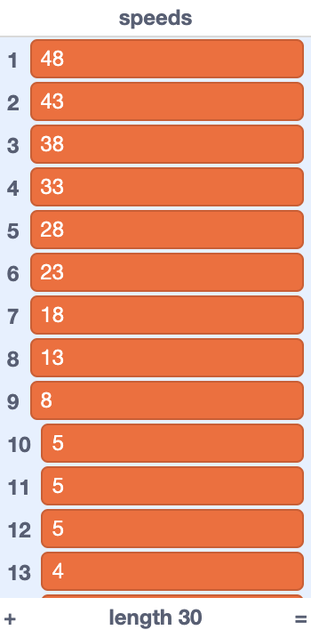
速度数组-Speeds

Slide 20
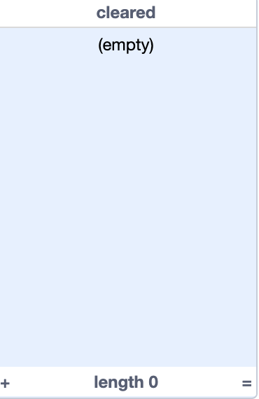
行消除相关数组-cleared

Slide 21
辅助变量定义
变量 1:
☁Global records 历史最高分
☁Score
Block
Clearedraws
Drop
Dropbonus
Droptimer
Dst
gameover
变量 10:
x
Hit
Key
Level
Lines
Nextplace
Numclones
Score
Speed
src
变量 19:
变量 2:
变量 11:
变量 3:
变量 12:
变量 4:
变量 13:
变量 5:
变量 14:
变量 6:
变量 15:
变量 7:
变量 16:
变量 8:
变量 17:
变量 9:
变量 18:

