Slide 1
Graphs/Figures for Expression Platform Paper
Lisa Hansen
6/17/22

Slide 2
Figure 1

Slide 3
Notes:
Figure 1: Strand displacement in pbuE riboswitch

Slide 4
Figure 2

Slide 5
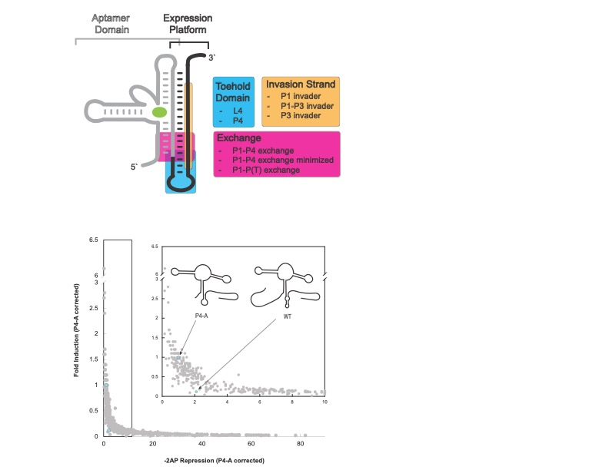
Notes:
Figure 2: A is layout of the libraries B graph with all library members and the two controls
Example of everything together…can change graph out

Slide 6
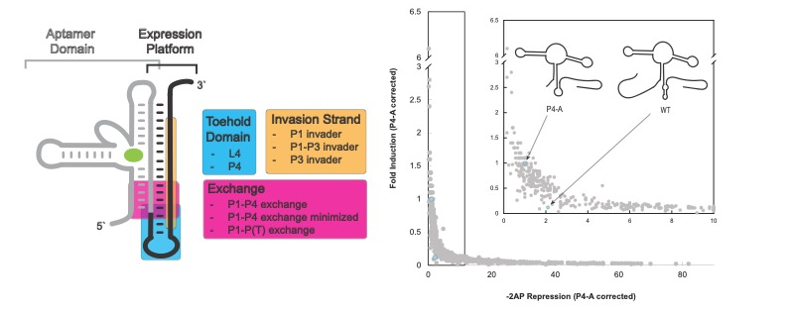

Slide 7
Figure 3

Slide 8
Pie charts, charts on left will be a supplemental figure
Notes:
Obvi need to increase size of labeling on pie charts
Need something in white space of loop…maybe specific variants??

