Slide 1
P4C ligand trial
Lisa Hansen

Slide 2
Ligands
Ligand | K_{D} For U74 (µM)
xanthine | n.d.¹
2,6-diaminopurine | 0.017 ± 0.006¹
2-aminopurine | 0.25 ± 0.03¹
2-fluoroadenine | 4.0 ± 1.1¹
6-methylaminopurine | 105 ± 4¹
2,4,6-triaminopyrimidine | 20 ± 3²
¹ Gilbert, S. D., Reyes, F. E., Edwards, A. L., and Batey, R. T. (2009) “Adaptive ligand binding by the purine riboswitch in the recognition of guanine and adenine analogs” Structure 17: 857-868.
²Gilbert, S. D., Mediatore, S. J. and Batey, R. T. (2006) “Modified pyrimidines specifically bind the purine riboswitch.” Journal of the American Chemical Society 128, 14214-14215.

Slide 3
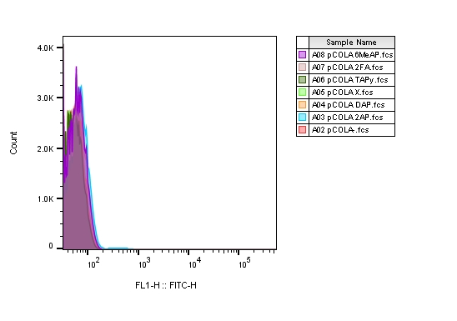
Negative control: pCOLA (kan resistant vector)

Slide 4
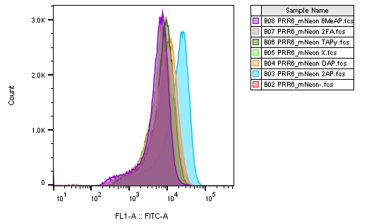
Positive control: PRR6_mNeon (mNeon and Kan resistance)

Slide 5
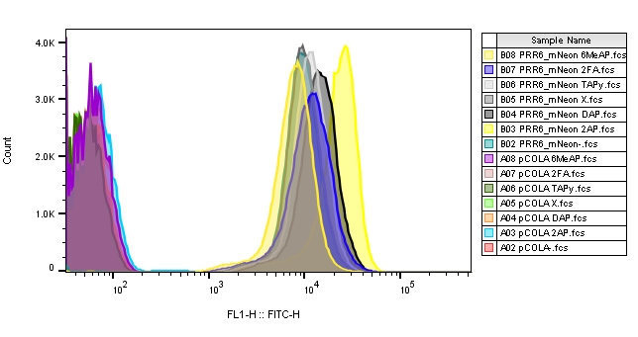
Positive and negative control (pCOLA and PRR6_mNeon

Slide 6
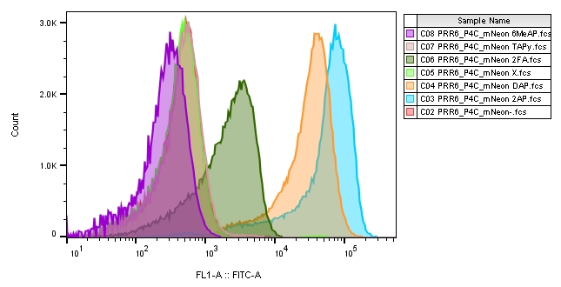
PRR6_P4C_mNeon

Slide 7
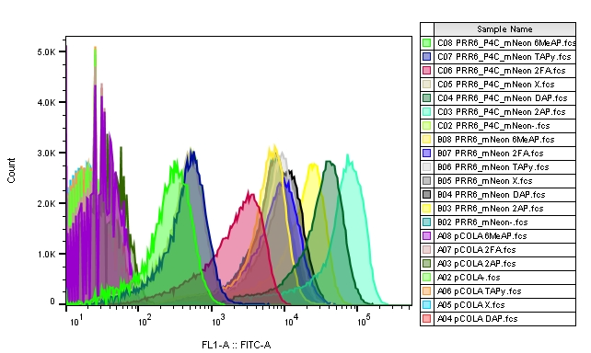
All samples on one plot

