Slide 1





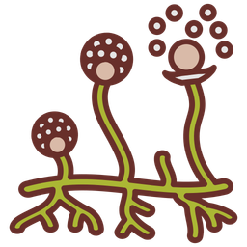


WE DIDN’T INVENT THE INTERNET
THE FUNGI DID IT FIRST
Presented by Anirudh Shridhar

Slide 2
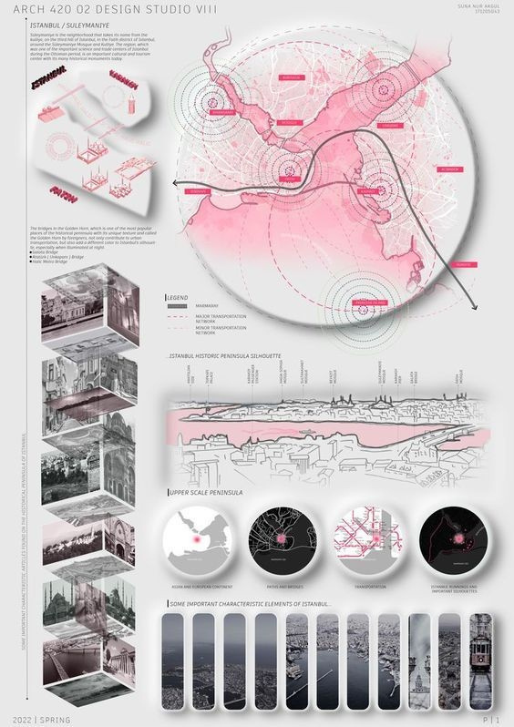
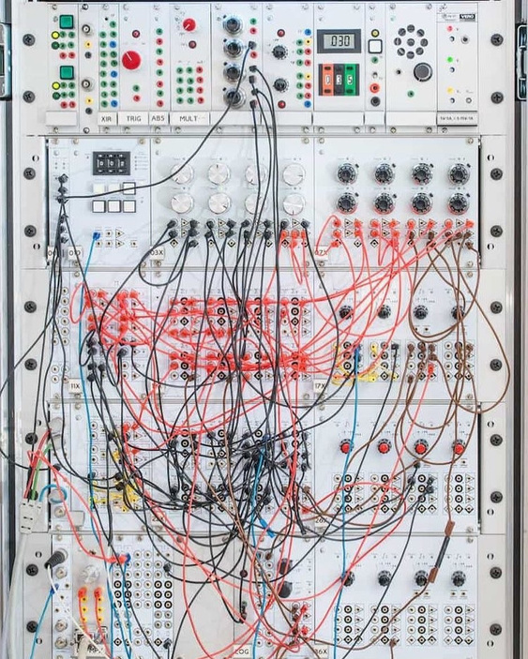
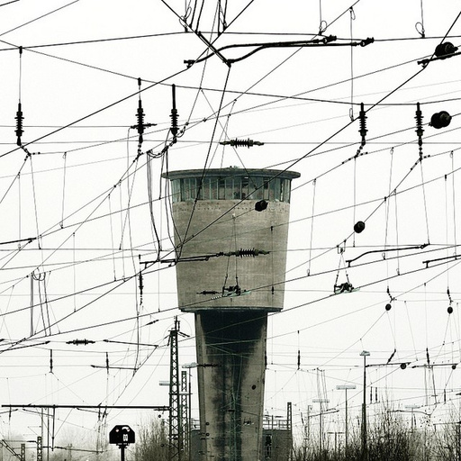
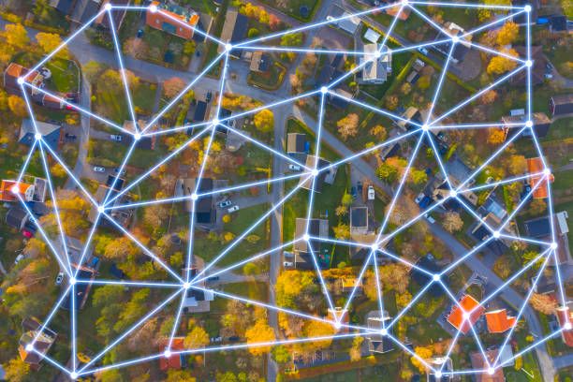
ARCHITECTURE OF CONNECTIVITY
Wifi mesh
Telegraph lines

Slide 3
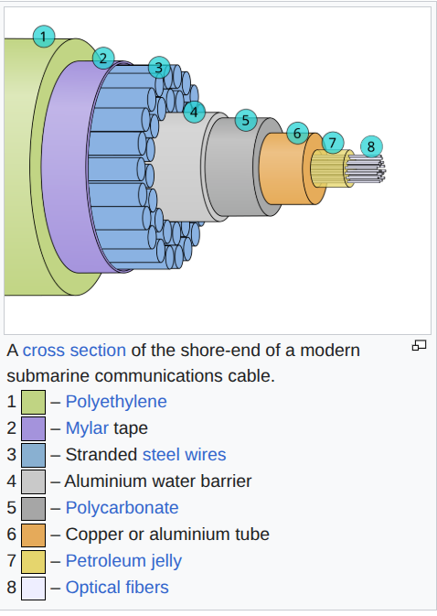
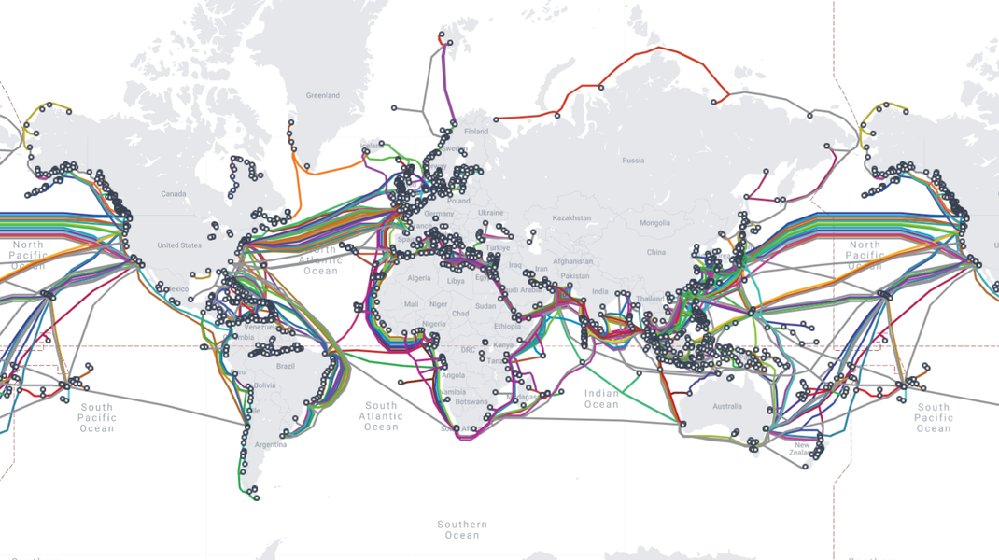
A map of the submarine optical fibre cables
Cross section of the submarine cables

Slide 4



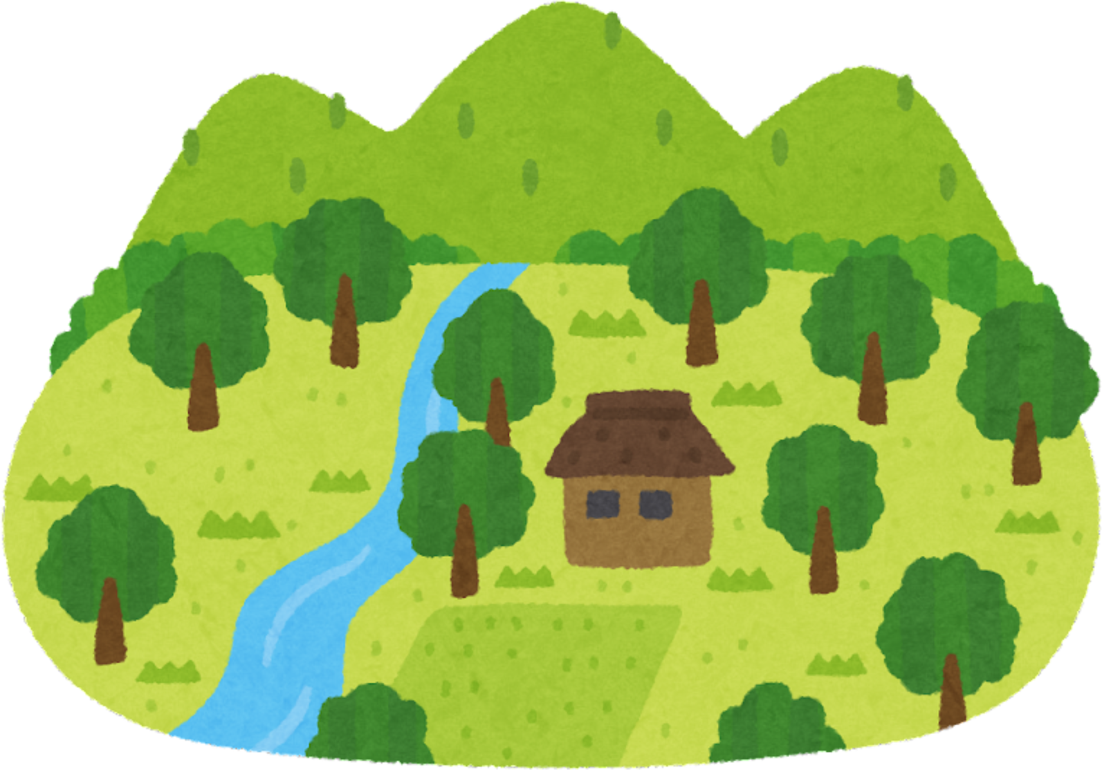

DECENTRALISED
SELF - HEALING
WIDE AREA NETWORK

Slide 5
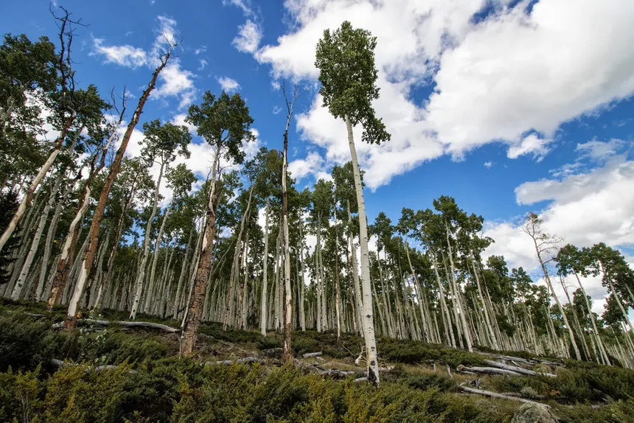
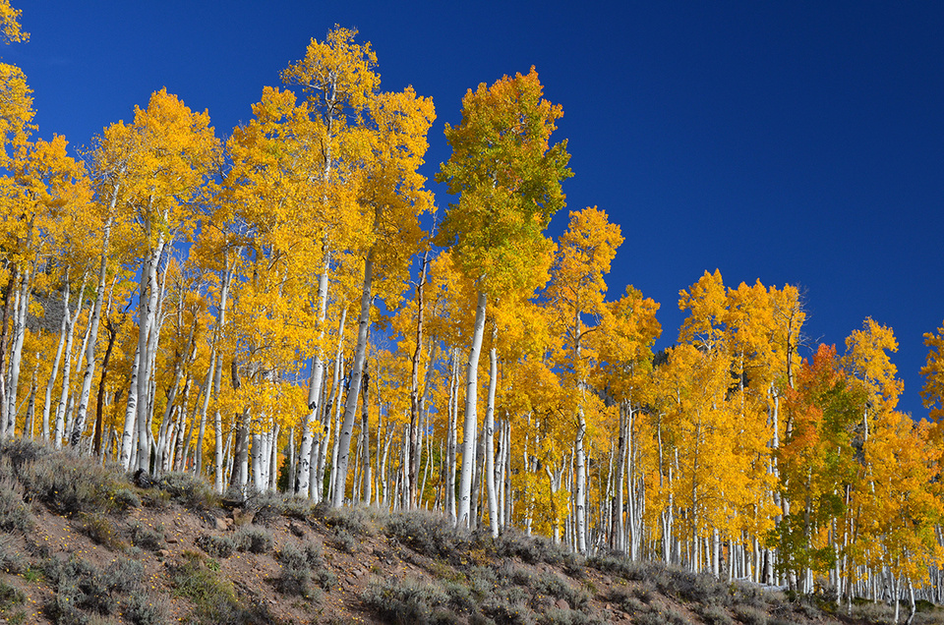
Meet
PANDO

Slide 6
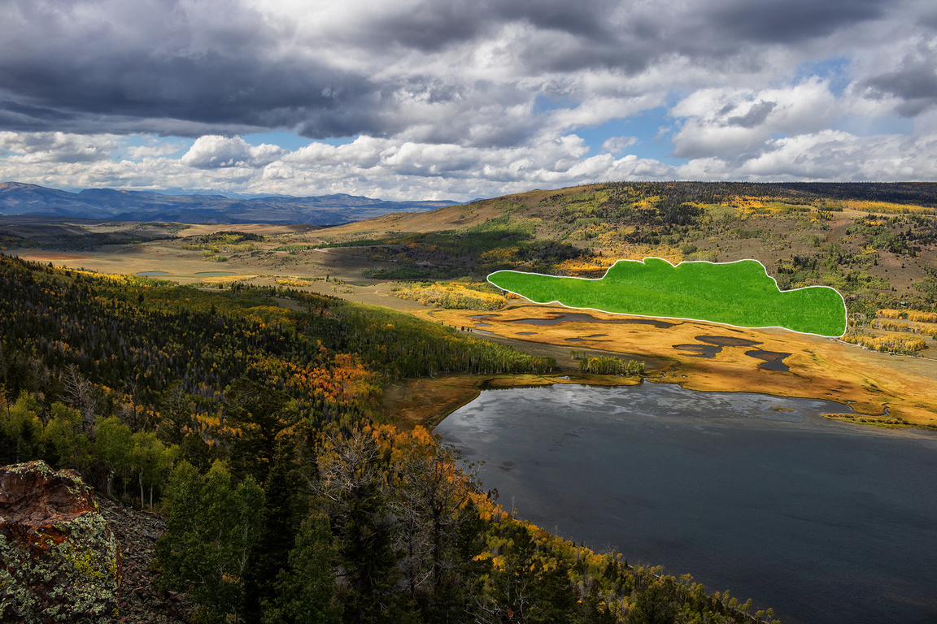



PANDO
42.8 HECTARES
Which is 106 acres
OR 80 FOOTBALL FIELDS

Slide 7
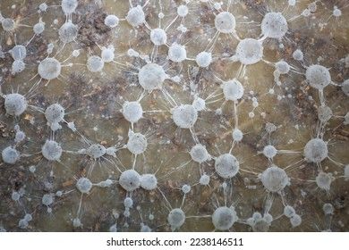
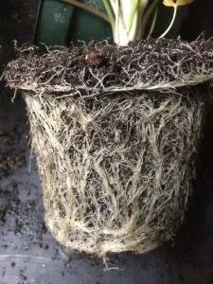
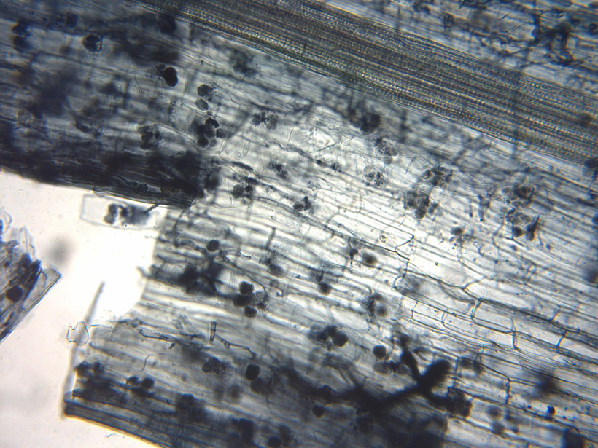
MYCORRHIZAL FUNGI

Slide 8
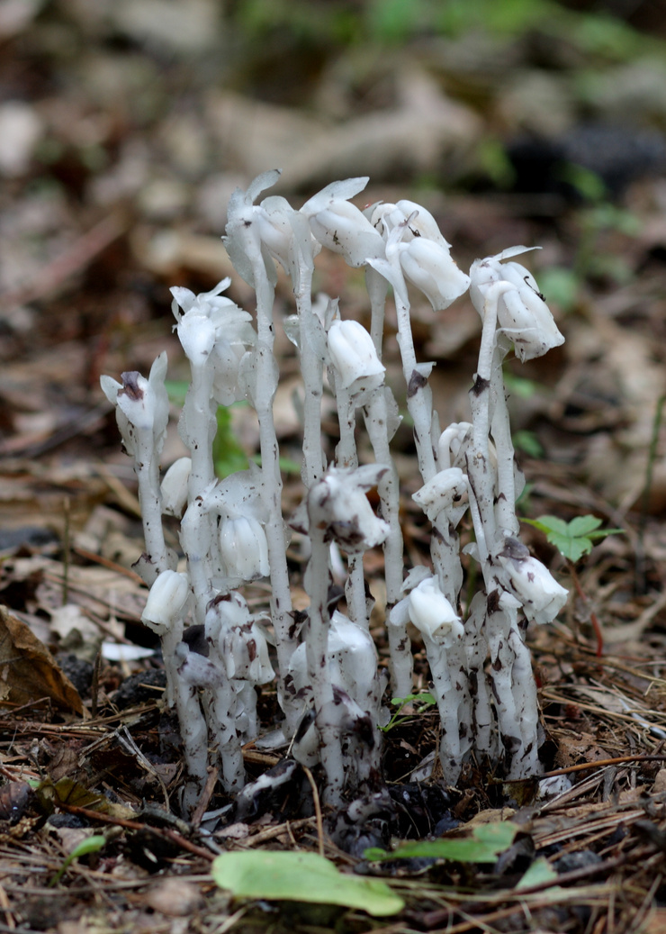
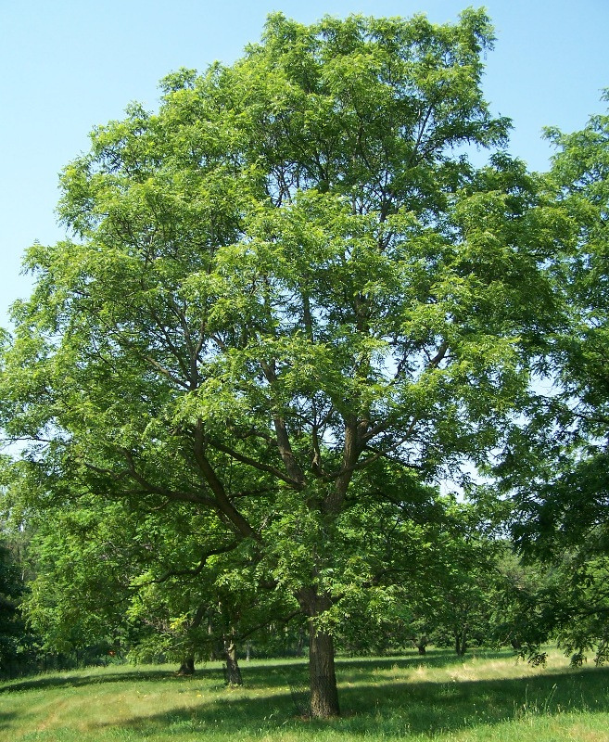
ghost pipe
walnut

Slide 9
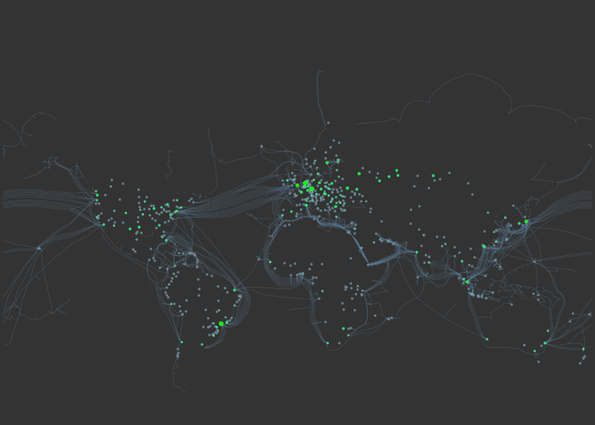
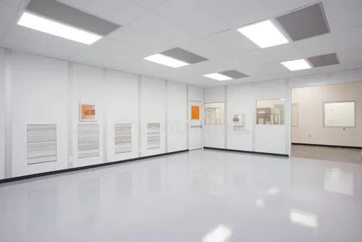
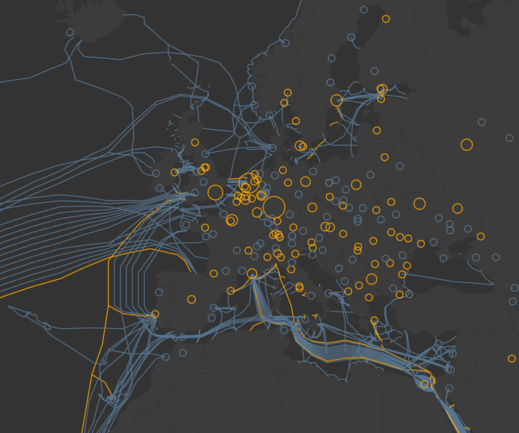

Slide 10
THANK
YOU

