Slide 1

RAJASTHAN HACKATHON 4.0
SMART SIGNATURE VERIFICATION SYSTEM
TEAM KRACKJACK
IIT ROORKEE

Slide 2
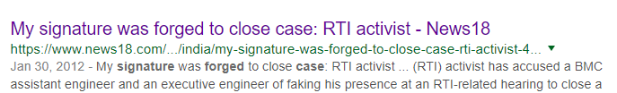
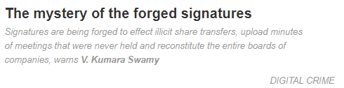
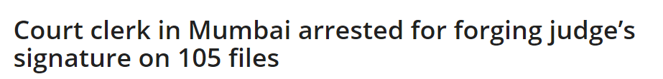


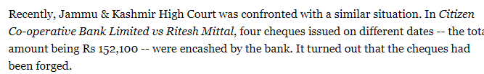
MOTIVATION
DO WE NEED MORE REASONS ??

Slide 3
SOME STATISTICAL ANALYSIS
Cheque Application Volume in India : 1000000 instruments per day
How RBI plans to solve the problem ? Let’s see..
Cheque Truncation Project : Run on Pilot basis in Delhi NCR Region
Setting up extra clearing houses : Increase in human efforts
Current process is manual in Banks and a person verifies the signature
Extremely High Amounts are cleared by Signature Experts in Clearing Houses
Chances of Human based error more than machine based error

Slide 4
SOME STATISTICAL ANALYSIS
How we plan to solve the issue ?
Use Artificial Intelligence (AI – Deep Learning based solution) and Image Processing Techniques (Computer Vision) to automate the process
Our WebApp takes 8 seconds on an average to verify signatures
A single machine can process :
7.5 cheques minute * 24 HOURS *60 MINUTES = 10800 Cheques a day
Total Number of Connections required : 1000000/10800 = 92 connections only

Slide 5
WHY SMART SIGNATURE VERIFICATION ?
Automation and Reduction of Human Effort
Artificial Intelligence : efficient hidden signature feature extraction and lesser chances of forgery (Safe and Secure Systems)
Big Step towards Digital India
Use Case Applications :
Banks, Post-Offices, Co-operative Societies and Self-Help Groups
Cases where Handwritten Signatures involved : Land Registry Offices
As an attendance proof of Schools, Colleges and Post Offices

Slide 6
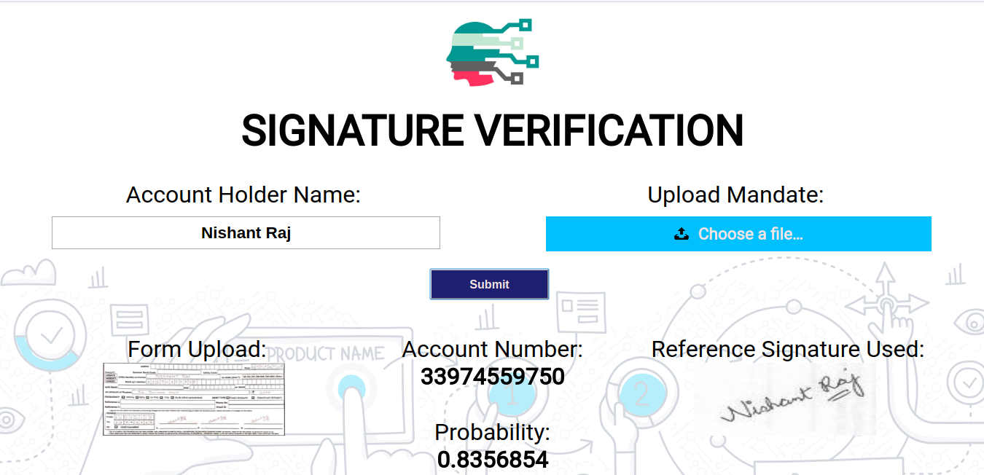
OUR WEB APP FRONT END LOOK

Slide 7
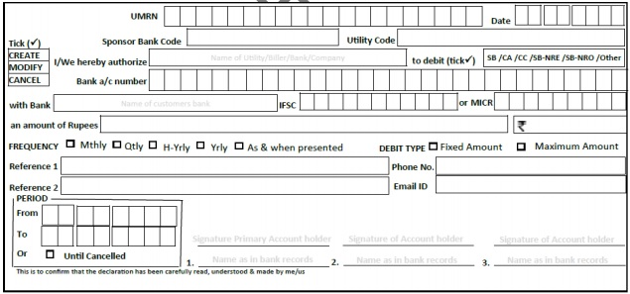
Framework:
Centralized Database System
Reference Signatures
Account Number
Signature Classification Model
Confidence Score
Signatures
Questioned Signatures
Start Date
Segmentation Model
End Date
Output Details
OCR Model
Amount
Name
Segmented Images

Slide 8
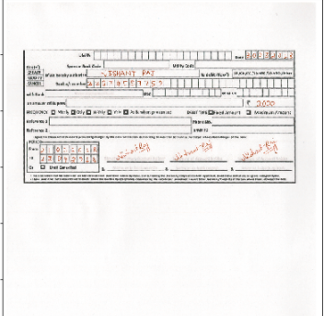
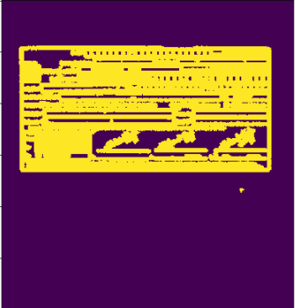
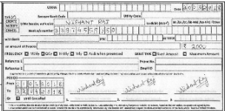
PRE-PROCESSING INVOLVED
Scanned Image
Canny Edge Detection &
Dilation
Extracted Image of Form

Slide 9
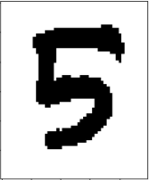

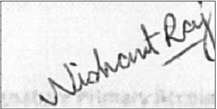
PRE-PROCESSING INVOLVED
Account Number Extracted
Number Recognition with MNIST
Extracted Signature

Slide 10
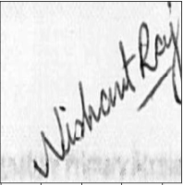
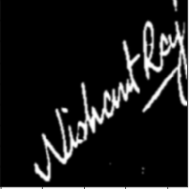
PRE-PROCESSING OF SIGNATURES

Slide 11
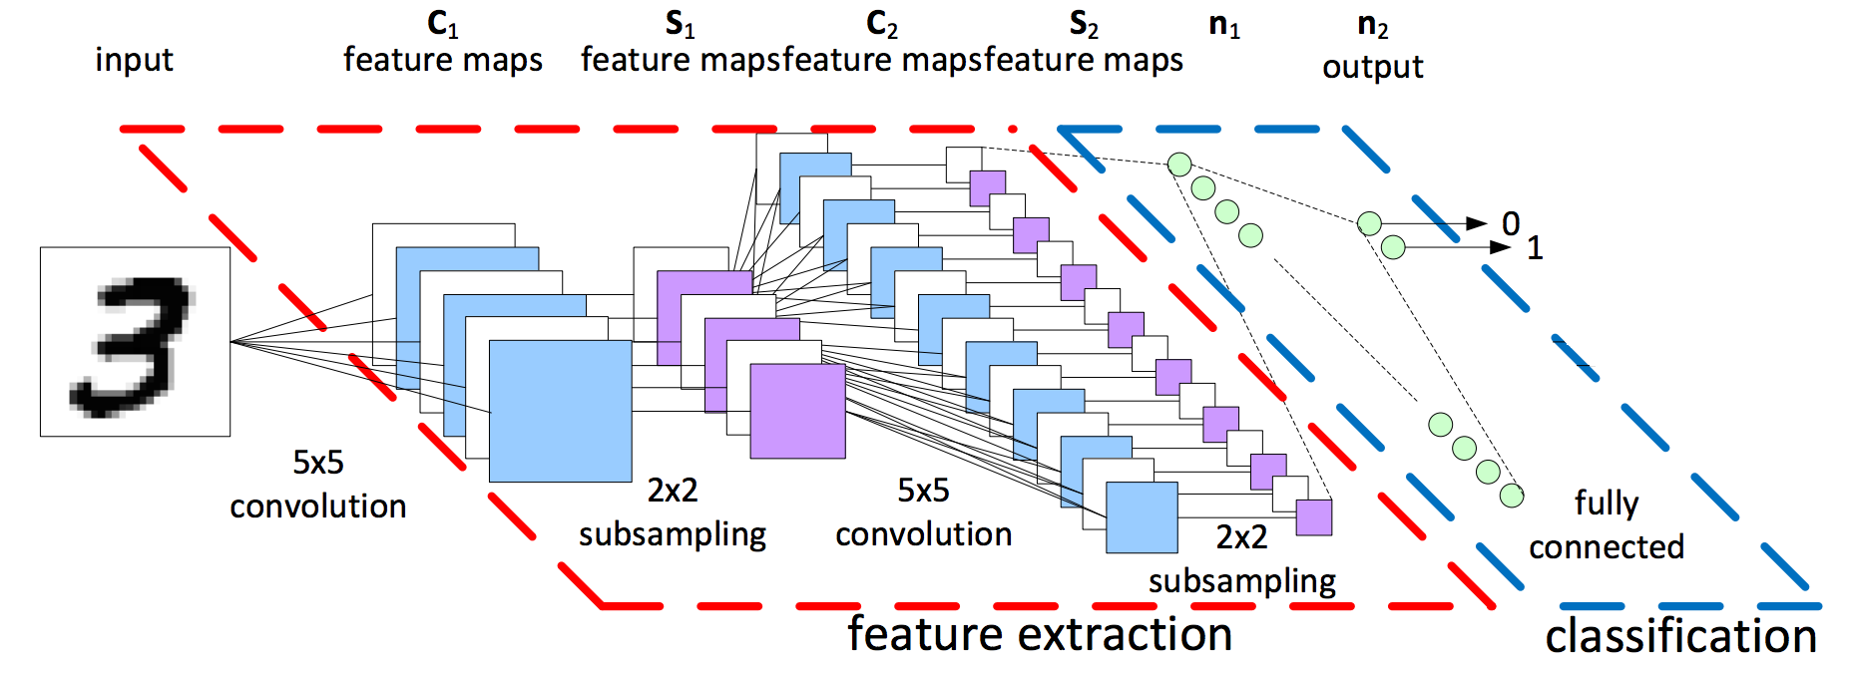
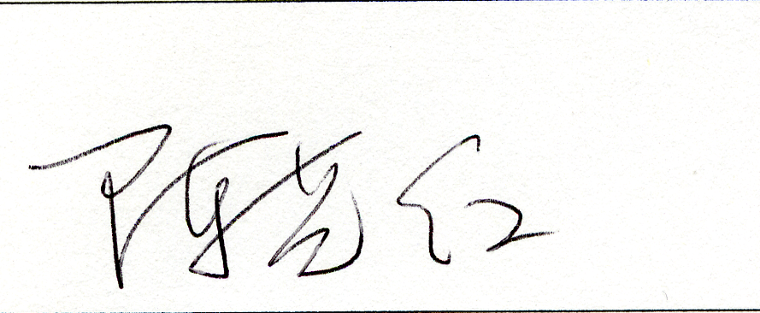
SIGNATURE DETECTION MODEL

Slide 12
Signature Classification Model:
Penalized Classification:
Predicted Class
1
0
Imposed an additional cost on the model for making classification mistakes on the negative class during training.
This was done keeping in mind that an incorrect signature when classified as correct would result in a greater loss for the bank
True Positives
(TP)
False
Negatives
(FN)
1
Actual
Class
False
Positives
(FP)
True Negatives
(TN)
0

Slide 13
Results for Segmentation Model and OCR Model:
Results for Signature Classification Model:
Accuracy : 100% (test cases) & MNIST model : 99.6%
Accuracy: 85%
False Acceptance Rate (FAR): 12%

Slide 14
IMPORTANT METRICS :
Relevance to Business Scenarios and Customer Experience
Can reduce Fake Signature Cases
Big step towards Digitalising Banking Solutions and reducing hassales
Highly user friendly designed for better Customer Experience
User can adopt without getting in intricacies of the model
Accuracy :
Extraction Accuracy (Numeric Fields) : 99.6%
Model Accuracy for Fake Signature Detection : 85% (present)
Presently we are using Chinese and Dutch Signatures for training model
With Indian Signature Dataset,model Accuracy can be increased to more than 85 %
FAR (False Accuracy Rate) penalizes the model to ensure false doesn’t gets classified as true

Slide 15
References:
Offline signature recognition using neural networks approach
Online handwritten signature verification system based on DWT features extraction and neural network classification
Offline Signature Verification Using Pixel Matching Technique
Learning features for offline handwritten signature verification using deep convolutional neural networks

