Slide 1
HANDWRITTEN
ANSYS
Problem 14: Cantilever I-Beam
Safety factor of the critical element: hand calculation vs FEA simulation
Atharva Bhosale
ME24B005
Ductile material, σyt = 250 MPa | von Mises and Tresca theories
Notes:
Introduce the problem: a statically loaded cantilever I-beam. We solved it by hand and verified it in ANSYS Mechanical 2026 R1 Student. This talk compares the two.

Slide 2
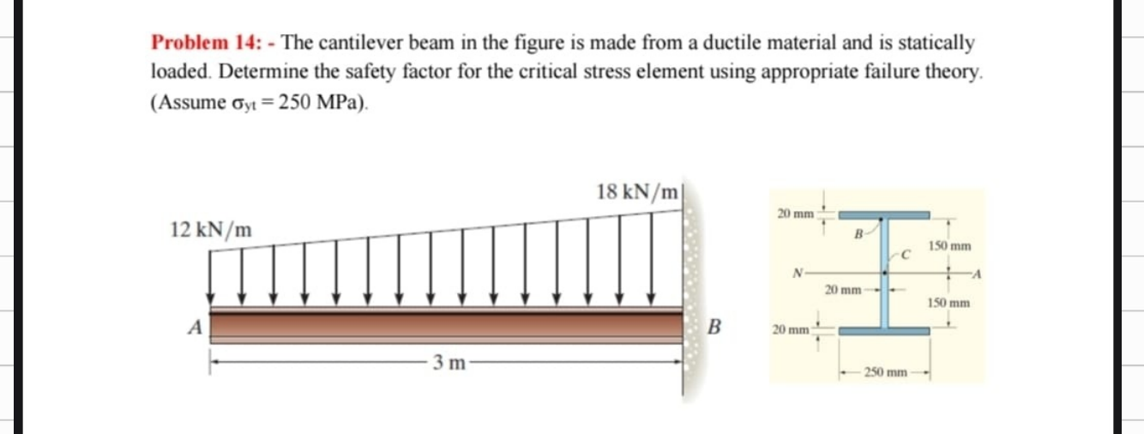
Problem statement and approach
σyt = 250 MPa
L = 3 m
12 → 18 kN/m
I-section
Ductile material, static load
Free end A, fixed wall B
Trapezoidal load, A to B
Flanges 250×20, web t = 20 mm
Method 1: hand calculation
Method 2: ANSYS static structural
Notes:
Given: sigma_yt = 250 MPa, 3 m cantilever, load rising from 12 kN/m at the free end to 18 kN/m at the wall. Find the safety factor at the critical element using an appropriate failure theory.

Slide 3
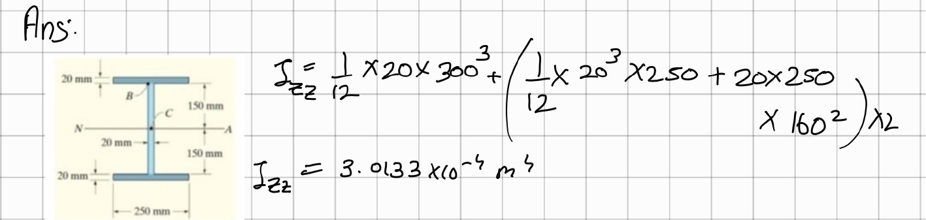
Handwritten: section property
HANDWRITTEN
Web: 4.50×10⁷ mm⁴
Flanges: 2.56×10⁸ mm⁴
Izz = 3.0133×10⁻⁴ m⁴
20 × 300 mm, bh³/12
250 × 20 mm each, centroid 160 mm from N.A.
Parallel-axis theorem
Notes:
Second moment of area: web 20 x 300 plus two flanges of 250 x 20 placed 160 mm from the neutral axis, using the parallel-axis theorem. Total Izz = 3.0133e-4 m^4.

Slide 4
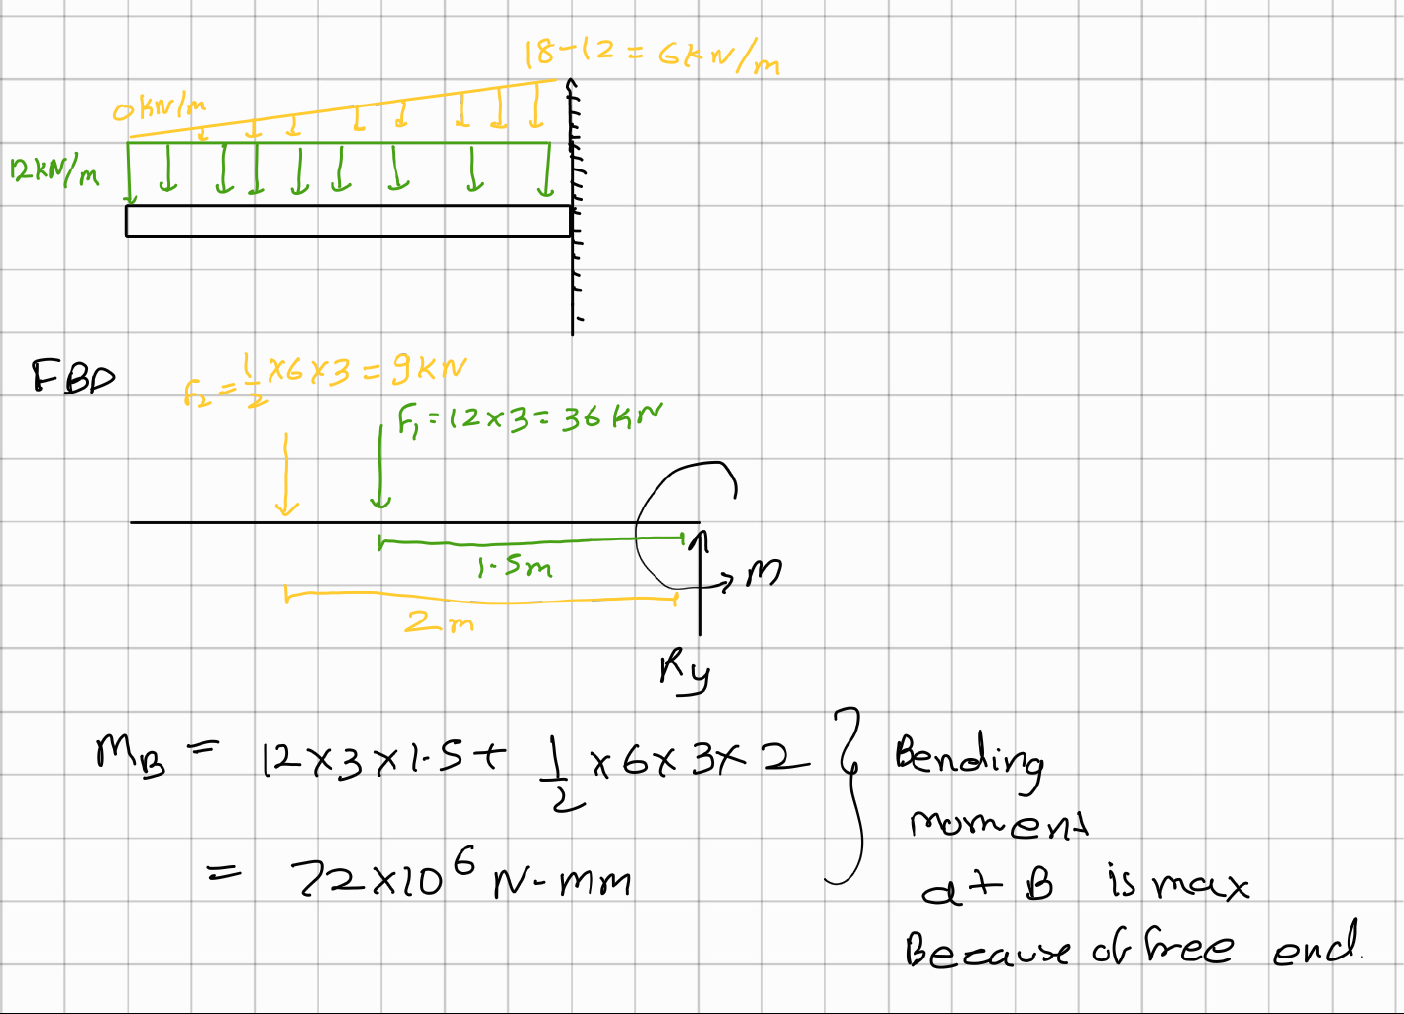
Handwritten: loads, shear and bending moment
HANDWRITTEN
Vmax = 45 kN
F1 + F2 = 36 kN + 9 kN at the wall
F1 = 36, F2 = 9 kN
Uniform 12 kN/m and triangle 0 → 6 kN/m
MB = 72 kN·m
As written: 36 × 1.5 + 9 × 2
Notes:
Load split into a 12 kN/m rectangle (36 kN at 1.5 m) and a 0 to 6 kN/m triangle (9 kN). Max moment and shear occur at the wall B. Note: the 2 m arm for the triangle is revisited on the verification slide.

Slide 5
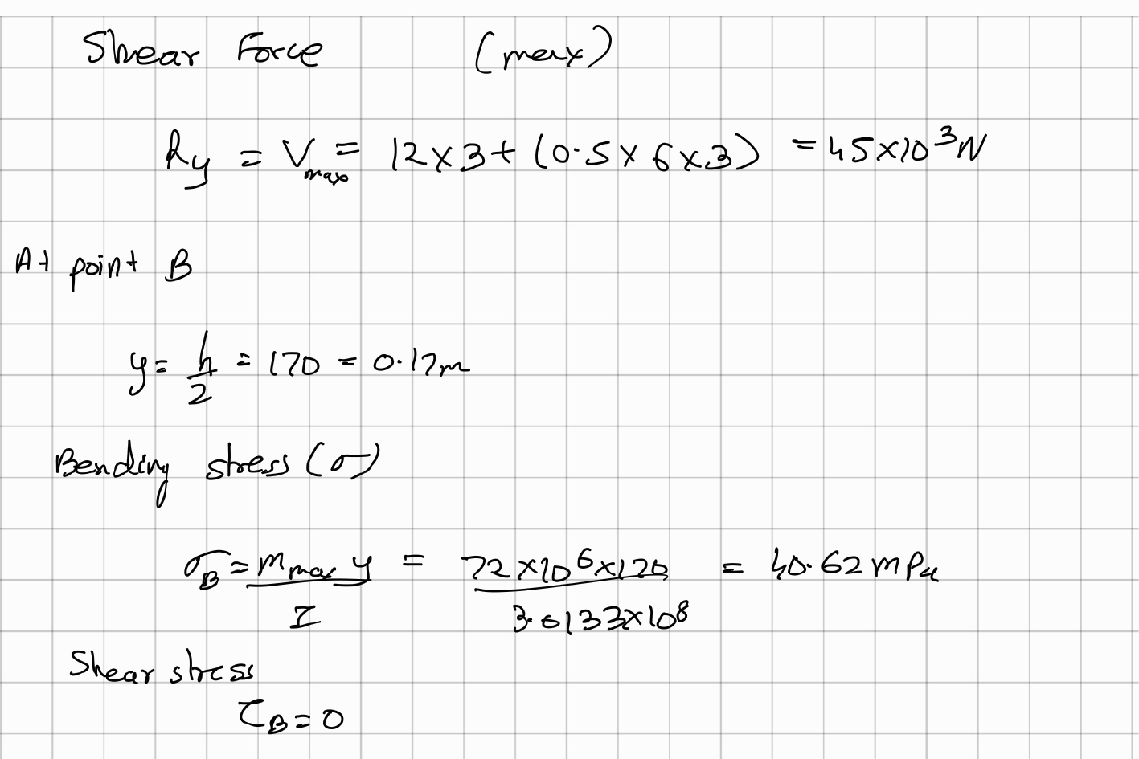
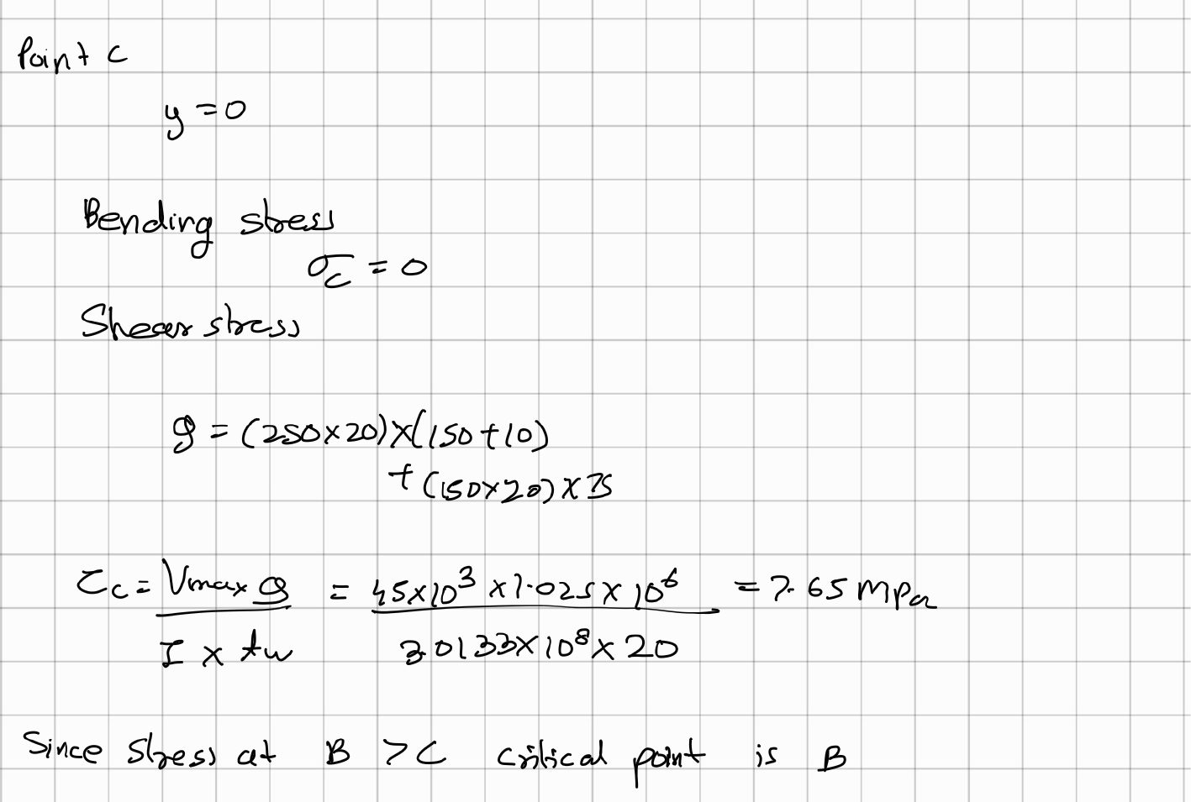
Handwritten: stresses at points B and C
HANDWRITTEN
σB = 40.62 MPa, τB = 0
σC = 0, τC = 7.65 MPa
Top fibre at the wall, y = 170 mm (bending only)
Neutral axis, Q = 1.025×10⁶ mm³ → B is critical
Notes:
Point B is the extreme fibre: pure bending, zero shear. Point C is the neutral axis: pure shear. Since 40.62 MPa is much larger than 7.65 MPa, B is taken as the critical element.

Slide 6
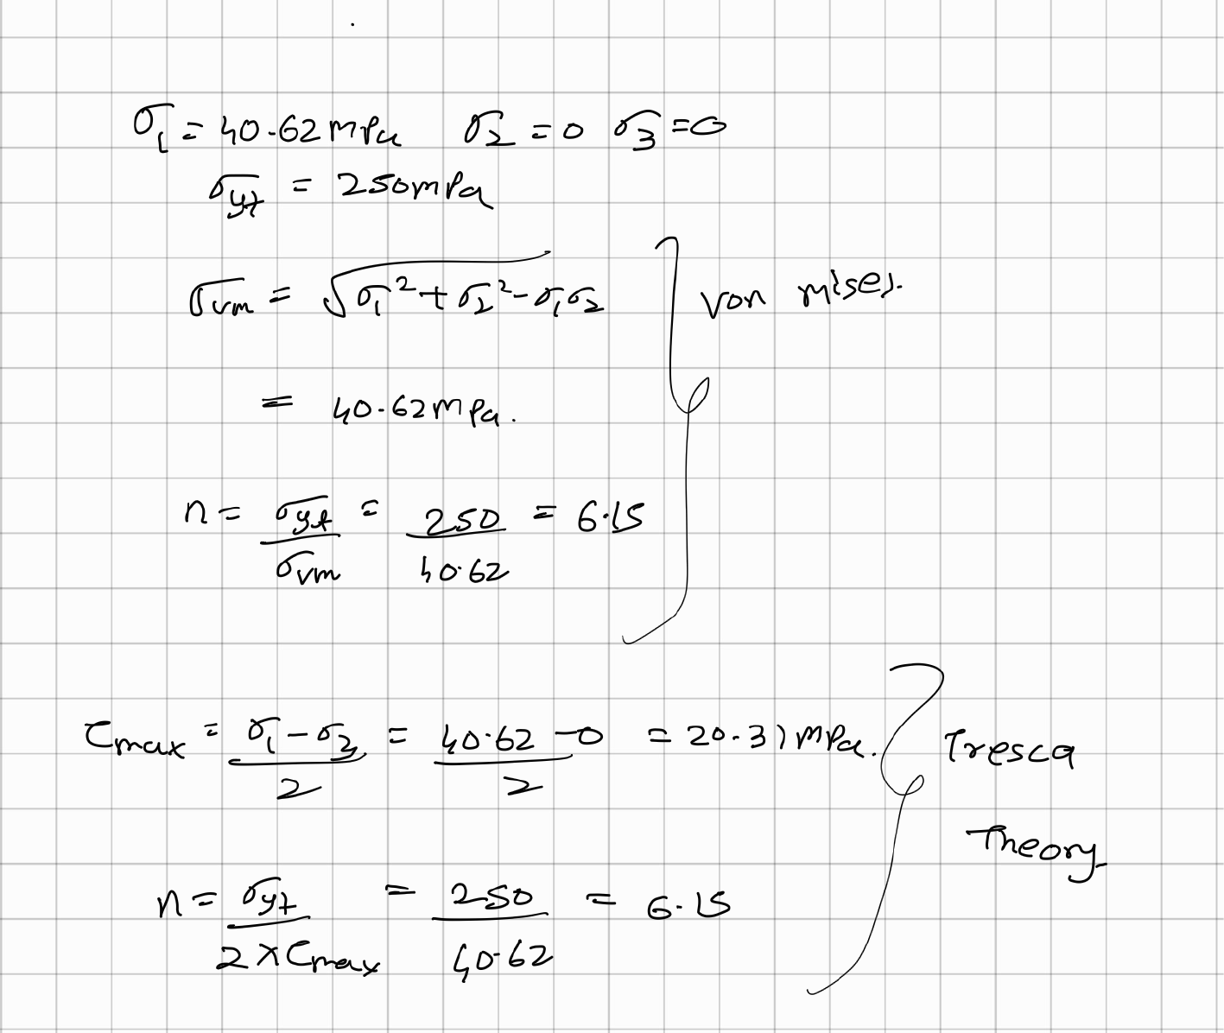
Handwritten: failure theories and safety factor
HANDWRITTEN
n = 6.15
von Mises: σvm = 40.62 MPa, n = 250 / 40.62
n = 6.15
Tresca: τmax = 20.31 MPa, n = 250 / (2 × 20.31)
Uniaxial stress state (σ2 = σ3 = 0), so both theories give the same result.
Notes:
At B the state is uniaxial, so von Mises and Tresca coincide. Safety factor = 6.15.

Slide 7
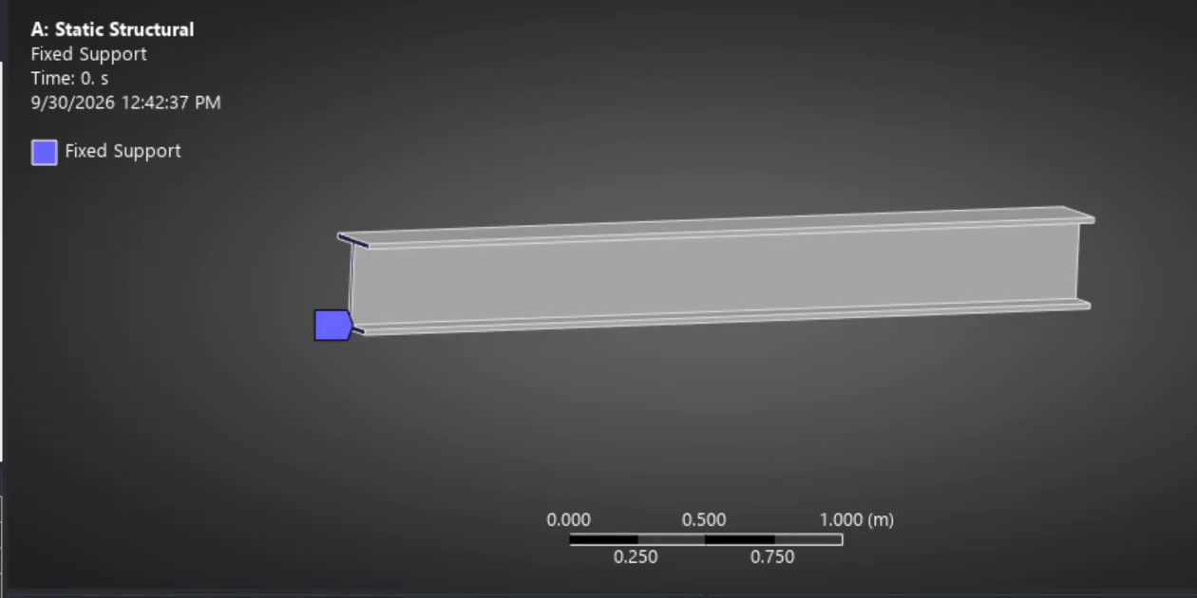
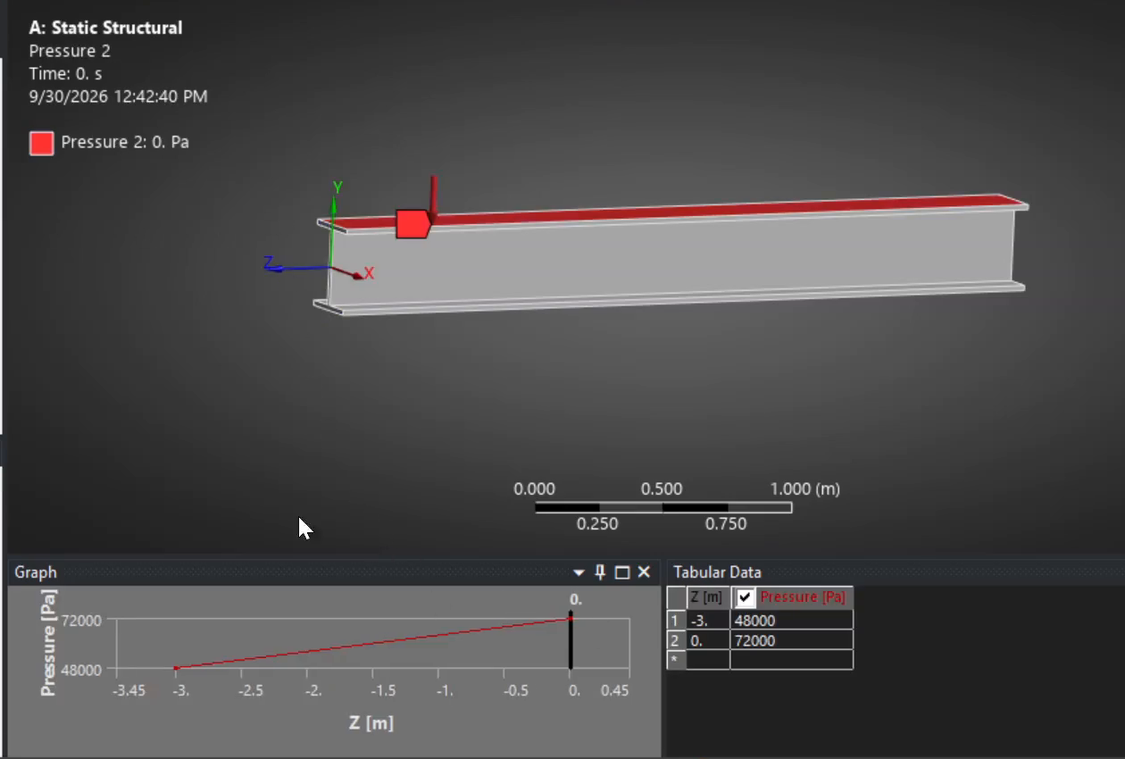
ANSYS: model setup and boundary conditions
ANSYS
Fixed support on the end face at wall B
Static structural, single load step (1 s)
Results: deformation, von Mises, max shear, max principal, Stress Tool safety factor
Pressure on the top face (250 mm wide), tabular in z: 48 kPa at the free end to 72 kPa at the wall. Multiplied by 0.25 m, that is 12 → 18 kN/m.
Notes:
The trapezoidal line load is applied as a tabular pressure on the top face. 48,000 Pa and 72,000 Pa times the 0.25 m face width reproduce 12 and 18 kN/m. The fixed support is at the left end, matching wall B.

Slide 8
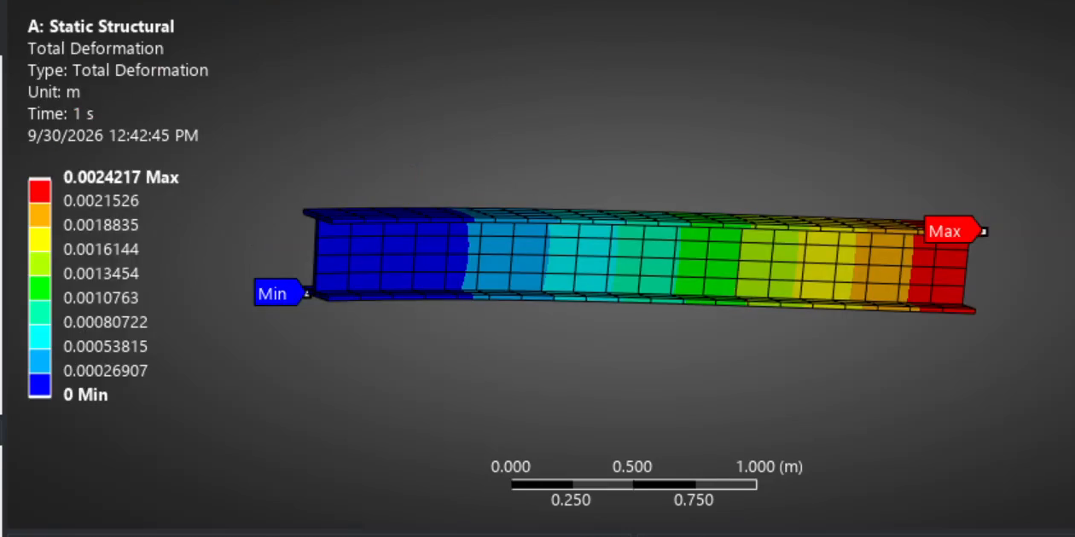
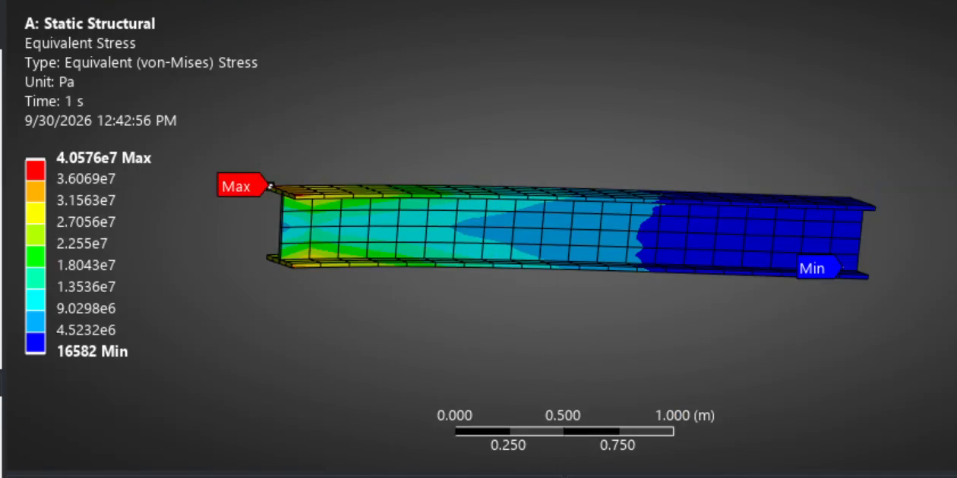

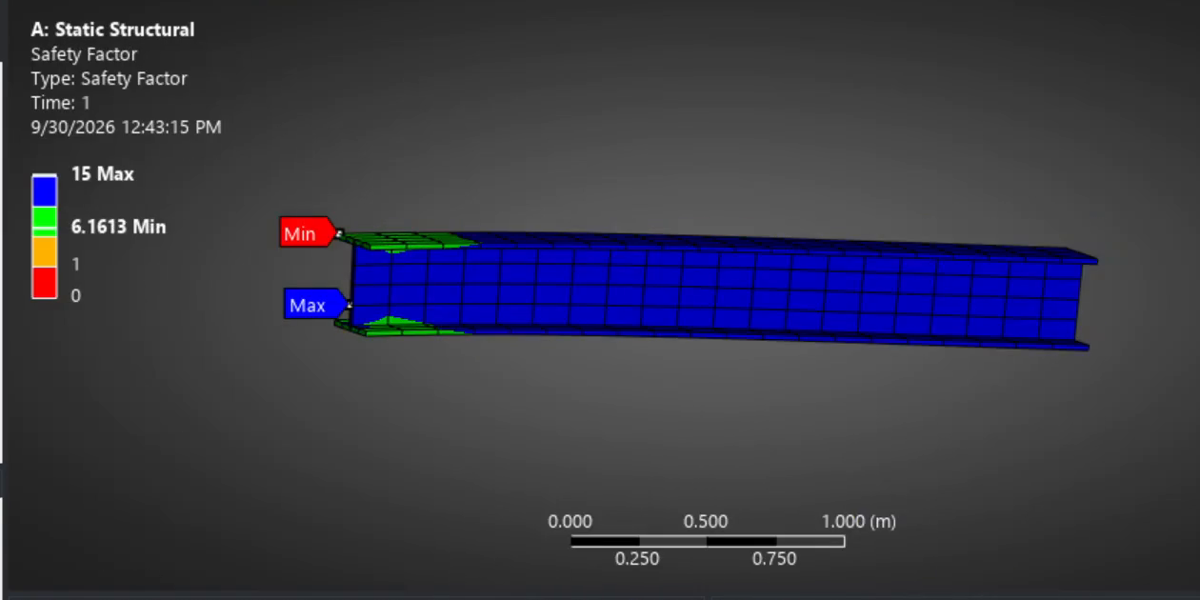
ANSYS results
Max deflection 2.42 mm
Max von Mises 40.58 MPa
Max shear 21.14 MPa
Min safety factor 6.16
Notes:
Deflection peaks at the free end (2.42 mm). Von Mises and shear stress peak at the top and bottom edges of the fixed end. The Stress Tool gives a minimum safety factor of 6.16 at the same location.

Slide 9
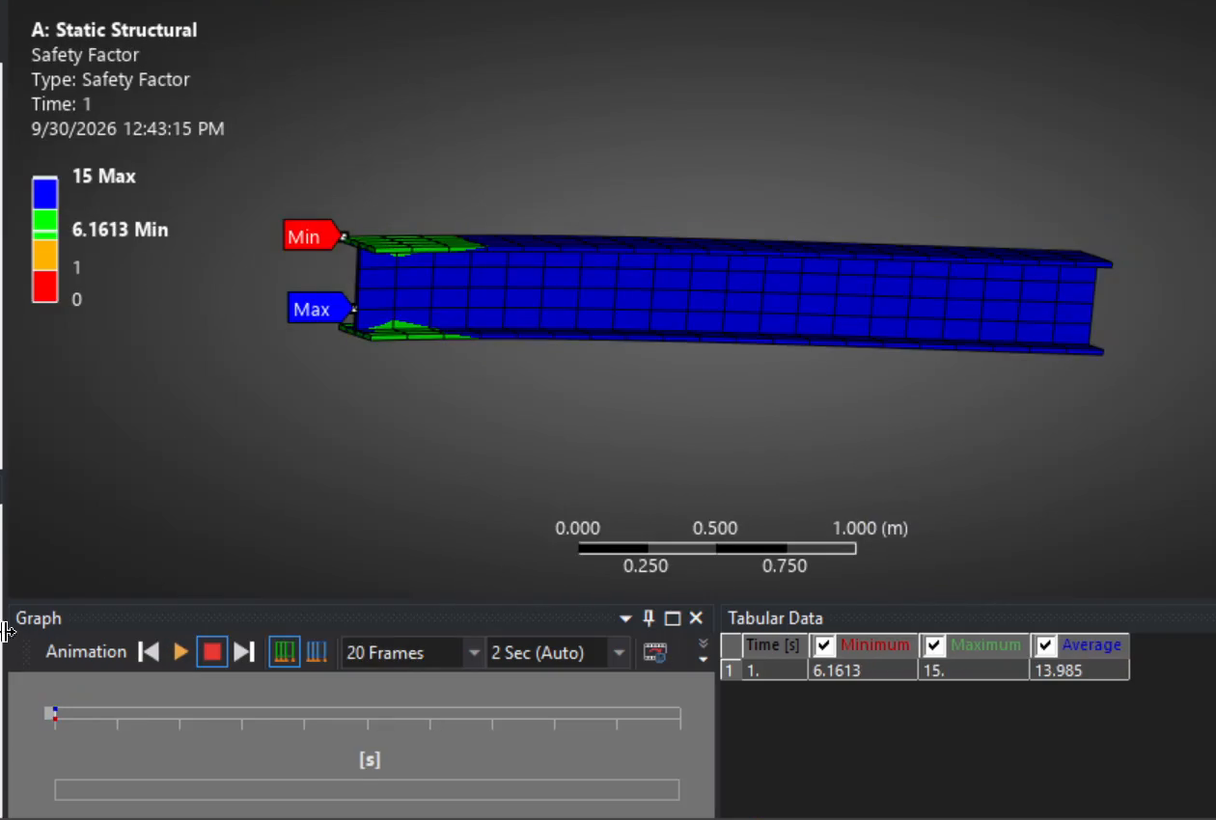
Side by side: safety factor
HANDWRITTEN
ANSYS
6.15
6.16
Δ 0.2%
Hand
ANSYS
Difference
Notes:
Both methods land at a safety factor of about 6.2. ANSYS reports 6.1613 as the minimum of the Stress Tool, hand calculation gives 6.15.

Slide 10
Numerical comparison
Quantity | Handwritten | ANSYS | Difference
Critical location | Top fibre at wall B | Top edge at fixed end | Same
Max normal / von Mises stress | 40.62 MPa | 40.58 MPa | 0.1 %
Max shear stress | 20.31 MPa (σ/2) | 21.14 MPa | 3.9 %
Safety factor (σyt = 250 MPa) | 6.15 | 6.16 | 0.2 %
Max deflection | not computed | 2.42 mm | n/a
Both methods agree: the beam is safe, with SF above 6 against yielding.
Notes:
Stress and safety factor agree within 0.2 percent. The hand shear value is the Tresca sigma/2, while ANSYS reports the full-field maximum shear stress, which includes local effects at the support.

Slide 11
Check before presenting: moment-arm slip
Worth fixing in the hand calculation; also affects how the match with ANSYS is read
Hand calculation
Triangle load is 0 at A and 6 kN/m at wall B, so its 9 kN resultant acts at L/3 = 1 m from B, not 2 m.
Corrected: MB = 36×1.5 + 9×1 = 63 kN·m (not 72).
σB line shows ×120, but the result uses y = 170 mm. Rewrite as 170.
Point B still governs: at the web-flange junction σ ≈ 31 MPa, τ ≈ 6 MPa, von Mises ≈ 33 MPa.
σB = 35.5 MPa
Corrected hand value (63 kN·m × 170 mm / Izz)
n = 7.03
Corrected hand safety factor
ANSYS: 40.58 MPa
About 14% above the corrected hand value
Likely cause: stress at a fixed-support face is overpredicted by FEA. Read stress 0.3 to 0.5 m from the wall or refine the mesh to confirm.
Notes:
Check this yourself before the presentation. For a triangular load that is zero at the free end and maximum at the wall, the centroid of the load is one third of the length from the wall, so the arm about B is 1 m. That gives 63 kN·m. The ANSYS model itself applies the load correctly (72 kPa at the wall, 48 kPa at the free end). If you keep the 72 kN·m version, be ready for this question.

Slide 12
Conclusions
1
Critical element is the top fibre at the fixed wall, in both methods.
2
Hand SF = 6.15 and ANSYS SF = 6.16: the beam is safe against yielding.
3
von Mises and Tresca agree because the critical state is uniaxial.
4
ANSYS adds the full-field view; correct the triangle moment arm (63 kN·m) and confirm with mesh refinement.
Notes:
Wrap up: both approaches identify the wall as critical and give SF around 6.2. The simulation is a useful cross-check, and the discrepancy analysis shows where to refine.

