Slide 1
Content Based Recommender System Using Structured Data
Compiled by:
Monica singh (rit2011006)
Anchit gupta (rit2011082)
Ankit bathla (rit2011089)

Slide 2
Recommender system
Recommender Systems (RSs) are software tools and techniques providing suggestions for items to be of use to a user.
Recommender Systems:
RS usually consist of three components. In order to use Linked Data, we
need to extend the architecture of the recommender system with two components:
the data interface allows accessing URIs via HTTP in order to acquire RDF data.
This provides an abstraction layer for accessing the data.
RDF libraries such as Redland6 provide a data interface component.
Figure shows all the steps of processing Linked Data
for collaborative recommendations:
Integrating the data about user-item connections from different sources a common vocabulary.
2. Transforming the representation of the data from an RDF graph to a user-item matrix.
3. Applying a specific content based algorithm on the user-item matrix.

Slide 3
Content-based (CB):
Recommendations are based on the assumption
that if in the past a user liked a set of items with particular
features, they will likely go for items having similar
characteristics.
Content based algorithms are algorithms that attempt to
recommend items that are similar to items the user liked
in the past.
They treat the recommendation's problem as a search
for related items.
Information about each item is stored and used for the
recommendations.
Items selected for recommendation are items that content
correlates the most with the user's preferences.
For example, whenever a user rated an items, the algorithm
construct a search query to find other popular items by the
same author, artist, or director, or with similar keywords or
subjects .
Content based algorithms analyze item descriptions to identify
items that are of particular interest to the user.

Slide 4
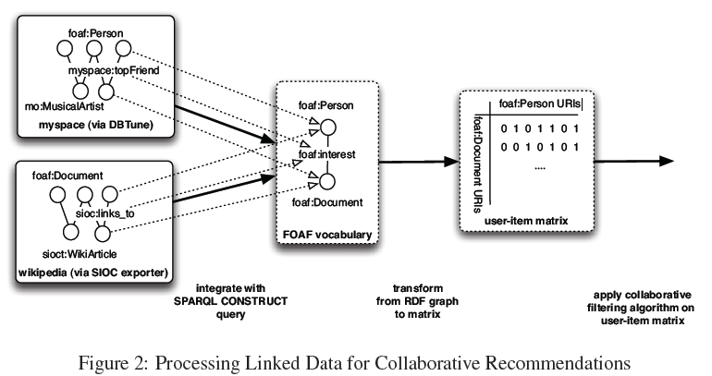

Slide 5
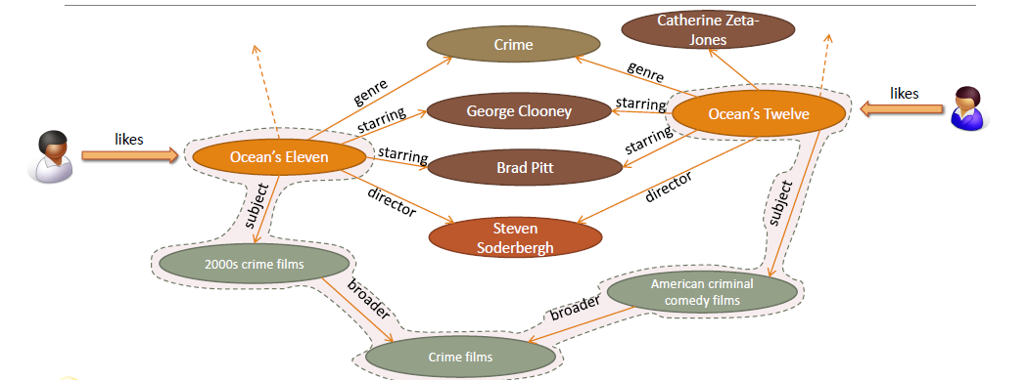
We needed the user item matrix, item feature and the user feature matrix.
we used the structured data from DBpedia to find these matrices used for
our content based approach using SVM (support vector machine).

Slide 6
STRUCTURED DATA :
Structured data analysis is the statistical data analysis of structured data.
This can arise either in the form of an a priori structure such as
multiple-choice questionnaires or in situations
with the need to search for structure that fits the given data, either exactly or approximately.
This structure can then be used for making comparisons, predictions,
manipulations .
Structured Data = Data organized by a markup language and avocabulary.
Can be organized and searched by machines.
Linked Data = Publishing structured data so it can be accessed at a URI
Semantic Web = The web of globally accessible, interlinked data entities.
DBpedia: a Nucleus for a Web of Open Data:
http://dbpedia.org
DBpedia is a crowd-sourced community effort to extract structured
information from Wikipedia and make this information available on the Web.
DBpedia allows you to ask sophisticated queries against Wikipedia, and
to link the different data sets on the Web to Wikipedia data.

Slide 7
MovieLens
GroupLens Research has collected and made available rating data sets from the MovieLens web site (http://movielens.org). The data sets were collected over various periods of time, depending on the size of the set.
MovieLens is a recommender system and virtual community website that recommends films based on user-provided ratings.
We have taken 100,000 ratings from 1000 users on 1700 movies.

Slide 8
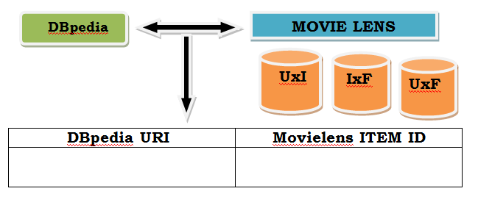
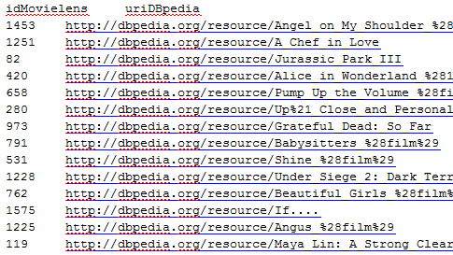
Step 1:

Slide 9
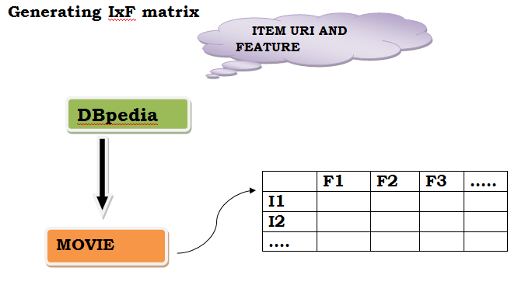
Step 2:

Slide 10
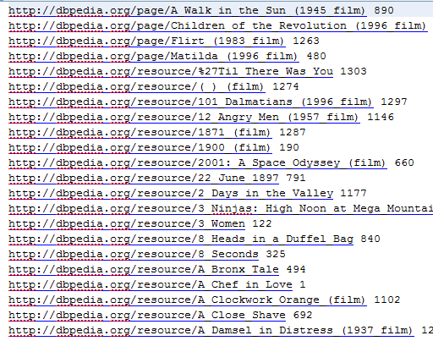
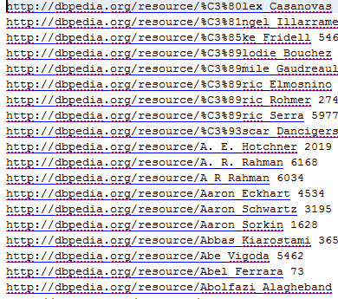
MOVIES
FEATURES

Slide 11
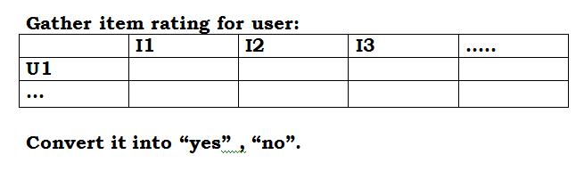
Step 3:

Slide 12
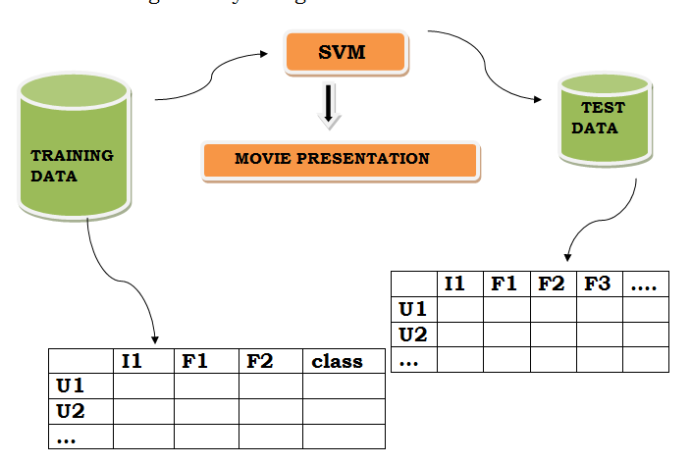
Training data is taken from the movielens site where the movies are
rated by the user.
If the rating given by the user is > 3 then it is labled in class ‘yes’
else in class ‘no’.
We will define the classes of our testing data on the
basis of training data by using SVM.

Slide 13
SVM (SUPPORT VECTOR MACHINE):
support vector machines (SVMs, also support vector networks) are supervised learning models with associated learning algorithms that analyze data and recognize patterns, used for classification and regression analysis. Given a set of training examples, each marked as belonging to one of two categories.
The Vector Space Model is an algebraic model for representing both
text documents and queries as vectors of index terms wt,d that are positive
and non-binary.

Slide 14
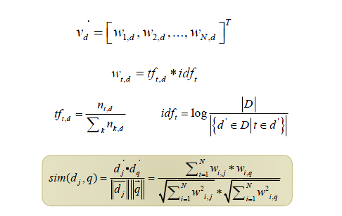

Slide 15
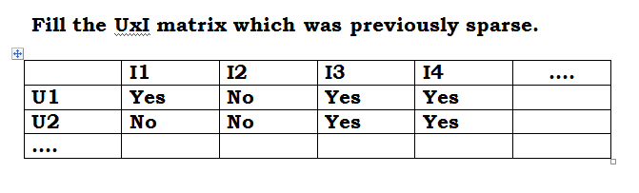
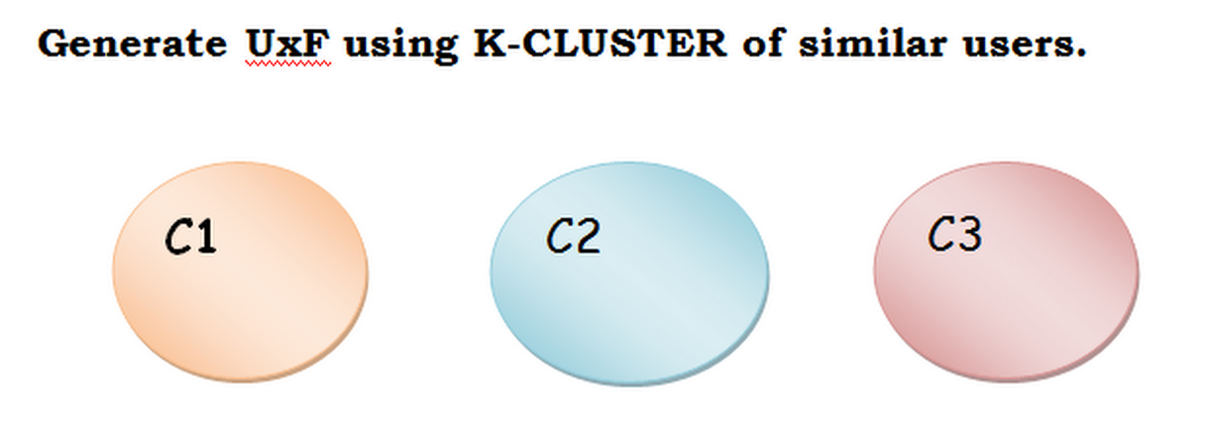

Slide 16
STEP 7:
Target user -> ‘U’
Find the similarity of ‘U’ to each cluster head (centroids) ,if fall in C2. Then suggest C2.

Slide 17
Work done till Mid-Sem
We collected the data from DBpedia and Movielens and loaded it as repositories
on virtuoso.
Queried the ontology to find the various features of the movies like director,
star cast, music composer, producer etc.
Prepared the Item Feature matrix which has all the items (movies) as the rows and
corresponding features as the columns.
Finding the user item matrix.

