Slide 1
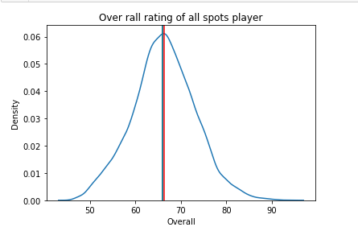
DISTRIBUTION OF OVERALL RATING

Slide 2
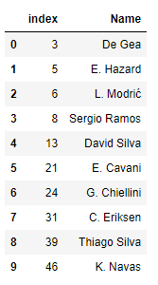
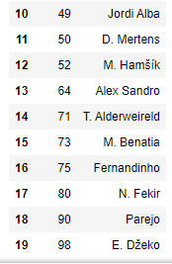
TOP TWENTY PLAYERS IN FIFA

Slide 3
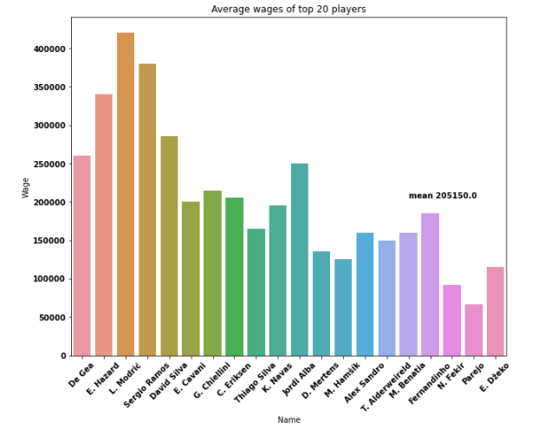
AVERAGE WAGES OF TOP 20 PLAYERS

Slide 4
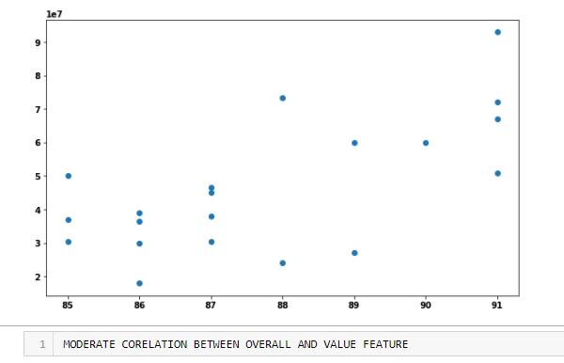

CORELATION BETWEEN OVERALL RATING AND VALUE FEATURES

Slide 5
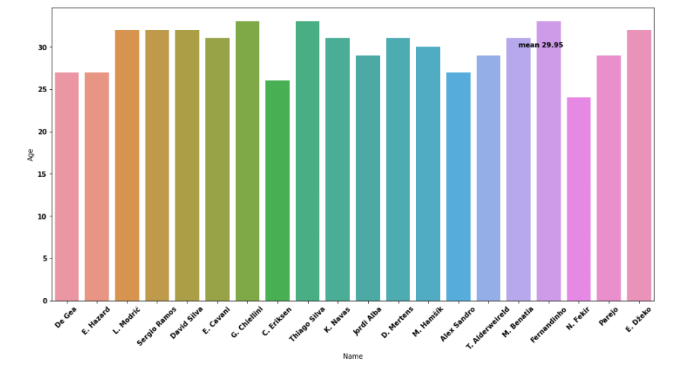
AVERAGE AGE OF THE PLAYERS

Slide 6

IS TOP PLAYERS APPEAR ANY OTHER TABLE

Slide 7
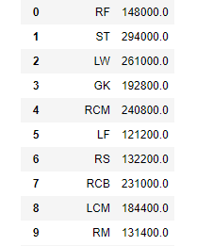
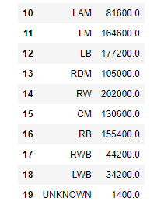
AVERAGE WAGE ONE CAN EXPECT IN EACH POSITION

