Slide 1
Creating Accessible content using Microsoft 365
Presented by the IT Accessibility Office (ITAO)
Notes:
IT: Information and Technology.
Office has become Microsoft 365 (https://www.microsoft.com/en-ca/microsoft-365?ocid=oo_support_mix_marvel_ups_support_smcuhfm365&rtc=1)
This session is using all the Desktop applications of Microsoft 365

Slide 2
Land Acknowledgment
We begin this course by acknowledging that we all live, work, and play on land and territories that were and are home to many diverse First Nations, Inuit, and Métis peoples and that this land is subject to many treaties and agreements. We wish to recognize the connection to the land that we experience and benefit from.
Notes:
To provide a better experience for persons who are blind, here an introduction of the Trainer:
Description of job duties and expertise
Appearance of trainer (say what you are comfortable with): age, gender, color or hair/eyes, brief physical description

Slide 3
Administrative Information
Caption and Transcription are available in MS Teams.
Questions are always welcomed.
The presentation contains speaker notes with additional information.
A short break will be taken halfway.
The session is three hours.
Making Technology work for everyone!

Slide 4
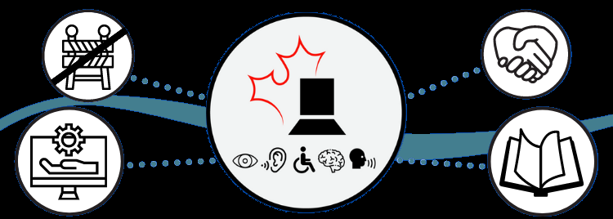
Course Objectives
Learn best practices when using Microsoft 365 (M365) to create accessible content with Outlook emails, Word, and PowerPoint.

Slide 5
Agenda
Global Accessibility Best Practices
Best practices for emails-Outlook
Best practices for Word
Break
Best practices for PowerPoint
Resources
Contact us
Making Technology work for everyone!

Slide 6

Global Accessibility Best Practices
Making Technology work for everyone!
6

Slide 7
Global Best Practices Section Includes
Plain language
Acronym
Appearance of text
Image
Alternative text for Non-text Object
Descriptive Hyperlink
Colour
Making Technology work for everyone!

Slide 8
Plain Language
The need to provide relevant information clearly and simply to ensure that everyone understands your message:
It applies within and between departments.
It applies to all types of communications and documents.
Reading level should aim for grade 8, up to 10 is accepted ‘internally’.
Making Technology work for everyone!
Notes:
Extract from Canada.ca Content Style Guide - Canada.ca (https://design.canada.ca/style-guide/)
The power of plain language - Writing for the Government (https://iservice.prv/eng/finance/disclosure/plain_language.shtml)
The Canadian Style-TERMIUM Plus (https://www.btb.termiumplus.gc.ca/tcdnstyl-chap?lang=eng&lettr=chapsect13&info0=13#zz13)
Termium also has a French guide available - ‘Le guide du rédacteur’ (https://www.btb.termiumplus.gc.ca/redac-chap?lang=fra&lettr=chapsect10&info0=10#zz10)

Slide 9
To Learn about Plain Language
College@ESDC offers a three-hour session that provides skills to clearly communicate. Details in Saba are :
Title: Writing in Plain Language
Number: 0000077971
Language: English and French
Making Technology work for everyone!
Notes:
New one:
The Power of Plain Language: Writing for the Government
Course ID:134833

Slide 10
Acronym
Spell it out the first time you use it
Do not add a period
Write them in uppercase
Do not add an apostrophe
Extracted from Termium Plus – Canadian Style
Making Technology work for everyone!
Notes:
French version: Termium Plus- le guide du rédacteur (https://www.btb.termiumplus.gc.ca/redac-chap?lang=fra&lettr=chapsect1&info0=1#zz1)

Slide 11

Appearance of Text
Example of sans serif font
Avoid a large amount of Italic, Bold, or Underline.
Use sans serif fonts like Arial, Verdana, or Calibri.
Use a limited number of font variations (max. 3).
Font size for documents and emails is between 11 and 14 points, for presentations content is minimal 30 points.
Avoid light versions of fonts because they are hard to read.
Making Technology work for everyone!
Notes:
Extract from 4.2 Underlining, bold and italics from Canada.ca content style guide (https://design.canada.ca/style-guide/#wp4-2)

Slide 12
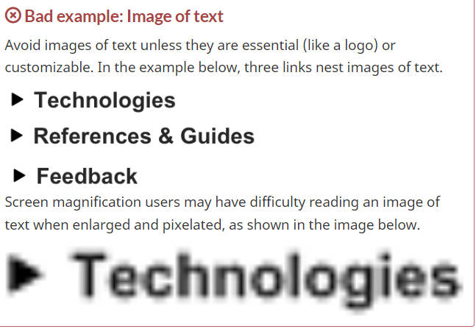
Image
Avoid images of text because they do not adapt to needs.
Avoid watermarks (background) because screen reader* software does not read them. For example, instead of a watermark insert the text ‘Draft’ on the title page, in the header, or in the footer.
Making Technology work for everyone!
Notes:
*Screen Reader: adaptive technology usually for a person that is blind
Source: ITAO Module 5 – images: (https://bati-itao.github.io/learning/esdc-self-paced-web-accessibility-course/module5/images-text.html)

Slide 13

Alternative Text for Non-text Object
All visual elements such as photos, icons, diagrams, and tables must have an alternative text (‘alt text’) that briefly explains the function of the image.
Tip: Write how you would describe the image over the phone.
Making Technology work for everyone!
Notes:
Image extracted from Microsoft Help page : https://support.microsoft.com/en-us/office/everything-you-need-to-know-to-write-effective-alt-text-df98f884-ca3d-456c-807b-1a1fa82f5dc2

Slide 14
Writing Alternative Text
Maximum length recommended for alt-text is 140* characters in English (including spaces and punctuation).
Do not repeat details that are already in the document.
Do not write about colors unless they serve a purpose.
Do not write the filename or link.
Do not include words such as ‘image of’, or ‘picture of’.
You may write ‘Screen capture’ or ‘Screen shot’.
Making Technology work for everyone!
Notes:
*In French, a maximum of 170 characters.
As per Canada.ca Content guide – section 6.2. Source: (https://design.canada.ca/style-guide/#wp6-2)

Slide 15
Descriptive Hyperlink
Descriptive hyperlinks should be as brief as possible and make sense ‘out of context’. Often the web page title is use.
Do not use generic words like ‘Click here’ or ‘Read more’.
Add the web address (URL*) along with the descriptive hyperlink, only if the document is to be produced in a print format (such as booklets, or pamphlets).
Making Technology work for everyone!
Notes:
Extract from the Digital Accessibility Toolkit. How to create accessible documents in Office 365: (https://a11y.canada.ca/en/guides/office365/)
* URL stands for ’Uniform Resource Locator’

Slide 16
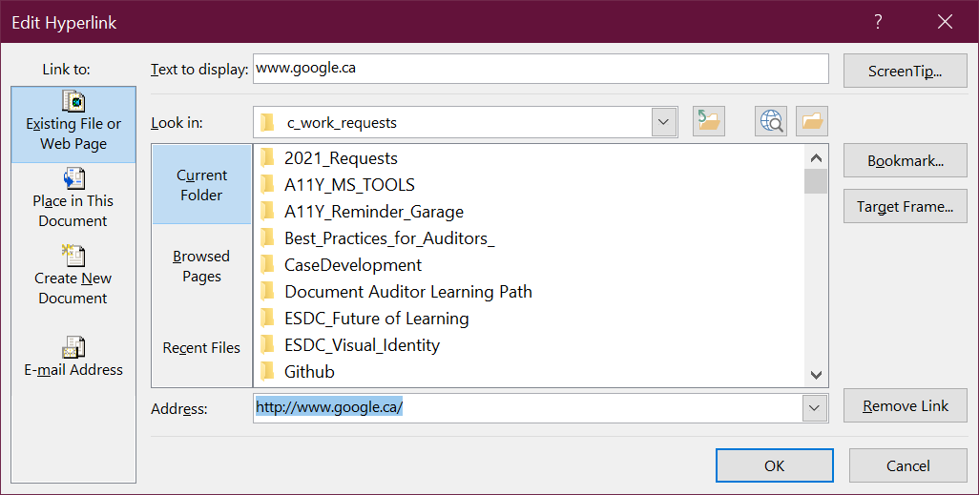
Edit Hyperlink with a Descriptive Text
Select or highlight the hyperlink
Right-click to open the context menu Select Edit Hyperlink
Type the desired descriptive text in the Text to display field
Activate the OK button
Making Technology work for everyone!

Slide 17
Colour
Do not convey information by colour only. Instead of writing ‘Mandatory fields are in red’, write ‘Mandatory fields are marked with an asterisk’.
Minimum colour contrast needs to be at least 4.5:1 for text and background; and at least 3:1 for non-text and background.
Use the Colour Contrast Analyser (CCA) to validate*.
Making Technology work for everyone!
Notes:
*CCA: To get CCA place a ticket with the National Service Desk. It is free and no approval required. It is not yet in the Software catalogue.
To test the visibility of your content, use High Contrast:
Activate: Press and hold Left ALT + Left SHIFT + Print Screen
Deactivate: Repeat this step

Slide 18
Best Practices for emails in Outlook
Making Technology work for everyone!
18

Slide 19
Outlook Section Includes
Write one language at a time.
Language markup must be done for bilingual emails.
Create a bookmark and a link to English text.
Hands-on exercise.
Making Technology work for everyone!

Slide 20
Write One Language at a Time
All English text together followed by all the French text (or French followed by English).
Create a link like ‘English follows French’ that jumps to a bookmark within the email. This link should be the first line of the message.
Tip: If your office is in Quebec, it should start with French text.
Notes:
EXTRACT (https://www.tbs-sct.canada.ca/pol/doc-eng.aspx?id=26164)
English or French first? 6.1.1 (Order of official languages) Ensuring that, when both official languages are used, the order in which they appear is:
French first when the issuing office is located in the province of Quebec; and
English first when the issuing office is located elsewhere in Canada.
NEVER: mix one paragraph in French followed by one paragraph in English

Slide 21

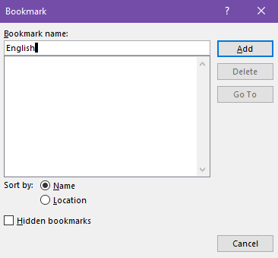
First: Create a Bookmark to Jump to
Place the cursor at the bookmark location
Select Insert ribbon
Select Bookmark
Type ‘English’ (Bookmark name)
Select Add button

Slide 22

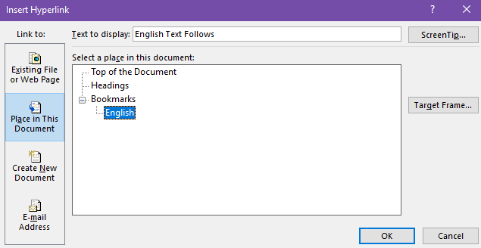
Second: Create a Link to the Bookmark
Select ‘English follows French’
Select Insert ribbon
Select Link
Select Place in This Document
Select English (bookmark name)
Select Ok button
Notes:
The link ‘English text follows’ or ‘le français suit’ should be the very first line of the email content

Slide 23
Accessible Signature Block
Stacking signature blocks makes the content accessible to a wider range of people with disabilities .
Information provided in French must be the same in English.
Should not include images except those authorized by the Federal Identity Program.
Notes:
Source:
Email Management Services Configuration Requirements(https://www.canada.ca/en/government/system/digital-government/policies-standards/enterprise-it-service-common-configurations/email.html)

Slide 24
Example of an Accessible Signature Block*
Marie Canadienne
(Elle/she-her)/optional Analyste, Direction générale des services d'infotechnologie Emploi et Développement social Canada / Gouvernement du Canada marie.canadienne@hrsdc-rhdcc.gc.ca / Tél. : 819-555-5555 Analyst, Information Technology Services Branch Employment and Social Development Canada / Government of Canada marie.canadienne@hrsdc-rhdcc.gc.ca / Tel: 819-555-5555
Notes:
*Note that this is an example of an email signature, and the text is smaller than 30 points to show the entire information (as displayed on the departmental templates on intranet) and is not 1.5 line spacing
Gender identity is optional and should be directly below name and followed by a blank line
Departmental templates-section ‘email signature block’. Source: http://esdc.prv/en/work_tools/templates.shtml

Slide 25

Language Markup
Without proper markup, adaptive technology such as JAWS (Job Access With Speech) which is a screen reader software used by persons that are blind, may try to read French text using the English language!

Slide 26
Steps to Identify Language
Select <all French text> to be marked
Select Review, Language
Select Set Proofing Language
Select French (Canada)
Repeat these steps for the English text (English Canada).

Slide 27
Also Applies to Outlook
Remember to check for plain language, acronyms, the appearance of text, alternative text for non-text objects, descriptive hyperlinks, the use of colour, and images.

Slide 28
Hands-on for Outlook
Open ‘M365_Acc_Outlook_V2’.
You have five minutes to find the errors in the email.
You may list them in the chat or discuss them afterward.

Slide 29
Best Practices for Word
Making Technology work for everyone!
29

Slide 30
Word Section Includes
Heading and style
Table
Alternative text for non-text object
Accessibility checker
Readability statistics
Hands-on exercise

Slide 31
Heading and Style
Using heading and style creates structure and improves the accessibility and readability of your document. Proper heading order is important for screen readers to help them navigate the document. For example:
Heading 1
Heading 2
Heading 3
Heading 3

Slide 32
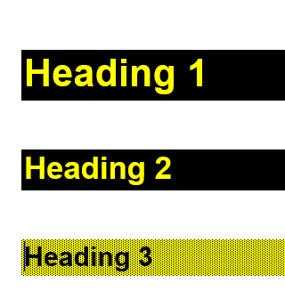
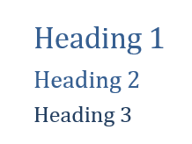
Why Use Heading and Style?
If someone has difficulties reading text in blue, for example, built-in styles can be changed to better fit their needs.
Original built-in styles
Modified built-in styles

Slide 33
Avoid Custom Styles
‘Created Styles’ (that are not based on built-in styles) will not be treated as headings and may not be recognized by adaptive technology.
Instead, modify existing built-in styles to better fit your needs.

Slide 34
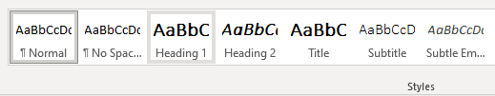
Apply Heading Style
Select ‘the text’ to which you want to apply a style
Select Home ribbon
Select a Style you want (such as the Heading 1), under the Styles section of the ribbon
Tip: Avoid skipping headings like H1-H3-H4 → H2 is missing! (H stands for heading)

Slide 35
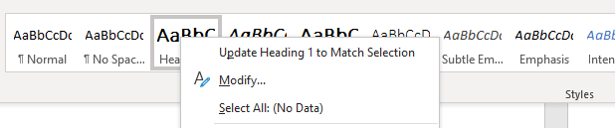
Modify a Style
Select ‘the text’ for which the style is already applied
Select the Home ribbon
Right-click on the Style to be altered
Select Modify
Change font, color, size (and more in Format)
Select Ok when done
Notes:
Under the Format button, you can change ‘paragraph’ style to add blank spaces before and/or after the style.

Slide 36
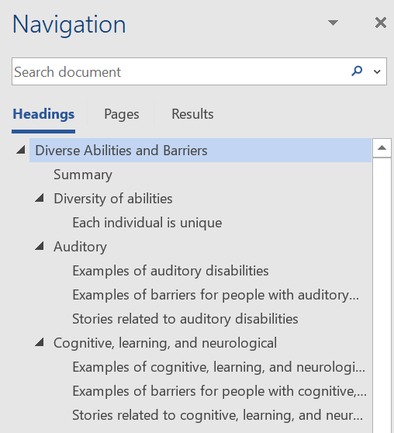
Use the Navigation Pane
To quickly review and validate levels of headings in your document:
From the View ribbon
Select Navigation Pane
Tip: Lets you jump to a specific location in a document.
Notes:
Document shown in the Navigation Pane is Diverse Abilities and Barrier.s You may read it in our SharePoint: (https://014gc.sharepoint.com/:w:/r/sites/BU6206833/Awareness_and_Governance/Toolkit%20Presentations/Diverse%20Abilities%20and%20Barriers.docx?d=w93e205da74ea47179b72ba2b9400e790&csf=1&web=1&e=He7Mp7)

Slide 37
Table
Screen reader software keeps track of their location in a table by counting table cells. As a result, if a table is nested within another table, or if a cell is merged or split, the screen reader software loses count and cannot provide helpful information about the table after that point.

Slide 38
Table Tips
Tables are used for the collection of data, not for text layout.
There should be no blank cells. Replaced them with text such as ‘0’ (zero) or ‘Not Applicable’ (NA).
Use simple table structures (no merged or split cells).

Slide 39
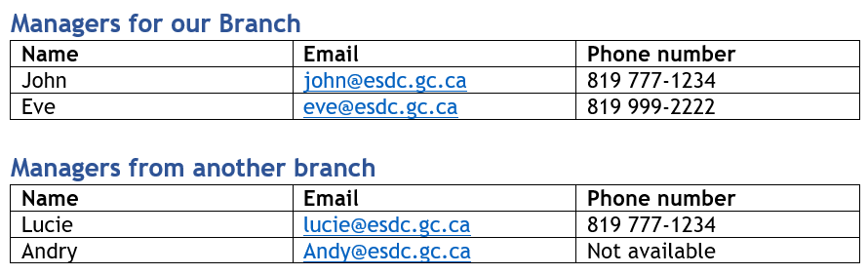
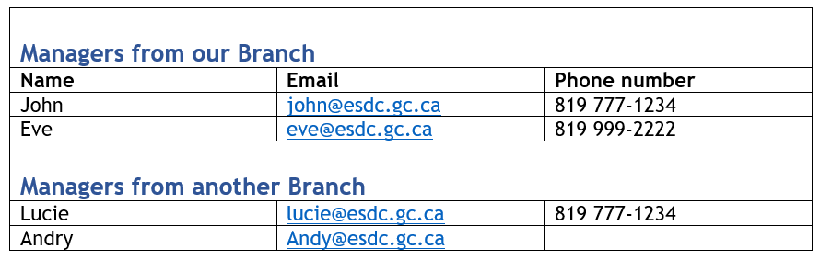
Example of Tables
Accessible: Instead of merged cells, consider creating a separate table with a title above it (using a heading style).
Not accessible: Contains merged cells.

Slide 40
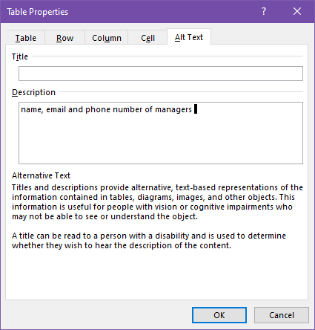
Add Alternative Text to a Table
Place the cursor in the table
Right-click and select Table Properties
Select the Alt Text tab
Add text in the Description field
Notes:
Set or change table properties - Microsoft Support: (https://support.microsoft.com/en-us/office/set-or-change-table-properties-3237de89-b287-4379-8e0c-86d94873b2e0?ns=winword&version=90&syslcid=1033&uilcid=1033&appver=zwd900&helpid=536&ui=en-us&rs=en-us&ad=us#__toc1)

Slide 41
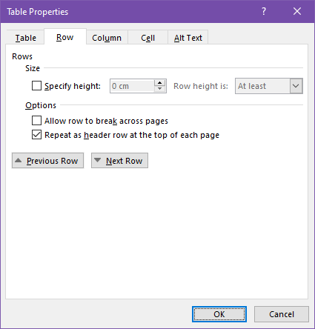
Define a Table Header Row
Place the cursor in table first row
Right-click or activate Context menu
Select Table Properties
Select the Row tab
Add checkmark to Repeat as header row at the top of each page
Notes:
Tip: It is good practice to remove the checkmark for ‘Allow row to break across page’

Slide 42
The Accessibility Checker
Looks for things such as missing alternative text, insufficient color contrast, or tables with merged/split cells.
The checker does not identify all accessibility issues. It does not validate if an alternative text is meaningful.
While the Accessibility Checker is running, an Accessibility ribbon appears with extra tools.
Notes:
because accessibility is about the human experience…. Extract from WebAIM site (https://webaim.org/articles/tools/).

Slide 43
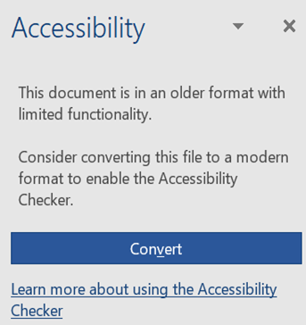
Older Document Format
If the document is in ‘compatibility mode’ the Accessibility Checker will not run and will display a Convert button.
Warning: Documents in compatibility mode may create issues for Adaptive Technologies (AT).

Slide 44

Where is the Accessibility Checker?
Select Review ribbon
Select Check Accessibility
Tip: The Word Accessibility appears on the status bar (bottom left) showing the status of your document. You can click this button to open the Accessibility Checker.

Slide 45
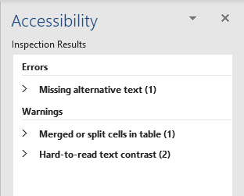
Inspection Results
The Accessibility Checker reports on three types of problems through the Inspection results:
Errors: difficult or impossible to read and understand
Warnings: in most (but not all) cases makes the document difficult to understand
Tips: could be presented in a different way to improve the user’s experience
Making Technology work for everyone!
Notes:
Rules for the Accessibility Checker (https://support.microsoft.com/en-us/office/rules-for-the-accessibility-checker-651e08f2-0fc3-4e10-aaca-74b4a67101c1?ui=en-us&rs=en-us&ad=us)

Slide 46
Reading level of content
Use Plain Language to make the information accessible and readable for everyone.
Content reading level (Flesch-Kincaid) higher than Grade 8 can be difficult to understand for some people.
Statistics tools help you check the reading level.
Notes:
Extract from Canada.ca content Guide (https://design.canada.ca/style-guide/#wp2-9)

Slide 47
Readability Statistics
Available in Word and must be activated (only one time).
Works only for English documents.
For French documents use Scolarius (if unclassified).
Notes:
To understand how the score is calculated visit Get your document's readability and level statistics
(https://support.microsoft.com/en-us/office/get-your-document-s-readability-and-level-statistics-85b4969e-e80a-4777-8dd3-f7fc3c8b3fd2?ui=en-us&rs=en-us&ad=us#__toc342546558)

Slide 48
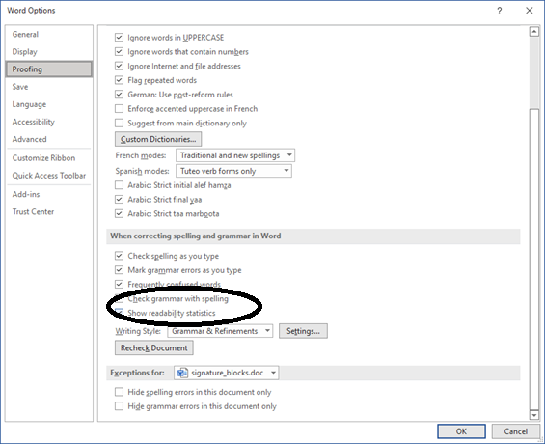
Activate Readability Statistics
Go to File…Options
Select Proofing
Go to the section When correcting spelling and grammar in Word
Check Show readability statistics

Slide 49
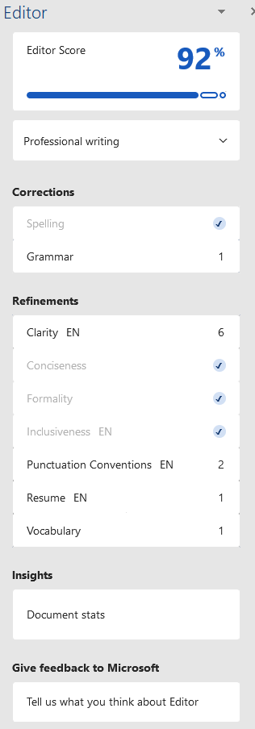
Obtain Readability Statistics
Go to Review
Select Editor*
Select Documents stats (below Insights)
A prompt appears ‘We are calculating the stats for you…’
Select Ok to proceed
Notes:
* If the document contains an Editor Score of 100%, the Readability Statistics will show immediately (steps 3 and 4 are skipped).
Long description for Editor tool:
It shows: Editor Score 92%, Professional writing, Corrections (spelling and grammar), Refinements (clarity EN, Conciseness, Formality, Inclusiveness EN, Punctuation Conventions EN, Resume EN, vocabulary), Insights (document stats), Give feedback to Microsoft (tell us what you think about Editor)
Read about how it is calculated: (https://support.microsoft.com/en-us/office/about-flesch-kincaid-readability-and-level-statistics-8fbb787e-4e1d-4dcc-933f-c7d2f06e76ac)
Help with the Microsoft Editor Video (https://support.microsoft.com/en-us/office/microsoft-editor-checks-grammar-and-more-in-documents-mail-and-the-web-91ecbe1b-d021-4e9e-a82e-abc4cd7163d7)
More on M365 Editor (https://support.microsoft.com/en-us/office/microsoft-editor-checks-grammar-and-more-in-documents-mail-and-the-web-91ecbe1b-d021-4e9e-a82e-abc4cd7163d7)

Slide 50
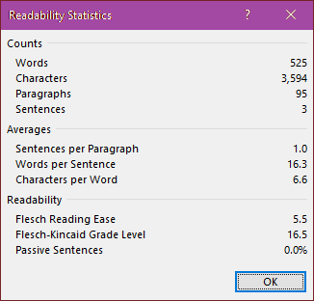
To Lower the Readability Statistics
Use short sentences (less than 25 words) or short paragraphs (less than 3 sentences).
Create numbered or bulleted lists for key tasks.
Keep words of 3 or more syllables only if they are well known.
Avoid technical jargon, Latin words, or expressions.
Remove details that people do not need.
Notes:
Long Description for Readability Statistics dialog box:
It shows: Counts ( Words 525, Characters 3594, Paragraphs 95, Sentences 3), Averages (Sentences per Paragraph 1.0, Words per Sentence 16.3, Characters per Word 6.6), Readability (Flesch Reading Ease 5.5, Flesh-Kincaid Grade Level 16.5, Passive Sentences 0.0%).
Termium plus – The Canadian Style - Plain language (https://www.btb.termiumplus.gc.ca/tcdnstyl-chap?lang=eng&lettr=chapsect13&info0=13#zz13)

Slide 51
Also Applies to Word
Remember to check for plain language, acronyms, the appearance of text, alternative text for non-text objects, descriptive hyperlinks, the use of colour, and images.

Slide 52
Hands-on Exercise for Word
Open the file ‘M365_Accessibility_Practice_Word’.
You have 5 minutes to find the errors in the document.
You may list them in the chat or discuss them afterward.

Slide 53
Break Time

Slide 54
Best Practices for PowerPoint
Making Technology work for everyone!
54

Slide 55
PowerPoint Section Includes
General tips
Reading order
Outline view
Accessible chart
Animation and transition
Hands-on exercise

Slide 56
PowerPoint General Tips
Use a unique title for each slide.
Use a consistent font size. The recommended minimum is size 30 points*.
Use three to seven bullet points per slide.
Avoid using shapes or WordArt for text since they are considered images.
Delete empty elements.
Notes:
* Smaller than 30 points ONLY for Footer and slide number that can be of 18 points minimum.

Slide 57
Reading Order Pane
The reading order defines the sequence a screen reader software would read out loud.
Changing the order of objects can affect how the slide looks if there are overlapping objects.
Grouping or marking objects as decorative may help fix the reading order.
Notes:
New with PowerPoint for Microsoft 365

Slide 58
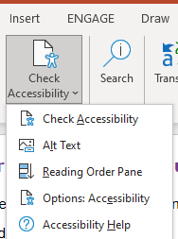
Display the Reading Order Pane
Select Review menu
Select Check Accessibility
Select Reading Order Pane

Slide 59
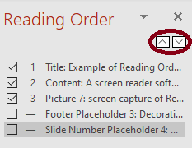
Example of Reading Order
A screen reader software reads the objects on a slide top-down.
Press the up or down arrow to reorder the objects.
Note: Objects without a number will be skipped because they are marked decorative.
Making Technology work for everyone!

Slide 60
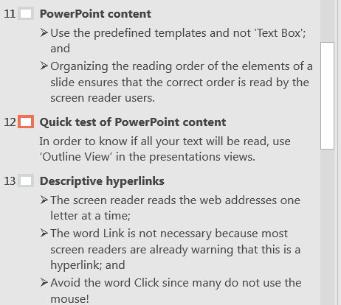
Outline View Pane
Shows accessible text contained in placeholders, such as Title and Content. Those are usually part of an accessible template.

Slide 61
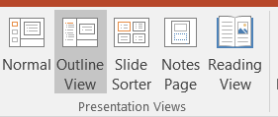
Display Outline View
Go to View ribbon
Select Outline View
Tip: Select Normal to view miniature slides in the left pane.

Slide 62
Accessible chart
Add chart alternative text (Alt-Text). The alternative text should only be a text summary.
For complex charts add the data below the chart.
Add data series outside the chart.
Use different colors with patterns for each value.

Slide 63
Example of an Accessible Pie Chart
Notes:
G111 - Using colour and pattern
http://www.w3.org/WAI/WCAG21/Techniques/general/G111.html
This technique relates to Success Criterion 1.4.1: Use of Colour

Slide 64
Animation and Transition
Keep transitions and animations simple and brief.
Avoid automatic transitions/animations as they limit the time for reading.
Use one transition and animation per slide.
Keeping animations to a minimum or eliminating them will increase the accessibility of your content.

Slide 65
Also applies to PowerPoint
Remember to check for plain language, acronyms, the appearance of text, alternative text for non-text objects, descriptive hyperlinks, the use of colour, and images.

Slide 66
Hands-on exercise for PowerPoint
Open file ‘M365_Accessibility_Practice_PowerPoint’
You have 5 minutes to find the errors in the document
You may list them in the chat or discuss them afterward

Slide 67
Resources
Making Technology work for everyone!
67

Slide 68
Resources on accessibility
Web Content Accessibility Guidelines 2.1: Most criteria apply to documents
The power of plain language: Writing for the government on iService
To get a copy of the Colour Contrast Analyser submit a request to the National Service Desk
Notes:
Color Contrast Analyser: No approval required
It is not in the software catalogue – yet!

Slide 69
Resources on accessibility – part 2
Making your content accessible: Training Videos on Microsoft
Accessibility Curriculum: List of available training related to IT Accessibility on GitHub
Make your content accessible to everyone from Microsoft Accessibility Support

Slide 70
Resources on accessibility – part 3
Digital Accessibility Toolkit: How to create accessible documents - Government of Canada on Github
Canadian Style – Plain Language from TermiumPlus
Microsoft Document Compliance Checklist from ITAO on GitHub

Slide 71
Resources from ITAO
Accessible Information and Communication Technology on iService
IT Accessibility Toolkit on SharePoint
IT Accessibility Office on GitHub

Slide 72
ITAO Contact Information
If you have questions about IT Accessibility or need a document review:
Complete the intake form on iService; or
Send us an email at
edsc.ti-it.a11y.esdc@hrsdc-rhdcc.gc.ca

Slide 73

Questions?
Making Technology work for everyone!
73

