Slide 1

Accessibility Requirements and Best Practices for PowerPoint
Presented by: The Information Technology Accessibility Office (ITAO)
Date: 2025

Slide 2
Purpose
Assist Employment and Social Development Canada (ESDC) employees promote accessibility and inclusion when creating PowerPoint presentations.

Slide 3
Contents
Accessible Templates
Proofing Language
Prebuilt Slide Layouts
Custom Slide Layouts
Layout Placeholder Versus Text Box
Reading Order
Outline View Versus Reading Order Pane
Slide Format
The Accessibility Checker
Using the Accessibility Checker
Font and Text Formatting
Use of Colour
Colour Contrast Ratio Requirements
Descriptive Hyperlinks
Alternative (Alt) Text
Long Descriptions
Alternative Text for Federal Identity Program – 1 of 2
Alternative Text for Federal Identity Program – 2 of 2
Tables
Charts and Graphs
Example Accessible Pie Charts
Audio and Video
Animations and Transitions
Microsoft 365 (M365) Language Preferences
Need more help?
Microsoft PowerPoint Resources

Slide 4
Accessible Templates
The IT Accessibility Office has created an accessible PowerPoint Template available to use. It will start you on the right path!
Steps to use the template:
Open the Accessible PowerPoint Template
Navigate to and select “File” from the menu ribbon
Navigate to and select “Save as”
Select the current file type “PowerPoint Template (*.potx)”, and change it to “PowerPoint Presentation (*.pptx)”
Select your preferred save location and select the “Save” button
Important! An accessible template will start you on the right path. However, accessibility verifications are still required to ensure no barriers are introduced.

Slide 5
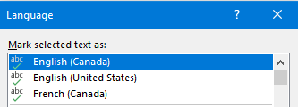
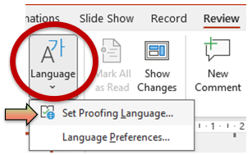
Proofing Language
All PowerPoint text must be set to the correct language. By not setting the proofing language correctly, assistive technology will read content with the incorrect pronunciation.
French text must be identified as French Canada and English must be identified as English Canada.
To set proofing language:
Select the text that you want to set the language of
Navigate to the “Review” menu
Select “Language” and then “Set Proofing Language”
Select the correct language of the selected text and then select “OK”

Slide 6
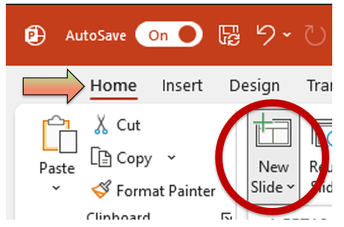
Prebuilt Slide Layouts
Prebuilt Slide Layouts are already designed to be accessible for assistive technology.
How to add a new slide with a Prebuilt Slide Layout:
Go to New Slide available in the Home ribbon
Choose the prebuilt slide that best fits your content requirements

Slide 7
Custom Slide Layouts
Prebuilt slide layouts are an excellent starting point for your presentations. If there is not a slide layout that meets your needs, you can create your own accessible slide layout from the Slide Master view.
To access the Slide Master view:
Navigate to the “View” menu from the ribbon
Select “Slide Master”
Create a new slide or edit an existing one
Select “Insert Placeholder”
Select “Content” type. E.g. Image, text, etc.
If using a mouse, draw a new placeholder on the slide
Select “Content” type. E.g. Image, text, etc.

Slide 8
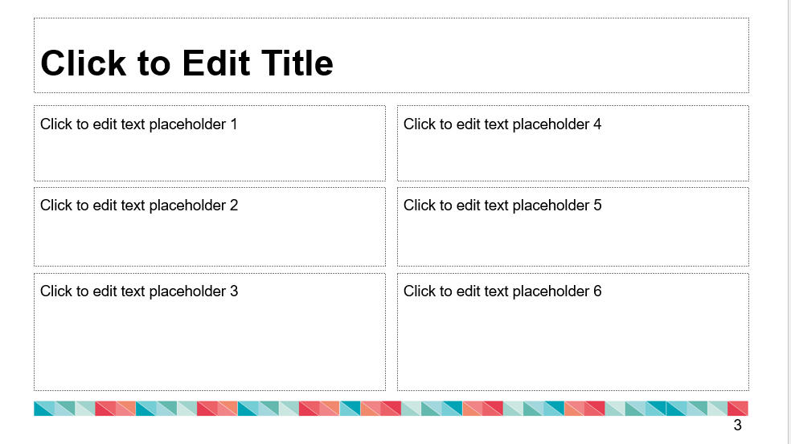
Layout Placeholder Versus Text Box
Recommend!
Enter your text into built in placeholders to make it accessible from the Outline View
Respect sequence established with Prebuilt or Custom Slide Layouts
Avoid
Text entered into Text boxes does not appear in the Outline View Pane
Important! Copying and pasting a placeholder in a slide will not work.

Slide 9
The Accessibility Checker
The Accessibility Checker is a great tool to help build accessible content, but it does not find all issues. All PowerPoint presentations also require manual verification by a human. The following lists show some key issues that can be found automatically, and some that require manual review:
Accessibility Checker
Missing Alt Text
Missing Slide Titles
No Table Headers
Text Contrast
Manual Check
Colour Contrast (other objects)
Accurate Reading Order
Meaningful Descriptive Links
Captions and Transcript Accuracy
Set Proofing Language – English or French Canada

Slide 10
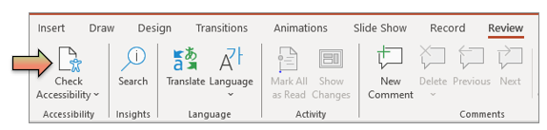
Using the Accessibility Checker
The Accessibility Checker is a fast way to catch accessibility issues that don’t require a manual check.
Use the Accessibility Checker as you build your deck, and in the final stage of review.
To use the Accessibility Checker:
Navigate to and select the “Review” from the menu ribbon
Select the “Check Accessibility” icon. The Accessibility Assistant pane will display.
Select the “Keep accessibility checker running while I work” button

Slide 11
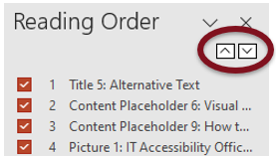
Reading Order
Reading order is the sequence in which assistive technology reads the content on the slide (typically left to right, top to bottom). It is important to verify that the reading order of your slides is in the correct, logical sequence.
To open the Reading Order pane
Navigate to and select “Accessibility” from the menu ribbon
Select “Reading Order Pane”
To change the order of objects:
Select the object and then use arrow buttons to move your objects up or down the reading order list. The top-most object will be announced first
Drag and drop or use up/down arrows to reorder the objects
Important! Unselect the checkbox for decorative objects to ensure they are ignored by assistive technology

Slide 12
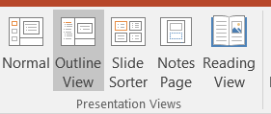
Outline View Versus Reading Order Pane
The Outline View is a feature that lets you see a text-only version of your presentation. It shows the titles and main text of each slide in a hierarchical format, making it easy to see the structure of your presentation.
How to open Outline View:
Navigate to and select “View” from the menu ribbon
Select “Outline View”
Important! Sequence established with Prebuilt or Custom Slide Layouts (available in the Outline View Pane); should be in the same order in the Reading Order Pane. This will ensure all users receive the information in the same order.

Slide 13
Slide Format
Required
Having a unique title for every slide. For duplicate slide Titles, suggest to use "Title (1 of 2)” and “Title (2 of 2)”
Ensuring all slide numbers have sufficient contrast, and are shown in the correct order
Avoid
Having images of text. Use typed text instead.
Having empty placeholders (objects with no content)
Recommend!
Informing readers if any slide has Notes in the notes pane.
Using a maximum of seven bullets per list. (Use sub-bullets if needed)
Ensuring all slide numbers are at least 18 points

Slide 14
Font and Text Formatting
Required
Ensure text can be resized and still be considered readable when magnified to 200%
Avoid
Using large amount of Italic, Bold, Underline
Recommend!
Using 18+ point minimum font size for virtual presentations and 30+ point for conference rooms or other live in-person presentations
Using a consistent font size throughout
Using a limited number of font variations (max. 3)
Using sans serif fonts like Arial, Calibri or Aptos
Avoiding light versions of fonts
Using consistent font types and sizes for headings and body text

Slide 15
Use of Colour
To ensure content accessibility, color choices should prioritize readability and avoid relying solely on color to convey information. This is because colorblindness, low vision, and other visual impairments can make it difficult for users to distinguish between colors, hindering their ability to understand and interact with the content.
Required
Using the Colour Contrast Analyser from the Application Catalogue to test the colour contrast of all text and graphical objects
Ensuring content is perceivable and understandable if colour is completely removed
Avoid
Colour should never be used as the only visual means of conveying information, indicating an action, prompting a response, or distinguishing a visual element. For example, “Mandatory fields are in red”.

Slide 16
Colour Contrast Ratio Requirements
When verifying your content with the Colour Contrast Analyser the intent is to provide enough contrast between text and its background. High contrast ratio means the colors are significantly different in brightness, making them easier to see and read.
For reference:
Normal Text is smaller than 18 points, or 14 points and in bold
Large Text is 18 points or 14 points and in bold or greater
Normal Text needs a greater contrast ratio than graphical objects or Large Text
Required
A minimum contrast ratio of 4.5:1 contrast for all Normal Text
A minimum contrast ratio of 3:1 for Large Text and graphical objects

Slide 17
Descriptive Hyperlinks
Hyperlinks that are descriptive and in a plain language format help users understand where a link will take them, instead of just reading a string of characters from the website address.
To add Descriptive Hyperlinks
Select the link text
Select CTRL-K to create a hyperlink and open the dialogue box
Type the desired descriptive text in the “Text to display” field.
Paste the URL into the address field
Select “OK”
Required
Using hyperlink text that describes where the links leads such as the destination Page Title or Site name E.g. Government of Canada
Avoid
Using generic words like ‘Click here’ or ‘Read more’

Slide 18
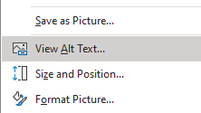

Alternative (Alt) Text
Visual elements such as logos, images, icons, tables, and diagrams, must have an alternative text (‘alt text’) that briefly explains the purpose of the image. If the image does not convey information of value, it must be marked as decorative.
To add Alternative Text:
Right-click the text or object to bring up the contextual menu
Select “View Alt Text…”
Describe the image as though you were telling someone over the phone
Important! Alternative text must be unilingual, concise, and meaningful. Limit your alternative text to a maximum of 140 characters with spaces (170 for French).

Slide 19
Alt Text - Long Descriptions
A long description provides detailed information about an image, chart, or other visual content that can't be fully conveyed through a short alt text. It's especially useful for complex visuals like graphs, or charts.
To add a Long Description
Write “Long Descriptions” in plain text next to or immediately after the object, if possible.
Reference the Long Description in the alt text to connect them together. E.g. “[alt]. Long Description follows”
Use a hyperlink for long descriptions located, in another document, or on an external web page
Reference the visual content in the Long Description Title. E.g. Long description of [content]”
Write a meaningful and descriptive text alternative that contains the same information as the visual content

Slide 20
Alternative Text for Federal Identity Program – 1 of 2
The ESDC banner and the Canada Wordmark are images. Always add alternative text to images representing the department and the federal government.
Important! For the logos and wordmarks, it is recommended to ensure the images display at a size that is visually equivalent to 12 points font. Visit the Departmental signatures for Federal Identity Program as well as the Official symbols: Design Standard for the Federal Identity Program - Canada.ca for more information.

Slide 21
Alternative Text for Federal Identity Program – 2 of 2
Approved Alt text for the Employment and Social Development Canada signature:
• In English: “Employment and Social Development Canada's bilingual banner and word “Canada with small flag”
• In French: “Bannière bilingue d’Emploi et développent social Canada avec le mot Canada et un petit drapeau”
Important! Alternative text must be unilingual. Therefore, two images are required to ensure alternative text is accessible: One French image with French alt text, and an English image with English alt text.

Slide 22
Tables
Required
From the table menu, select the Header Row checkbox to indicate a header for the data table
Avoid
Merging or splitting cells
Leaving empty cells. Suggest to write [none] or [empty] as needed
Recommend!
Using built-in table styles with good contrast
Using an ordered/unordered list when data is simple
Example of an accessible table:
Day | Location | Hours of work
Monday | Office | 8 AM – 4 PM
Tuesday | Office | 8 AM – 4 PM
Wednesday | Remote | 8 AM – 4 PM
Thursday | Remote | 8 AM – 4 PM
Friday | Office | 8 AM – 4 PM

Slide 23
Charts and Graphs
Required
Adding alternative text summarizing chart and graph images
Having sufficient colour contrast (3:1)
Avoid
Relying on colour alone to convey meaning
Recommend!
Adding a Title for all Chart and Graphs
Using patterns to better distinguish coloured sections of your charts and graphs
Adding data values next to or inside the chart for clarity
Adding an equivalent table of the chart data

Slide 24
Example of an Accessible Pie Chart

Slide 25
Audio and Video
Required
All audio must have closed captions and transcription available.
Recommend!
When using PowerPoint Live in Teams embed the video (with captions) in a PowerPoint file so that participants can:
Turn captions on/off
Navigate slides independently
Use screen readers more effectively

Slide 26
Animations and Transitions
Recommend!
Having one transition and animation at most per slide (if needed)
Using simple transitions and animations only
Avoid
Avoid content flashing more than 3 times per second
Avoid automatic transitions/animations as they limit the time for reading

Slide 27
Microsoft 365 (M365) Language Preferences
Important
Your M365 language preferences determines the language of the placeholders in the Selection Pane and Reading Order Pane when you add new slides
Recommend!
To create French content: Set your M365 Language Preferences to French
To create English content: Set your M365 Language Preferences to English
If you do not wish to change your M365 Language Preferences:
Use the Selection Pane to rename Placeholders in the proper language
Or
Duplicate preexisting slides to replicate the slides rather than adding a New Slide. This will replicate placeholders' languages.

Slide 28

Need more help?
Contact Us
ITAO intake form
Email us: EDSC.TI-IT.A11Y.ESDC@hrsdc-rhdcc.gc.ca
Additional Accessibility Information
ITAO Intranet
ITAO GitHub

Slide 29
Microsoft PowerPoint Resources
IT Accessibility office - Accessible Documents Link
Accessibility Best Practices For PowerPoint Documents
Microsoft Document Compliance Checklist
Microsoft Support - Make your PowerPoint presentations accessible to people with disabilities
Video: Present inclusively with PowerPoint - Microsoft Support

