Slide 1
SE 2228-Analysis and Design of Algorithms
Analysis-1
Review of Basic Concepts

Slide 2
Review of Basic Concepts
Suppose we have two algorithms, how can we tell which one is better?
We could implement both algorithms, run them both
Experimental evaluation : Expensive and error prone
Preferably, we should analyze them mathematically
Algorithm analysis
For this ,we need to use description of the algorithm together with the properties of an associated data structure in a machine-independent way

Slide 3
Running Time
How to quantify the machine independent running time of an algorithm?
Count the Number of basic steps that are executed
Most statements roughly require the same amount of time
We can be more exact if need be
Obtain Worst case and average case numbers of steps
Using standard time units (sec, msec…) is not appropriate
Counting all operations is not appropriate
Reasonable Approach: Identify and count the basic operation(s) in the algorithm.

Slide 4
Asymptotic Performance
Asymptotic performance: How does an algorithm behave as the problem size gets very large?
Time efficiency
Storage requirements
Network usage
Remember that we use the RAM model:
All memory cells are equally expensive to access
No concurrent operations
All reasonable instructions take unit time
Except, of course, function calls
Usually, time efficiency is more important.

Slide 5
Measuring Efficiency :Types of Mathematical Functions
y = xª : power function
y = a^{x} : exponential function

Slide 6
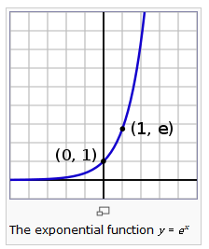
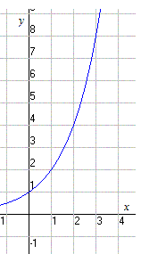
The Exponential Function
y = b^{x} , b>1 , b - base
y=2^{x}

Slide 7
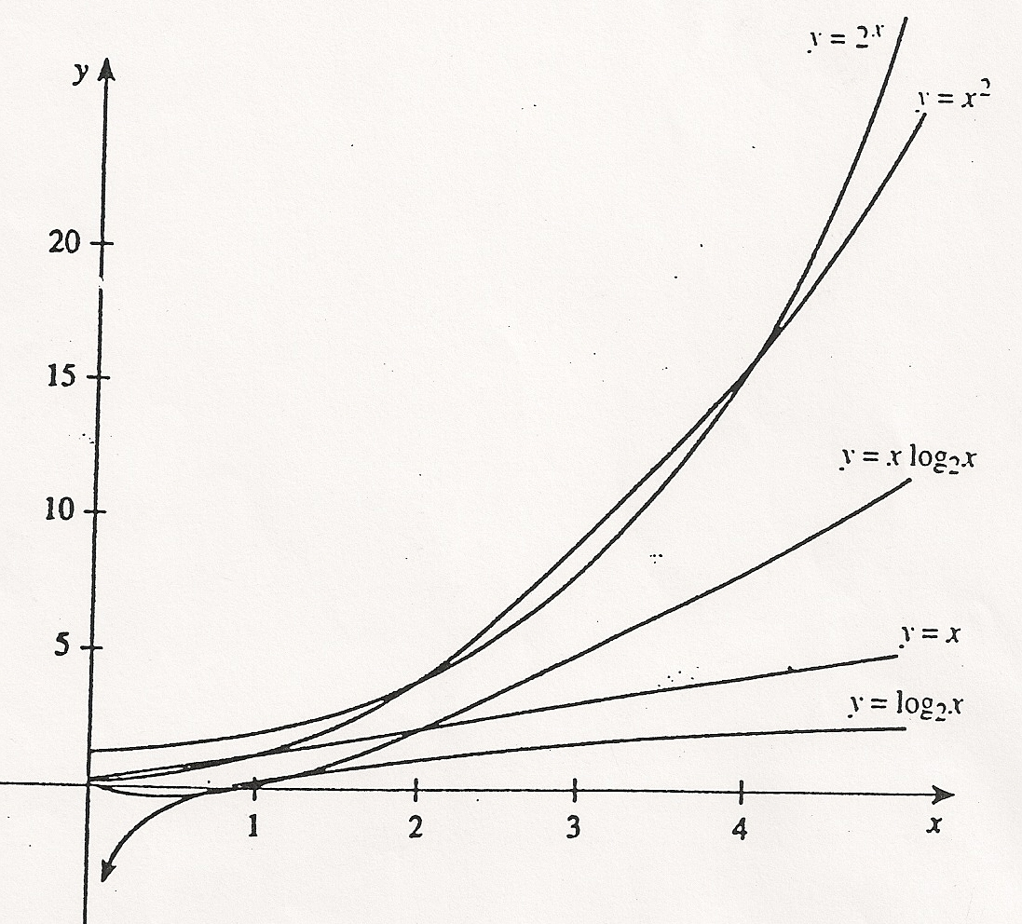
Comparison of Functions

Slide 8
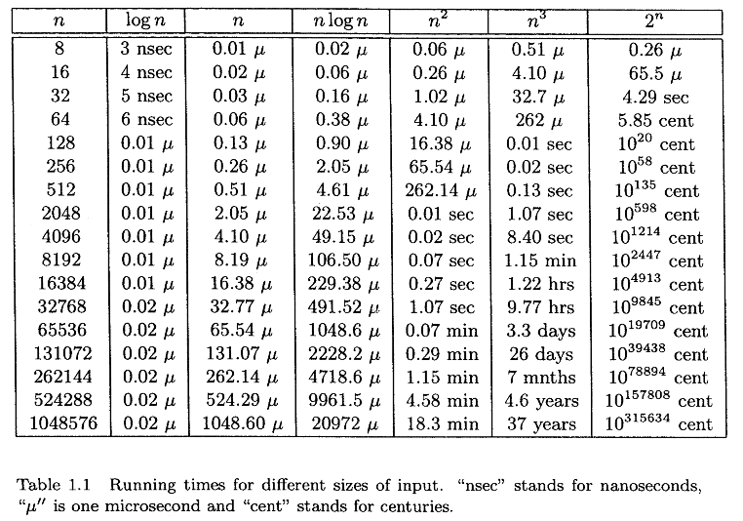
Assume a function represents the number of operations executed and one operation takes 1 ns. Time needed for input size n:

Slide 9
How to Define Time Efficiency
Problematic to measure the absolute running time
Depends on the size of the instance
For instances of the same size, may depend on:
Computer
Programming language, compiler operating system
Details of implementation, skills of programmer
………..
Therefore absolute time measures are not appropriate and not used

Slide 10
How to Define Time Efficiency
We want the measure to be machine-independent, language-independent, etc. , and should survive technological advances.
We are mainly concerned about large values of n.
We don’t use the absolute time, but rather use
rate/order of growth.
Recall that the efficiency functions are non-decreasing
Order is an asymptotic notation – we are only interested what happens for large n.

Slide 11
How to Define Time Efficiency
Assume we have come up with some constant c > 0, such that the running time is at most cn². The value of c becomes inconsequential as n gets bigger and bigger.
If we compare algorithms A and B that take times cn² and dn³: t_{B}/t_{A} = dn³/cn² = (d/c) * n;
For big n, the ratio d/c also has insignificant effect.
Therefore we say A is of order n², and B is of order n³, disregarding the constants.
If two algorithms are of the same order, only then we may consider the constants to determine which algorithm is preferable.

Slide 12
Using the Input Size
Time efficiency → the number of repetitions of the basic operations as a function of input size
Input size is influenced by
the data representation, e.g. matrix, list , tree…
the basic operations of the algorithm, e.g. computations, string operations, pointer usage…
the properties of the objects in the problem, e.g. checking if a given integer is a prime number
Basic Operations :
Applied to all input items in order to carry out the algorithm
Contribute most towards the running time of the algorithm

Slide 13
Examples
Problem | Size of input
Find x in an array | The number of the elements in the array
Multiply two matrices | The dimensions of the matrices
Sort an array | The number of elements in the array
Traverse a binary tree | The number of nodes
Solve a system of linear equations | The number of equations, or the number of the unknowns, or both

Slide 14
Time Cost of an Algorithm
Exact formula : Assume the cost is
C(n) = n(n-1)/2
Approximate formula: indicating order of growth with unknown multiplicative constant : C(n) ≈ c n²
Let
T(n): running time c_{op} : execution time cost for a basic operation
C(n) : number of times the basic operation is executed Then for a basic operation we have: T(n) ≈ c_{op} C(n)

Slide 15
Growth Rates
In general we only worry about growth rates because:
Our main objective is to analyze the cost performance of algorithms.
Another obstacle to having the exact cost of algorithms is that sometimes the algorithms are quite complicated to analyze.
When analyzing an algorithm we are not that interested in the exact time the algorithm takes to run .
→What makes one algorithm more desirable than another is its growth rate relative to the other algorithm’s growth rate.

Slide 16
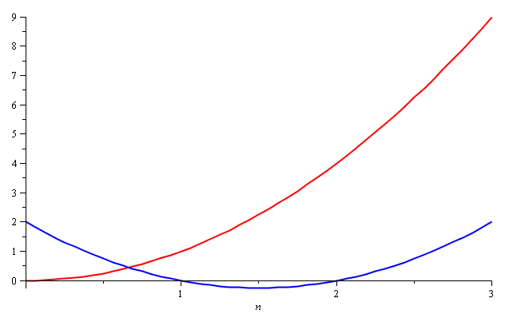
Similar Growth Rates :Quadratic Growth
The meaning of asymptotic growth: Consider the two functions:
f(n) = n² and g(n) = n² – 3n + 2 . Which one is better ?
Around n = 0,1,2,3… they look very different!

Slide 17
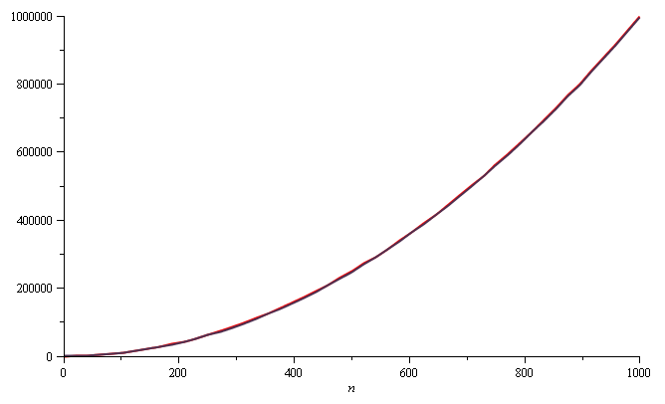
Similar Growth Rates :Quadratic Growth
Yet on the range n = [0, 1000], they are (relatively) indistinguishable:

Slide 18
Similar Growth Rates :Quadratic Growth
The absolute difference is large, for example,
f(1000) = 1 000 000
g(1000) = 997 002
But the relative difference is very small:
This difference goes to zero as n → ∞
→Asmptotically, the behaviors of f(n) and g(n) is the same.

Slide 19
Polynomial Growth
The justification for both pairs of polynomials being similar is that, in both cases, they each had the same leading term with the same coefficient : n²
Suppose however, that the coefficients of the leading terms were different
In this case, both functions would exhibit the same rate of growth, however, one would always be proportionally larger.

Slide 20
Reminder : Different Notions of Complexity
Worst case complexity of an algorithm A :
the maximum number of computational steps required for its execution over all the inputs of the same size, s. It provides an upper bound for an algorithm. The worst that can happen given the most difficult instance:
the pessimistic view.
Best case complexity of an algorithm A -the minimum number of computational steps required for its execution over all the inputs of the same size, s. The most optimistic view of an algorithm– it tells us the least work a particular algorithm could possibly get away with the easiest input of a given size.

Slide 21
Average Case Complexity
Average case complexity of an algorithm A - i.e., the average amount of resources the algorithm consumes assuming some plausible frequency of occurrence of each input.
Determining the average cost is much more difficult than determining either the worst or best-cost.
→ we have to assume a given probability distribution for the types of inputs we may get.

Slide 22
Which Case ?
To which case should we base our algorithm/Program design?
“Life teaches us to be always prepared for the worst!”
Remember Murphy's laws :
Anything that can go wrong will go wrong.
Left to themselves, things tend to go from bad to worse
Everything goes wrong all at once.
Every solution breeds new problems.
Smile , tomorrow will be worse!

Slide 23
Example : Sequential (Linear) Search
Problem: Given a list of n elements and a search key K, find an element equal to K, if any.
Informal Algorithm: Scan the list and compare its successive elements with K until either a matching element is found (successful search) or the list is exhausted (unsuccessful search)
Number of comparisons:
Worst case: c_{n} = n
= O(n)
x is either not in the list or it is in the last position
Best case: c_{n} = 1
= O(1)
x is the first element of the list

Slide 24
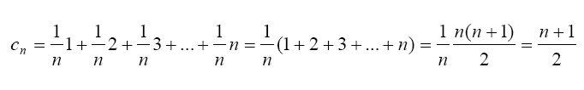
Average Case Analysis
We need a probability distribution for finding the key in position i.e.Assume every position is equally likely
This is called the Uniform distribution.
The expected value of n for the uniform distribution can be expressed as:
f(n)= ∑ p_{i}(f_{i}(n)) ,where p_{i}=1/n.Expected number of comparisons: ^{i} ^{So that}
So that c_{n} = O(n)

Slide 25
Example: Sequential Search
If n = 1000000
Best case c₁₀₀₀₀₀₀ = 1
Worst case c₁₀₀₀₀₀₀ = 1000000
Average case : c₁₀₀₀₀₀₀= 500000
Question repeated:
To which case should we base our algorithm/Program design?
Remember: “Life teaches us to be always prepared for the worst!”
“I am prepared for the worst, but hope for the best.”
Benjamin Disraeli
We have a saying in Turkish:
“Sen tedbirini kış tut, yaz çıkarsa bahtına.”

Slide 26
Reminder :Upper Bound(Big - O) Notation
In general a function f(n)
is O(g(n)) if there exist positive constants c and n₀ such that
f(n) ≤ c ⋅ g(n) for all n ≥ n₀
When we say f (n) = O(g(n))
we really mean f (n) ∈ O(g(n)) .
Example : n ² + 42n + 7 = O(n ² ) means:
The function f (n) = n ² + 42n + 7
is an element of the set O(n ² )

Slide 27
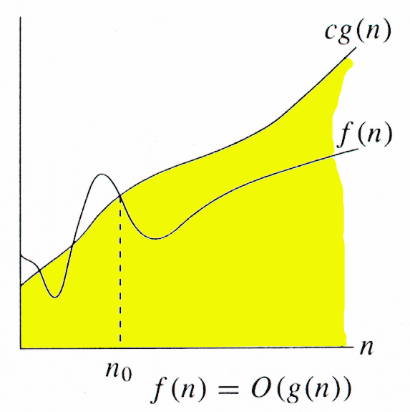
Big O-notation
For function g(n), we define O(g(n)), big-O of n, as the set:
O(g(n)) = {f(n) : ∃ positive constants c and n_{0,} such that ∀n ≥ n₀,
we have 0 ≤ f(n) ≤ cg(n) }
Intuitively: Set of all functions whose rate of growth is the same as or lower than that of g(n).
g(n) is an asymptotic upper bound for f(n).
f(n) = Θ(g(n)) ⇒ f(n) = O(g(n)).
Θ(g(n)) ⊂ O(g(n)).

Slide 28
Example : Illutration
f(n)= 2n+5 is O(n) [ c=3 and n₀=5]
3n
2n+5
2n+5
n
Point where 3n “beats” 2n+5
We are not concerned of n < 5.
5
2n+5 is O( n )

Slide 29
Big-O Examples
2n + 10 is O(n)
2n + 10 ≤ cn
(c − 2) n ≥ 10
n ≥ 10/(c − 2)
Pick c = 3 and n₀ = 10
The function n² is not O(n)
n² ≤ cn
n ≤ c
The above inequality cannot be satisfied since c must be a constant
3n³ + 20n² + 5 is O(n³)
need c > 0 and n₀ ≥ 1 such that 3n³ + 20n² + 5 ≤ c•n³ for n ≥ n₀
Simplifies to : (c-3) n³ - 20n² ≥ 5, Take c =4 → n³ ≥ 20n²⁺5
This is true for c = 4 and n₀ ≥ 21 (Other pairs can also be found)
3 log n + 5 is O(log n)
need c > 0 and n₀ ≥ 1 such that : 3 log n + 5 ≤ c•log n for n ≥ n₀
Simplifies to (c-3) log n) ≥ 5.
This is true for c = 4 and n₀ = 32 and many other pairs.

Slide 30
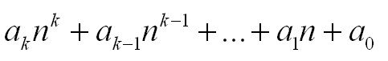
Simplifying Big-O
Theorem:
If f(n) is a polynomial time complexity function of order k and a_{k}>0 (the other coefficients may be positive or negative) then f(n)=O(n^{k}) .
Example: f(n) =
Implication: Only the highest order term is important.
We can ignore the rest (lower order terms and coefficients).
Example : f(n)= n³ + 12 n²-8n+45 =O(n³)

Slide 31
Practice Problems
The complexity of algorithm A is given as O(n²).
For an input size of n=4,the algorithm runs for 20 ms.
How long can you expect it to take to run on an input size of n=16?
We’re given f(n) = n² ,n = 4, and time = 10ms
Time for size 16 would be proportional to 16 ²
so that the time neded for n = 16 can be expressed as
( (16 ²) /4² ) *20
= 320 ms

Slide 32
Practice Problems
2 ) The complexity of algorithm A is O(log n).
For an input size of 16, the algorithm runs for 56 ms.
How long can you expect it to take to run on an input size of 64?
The time needed for input size 64 is proportional to log 64:
→The time needed for n=64 :
[log (64)) / log (16)]*56 ms
= [6/4]*56
=84 ms

Slide 33
Basic asymptotic efficiency classes Note :These order classes are upwardly inclusive, i.e., if T(n) = O(log(n), then of course, T(n) = O(n).
1 | constant
log n | logarithmic
n | linear
n log n | nlogn
n² | quadratic
n³ | cubic
2^{n} | exponential
n! | factorial

Slide 34
Lower Bound : (Big- Omega) Notation Definition:
O-notation provides an asymptotic upper bound on a function f(n).
Similarly -notation provides an asymptotic lower bound on a function f(n).
Notes:
34

Slide 35
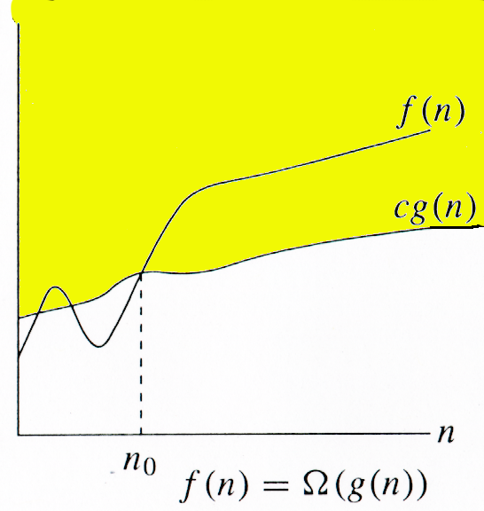
Ω -notation
For function g(n), we define Ω(g(n)), big-Omega of n, as the set:
Ω(g(n)) = {f(n) : ∃ positive constants c and n_{0,} such that ∀n ≥ n₀,
we have 0 ≤ cg(n) ≤ f(n)}
Intuitively: Set of all functions whose rate of growth is the same as or higher than that of g(n).
g(n) is an asymptotic lower bound for f(n).
f(n) = Θ(g(n)) ⇒ f(n) = Ω(g(n)).
Θ(g(n)) ⊂ Ω(g(n)).

Slide 36
- Notation :Illustration
f(n)= Ω(g(n)) for all n>=1
n₀=1
n
Notes:
36

Slide 37
-Notation Examples
Example 1: f(n)= n³ is Ω (n²) for all n>1. Because n³> n² for all n>1.
Example-2 : f(n) = 2n³ - 7n + 1 is Ω(n³)
Here g(n) = n³
Choose n₀= 3, c = 1,
then for all n >= n₀,
2n³ - 7n + 1 > = n³ because for n=3 and c=1 we have
2.27 -7*3 +1 >=27 (Check for n=4)
Example-3 : f(n)= n ³ - 4n ² = Ω(n ² )
g(n) = n ²
Choose c=1 then
n³ >= 5 n²
→ n >=5 so we have
n ³ - 4n ² > = n ² for all c=1 and n >=5 .

Slide 38
- Notation (Big Theta)
Notes:
38

Slide 39
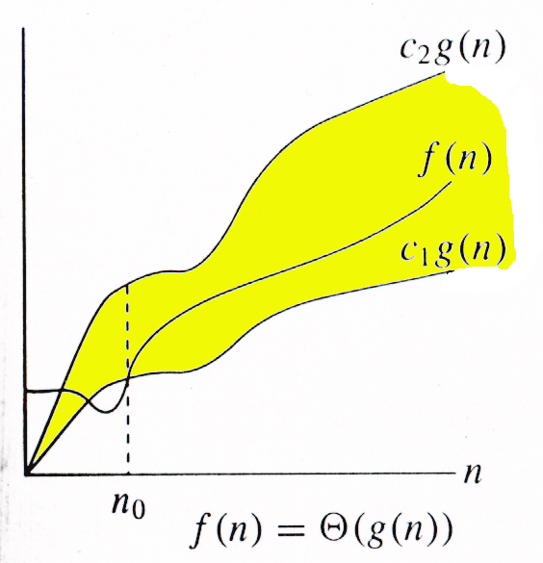
Θ-notation
For function g(n), we define Θ(g(n)), big-Theta of n, as the set:
Θ(g(n)) = {f(n) : ∃ positive constants c₁, c₂, and n_{0,} such that ∀n ≥ n₀,
we have 0 ≤ c₁g(n) ≤ f(n) ≤ c₂g(n)
}
Intuitively: Set of all functions that
have the same rate of growth as g(n).
g(n) is an asymptotically tight bound for f(n).

Slide 40
Relations Between O, Ω,Θ
→Θ(g(n)) = O(g(n)) ∩ Ω(g(n))

Slide 41
Examples : O, Ω ,Θ
10n² ∈ O(n²)
10n² + 2n ∈ O(n²)
100n + 5 ∈ O(n)
5n+20 ∈ O(n)
10n² ∈ Ω(n²)
10n² + 2n ∈ Ω(n²)
10n³ ∈ Ω(n²)
10n² ∈ Θ(n²)
10n² + 2n ∈ Θ(n²)
(1/2)n(n-1) ∈ Θ(n²)

Slide 42
Classifying Growth Functions
Given functions f (n) and g(n) we might like to
determine if one grows faster than the other.
To do this we take the limit of the two functions as n grows to infinity
If the limit goes to zero, then f (n) is in O(g(n)).
If this limit goes to ∞, then f (n) is in Ω(g(n)).
If the limit goes to a constant then f (n) is in Θ(g(n)).
Notes:
42

Slide 43
Rules to manipulate Big-Oh
Let T1(N) and T2(N) be run times such that:
T1(N) = O( f(N) ), T2(N) = O( g(N) )
Then,
T1(N) + T2(N) = max( O( f(N) ), O( g(N) ) )
T1(N) * T2(N) = O( f(N) * g(N))
If T(N) is a polynomial of degree k, then T(N) = Θ(N^{k}) = O(N^{k} ).

Slide 44
Growth-Rate Functions:Practice
If an algorithm takes 1 second to run with problem size 8, find the time requirement (approximately) for that algorithm with problem size 16, for the following orders:
O(1) ➔ T(n) = 1 second
O(log₂n)➔ T(n) = (1*log₂16) / log₂8 = 4/3 seconds
O(n) ➔ T(n) = (1*16) / 8 = 2 seconds
O(n*log₂n)➔ T(n) = (1*16*log₂16) / 8*log₂8 = 8/3 seconds
O(n²) ➔ T(n) = (1*16²) / 8² = 4 seconds
O(n³) ➔ T(n) = (1*16³) / 8³ = 8 seconds
O(2^{n}) ➔ T(n) = (1*2¹⁶) / 2⁸ = 2⁸ seconds = 256 seconds
44

Slide 45
Summary : Asymptotic Notations
O notation: asymptotic “less than”:
f(n)=O(g(n)) implies: f(n) “≤” g(n)
Ω notation: asymptotic “greater than”:
f(n)= Ω (g(n)) implies: f(n) “≥” g(n)
Θ notation: asymptotic “equality”:
f(n)= Θ (g(n)) implies: f(n) “=” g(n)

