Slide 1

Supporting Social Relationships Through Nostalgia And Reminiscence
SOCIAL AND MOBILE COMPUTING: DECO 3500/7660
Team - NO_PARKING!
Notes:
Hi all! We are Team , and our team name is . Our project focuses on supporting relationships through nostalgia and reminiscence. We will be exploring what kinds of relationships these are, how people connect to memories, the objects that carry those memories, and more. Since this course is about Social and Mobile Computing, our focus is specifically on how people connect with or experience nostalgia together not just as an individual experience, but a shared one. To start, we spoke to tutors and students, and looked into existing research papers online, what kind of work has been done

Slide 2
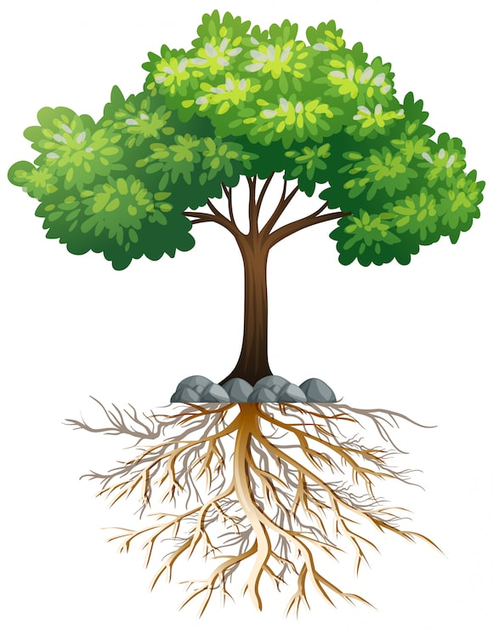
Hello!
Design Experts
Collaborative
Empathetic
Researchers
Human-centered
Cross-disciplinary
Analytical
Strategic Clarity
Dong
Vim
Dev
Shirish
Dattatray
Notes:
Our combined, diverse backgrounds in law, business, market strategy and analysis, and design and now converging into IT, design, and research, will help us shape this experience understanding the space, digging into the why, identifying current gaps, and executing effectively for this course. We also bring strong visual and design backrounds, alongside technical development experience. And since we're all in our final year, team coordination and mutual understanding should come naturally.

Slide 3




The Domain
Supporting relationships through nostalgia & reminiscence
WHY IT MATTERS
Recreative Curation
Digital VS. Physical asymmetry
Deliberately unopened memories
Contested Inheritance
Place-Triggered recall
Socially learned methods
Branches of Nostalgia
Personal vs Collective
Restorative vs Reflective
Social vs Sensory
Evidence: 3 semi-structured interviews — ages 60+, late 20s, early 20s
Notes:
Domain: We're looking at how people preserve and revisit memories, and how that affects their relationships and connection to their own past.
Why it matters:
- Reactive curation: nobody decides what matters upfront - they only sort it out once forced to, like running out of storage.
- Digital vs physical asymmetry: people hoard physical items because space feels endless, but delete digital memories constantly because storage runs out.
- Deliberately unopened memories: one interviewee kept a video of her grandmother she's never watched - preservation isn't always about wanting to revisit.
- Contested inheritance: some want to pass down objects, others explicitly want to pass down values instead - no consensus.
- Place-triggered recall: two interviewees independently described memories flooding back just from visiting a childhood location.
- Socially-learned methods: people are picking up preservation tricks like flower-drying from Instagram, not from family.
Evidence: Based on 3 semi-structured interviews across age groups - 60+, late 20s, early 20s.
Branches of nostalgia: personal (your own past) vs collective (shared cultural past); restorative (wanting it back) vs reflective (making peace with it); social nostalgia specifically tied to people, which ties back to our domain title; and sensory triggers as the practical entry point - smell, music, place, photos.

Slide 4
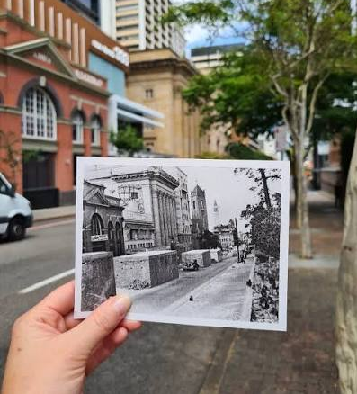
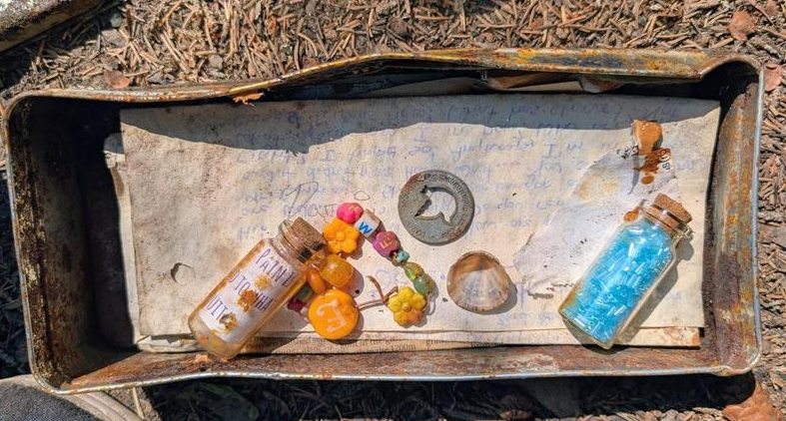
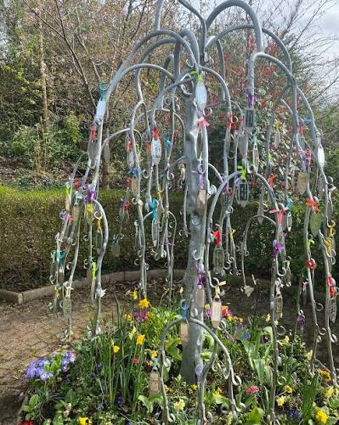
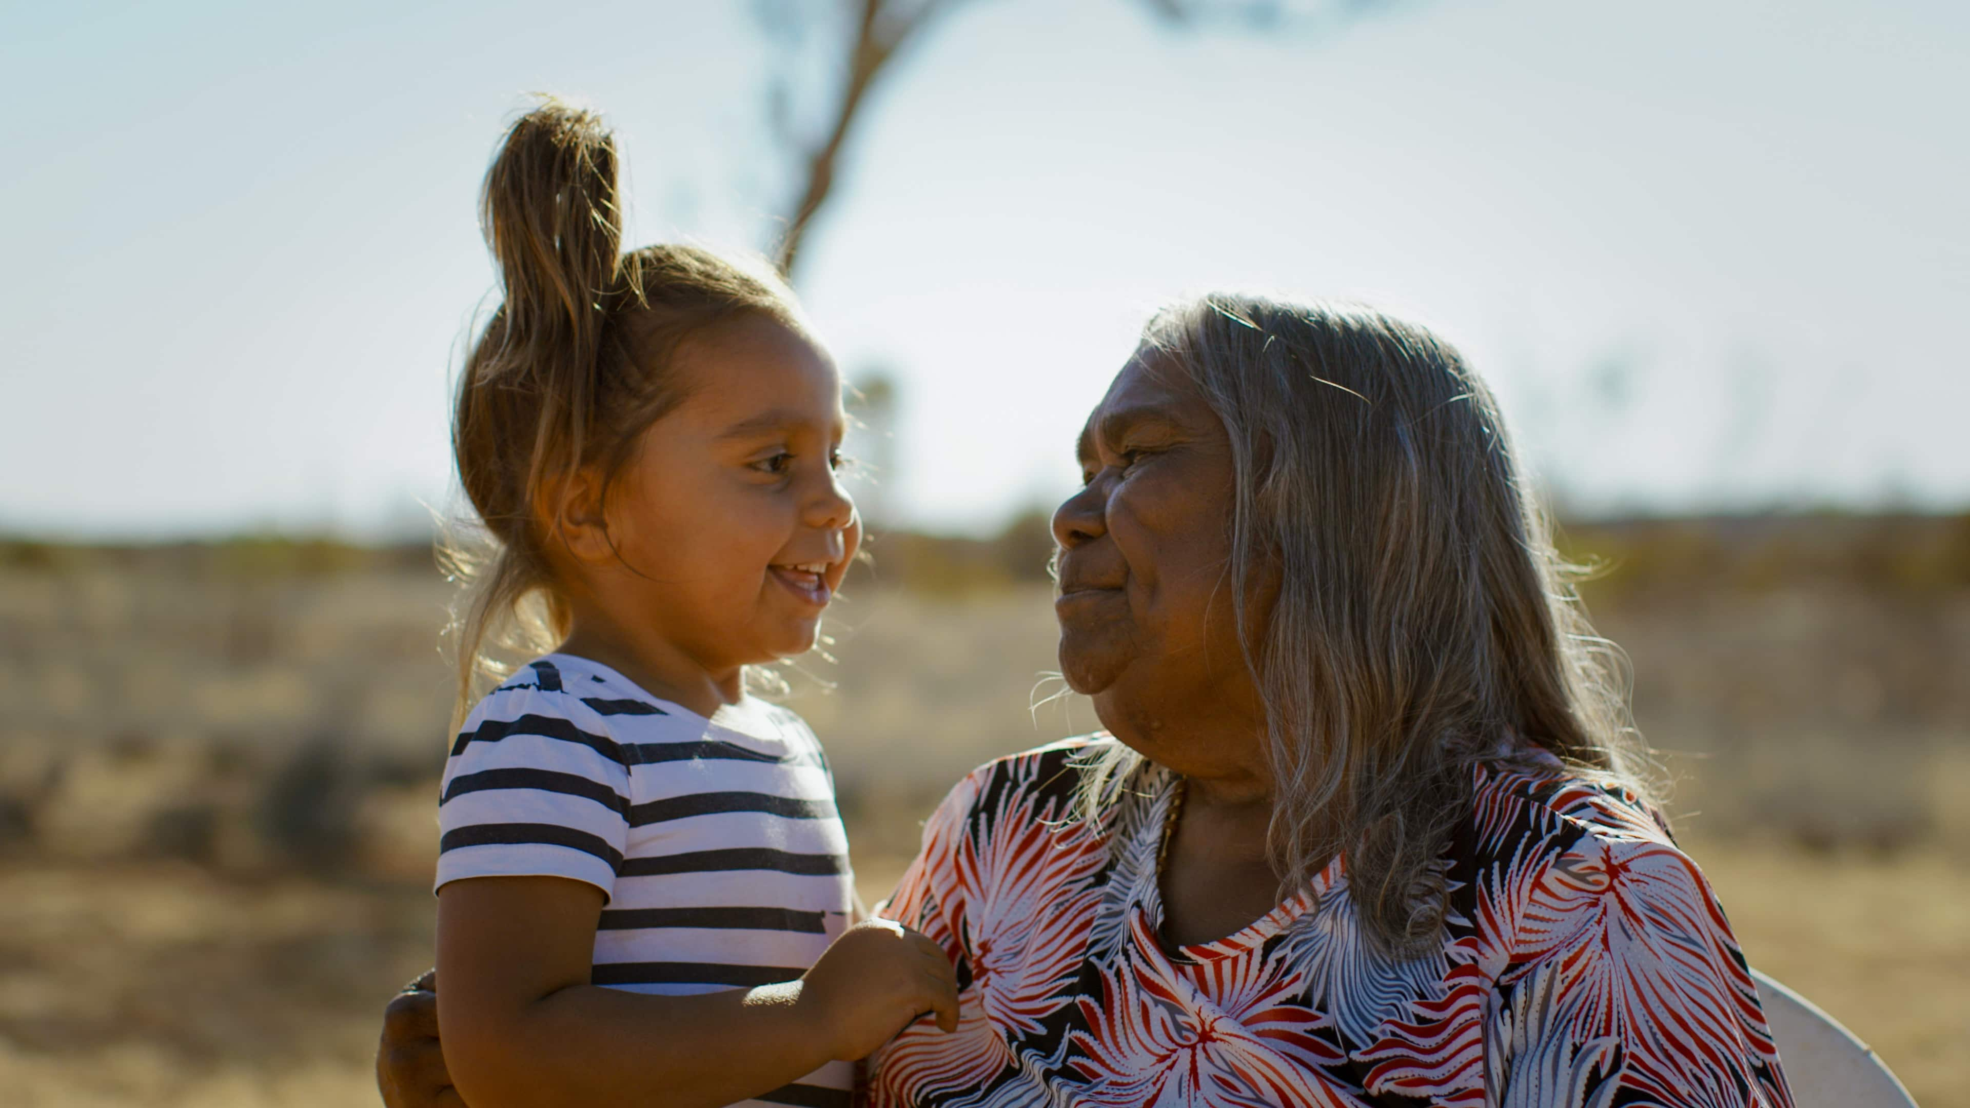

Design Opportunity, Concepts Backed By Research
What did it look like then?
Digital time capsule
Collective Audio Tree
Ancestral language preservation fragmented elder knowledge
A memory lasts by emotional significance, identity relevance (Wardell & Palombo, 2024)
People typically preserve memories through external artefacts like photographs, videos, and messages (Wardell & Palombo, 2024)
Compared to physical mementoes of memories, digitally created memories tend to feel less significant and forgotten easily (Petrelli & Whittaker, 2010)
Autobiographical remembering serves ongoing psychological needs (Bluck et al., 2005;)
Memories can remain accessible for decades (Hirst et al., 2015)
Notes:
A shared audio capsule for a family or friend group. Each member records periodically (weekly/monthly). Individual recordings show up as living visual elements on a shared tree flowers glow when someone's doing well, leaves dim when someone's struggling. Once a year, at a "harvest" point, accumulated recordings crystallize into fruit a compiled memory of what the group grew through together.
1- Digital time capsule – time capsules are done among a group of friends of any age and mix to collectively preserve their memories in a container to revisit it after a certain agreed number of years. For example, a group of friends in a university, in their graduation party would get together and put some class notes, photos, notes to future selves, uni memorabilia, and various items into a container and bury it in a marked place and pledge to get together after 20 years to unearth it and cherish their memories. We want to extend this experience to have a mobile and digital experience given the challenges of full-physical time capsule like limited space to bury, rapidly changing landscapes and geographical distances of people from one another (friends).
2- What did it look like then? - People both locals and visitors alike often wonder how certain places looked like in the past and how it changed over the time. Photographic preservation of 'places' often happen spontaneously without intentional preservation for the future. Specially public places. For example - what did this house look like in 2015 might be a very difficult thing to visualise and refer, unless someone accidently took a picture then, often not archived. We want to explore a social collaboration which supports creating these memories by installing signals which reminds public to take a picture of the object and upload it to the identified destination in the public web. The signal, imagine a light installed on a lamp-post by the great-court at UQ would turn red on a given month annually which is the signal for somebody who walks by to take a picture and upload it to the memory time-line of the great-court.
Bluck, S., Alea, N., Habermas, T., & Rubin, D. C. (2005). A tale of three functions: The self-reported uses of autobiographical memory. Social Cognition, 23(1), 91–117. https://doi.org/10.1521/soco.23.1.91.59198
Conway, M. A. (2005). Memory and the self. Journal of Memory and Language, 53(4), 594–628. https://doi.org/10.1016/j.jml.2005.08.005
Hirst, W., Phelps, E. A., Meksin, R., Vaidya, C. J., Johnson, M. K., Mitchell, K. J., Buckner, R. L., Budson, A. E., Gabrieli, J. D. E., Lustig, C., Mather, M., Ochsner, K. N., Schacter, D. L., Simons, J. S., Lyle, K.
B., Cuc, A. F., & Olsson, A. (2015). A ten-year follow-up of a study of memory for the attack of September 11, 2001: Flashbulb memories and memories for flashbulb events. Journal of Experimental Psychology: General, 144(3), 604–623. https://doi.org/10.1037/xge0000055
Petrelli, D., & Whittaker, S. (2010). Family memories in the home: Contrasting physical and digital mementos. Personal and Ubiquitous Computing, 14(2), 153–169. https://doi.org/10.1007/s00779-009-0277-7
Wardell, V., & Palombo, D. J. (2024). Stability and malleability of emotional autobiographical memories. Nature Reviews Psychology, 3(6), 393–406. https://doi.org/10.1038/s44159-024-00312-1

Slide 5
Slides 4: Audience, prior attempts
Your intended audience go beyond demographics: their skills, values, workflows, priorities
-General audience - uni friends, work mate, highschool friends, sports team
A critique of existing solutions in this space and how yours differs
- Openitlater, Timecapsule.com, Capsuled, PersonalCapsule, Day One
Do not edit, remove this slide. Use a new slide in sequence for your work. Use this slide to assist your work and evaluate

Slide 6
Plan of Work & Methods
What we still need to find out, and how we'll investigate it
STILL TO FIGURE OUT
HOW WE'LL INVESTIGATE IT
Which concept direction fits real groups
Nostalgia vs. reflective-memory framing
Will groups commit to a future “vow to return”?
How our gap differs from existing solo-focused tools
Competitor teardown (3 existing tools)
User interviews across group types
Converge on one concept direction
Low-fidelity prototype + small test
TIMELINE
Wk 5–7
Wk 7–8
Wk 9
Wk 10–12
Wk 13
Interviews + converge on concept
Requirements + low-fi prototype
Stand-up: research, prototype, first testing
Build + refine, prep poster/pitch
Final documentation submitted
Notes:
Still to Figure Out
Which concept direction fits real groups
We have several variations on the table at the moment, like a simple digital time-capsule, digital memory bubble, house stories, NFC tags to access memories, Digital memory museum, Digital reunion, etc.
We as a group don’t yet know which one actually resonates with people vs which one sounds interesting to them
Nostalgia vs. Reflective-memory
our research lead to an important distinction
Do individuals look back fondly for the nostalgia or do they grow from a memory and reflect
Both can lead to different design
Need to find out which framing our target audience want
Will group of people commit to the “vow to return”
This is the core concept of our domain topic but not tested
Does shared future date get honoured in real life? Or does it become something groups abandon
How our gap differs from existing solo-focused tools
Several existing time capsule apps already exist as mentioned before, but most appear for individual use.
Research and understand why no one has built a group version yet.

Slide 7
References
Bluck, S., Alea, N., Habermas, T., & Rubin, D. C. (2005). A tale of three functions: The self-reported uses of autobiographical memory. Social Cognition, 23(1), 91–117. https://doi.org/10.1521/soco.23.1.91.59198
Conway, M. A. (2005). Memory and the self. Journal of Memory and Language, 53(4), 594–628. https://doi.org/10.1016/j.jml.2005.08.005
Hirst, W., Phelps, E. A., Meksin, R., Vaidya, C. J., Johnson, M. K., Mitchell, K. J., Buckner, R. L., Budson, A. E., Gabrieli, J. D. E., Lustig, C., Mather, M., Ochsner, K. N., Schacter, D. L., Simons, J. S., Lyle, K. B., Cuc, A. F., & Olsson, A. (2015). A ten-year follow-up of a study of memory for the attack of September 11, 2001: Flashbulb memories and memories for flashbulb events. Journal of Experimental Psychology: General, 144(3), 604–623. https://doi.org/10.1037/xge0000055
Petrelli, D., & Whittaker, S. (2010). Family memories in the home: Contrasting physical and digital mementos. Personal and Ubiquitous Computing, 14(2), 153–169. https://doi.org/10.1007/s00779-009-0277-7
Wardell, V., & Palombo, D. J. (2024). Stability and malleability of emotional autobiographical memories. Nature Reviews Psychology, 3(6), 393–406. https://doi.org/10.1038/s44159-024-00312-1

