Slide 1
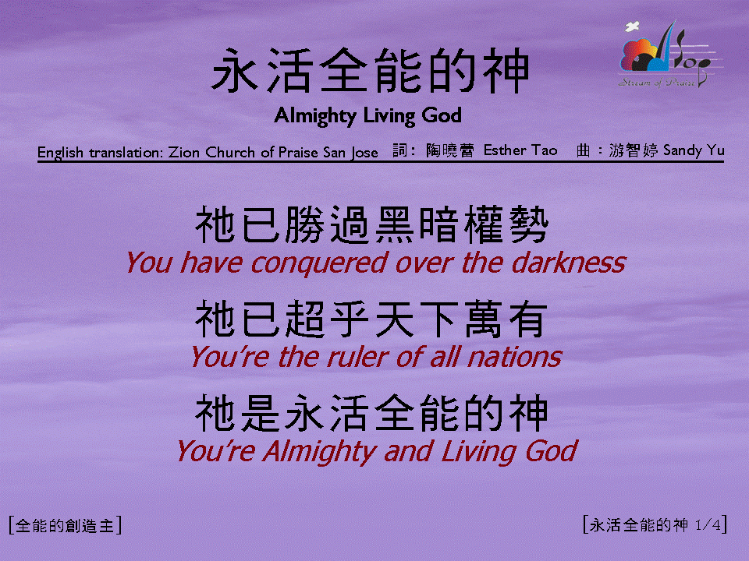
永活全能真神 (1/4)
[Almighty Living God]

Slide 2
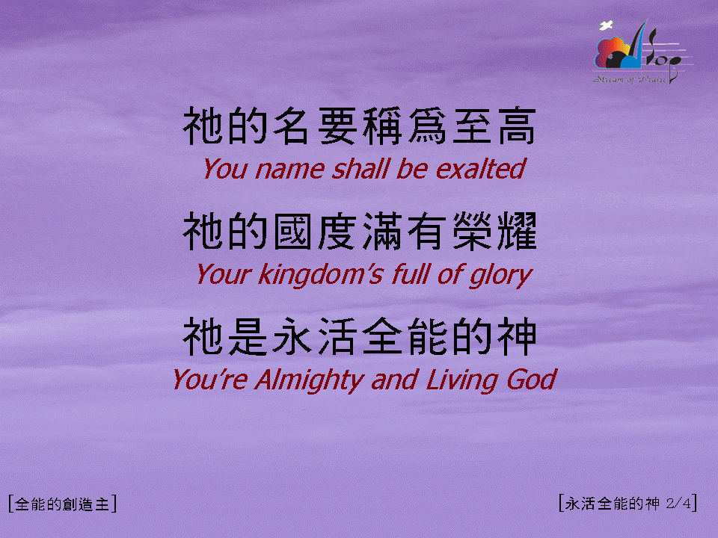
永活全能真神 (2/4)
[Almighty Living God]

Slide 3
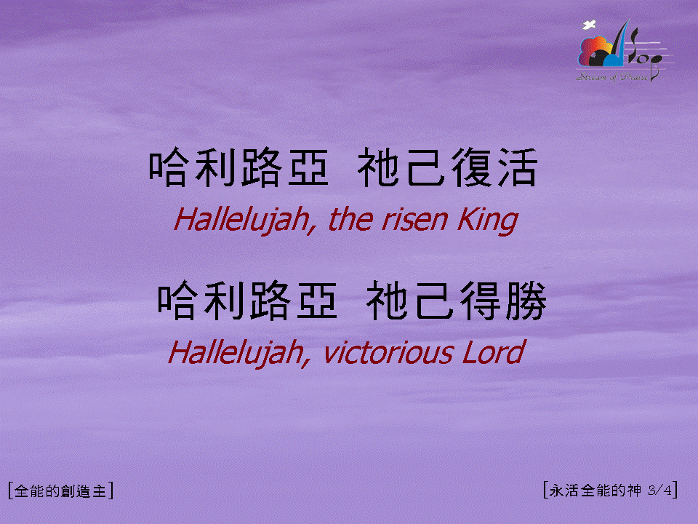
永活全能真神 (3/4)
[Almighty Living God]

Slide 4
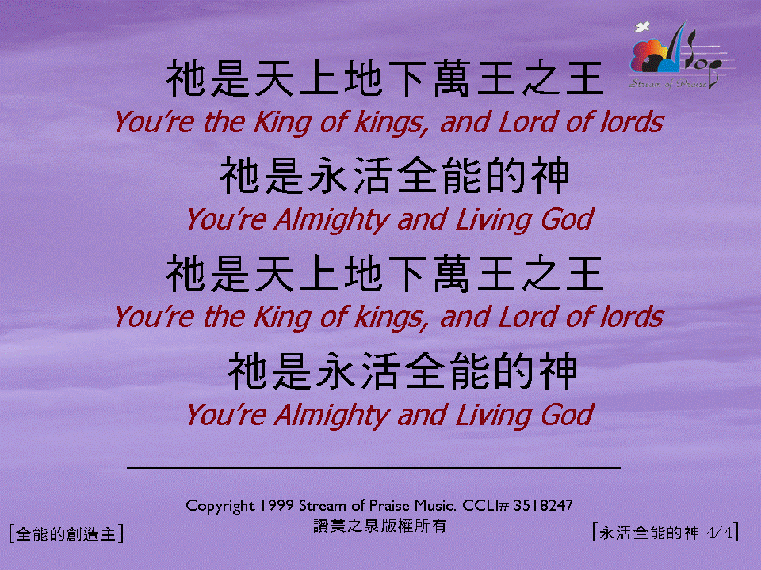
永活全能真神 (4/4)
[Almighty Living God]

