Slide 1
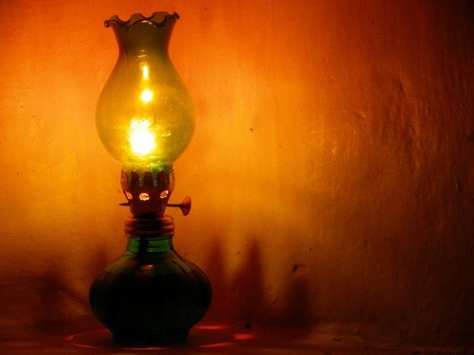
GIVE ME OIL
IN MY LAMP

Slide 2

Oil: dầu (nói chung)
Lamp: đèn
Burn: đốt cháy
Til = Until: cho đến khi...
Break of day: bình minh
Praise: ca ngợi, khen ngợi

Slide 3
Peace: bình an, hòa bình
Rest: yên lòng, thanh thản
Hosana: lời chúc tụng Chúa

Slide 4
dầu (nói chung)
đèn
đốt cháy
cho đến khi...
bình minh
ca ngợi, khen ngợi

Slide 5
Peace: bình an, hòa bình
Rest: yên lòng, thanh thản
Hosana: lời chúc tụng Chúa

Slide 6
Oil:
Lamp:
Burn:
Til = Until:
Break of day:
Praise:

Slide 7
Peace:
Rest:
Hosana:

Slide 8

1
Give me oil in my lamp,
keep me burning
Give me oil in my lamp,
I pray
Give me oil in my lamp,
keep me burning
Keep me burning
til the break of day

Slide 9
Chorus
Sing hosanna, sing hosanna
Sing hosanna to the
King of Kings
Sing hosanna, sing hosanna
Sing hosanna to the
King

Slide 10
2
Give me joy in my heart,
keep me praising
Give me joy in my heart,
I pray
Give me joy in my heart,
keep me praising
Keep me praising
til the break of day

Slide 11
Chorus
Sing hosanna, sing hosanna
Sing hosanna to the
King of Kings
Sing hosanna, sing hosanna
Sing hosanna to the
King

Slide 12
3
Give me peace in my heart,
keep me resting
Give me peace in my heart,
I pray
Give me peace in my heart,
keep me resting
Keep me resting
til the break of day

Slide 13
Chorus
Sing hosanna, sing hosanna
Sing hosanna to the
King of Kings
Sing hosanna, sing hosanna
Sing hosanna to the
King

Slide 14
