Slide 1


Slide 2
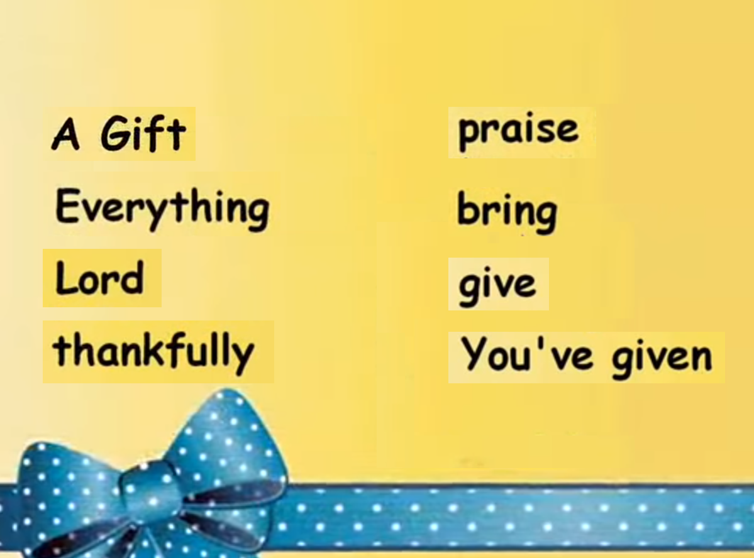
VOCABULARY

Slide 3


Slide 4


Slide 5


Slide 7


