Slide 1
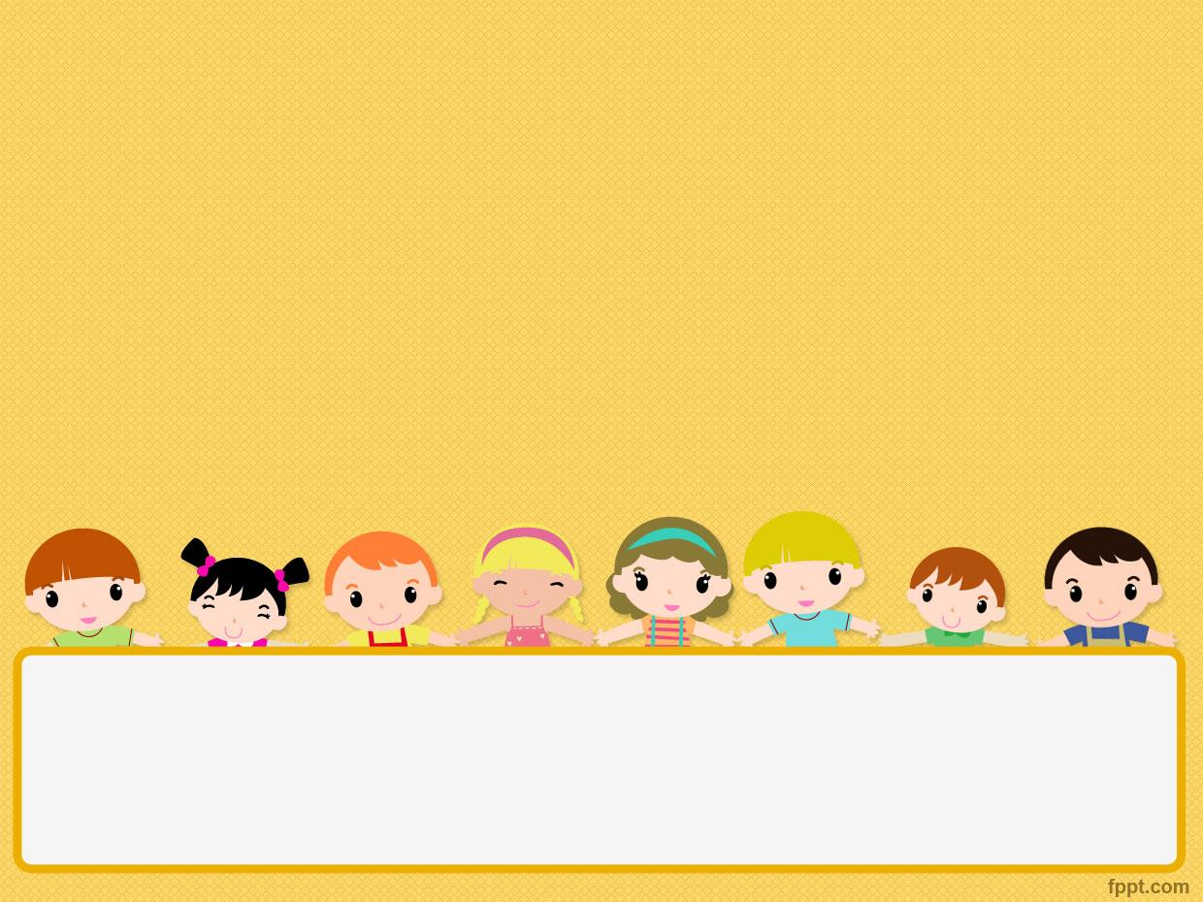
Song O-B-E-D-I-E-N-C-E

Slide 2

Obedience: Very best: Way: Show: Believe: Exactly: Commands Happily:

Slide 3

Action:
Key:
Immediately:
Joy:
Will receive:

Slide 4
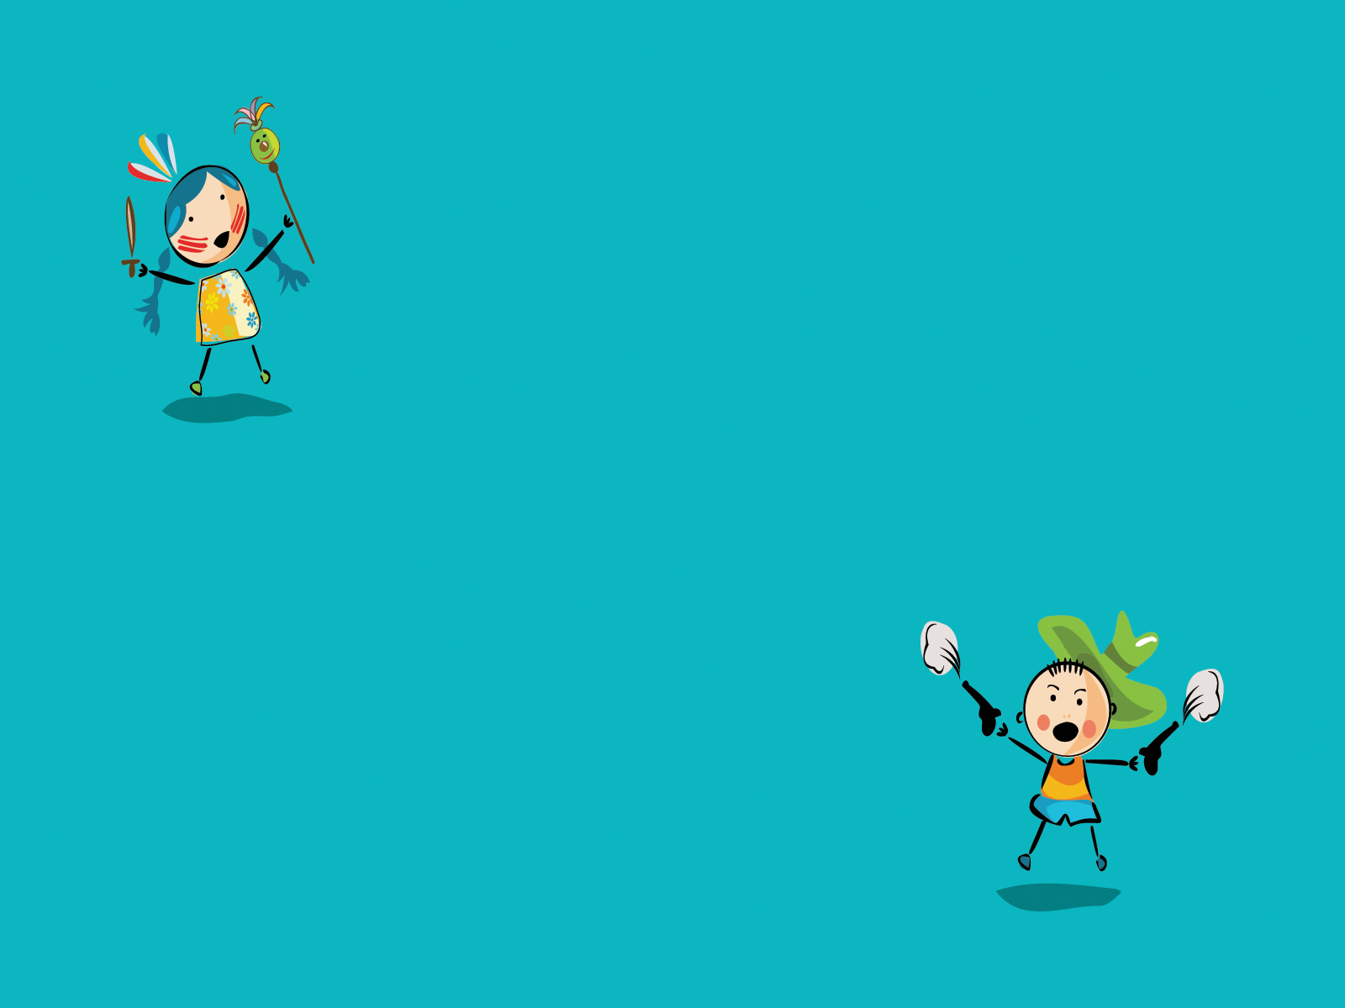
Obedience
is the very best way
To show that you believe
Doing exactly what the Lord commands
Doing it happily

Slide 5

Action is the key
do it immediately
Joy you will receive
Obedience
is the very best way
to show that you believe

Slide 6

O-B-E-D-I-E-N-C-E Obedience
is the very best way
to show that you believe

