Slide 1

























Slide 3
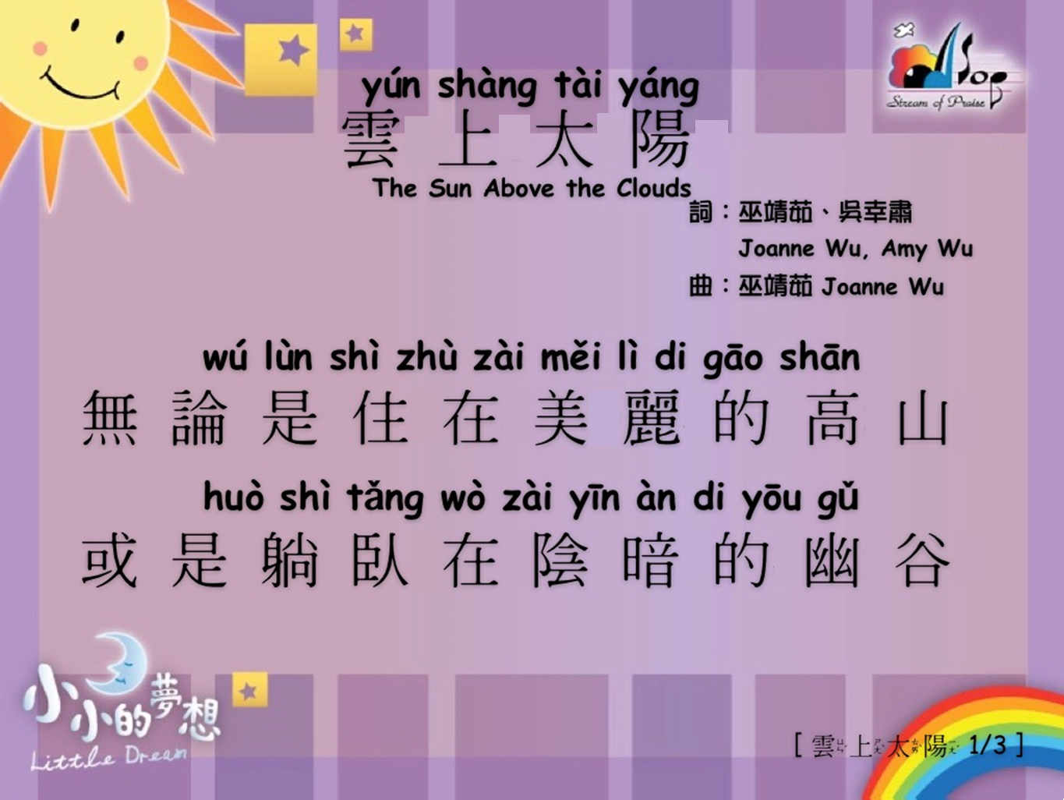

Slide 4
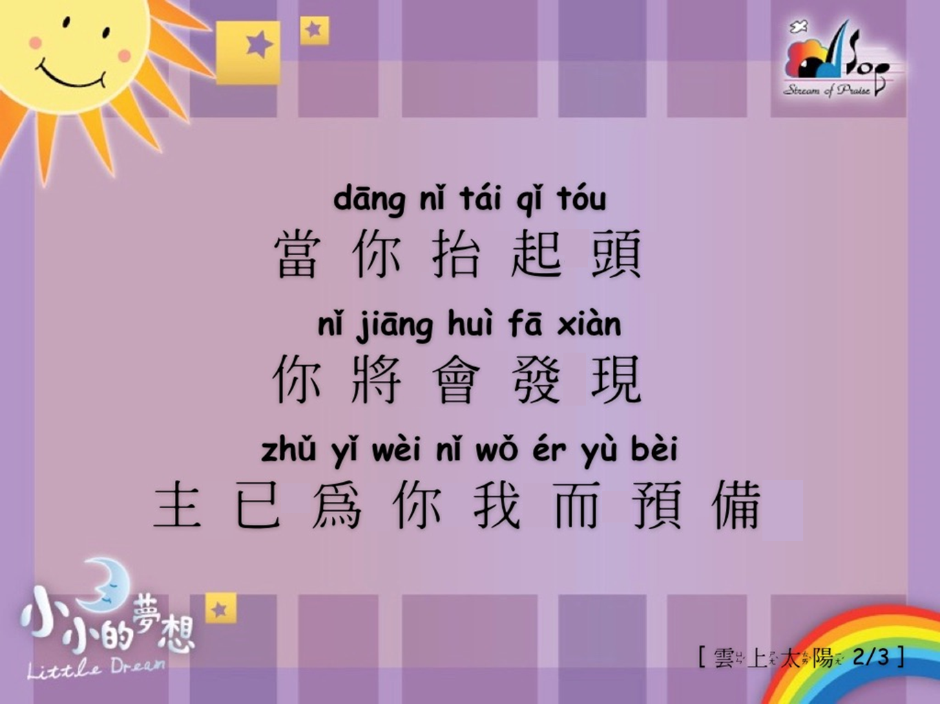

Slide 5
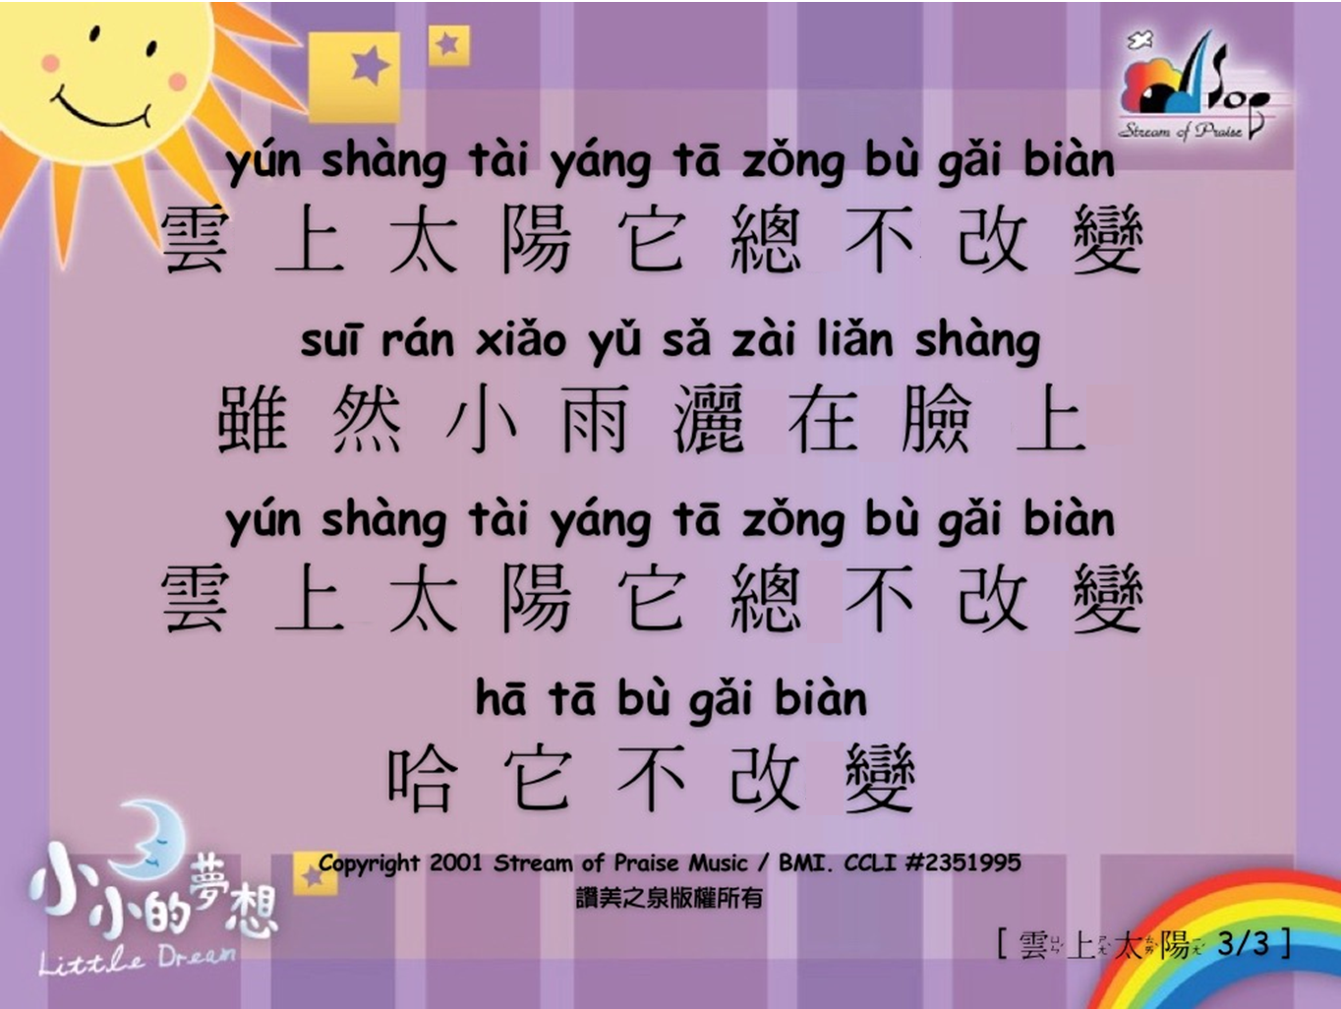

Slide 6
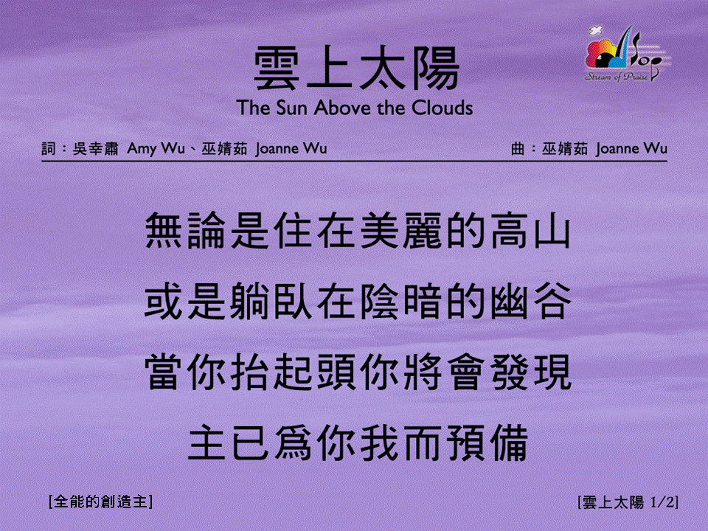
雲上太陽 <1/2>
The Sun Above the Clouds
[全能的創造主]

Slide 7
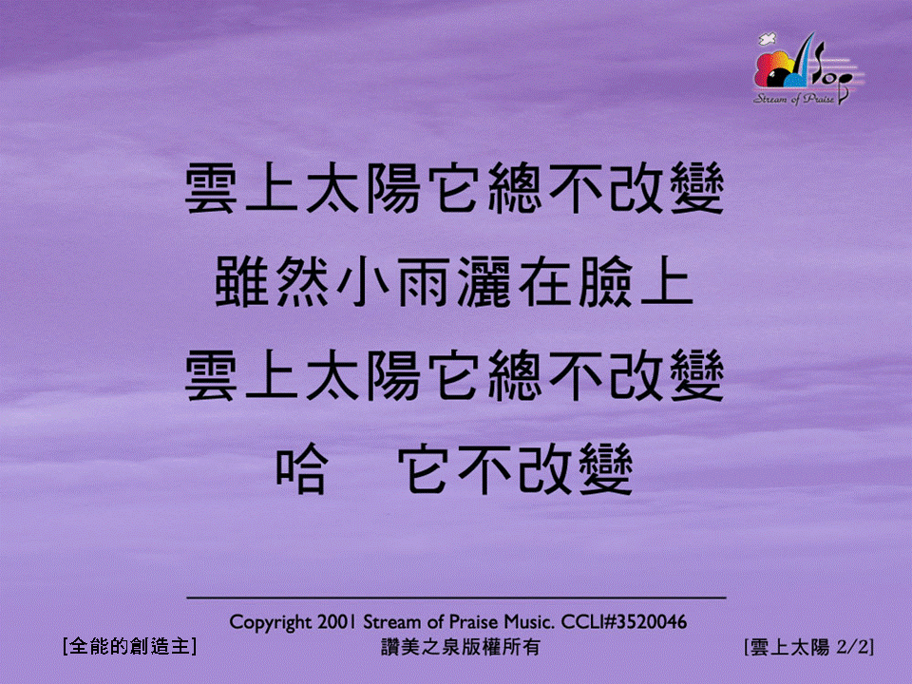
雲上太陽 <2/2>
The Sun Above the Clouds
[全能的創造主]

