Slide 1


Stand Together

Slide 2
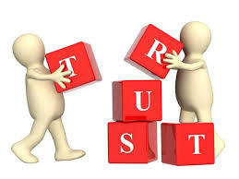
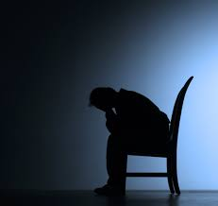
Vocabulary
Trust
Alone
Stand
Stand upon
Whatever

Slide 3


Strong
Brave
Guide
Through
Darkest

Slide 4


Strength
Together
Forever
Stand up
Each

Slide 5

We will trust,
trust in God alone
We will stand,
stand upon his word

Slide 6
And whatever
comes our way
We are strong,
and we are brave

Slide 7
His truth,
truth will be our guide
Through the day,
and the darkest night

Slide 8
Our God will
give us strength
We are strong, and we are brave, and
we will

Slide 9
Stand TOGETHER
Stand FOREVER
We will stand strong
Standing up for God each day
We will stand strong

