Slide 1
VOCABULARY

Slide 2
Jesus

Slide 3
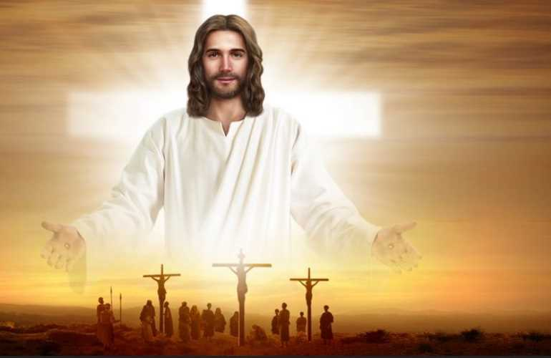

Slide 4
L0VE

Slide 5


Slide 6
Little

Slide 7


Little

Slide 8
Children

Slide 9


Slide 10
ALL

Slide 11
World

Slide 12
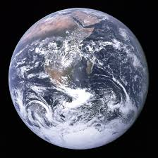

Slide 13
Red

Slide 14


Slide 15
Yellow

Slide 16


Slide 17
Black

Slide 18


Slide 19
White

Slide 20


Slide 21
Precious

Slide 22
Sight

Slide 23
Care

