Slide 1
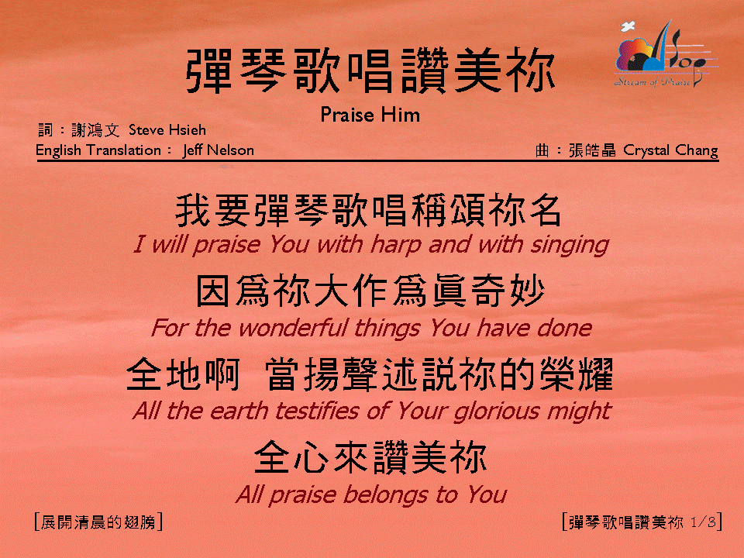
彈琴歌唱讚美你 (1/3)
[Praise Him]

Slide 2
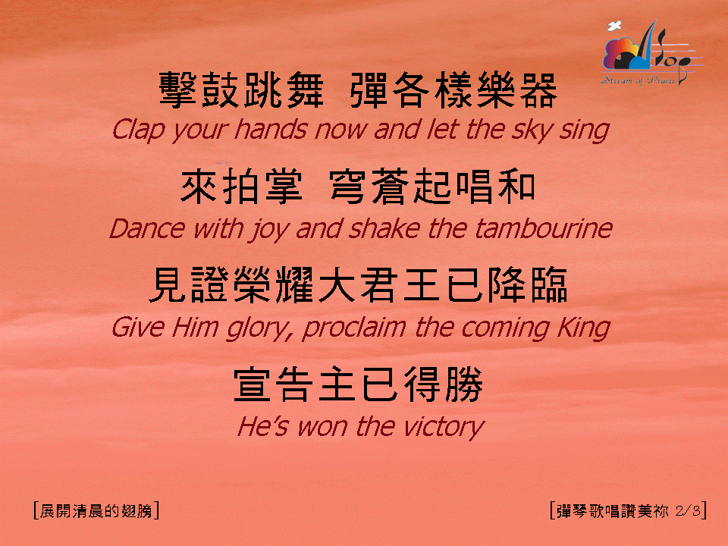
彈琴歌唱讚美你 (2/3)
[Praise Him]

Slide 3
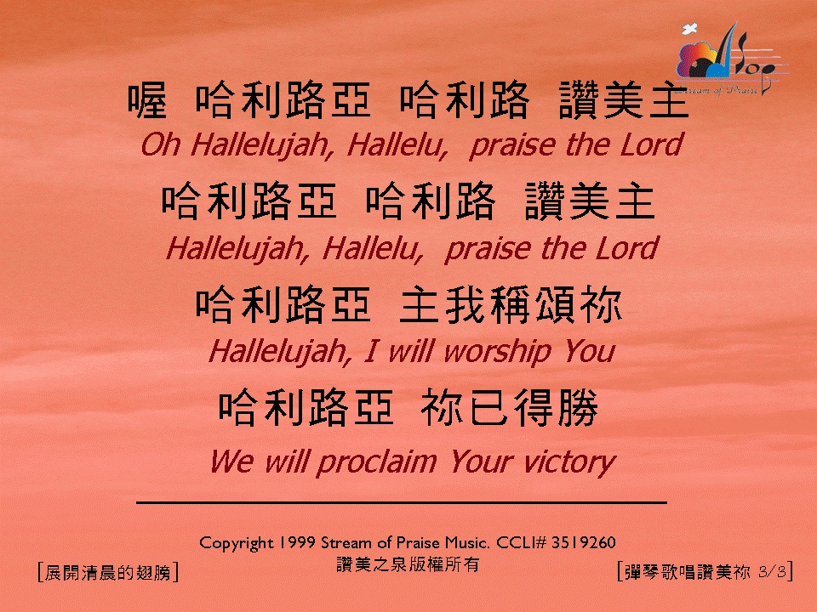
彈琴歌唱讚美你 (3/3)
[Praise Him]

