Slide 1
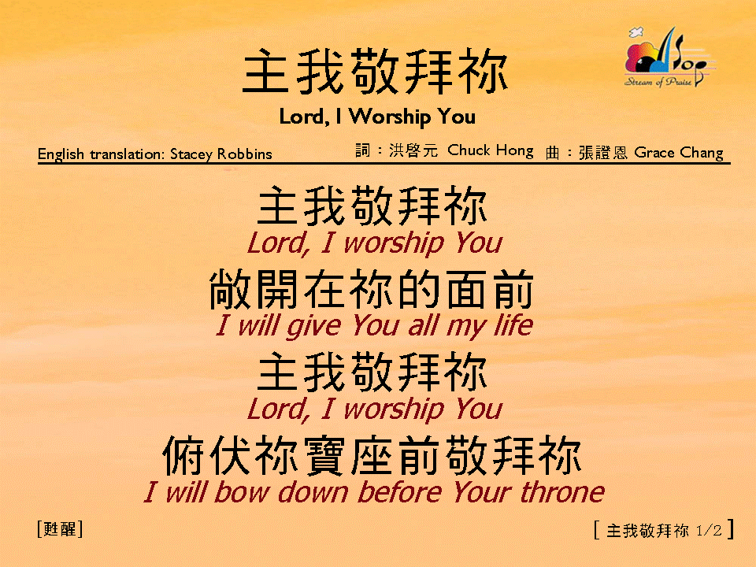
主我敬拜你 (1/2)
[Lord, I Worship You]

Slide 2
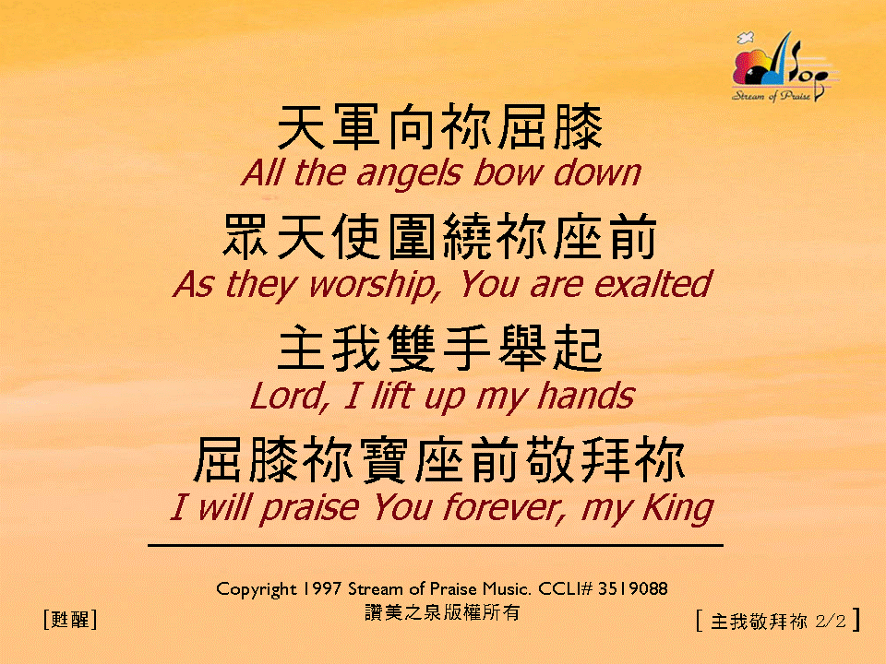
主我敬拜你 (2/2)
[Lord, I Worship You]

