Slide 1
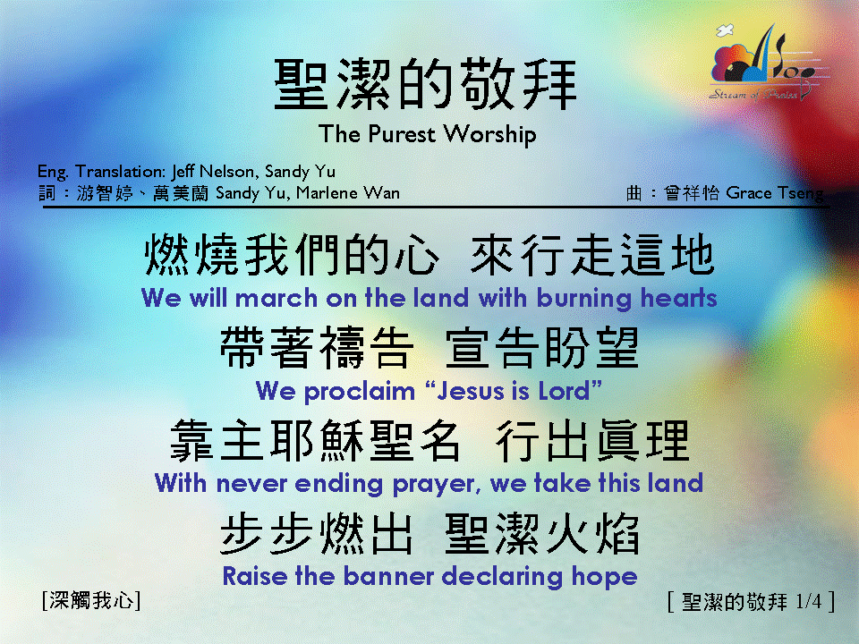
聖潔的敬拜 <1/4> The Purest Worship

Slide 2
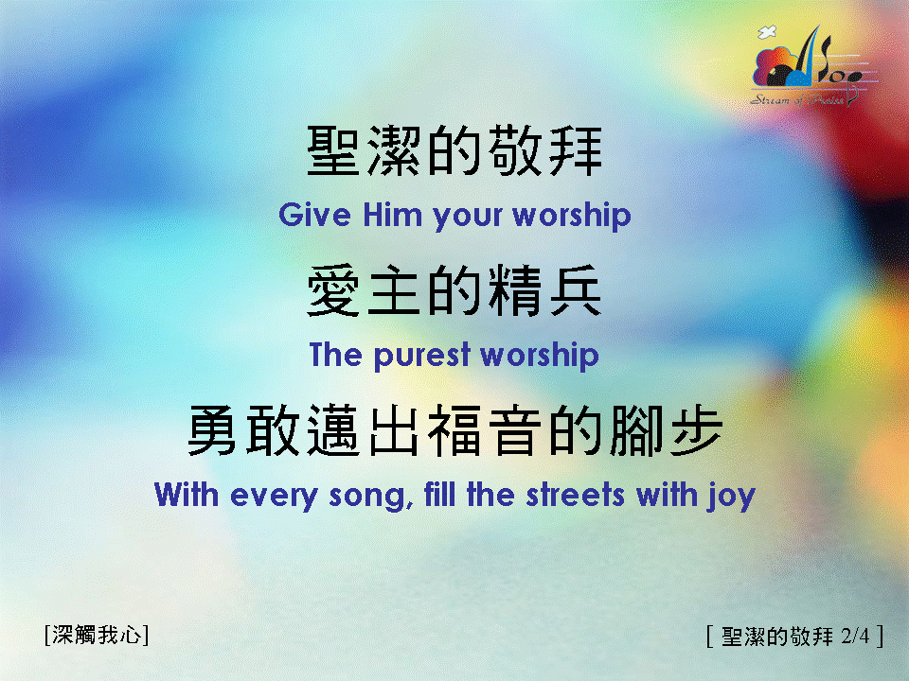
聖潔的敬拜 <2/4> The Purest Worship

Slide 3
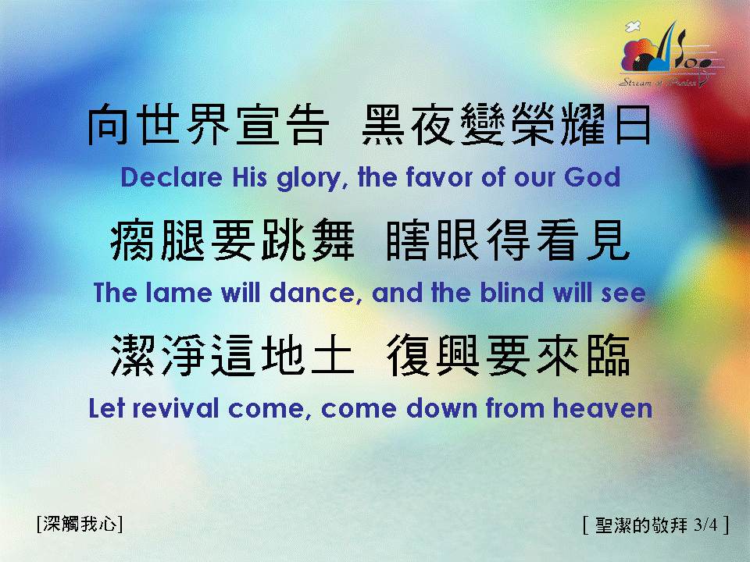
聖潔的敬拜 <3/4> The Purest Worship

Slide 4
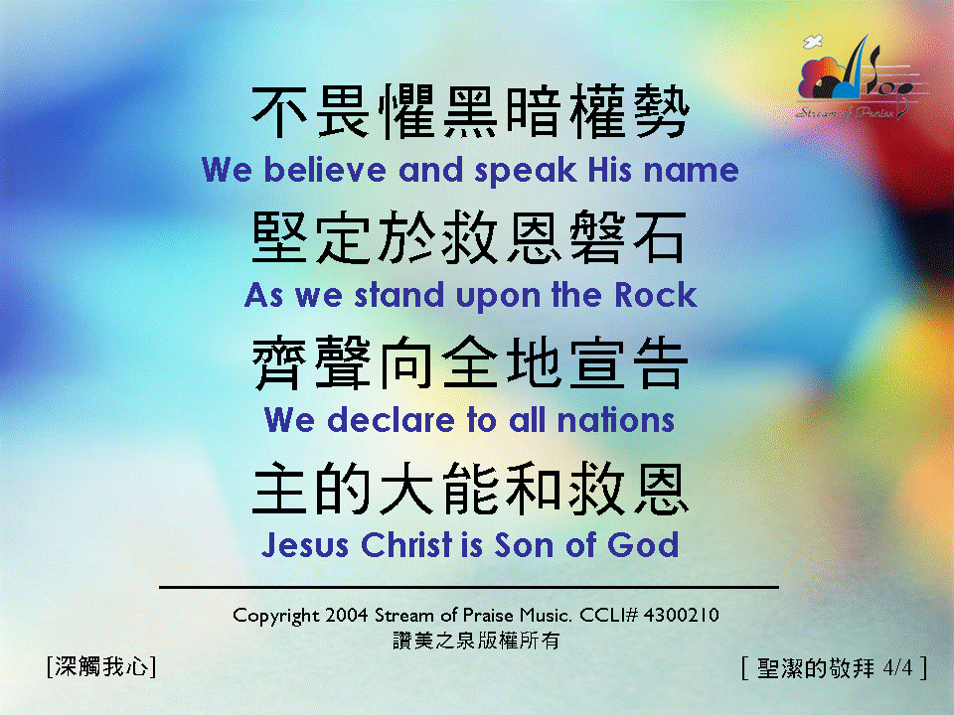
聖潔的敬拜 <4/4> The Purest Worship

