Slide 1
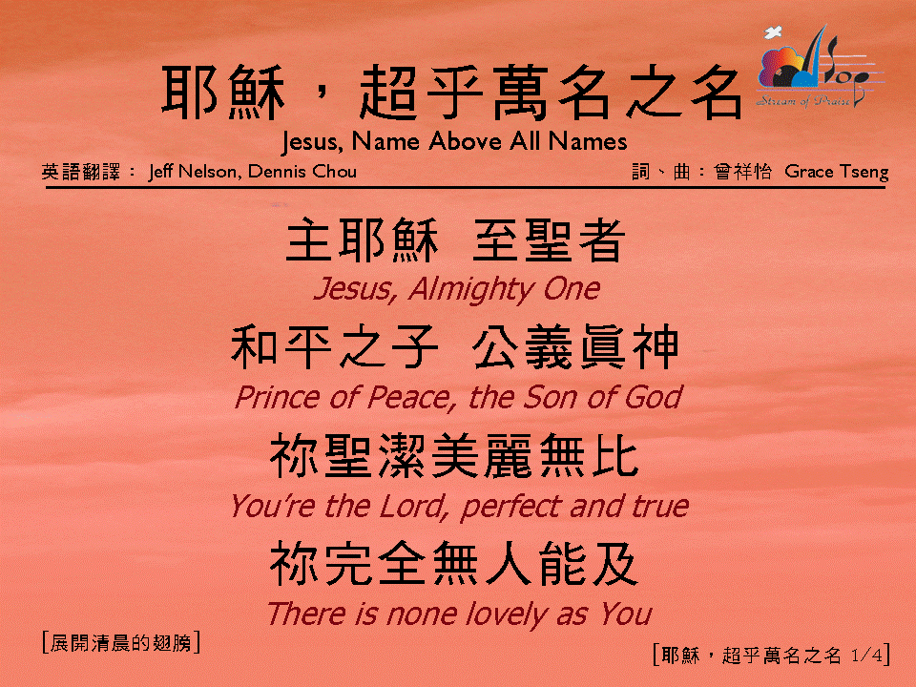
耶穌，超乎萬名之名 (1/4)
[Jesus, Name Above All Names]

Slide 2
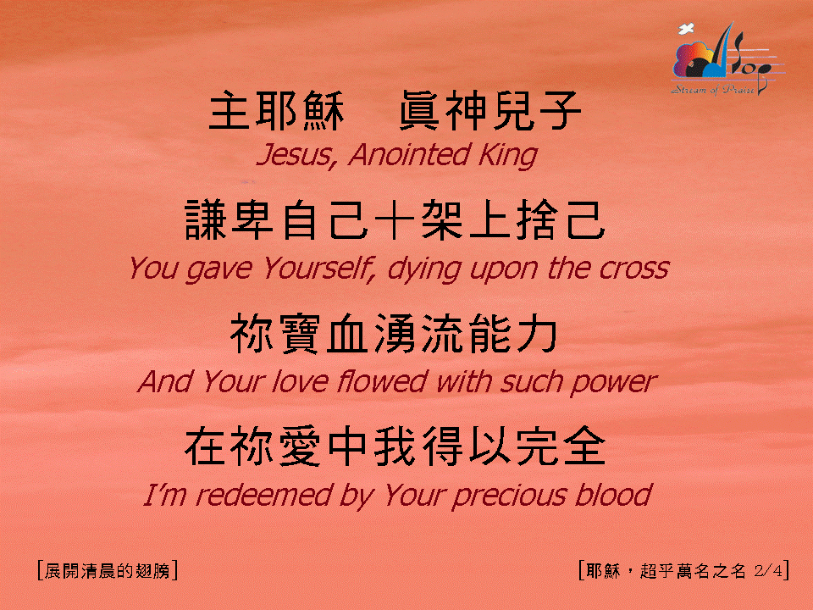
耶穌，超乎萬名之名 (2/4)
[Jesus, Name Above All Names]

Slide 3
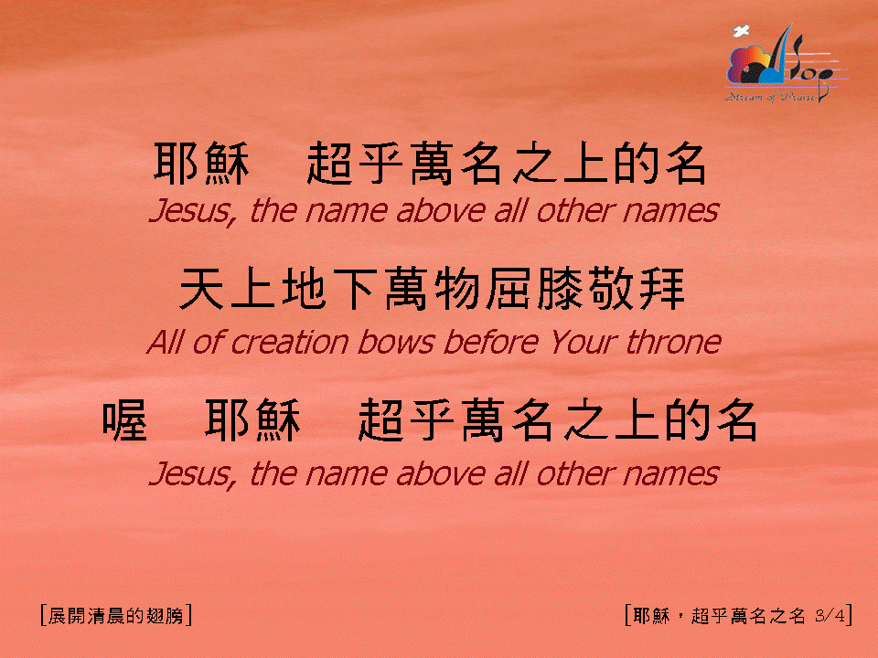
耶穌，超乎萬名之名 (3/4)
[Jesus, Name Above All Names]

Slide 4
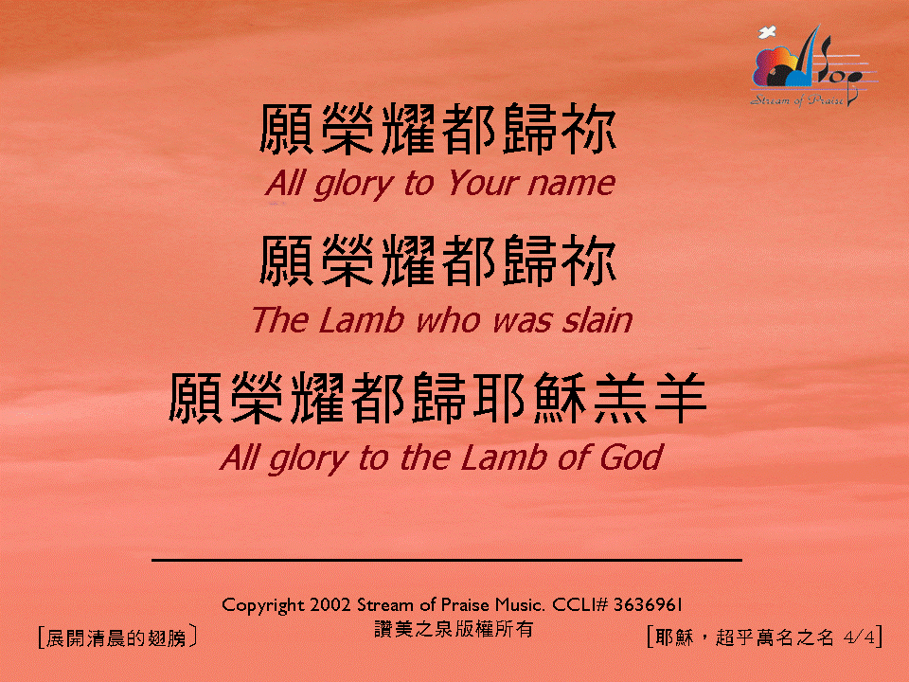
耶穌，超乎萬名之名 (4/4)
[Jesus, Name Above All Names]

