Slide 1
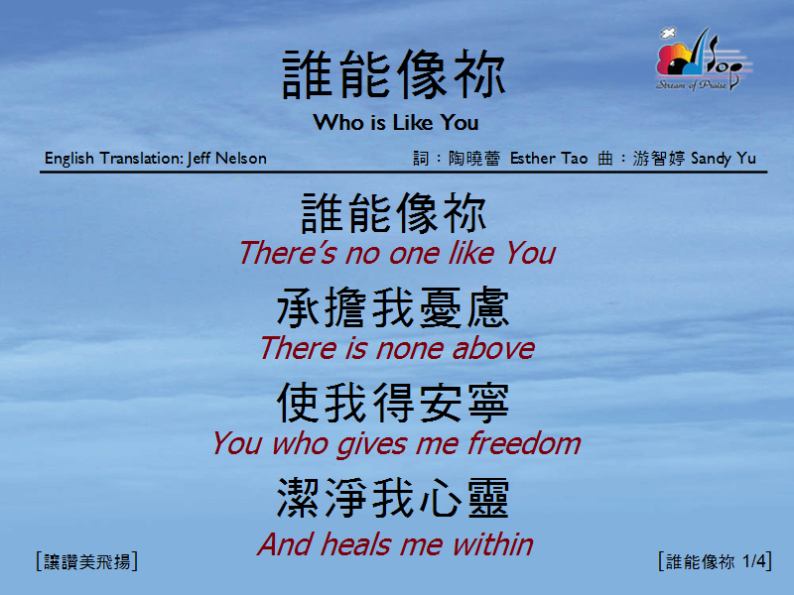
誰能像你 <1/4>
Who is Like You

Slide 2
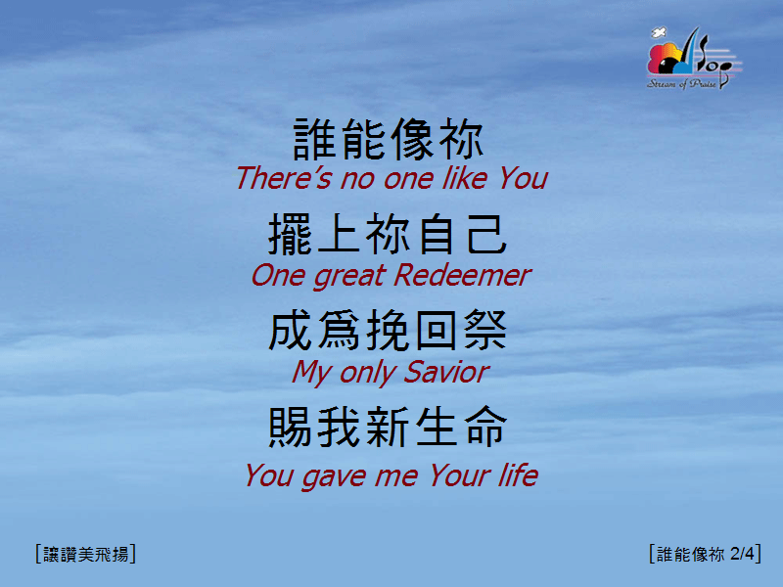
誰能像你 <2/4>
Who is Like You

Slide 3
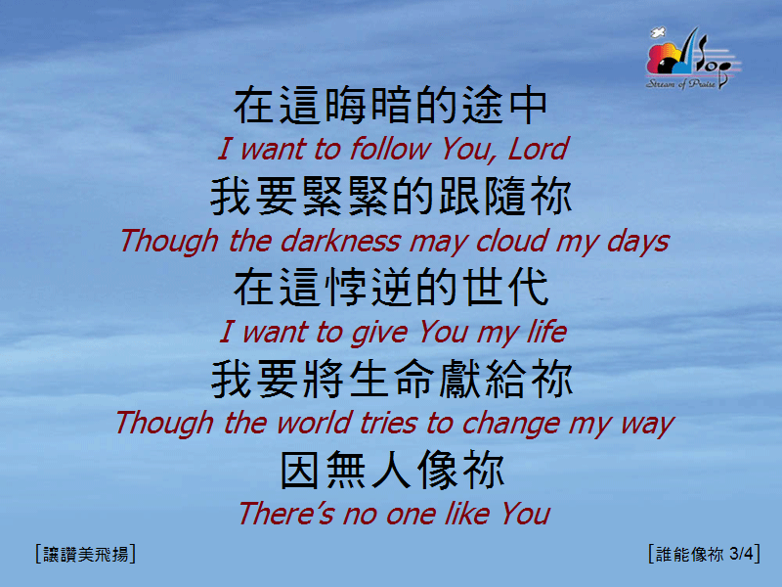
誰能像你 <3/4>
Who is Like You

Slide 4
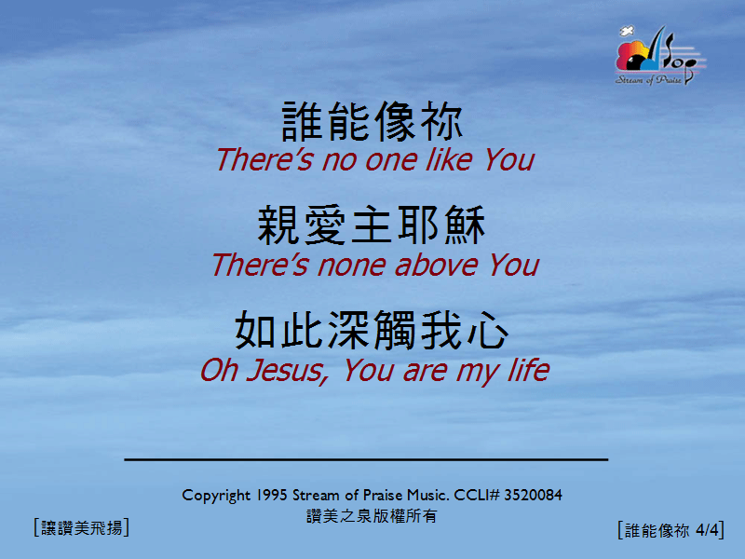
誰能像你 <4/4>
Who is Like You

