Slide 1
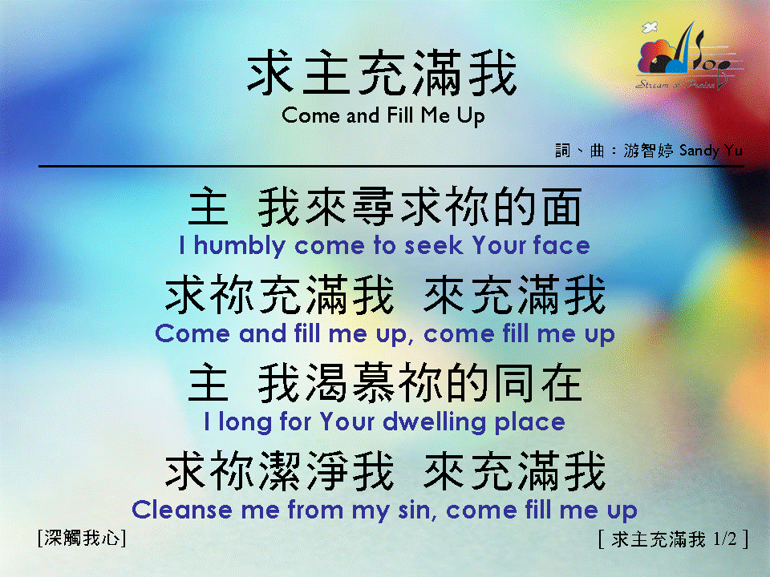
求主充滿我 <1/2> Come and Fill Me Up

Slide 2
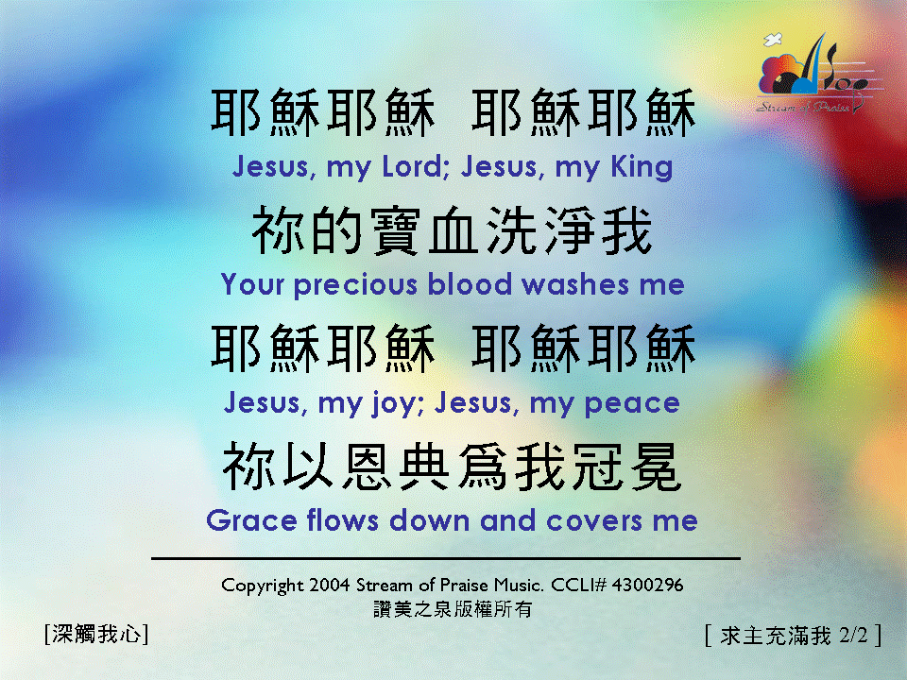
求主充滿我 <2/2> Come and Fill Me Up

