Slide 1

這一生最美的祝福 <1/3>
The Gift of Knowing You

Slide 2
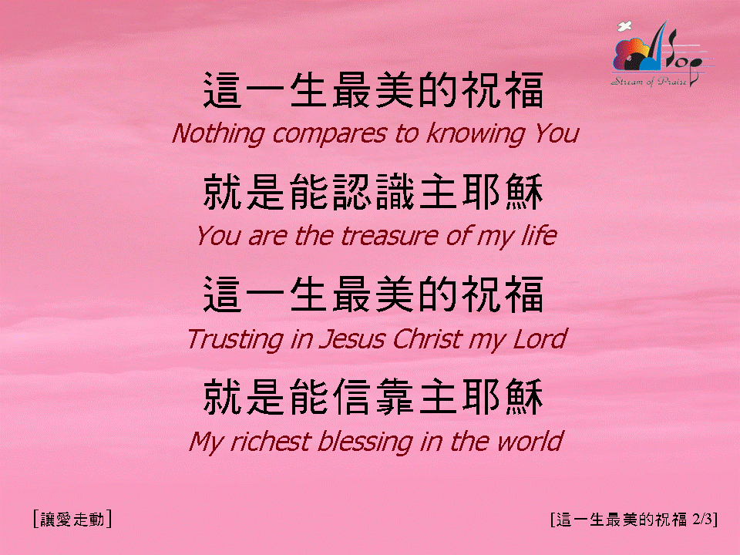
這一生最美的祝福 <2/3>
The Gift of Knowing You

Slide 3

這一生最美的祝福 <3/3>
The Gift of Knowing You

