Slide 1
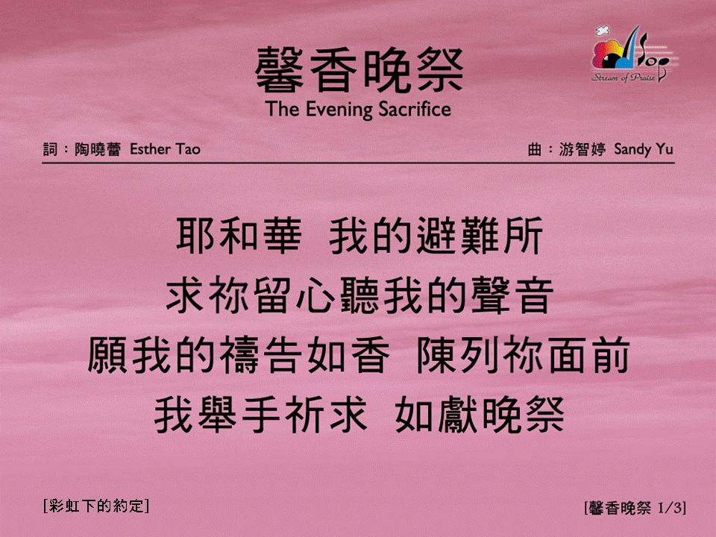
馨香晚祭 (1/3)
[The Evening Sacrifice]
[彩虹下的約定]

Slide 2
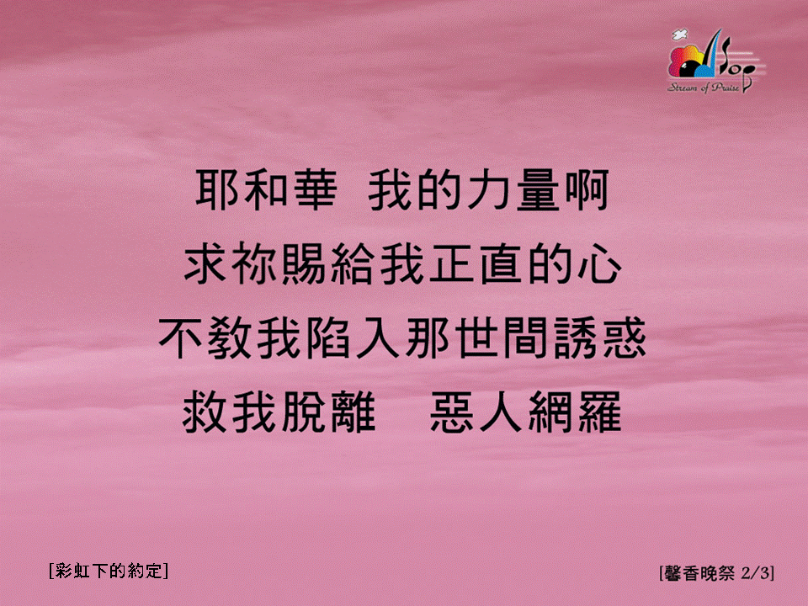
馨香晚祭 (2/3)
[The Evening Sacrifice]
[彩虹下的約定]

Slide 3
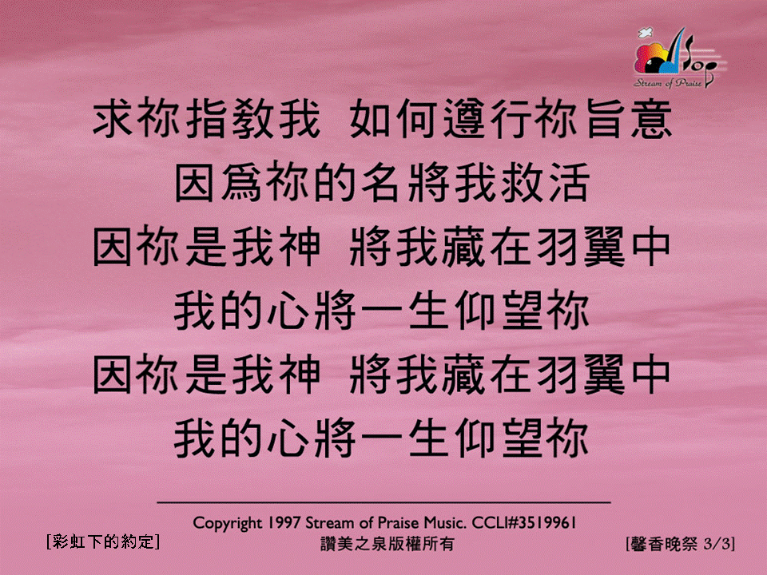
馨香晚祭 (3/3)
[The Evening Sacrifice]
[彩虹下的約定]

