Slide 1
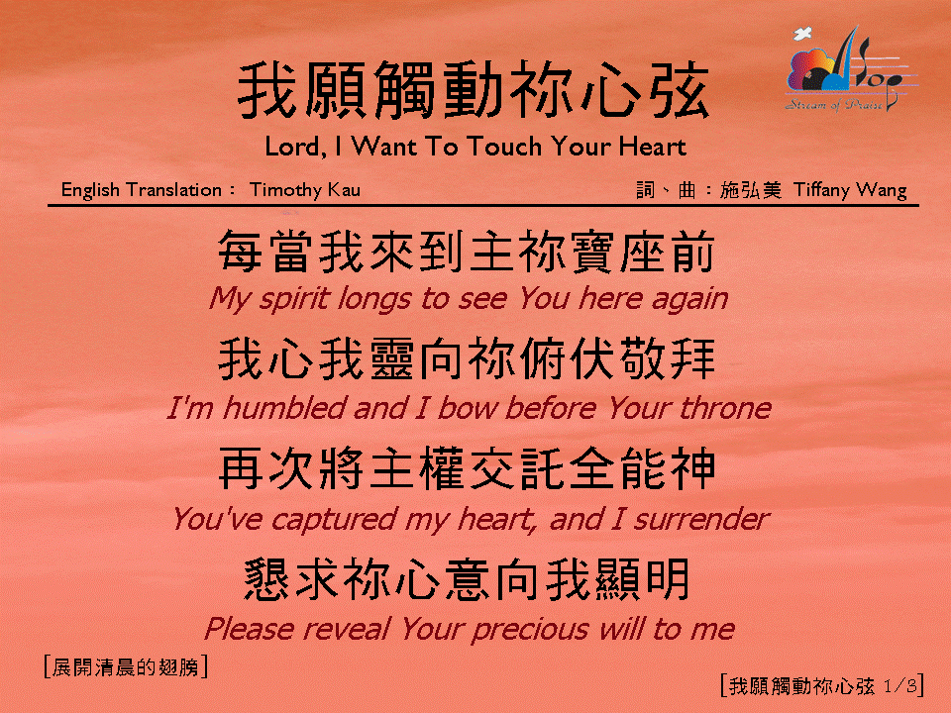
我願觸動你心弦 (1/3)
[Lord, I Want To Touch Your Heart]

Slide 2
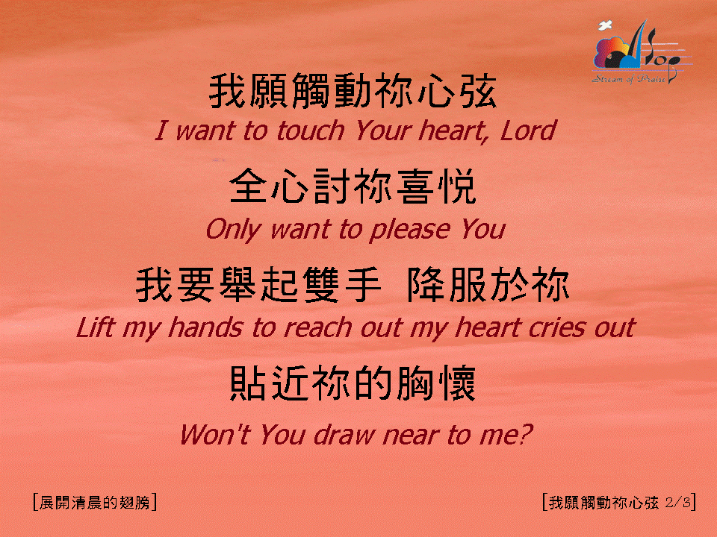
我願觸動你心弦 (2/3)
[Lord, I Want To Touch Your Heart]

Slide 3
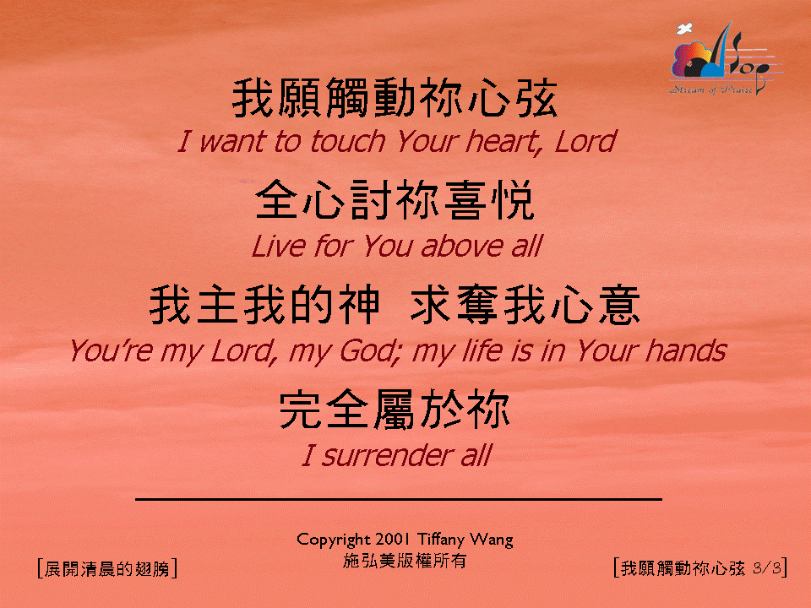
我願觸動你心弦 (3/3)
[Lord, I Want To Touch Your Heart]

