Slide 1
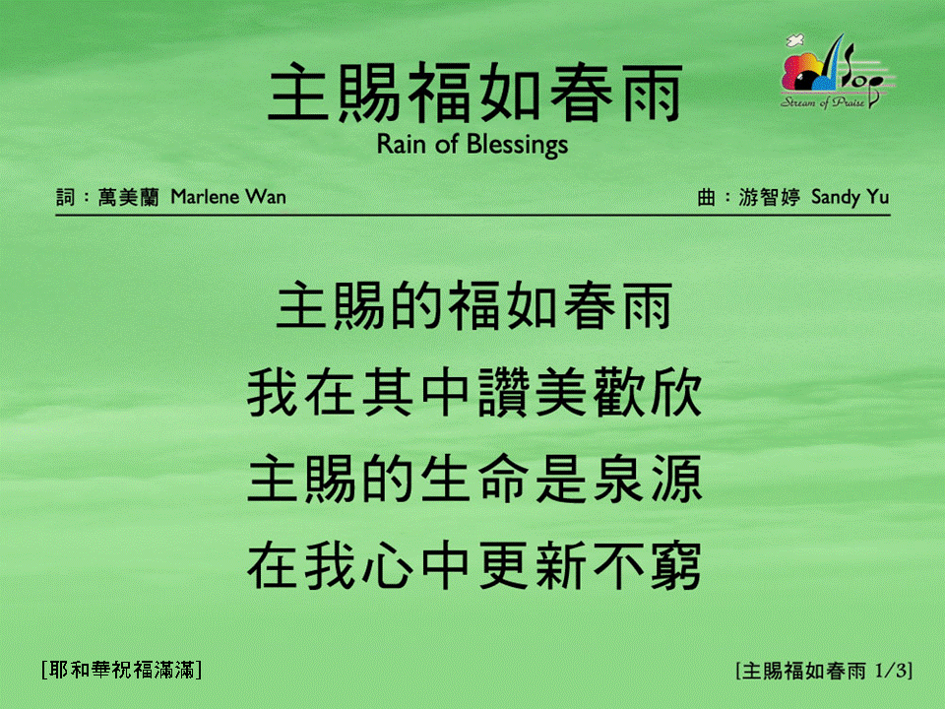
主賜福如春雨 (1/3)
[Rain of Blessings]
[耶和華祝福滿滿]

Slide 2

主賜福如春雨 (2/3)
[Rain of Blessings]
[耶和華祝福滿滿]

Slide 3

主賜福如春雨 (3/3)
[Rain of Blessings]
[耶和華祝福滿滿]

