Slide 1
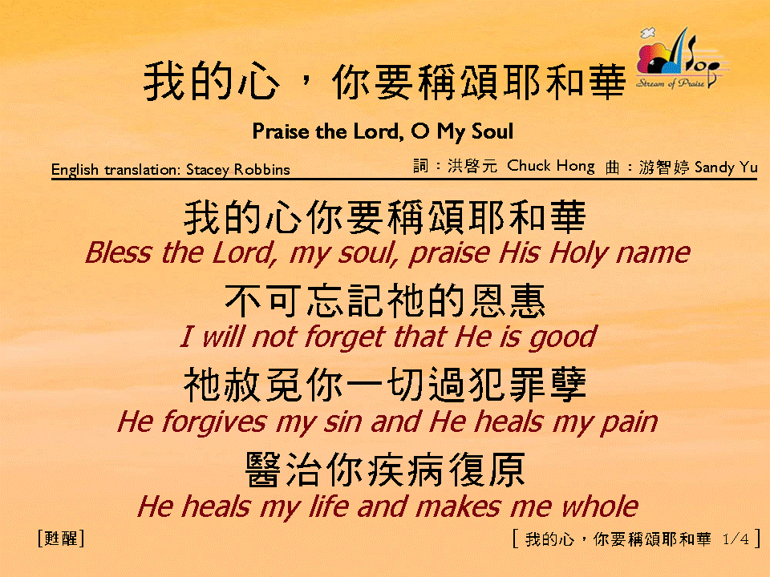
我的心，你要稱頌耶和華 (1/4)
[Praise the Lord, O My Soul]

Slide 2
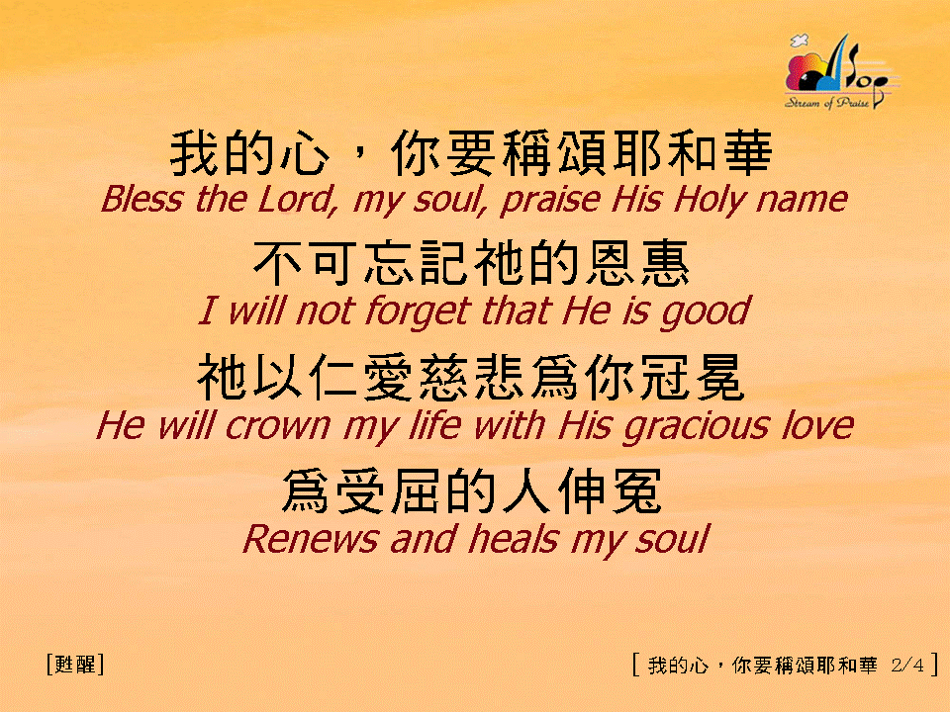
我的心，你要稱頌耶和華 (2/4)
[Praise the Lord, O My Soul]

Slide 3
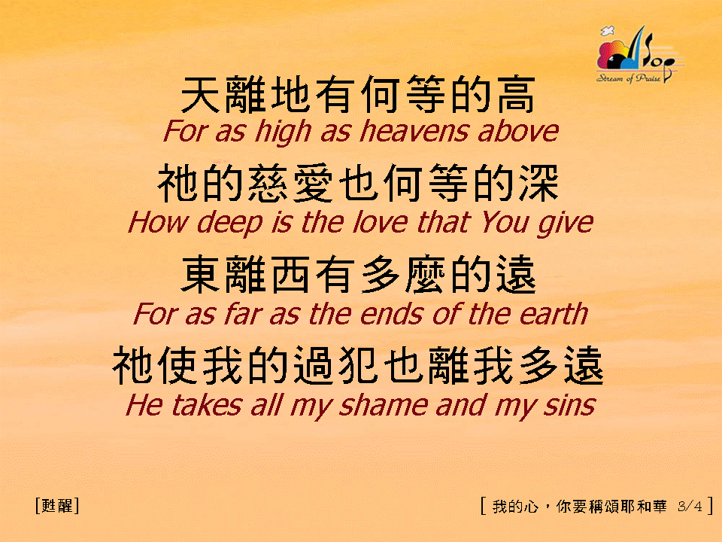
我的心，你要稱頌耶和華 (3/4)
[Praise the Lord, O My Soul]

Slide 4
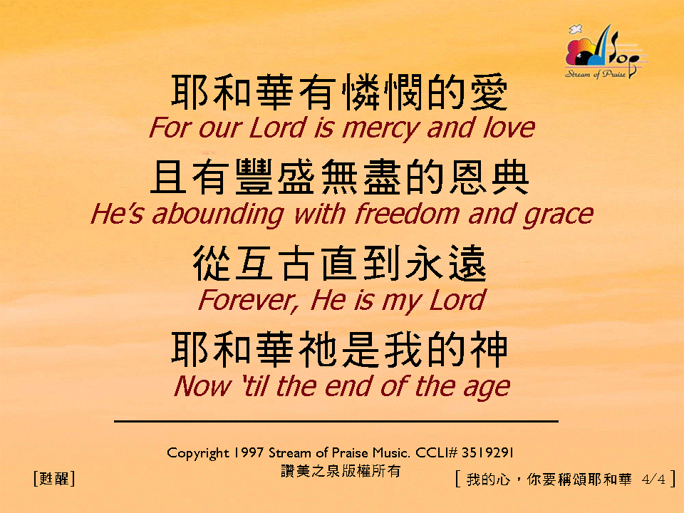

我的心，你要稱頌耶和華 (4/4)
[Praise the Lord, O My Soul]
亙

