Slide 1
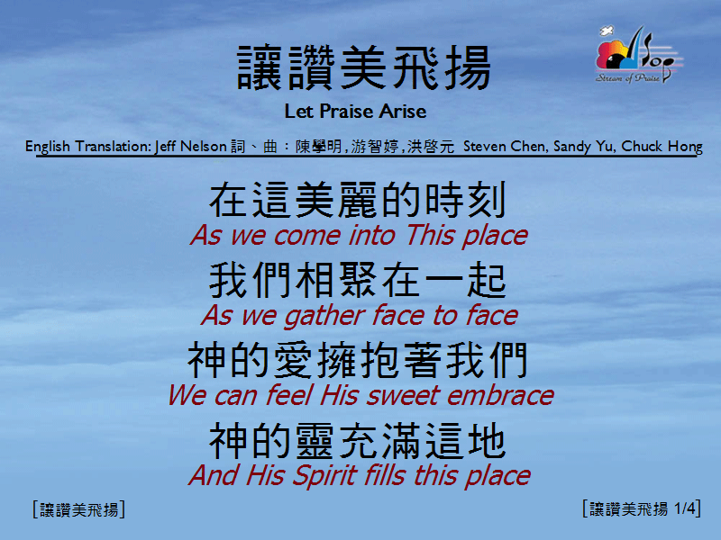
讓讚美飛揚 <1/4>
Let Praise Arise

Slide 2
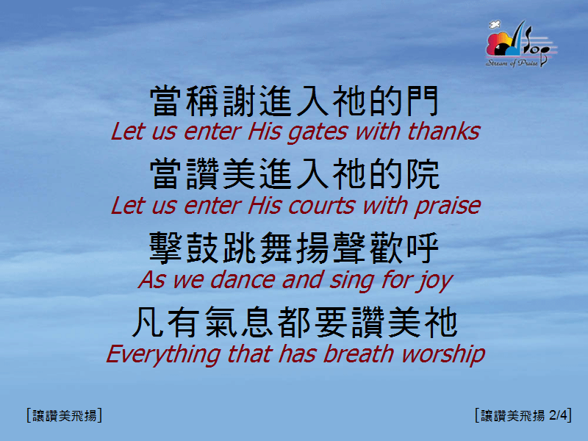
讓讚美飛揚 <2/4>
Let Praise Arise

Slide 3
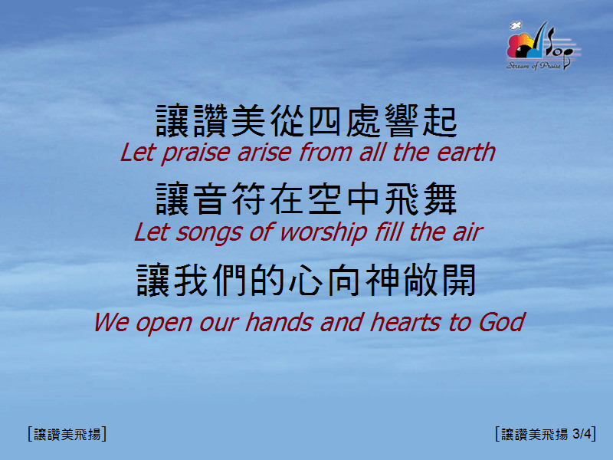
讓讚美飛揚 <3/4>
Let Praise Arise

Slide 4

讓讚美飛揚 <4/4>
Let Praise Arise

