Slide 1
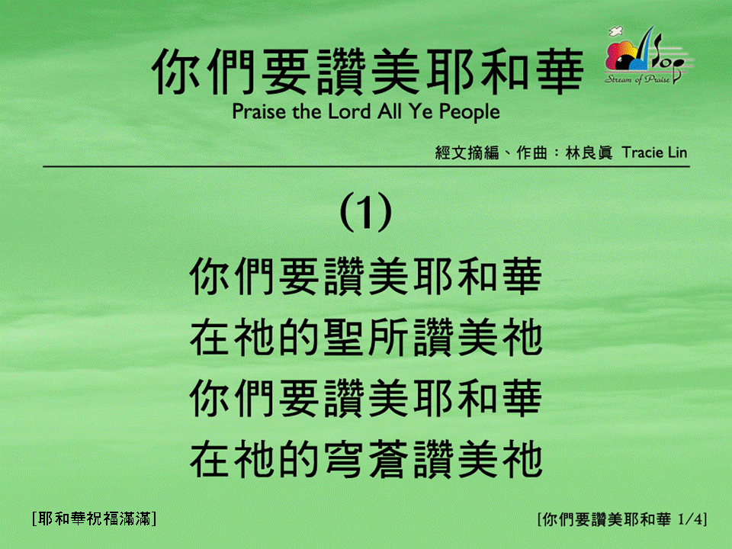
你們要讚美耶和華 (1/4)
[Praise the Lord All Ye People]
[耶和華祝福滿滿]

Slide 2
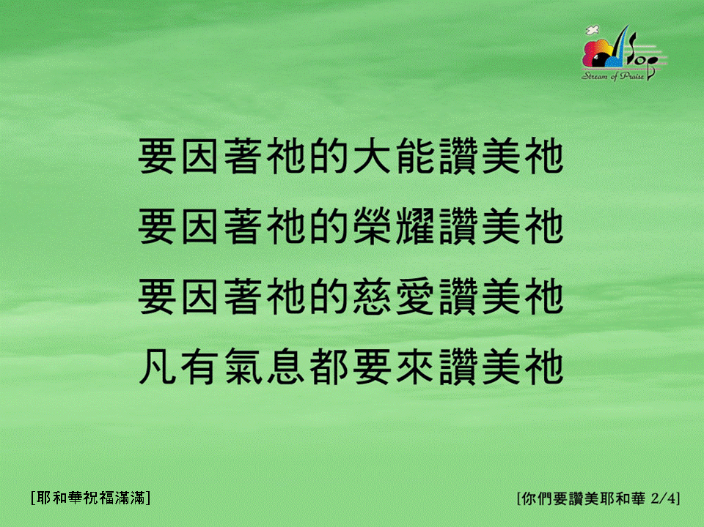
你們要讚美耶和華 (2/4)
[Praise the Lord All Ye People]
[耶和華祝福滿滿]

Slide 3
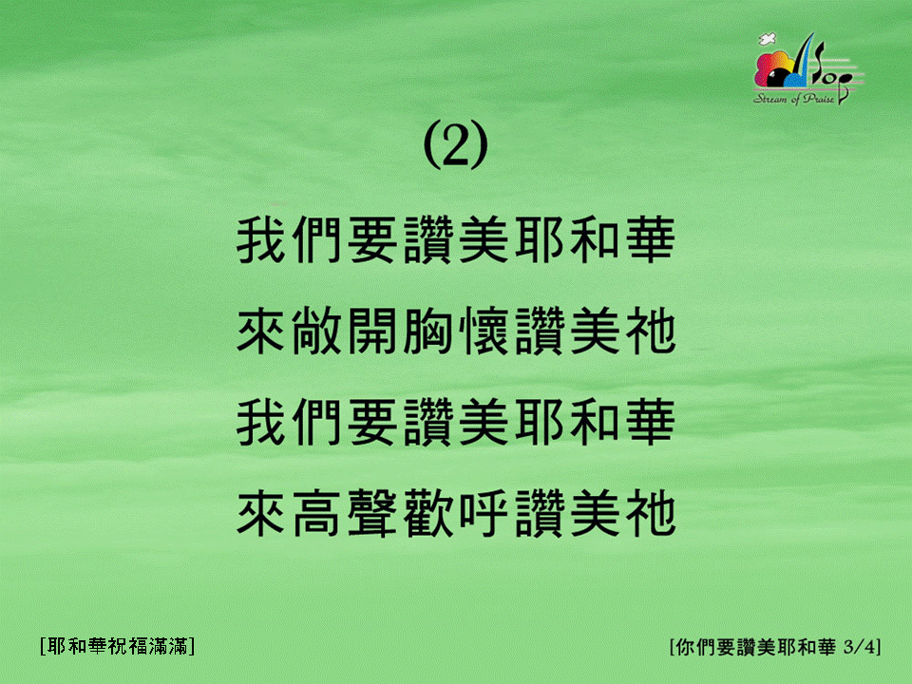
你們要讚美耶和華 (3/4)
[Praise the Lord All Ye People]
[耶和華祝福滿滿]

Slide 4

你們要讚美耶和華 (4/4)
[Praise the Lord All Ye People]
[耶和華祝福滿滿]

