Slide 1
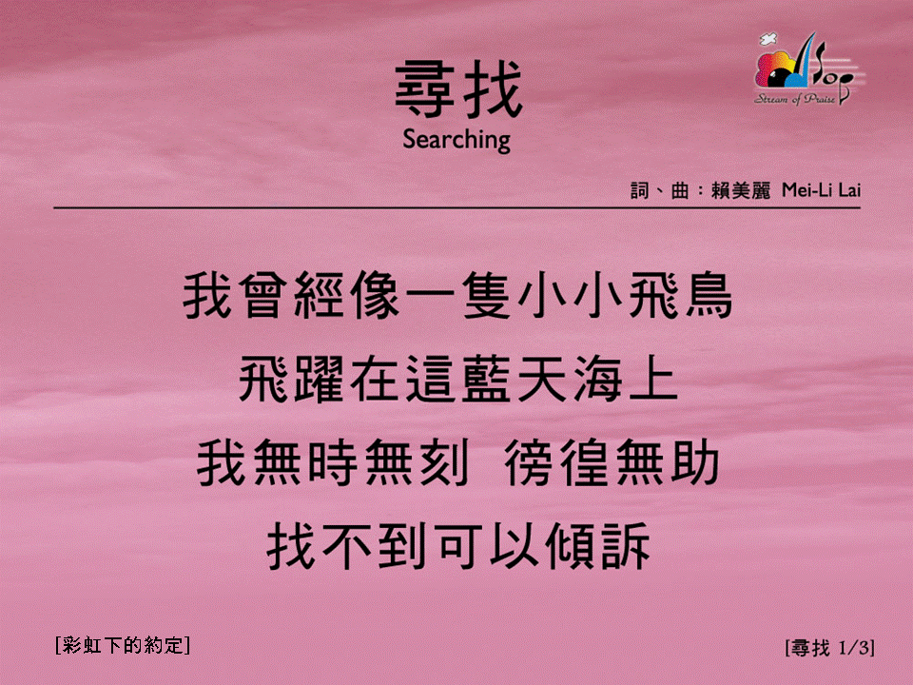
尋找 (1/3)
[Searching]
[彩虹下的約定]

Slide 2
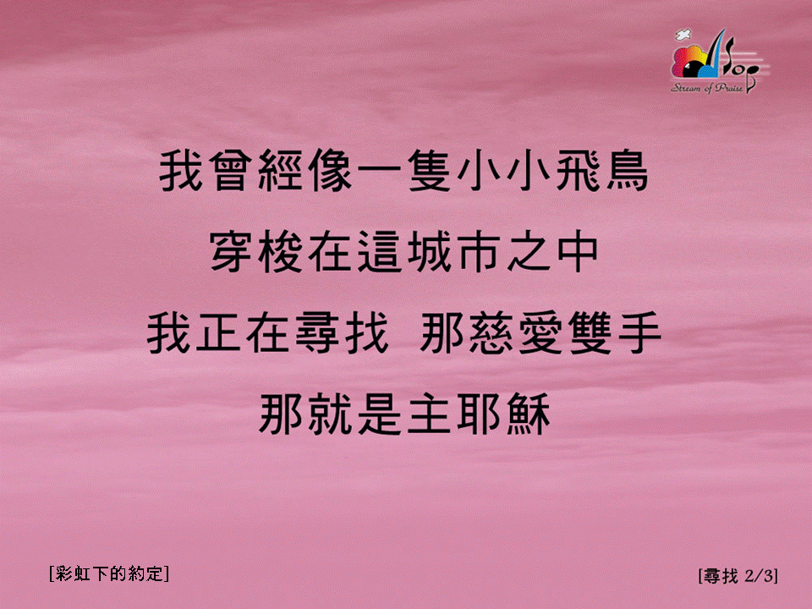
尋找 (2/3)
[Searching]
[彩虹下的約定]

Slide 3

尋找 (3/3)
[Searching]
[彩虹下的約定]

