Slide 1
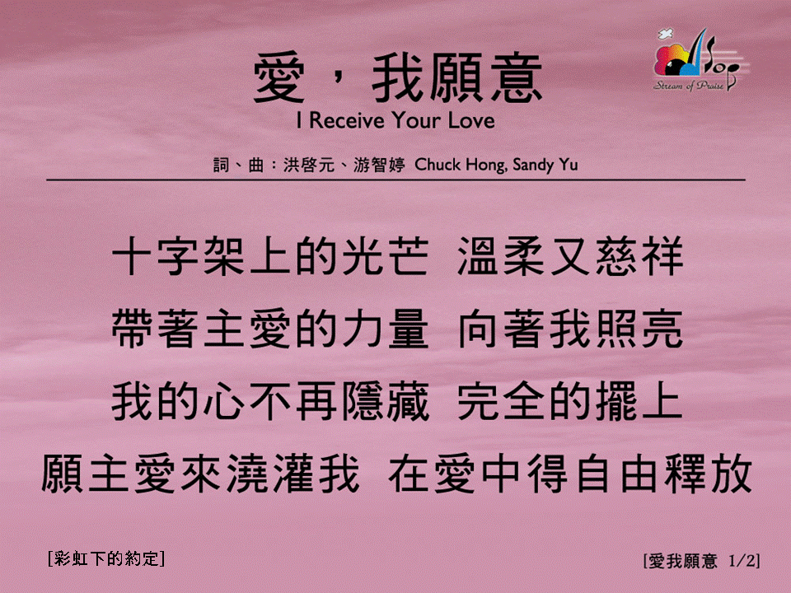
愛，我願意 (1/2)
[I Receive Your Love]
[彩虹下的約定]

Slide 2
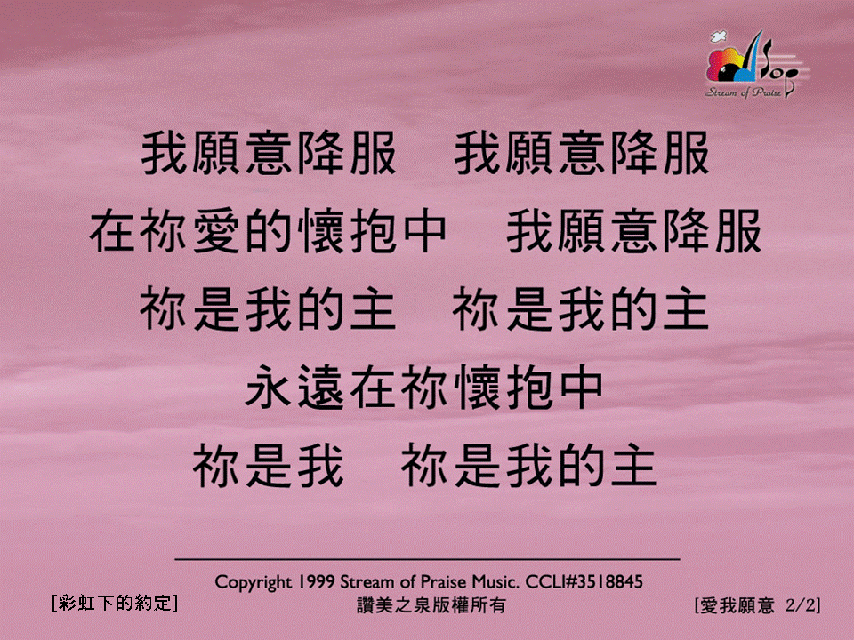
愛，我願意 (2/2)
[I Receive Your Love]
[彩虹下的約定]

