Slide 1
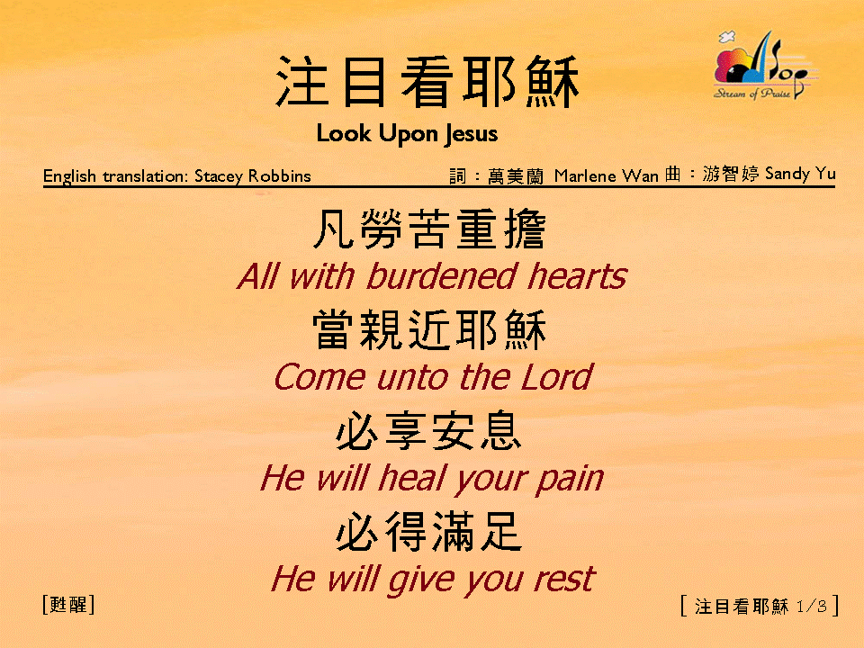
注目看耶穌 (1/3)
[Look Upon Jesus]

Slide 2
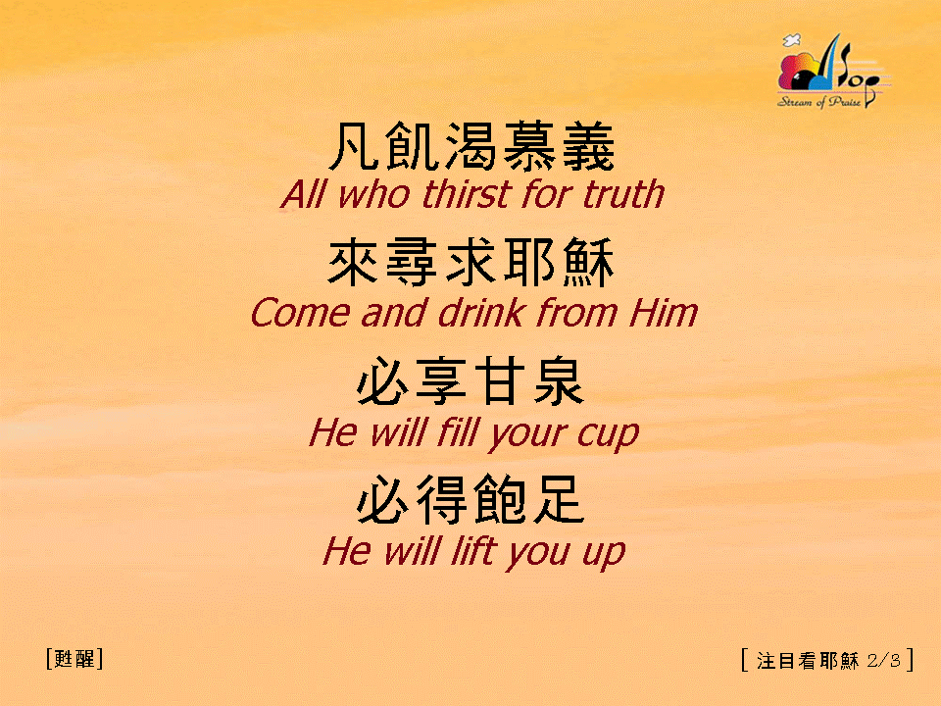
注目看耶穌 (2/3)
[Look Upon Jesus]

Slide 3
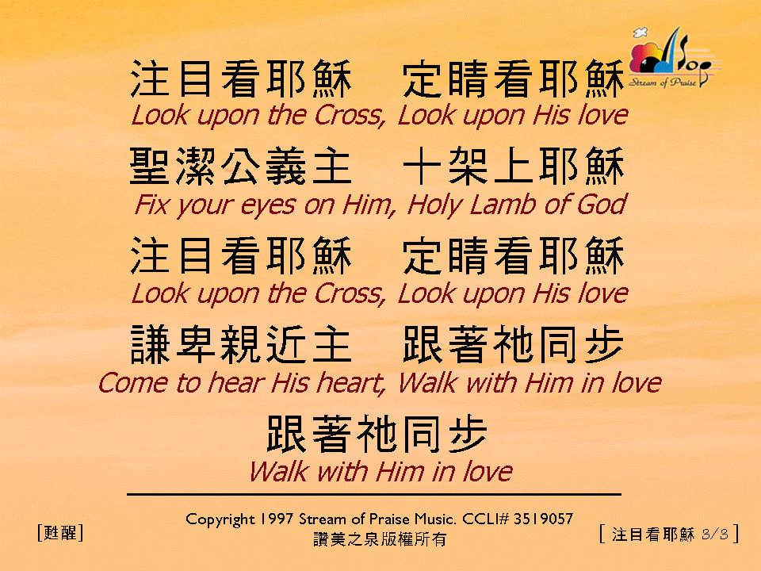
注目看耶穌 (3/3)
[Look Upon Jesus]

