Slide 1

激起生命的浪花 (1/3)
[The Journey Through the Waves]
[彩虹下的約定]

Slide 2
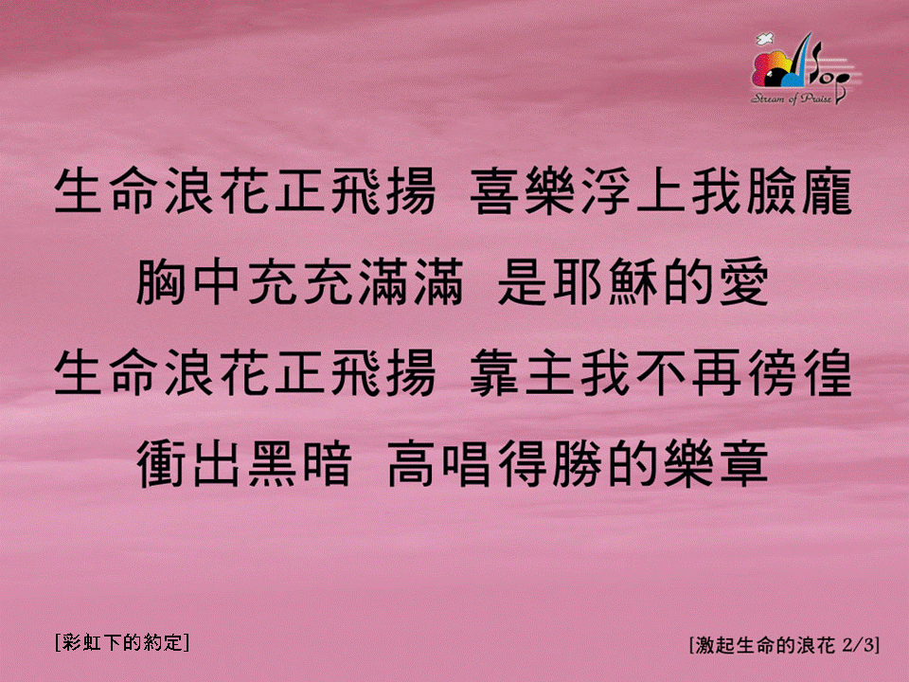
激起生命的浪花 (2/3)
[The Journey Through the Waves]
[彩虹下的約定]

Slide 3
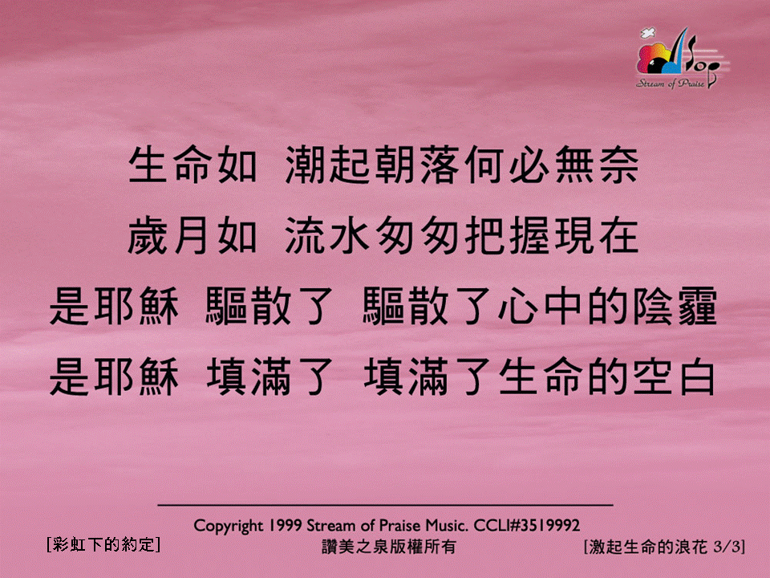
激起生命的浪花 (3/3)
[The Journey Through the Waves]
[彩虹下的約定]

