Slide 1
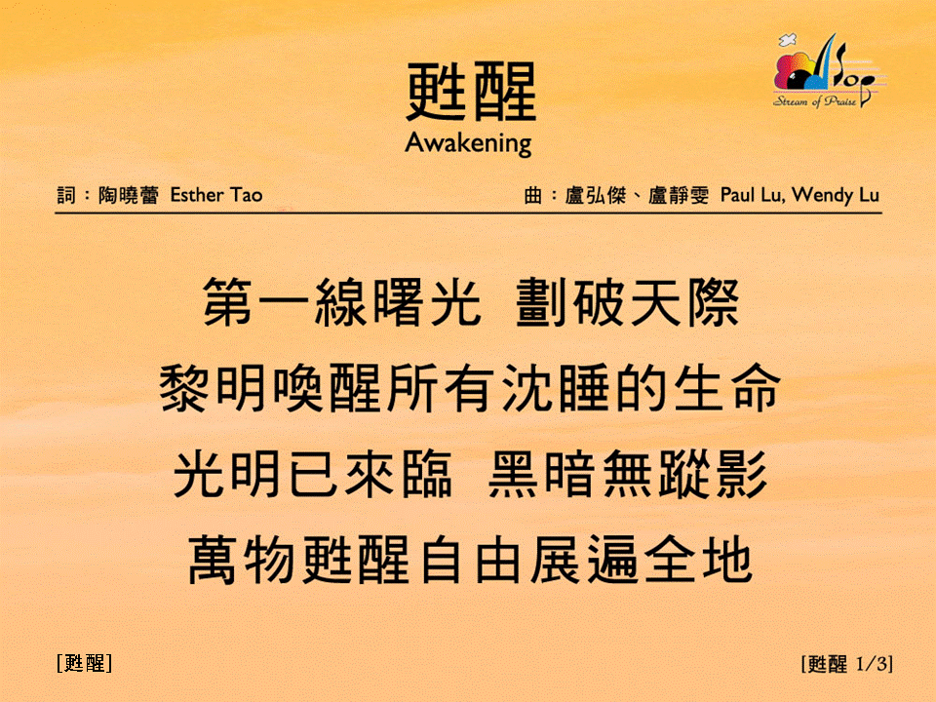
甦醒 (1/3)
[Awakening]
[甦醒]

Slide 2
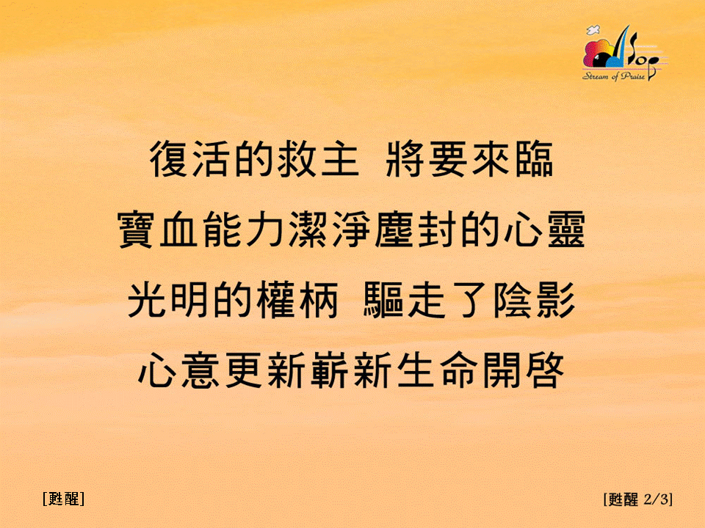
甦醒 (2/3)
[Awakening]
[甦醒]

Slide 3

甦醒 (3/3)
[Awakening]
[甦醒]

