Slide 1
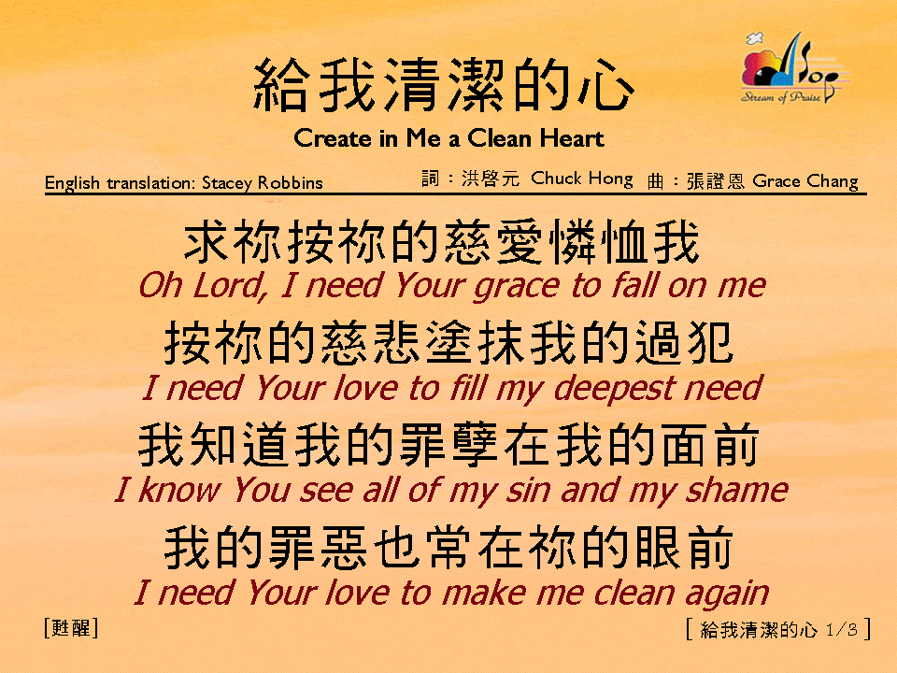
給我清潔的心 (1/3)
[Create in Me a Clean Heart]

Slide 2
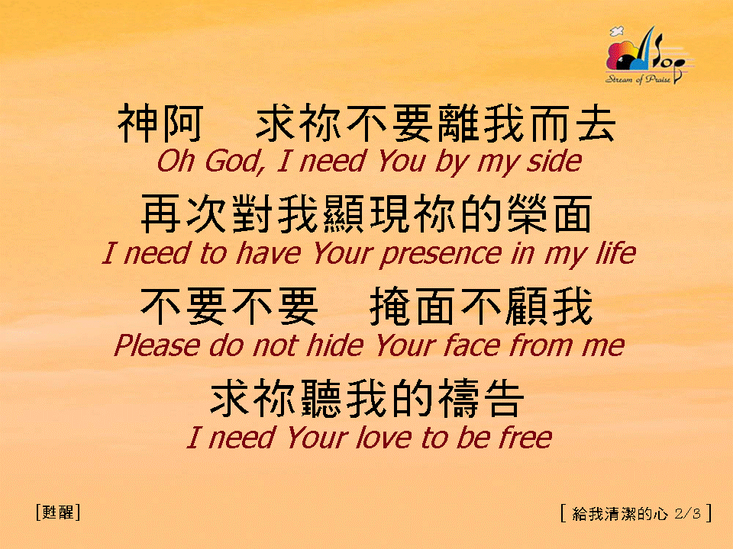
給我清潔的心 (2/3)
[Create in Me a Clean Heart]

Slide 3
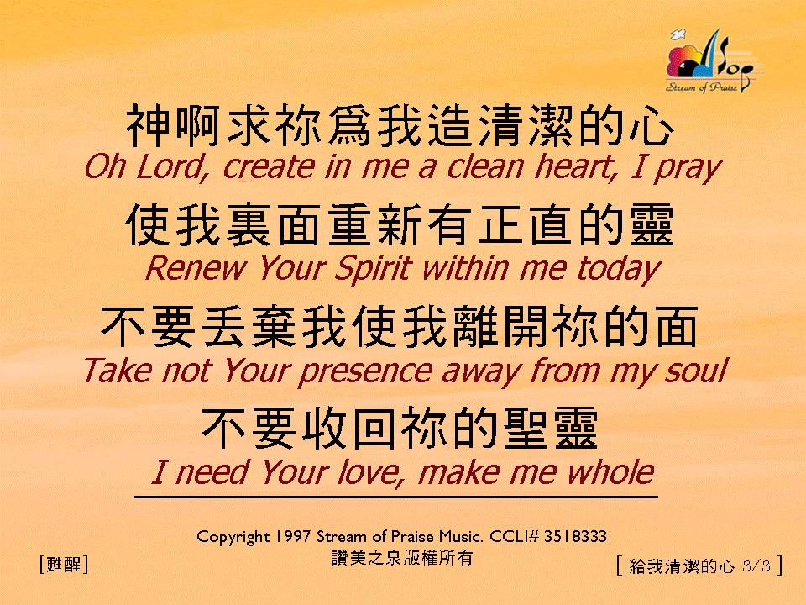
給我清潔的心 (3/3)
[Create in Me a Clean Heart]

