Slide 1
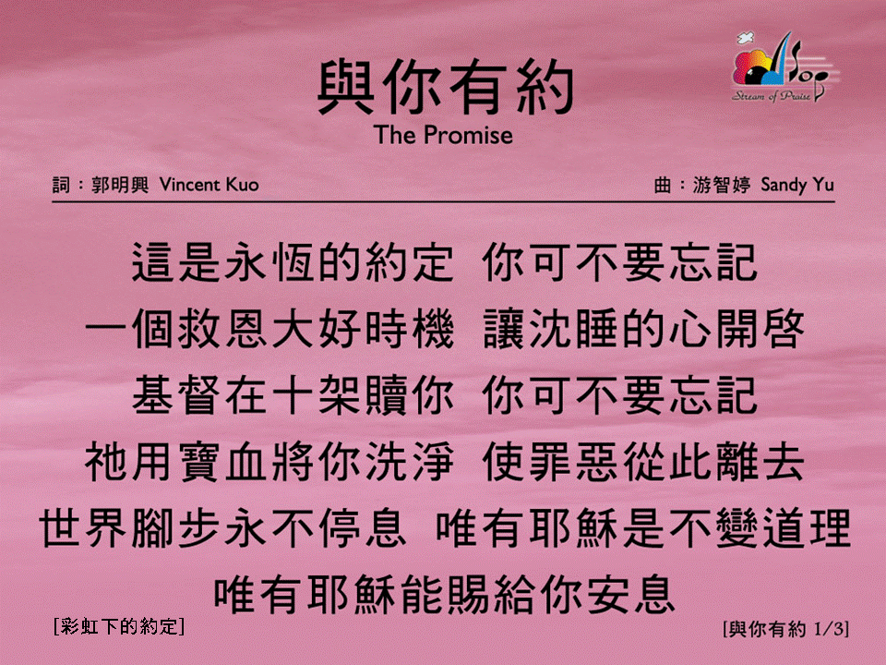
與你有約 (1/3)
[The Promise]
[彩虹下的約定]

Slide 2
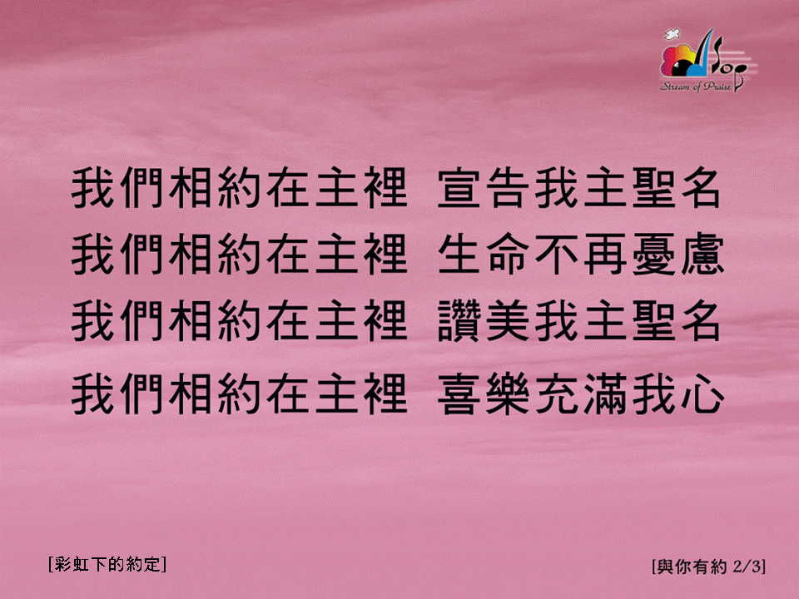
與你有約 (2/3)
[The Promise]
[彩虹下的約定]

Slide 3

與你有約 (3/3)
[The Promise]
[彩虹下的約定]

